Slide 1
The beauty of Solitude (sat. Service)

Slide 2

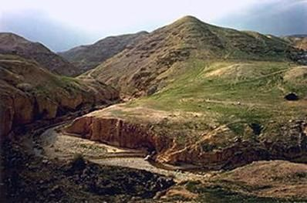
The Beauty of Solitude –
follow Jesus up the mountain
Mark 3:13-19; Luke 6:12-16
Man’s Birthday (HWS)
The beauty of Solitude (sat. service)

Slide 3
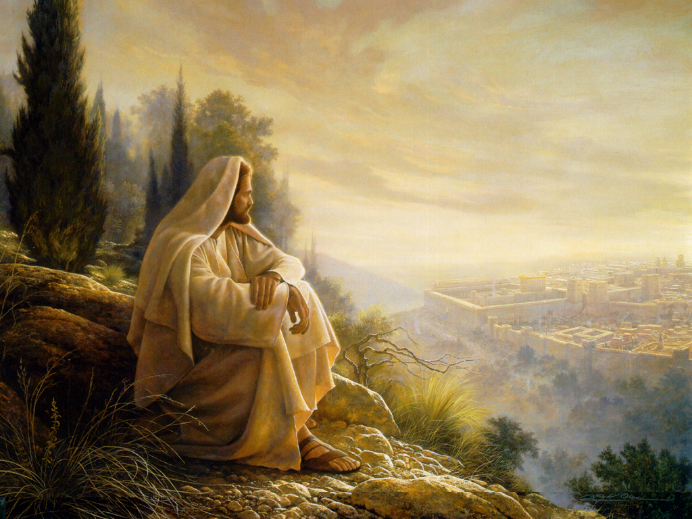
Man’s Birthday (HWS)
The beauty of Solitude (sat. service)

Slide 4
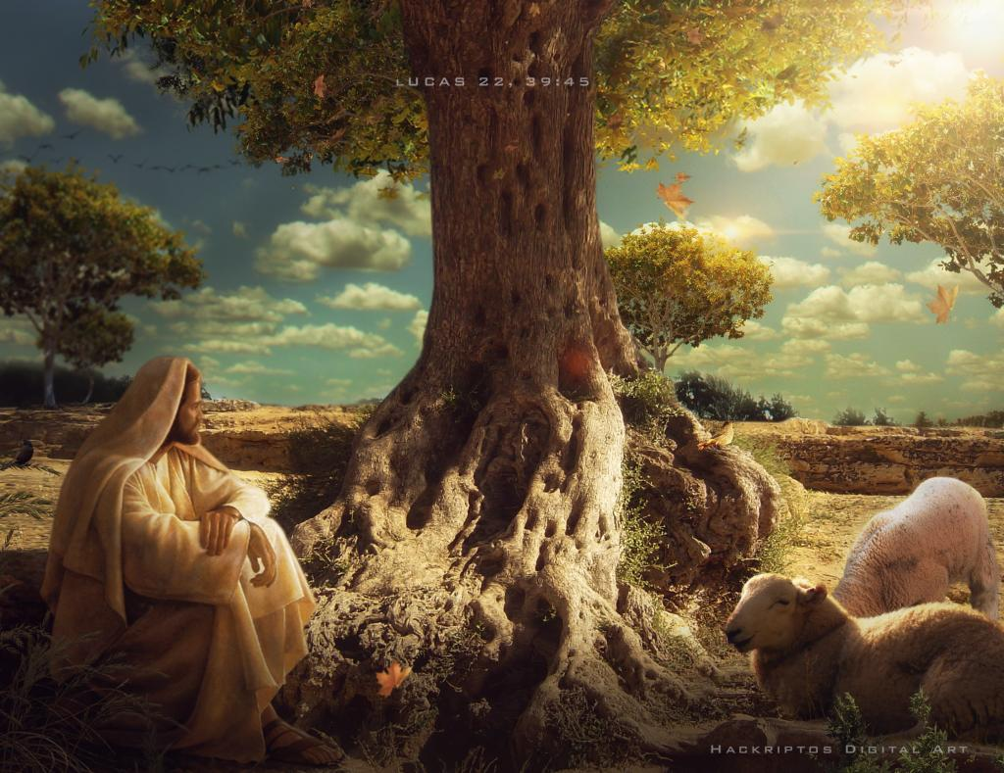
Man’s Birthday (HWS)
The beauty of Solitude (sat. service)

Slide 5
Which mountain is Jesus’s Prayer Mountain?
Man’s Birthday (HWS)
The beauty of Solitude (sat. service)

Slide 6
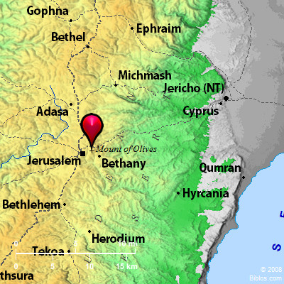
Which mountain is Jesus’s Prayer Mountain?
Mount of Olives
Man’s Birthday (HWS)
The beauty of Solitude (sat. service)

Slide 7
Acts 1:10 -12
¹⁰ And while they were gazing into heaven as he went, behold, two men stood by them in white robes,
Mount of Olives
Man’s Birthday (HWS)
The beauty of Solitude (sat. service)

Slide 8
¹¹ and said, “Men of Galilee, why do you stand looking into heaven? This Jesus, who was taken up from you into heaven, will come in the same way as you saw him go into heaven.”
Mount of Olives
Man’s Birthday (HWS)
The beauty of Solitude (sat. service)

Slide 9
¹² Then the apostles returned to Jerusalem from the hill called the Mount of Olives, a Sabbath day’s walk from the city.
Mount of Olives
Man’s Birthday (HWS)
The beauty of Solitude (sat. service)

Slide 10
Luke 22:39
Jesus went out as usual to the Mount of Olives, and his disciples followed him.
Mount of Olives
Man’s Birthday (HWS)
The beauty of Solitude (sat. service)

Slide 11
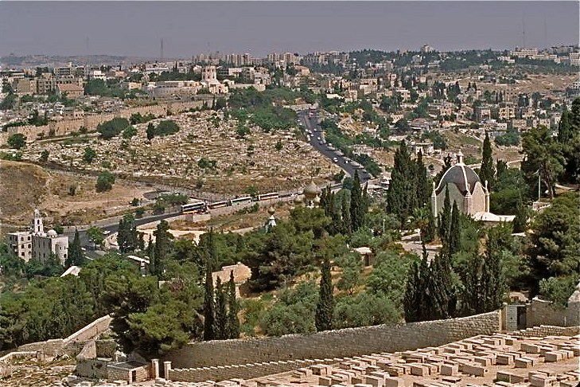
Man’s Birthday (HWS)
The beauty of Solitude (sat. service)

Slide 12
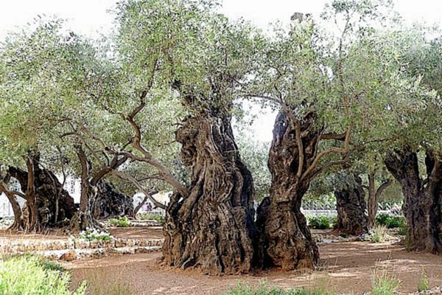
Man’s Birthday (HWS)
The beauty of Solitude (sat. service)

Slide 13
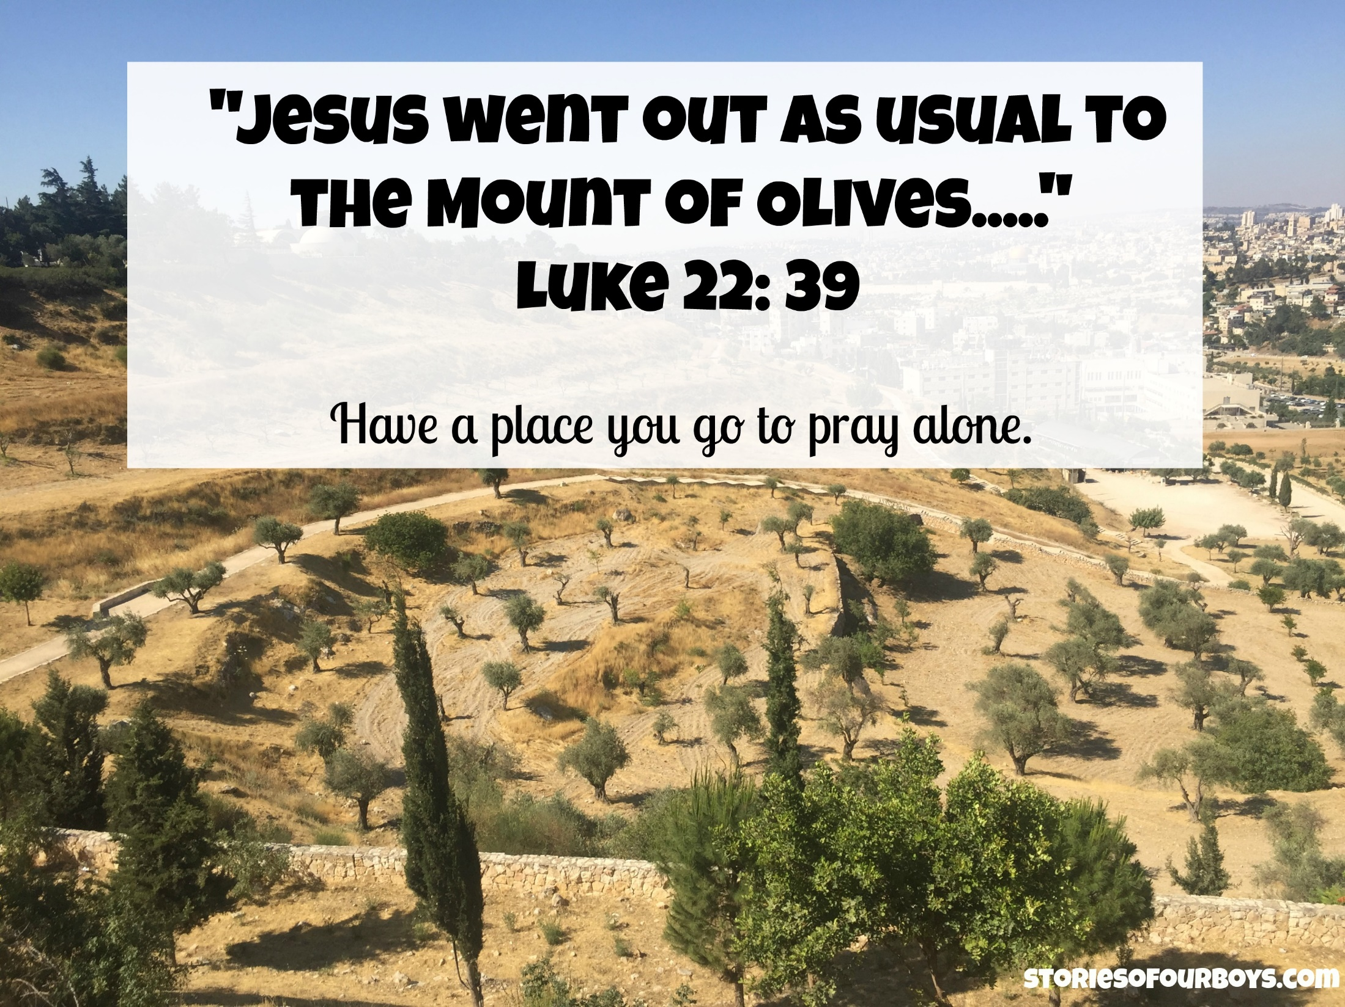
Man’s Birthday (HWS)
The beauty of Solitude (sat. service)

Slide 14
Do you have a place you go to pray alone ?
Man’s Birthday (HWS)
The beauty of Solitude (sat. service)

Slide 15
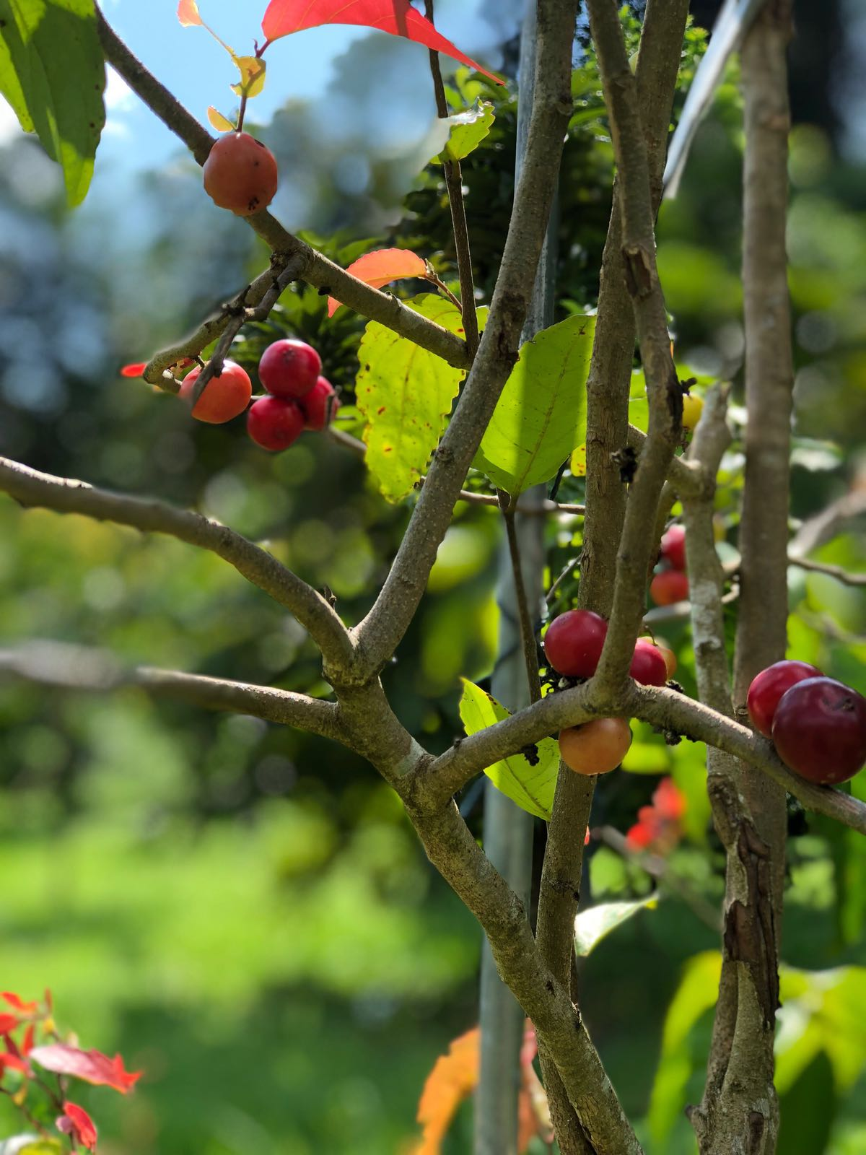
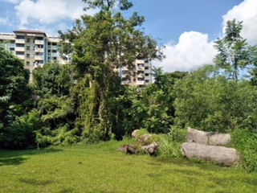
Man’s Birthday (HWS)
The beauty of Solitude (sat. service)

Slide 16
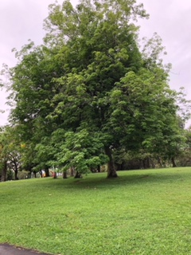
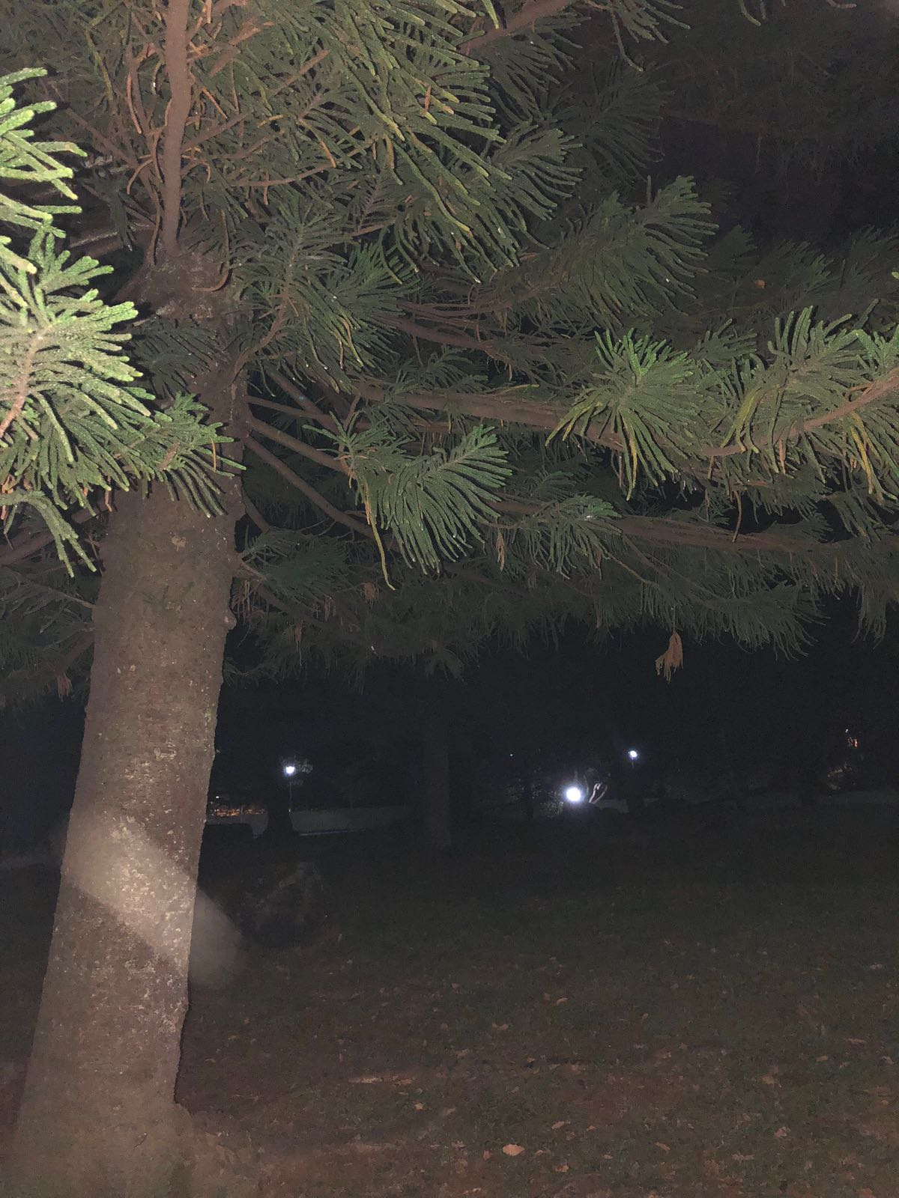
Man’s Birthday (HWS)
The beauty of Solitude (sat. service)

Slide 17

Man’s Birthday (HWS)
The beauty of Solitude (sat. service)

Slide 18
Man’s Birthday (HWS)
The beauty of Solitude (sat. service)

Slide 19
Mark 3:13
And he went up on the mountain and called to him those whom he desired, and they came to him.
Jesus called His disciples to observe a “time-out” with Him.
Man’s Birthday (HWS)
The beauty of Solitude (sat. service)

Slide 20
Mark 3:13-19
¹³ And he went up on the mountain and called to him those whom he desired, and they came to him.
¹⁴ And he appointed twelve (whom he also named apostles) so that they might be with him and he might send them out to preach
¹⁵ and have authority to cast out demons.
Man’s Birthday (HWS)
The beauty of Solitude (sat. service)

Slide 21
¹⁶ He appointed the twelve: Simon (to whom he gave the name Peter);
¹⁷ James the son of Zebedee and John the brother of James (to whom he gave the name Boanerges, that is, Sons of Thunder);
¹⁸ Andrew, and Philip, and Bartholomew, and Matthew, and Thomas, and James the son of Alphaeus, and Thaddaeus, and Simon the Zealot,
Man’s Birthday (HWS)
The beauty of Solitude (sat. service)

Slide 22
¹⁹ and Judas Iscariot, who betrayed him.
Man’s Birthday (HWS)
The beauty of Solitude (sat. service)

Slide 23
Luke 6:12-16
¹² In these days he went out to the mountain to pray, and all night he continued in prayer to God.
¹³ And when day came, he called his disciples and chose from them twelve, whom he named apostles:
¹⁴ Simon, whom he named Peter, and Andrew his brother, and James and John, and Philip, and Bartholomew,
Man’s Birthday (HWS)
The beauty of Solitude (sat. service)

Slide 24
¹⁵ and Matthew, and Thomas, and James the son of Alphaeus, and Simon who was called the Zealot,
¹⁶ and Judas the son of James, and Judas Iscariot, who became a traitor.
Man’s Birthday (HWS)
The beauty of Solitude (sat. service)

Slide 25
Man’s Birthday (HWS)
The beauty of Solitude (sat. service)

Slide 26
Man’s Birthday (HWS)
The beauty of Solitude (sat. service)

