Slide 1
The Procession
Psalm 118:19-27, John 12:12-16
Palm Sunday 2018, SAC

Slide 2
^{Psalm 118}
²⁴ This is the day that the Lord has made; let us rejoice and be glad in it.
²⁵ Save us, we pray, O Lord! O Lord, we pray, give us success!
²⁶ Blessed is he who comes in the name of the Lord! We bless you from the house of the Lord. ²⁷ The Lord is God, and he has made his light to shine upon us. Bind the festal sacrifice with cords, up to the horns of the altar!

Slide 3
1. The Reason for Prayer: Hosanna!
²⁵ Save us, we pray, O Lord! O Lord, we pray, give us success!

Slide 4
“
“Sin is believing the lie that you are self-created,
self-dependent & self-sustained.”
St Augustine

Slide 5
And they were bringing children to him that he might touch them, and the disciples rebuked them. But when Jesus saw it, he was indignant and said to them, “Let the children come to me; do not hinder them, for to such belongs the kingdom of God. Truly, I say to you, whoever does not receive the kingdom of God like a child shall not enter it.” And he took them in his arms and blessed them, laying his hands on them.
Mark 10:13-16

Slide 6
“
Truly, I say to you, whoever does not receive the kingdom of God like a child shall not enter it.”
Mark 10:15

Slide 7
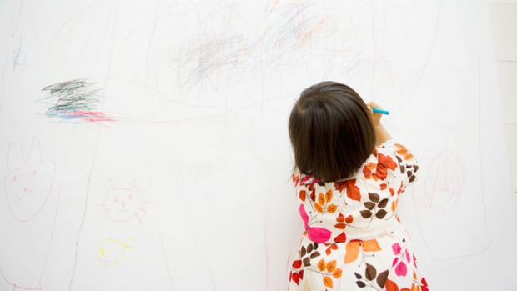
Can a child draw a bad picture?
Truly, I say to you, whoever does not receive the kingdom of God like a child shall not enter it.”
Mark 10:15

Slide 8
10 top richest men in Singapore (2016)
1. Robert and Philip Ng – US$10.1billion (S$12.5 billion)
2. Wee Cho Yan – US$5 billion (S$6.2 billion)
3. Kwee brothers – US$4.6 billion (S$5.7 billion)
4. Kuok Khoon Hong – US$2.6 billion (S$3.2 billion)
5. Peter Lim – US$2 billion (S$2.5 billion)
6. Sam Goi – US$1.7 billion (S$2.1 billion)
7. Zhong Sheng Jian – US$1.7 billion (S$2.1 billion)
8. Lim Oon Kuin – US$1.5 billion (S$1.9 billion)
9. Koh Wee Meng – US$1.4 billion (S$1.7 billion)
10. Asok Kumar Hiranandani – US$1 billion (S$1.2 billion)
.... Terry Wong

Slide 9
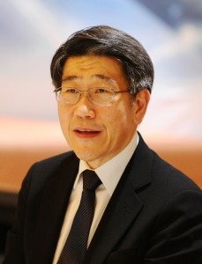
“
…I had always wanted to know God, perhaps in an intellectual way. I did not realise that knowing God involved a relationship. So I searched as there was always something missing in me.

Slide 10
2. The Reason for Praise: He is King!
²⁶ Blessed is he who comes in the name of the Lord.
From the house of the Lord we bless you.

Slide 11
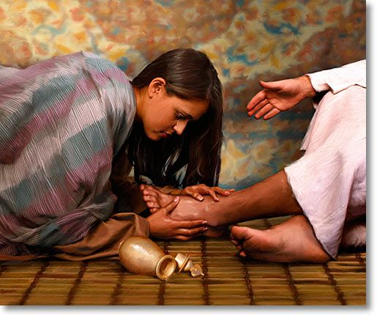
Then Mary took about a pint of pure nard, an expensive perfume; she poured it on Jesus' feet and wiped his feet with her hair... (John 12)

Slide 12
3. The Reason for Procession: The Sacrifice
²⁷ The Lord is God and he has made his light to shine upon us. Bind the festal sacrifice with cords, up to the horns of the altar!

Slide 13
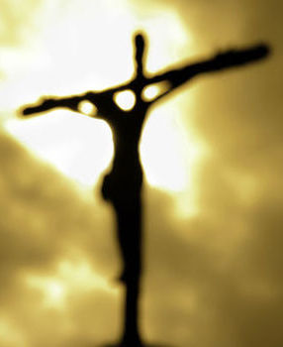
Jesus resolutely set out for Jerusalem.
Luke 9:15

Slide 14
Three summa supplicia (3 supreme Roman punishments):
Decollatio
Crematio
Crux

Slide 15
The offering of Christ once made is that perfect redemption, propitiation, and satisfaction, for all the sins of the whole world, both original and actual; and there is none other satisfaction for sin, but that alone.
- 39 Articles; No 3

Slide 16
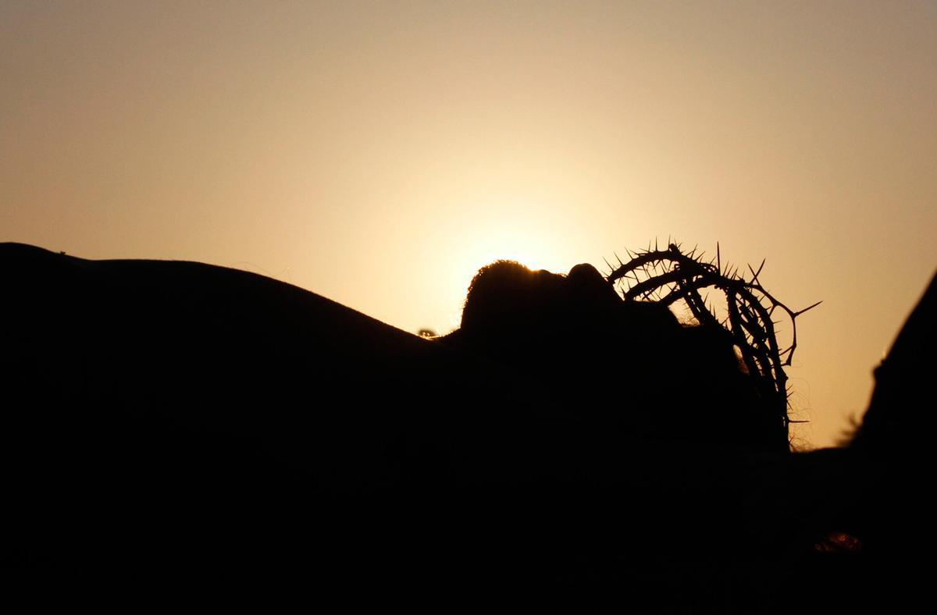
Our Response
Psalms 118:
Reason for Prayer: He is here Reason for Praise: He is King
Reason for Procession: He is our Sacrifice
²⁸ You are my God, and I will give you thanks,
You are my God, and I will exalt you.”

Slide 17
Were the whole realm of nature mine,
That were a present far too small;
Love so amazing, so divine,
Demands my soul, my life, my all.

