Slide 1
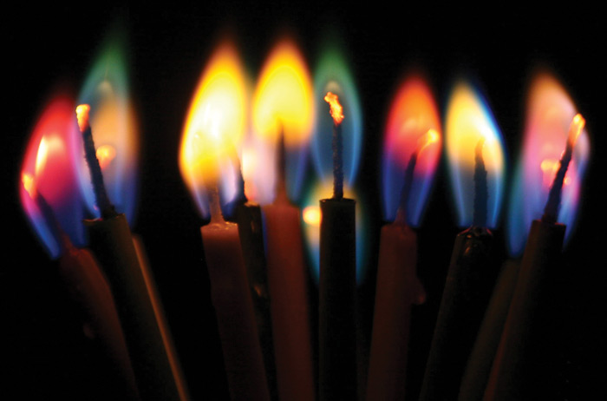
Shine for Jesus right where you are (lessons from the king’s cupbearer)

Slide 2


Slide 3
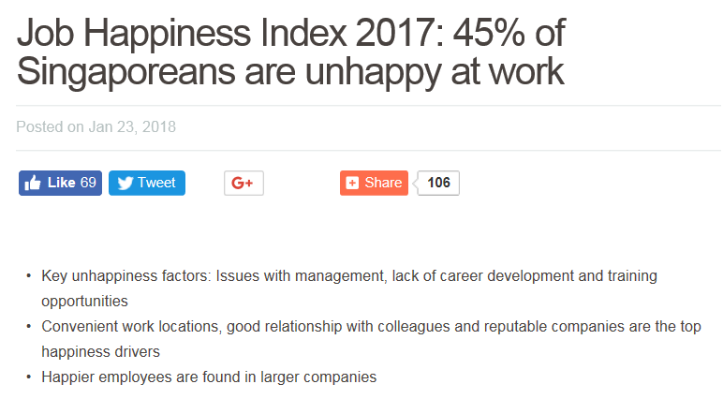

Slide 4
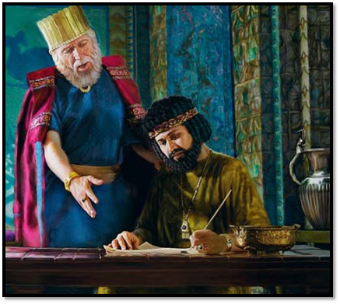
Nehemiah, the king’s cupbearer

Slide 5
#1
Seek His direction and favour to do what we have to do

Slide 6
#2
Diligence and excellence should be the hallmark of God’s people

Slide 7
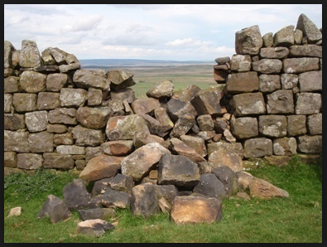
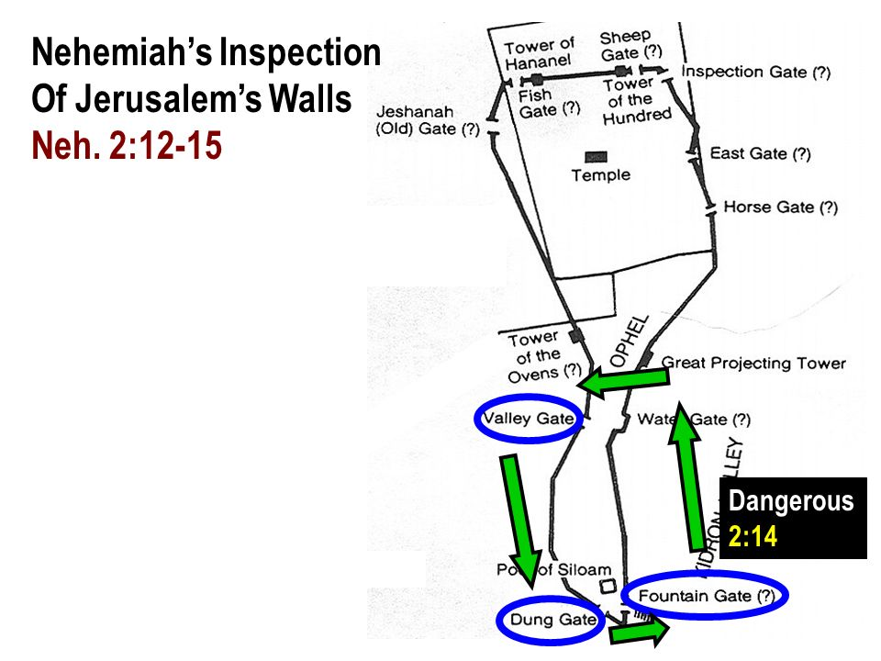

Slide 8
Col 3:23-24
²³ Whatever you do, work heartily, as for the Lord and not for men, ²⁴ knowing that from the Lord you will receive the inheritance as your reward. You are serving the Lord Christ.

Slide 9
What you should do
What you want to do
What you do well

Slide 10
What you should and want to do = What you do well

Slide 11
What you should do
What you want to do
What you do well

Slide 12
#3
Do not give up in the face of oppositions and setbacks

Slide 13
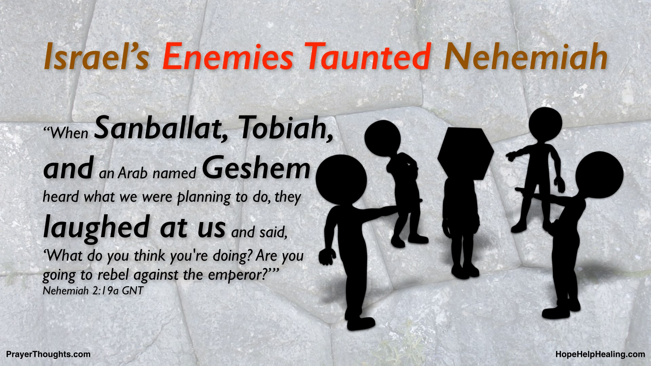
Opposition

Slide 14
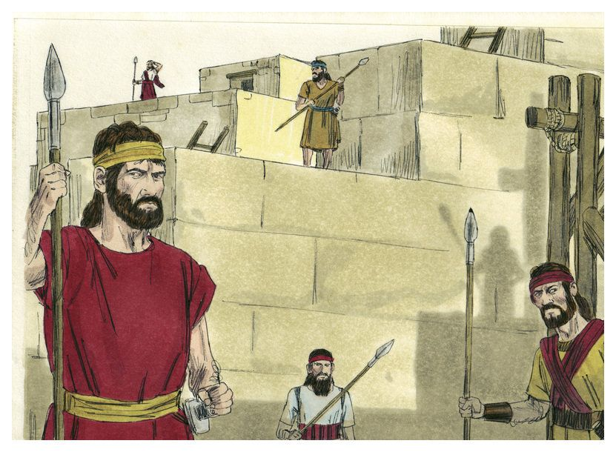
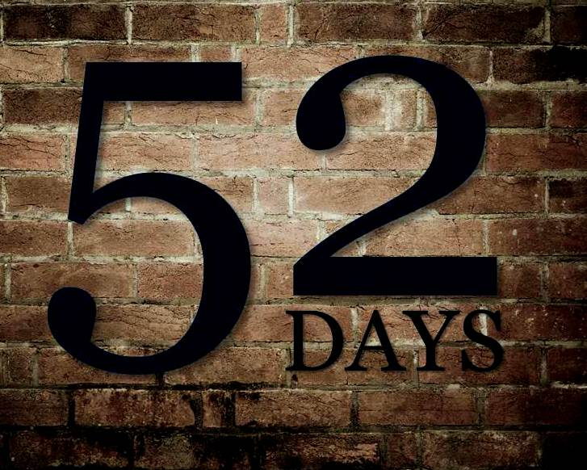
Completion

Slide 15


Slide 16
#4
Walk the talk and do the
right thing

Slide 17
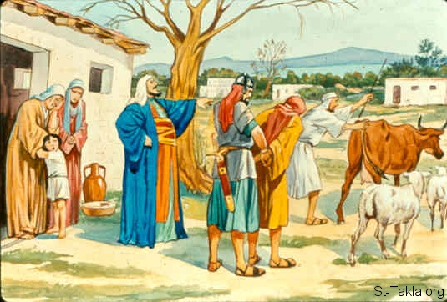
Internal Problems
Food scarcity
Heavy taxes by Jewish rulers
Nehemiah led in repentance
Nehemiah as governor

Slide 18
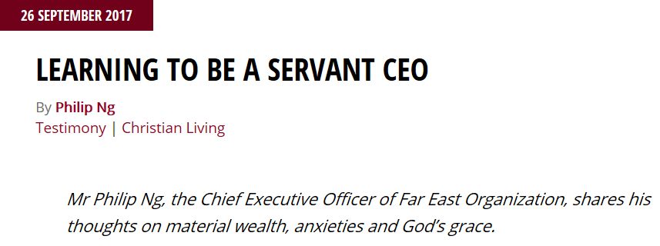
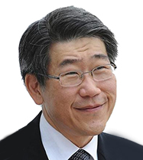

Slide 19
“Some may know me as a property developer, but I am really a servant of the most high God whom I know through my Lord Jesus Christ. Property development is for me just a way of making a living…I am in business and business is about money. But money and possessions can possess us. How then do I serve God as a business person?..

Slide 20
“..The way to do this is to realise that I am a steward; money has been entrusted by the Lord to me to be managed responsibly. At the end of the day, we take nothing with us. As the Chinese saying goes: ‘You cannot take it with you, your coffin will be empty.’..

Slide 21
“..As a businessman, one of the things I guard against is covetousness. A friend once remarked to me that, in this world, we trade in the currency of Mammon — of money — which is a pagan god. But as believers, knowing that the kingdom of God has come and being part of this kingdom, we must trade in the currency of love. How do we make that conversion from the currency of money to that of love? Jesus will teach us how…

Slide 22
“.. I tell my people in the organization that when we do business, we want to do good business and to do good in business. That is my call to them. But we welcome and certainly include those from other faiths. We hope that our message of love can truly find a place in their hearts..

Slide 23
“.. What is the difference between the time that I did not know Christ and now? Situations are the same, in a sense, there continues to be turmoil in the world. We continue to be faced with problems and are vulnerable to temptations. What has changed is that there is one certainty: my certainty of hope in our Lord Jesus Christ.”
Mr Philip Ng, CEO, Far East Organization

Slide 24
“It is therefore incumbent for believers to show that we belong to Christ. Jesus told us to go make disciples of all the nations so that is a call for Christians, in that when we are doing our work, we have to show the love of God.”
Mr Philip Ng, CEO, Far East Organization

Slide 25
#1
Seek His direction and favour to do what we have to do

Slide 26
#2
Diligence and excellence should be the hallmark of God’s people

Slide 27
#3
Do not give up in the face of oppositions and setbacks

Slide 28
#4
Walk the talk and do the
right thing

Slide 29
Shine for Jesus right where you are (lessons from the king’s cupbearer)

