Slide 1
Do Not
Harden
Your Heart
Heb. 3:7-15

Slide 2
meribah

Slide 3
“Why do you quarrel with Moses?” Ex.17:2

Slide 4
Do Not
Harden
Your Heart
Heb. 3:7-15

Slide 5
massah

Slide 6
“Why do you say the Lord is not with us?” Ex.17:7

Slide 7
Do Not
Harden
Your Heart
Heb. 3:7-15

Slide 8
“lead us not into temptation” Mt.6:13

Slide 9
“lead us not into Meribah and Massah”

Slide 10
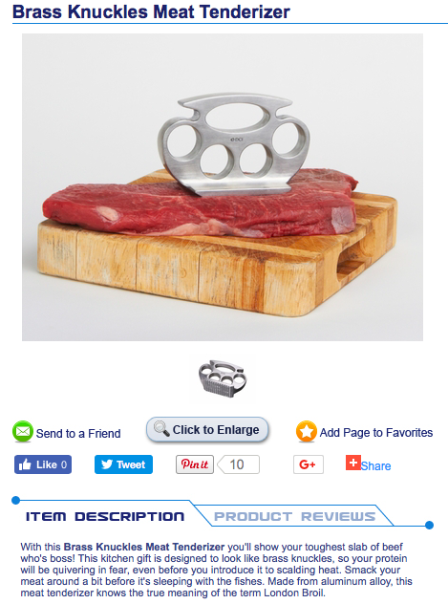

Slide 12
Batter my heart, three-person'd God, for you
As yet but knock,
breathe, shine, and seek to mend;
That I may rise and stand,
o'erthrow me, and bend
Your force to break,
blow, burn, and make me new.
John Donne, 1623

Slide 13
= rakak = soft

Slide 14
“I am this day rakak though anointed King”
2 Sam. 3:39

Slide 15
“My son Solomon, the one whom God has chosen, is young and rakak” 1 Chr. 29:1

Slide 16
“A rakak answer turns away anger and wrath” Prov. 15:1

Slide 17
“A rakak tongue can break bones” Prov. 25:15

Slide 18
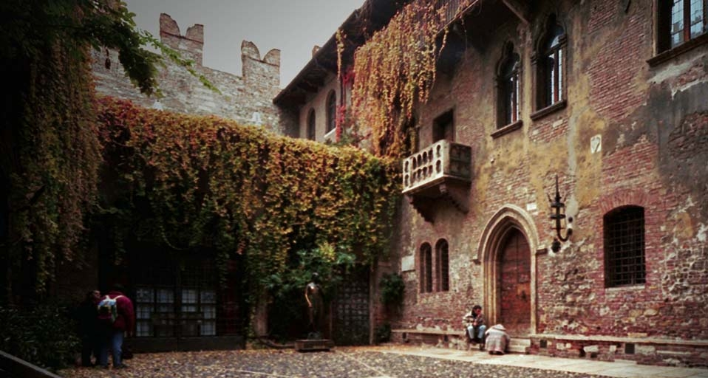
“But soft, what light through yonder window breaks? It is the east and Juliet is the sun!” Shakespeare, Romeo and Juliet, Act 2, scene II.

Slide 19
Do Not
Harden
Your Heart
Heb. 3:7-15

Slide 20
“They will not enter my rest.” Heb. 3:11

Slide 21
“They [with hard hearts] will not enter my rest.” Heb. 3:11

Slide 22
Do Not
Harden
Your Heart
Heb. 3:7-15

Slide 23
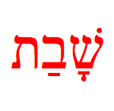
= shabbat = rest

Slide 24
“The LORD blessed the Sabbath day and hallowed it”
Ex. 20:11

Slide 25
“Surely My Sabbaths you shall keep, for it is a sign between Me and you throughout your generations, that you may know that I am the LORD who sanctifies you.” Ex. 31:13

Slide 26
Do Not
Harden
Your Heart
Heb. 3:7-15

Slide 27
“The seventh day is the Sabbath of the LORD your God. In it you shall do no work… remember that you were a slave in the land of Egypt, and the LORD your God brought you out…” Dt. 31:13

Slide 28
Do Not
Harden
Your Heart
Heb. 3:7-15

Slide 29
¹²“You have been telling me to lead these people… ¹⁴ my presence will go with you, and I will give you rest” Ex. 33:12-14

Slide 30
Do Not
Harden
Your Heart
Heb. 3:7-15

