Slide 1
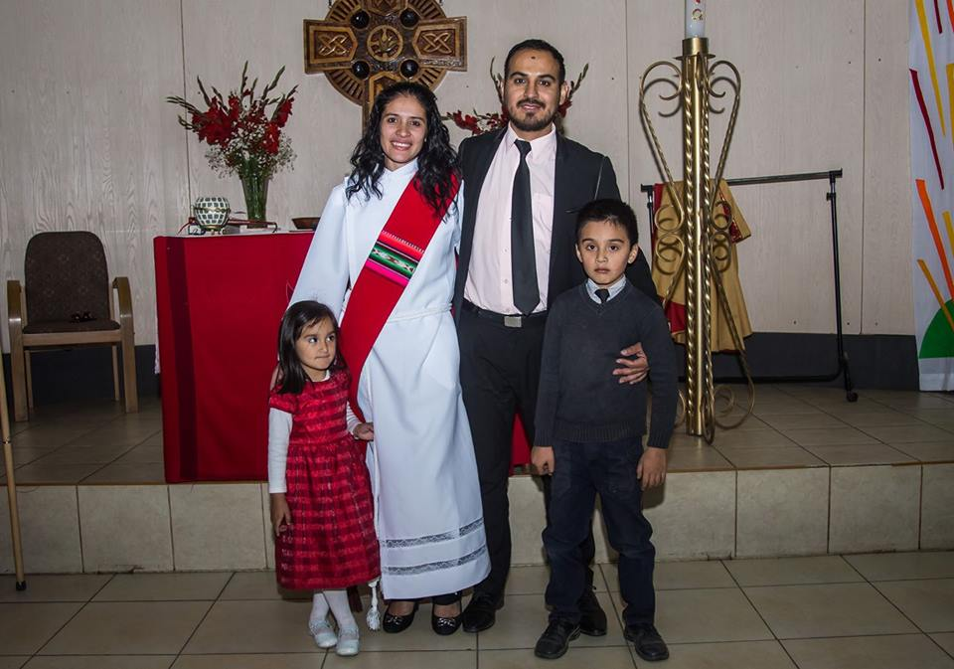

Slide 2
CHRIST FREES US TO PURSUE HIS PATH…
Christ freed Paul to pursue a fresh path of learning and brokenness in a blinding experience on the road to Damascus and a life changing encounter with Ananias

Slide 3
CHRIST FREES US TO PURSUE HIS PATH…
Christ frees us not to exercise choices which feed our pride or personal interests but to experience the joys and agony of service.

Slide 4
1. FREEDOM TO PURSUE TRUST IN THE PATH - ACTS 9:4
Jesus frees Paul from misplaced zeal; helps him pursue a path where he LEARNS to trust God in brokenness.
Paul must learn to not only trust Jesus but also Ananias on the path.
We must learn to not only trust Jesus but to also trust those whom he brings the path.
Can Jesus trusted after a crisis/failure in the path?

Slide 5
2. FREEDOM TO PURSUE SUBMISSION IN THE PATH - Acts 9:6
Jesus frees Paul from fleshly certainty to help him pursue a path where he LEARNS to submit n wait in brokenness. Paul is told to “only go into the city…and you will be told.” No other information is given except to go…Paul submits and goes in the path
Submission to God lowers all our defenses and exposes us to uncertainty and doubt

Slide 6
3. FREEDOM TO PURSUE EMPOWERMENT IN THE PATH Acts 9:15
Jesus frees Paul from the layers of self-sufficiency n jewish religiosity to help him pursue a path where he LEARNS be empowered in brokenness to reach out to the gentiles – a bruised reed he will not break (Mt 12:20)
We are empowered in our weaknesses (2Cor 12:10)

