Slide 2
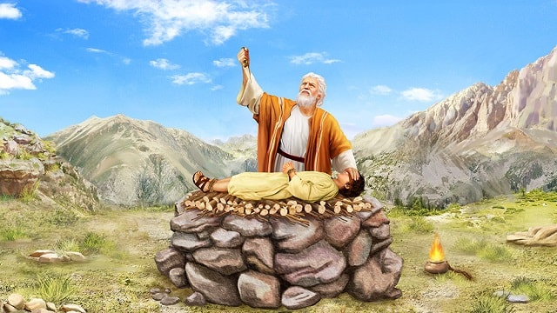
Give Me The One Whom You Love
Genesis 22:1-19

Slide 3
God tests Abraham
Take your son
Your only son Isaac
Whom you love
Sacrifice him on one of the mountains at Moriah

Slide 4
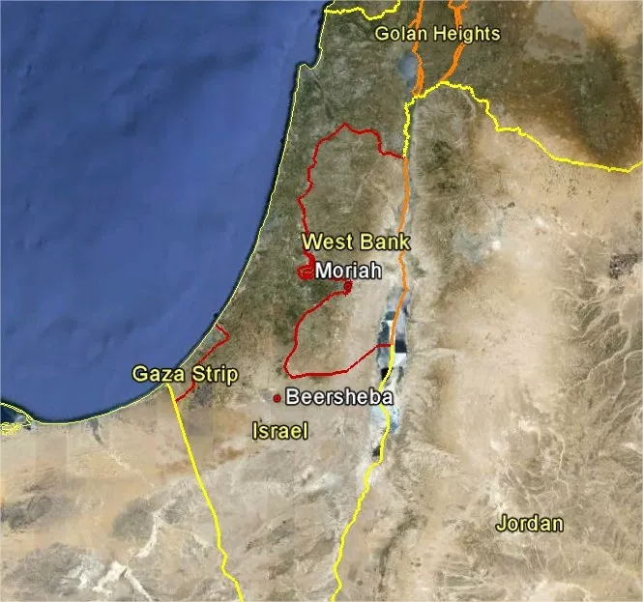

Slide 5
God tests Abraham
No questions asked?
Travelled 3 days
Gathered all resources necessary for sacrifice
Isaac’s question vis-à-vis Abraham’s reply
Reached the place and built the altar
Prepares to kill Isaac

Slide 6
Dramatis personae
Abraham
Isaac
God

Slide 7
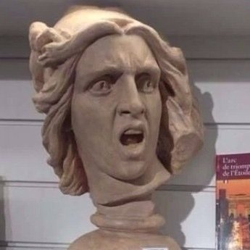
Abraham
Waited a LONG time for an impossible promise
Dared to believe
Saw for himself God’s fulfilment
Now told to give up that fulfilment

Slide 8
Abraham
Wasn’t easy
Plenty of chances to doubt
Yet he obeys
Why???

Slide 9
Lesson #1:
God doesn’t always give us the full picture
What will you do?
Insist on relying on what you can see
Gamble on the trustworthiness of a God you can’t see
Confidence in the flesh
Confidence on the Spirit

Slide 10
Intellect is not the enemy of faith!

Slide 11
Intellect in faith
Abraham was confronted with God’s challenge
Isaac’s birth vis-à-vis the call to sacrifice him
God kept His promise + He doesn’t change
= Message is authentic

Slide 12
Lesson #2: Obedience is always costly
2 Samuel 24:24b
I will not offer burnt offerings to the LORD my God that cost me nothing.
~King David~

Slide 13
Isaac
Seems passive
Not much is said about him
Not much is said by him
Other than to ask an obvious question
But put yourself in his shoes for a moment

Slide 14
Isaac
Your father evades your obvious question
Continues the journey
All the materials for a sacrifice are there except for one thing
Genesis 22:9b
…Abraham built the altar there and laid the wood in order and bound Isaac his son and laid him on the altar, on top of the wood.

Slide 15
Isaac
Your father evades your obvious question
Continues the journey
All the materials for a sacrifice are there except for one thing
Isaac’s willingness to give up his life
=
Abraham’s willingness to give up his son

Slide 16
God
What if Abraham had not given up Isaac?
The point of Isaac’s sacrifice?
God will bring us to the edge
He will tell us to give up things
If we give that up, a part of us dies

Slide 17
God
Genesis 22
John 3
Abraham gave up his son
Abraham got his son back
Trust deepened
God gave up His Son
God did NOT
Salvation made available

Slide 18
God and Abraham
God was not toying with Abraham
God was testing him
To convince him
Is God worth trusting?
How far are you willing to go?

Slide 19
Abraham’s sacrifice of Isaac was a foreshadow of God’s giving up of His Son!

Slide 20
Soul search
Is there anything you need to give up?
Is there anything that the Saturday Service needs to give up?
Are you willing to be a willing partner?

Slide 21
God challenges Abraham to give up that whom he loves
God gives up that whom He loves
What would you give up that whom you love?

