Slide 1
Rooted in the Word of God
Eleven30 Service 25th February 2018

Slide 2
Can I qualify?

Slide 3

Paired Group Discussion
If you were Satan (The adversary), what would be your main offense against the church and God’s people today?

Slide 4
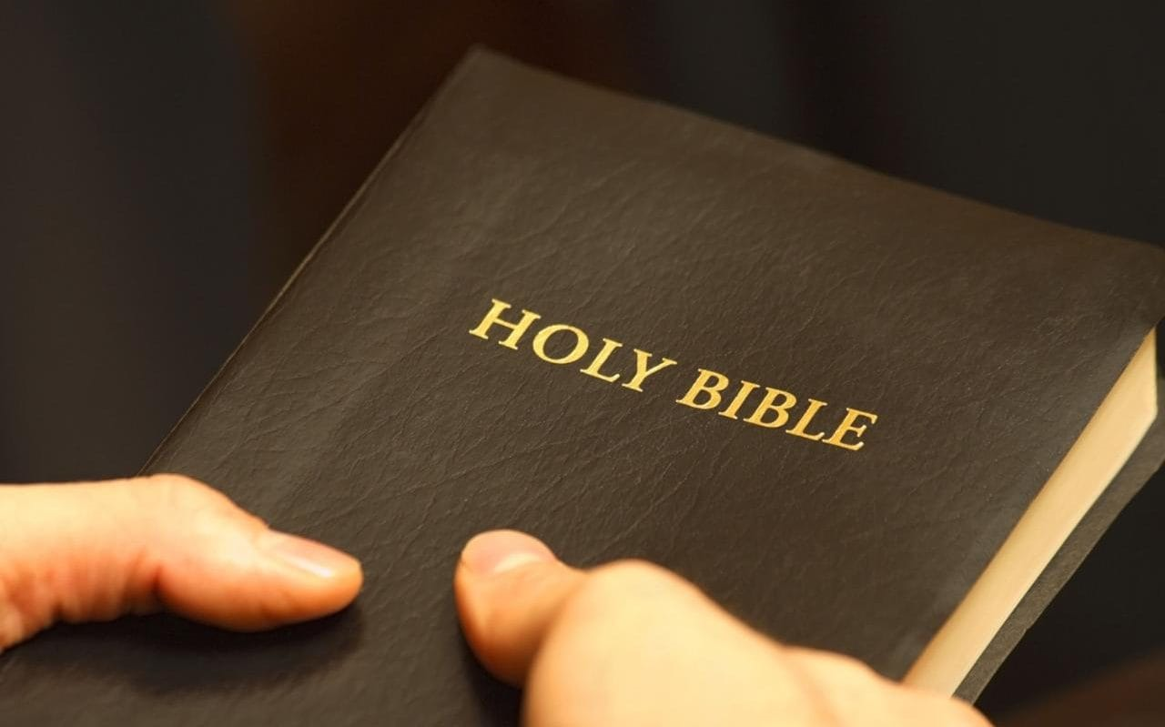
When the Church loses the authority of God’s word in their personal and corporate lives, the Church loses the authority to be the salt and the light to the nation.

Slide 5
The Parable of the Sower.(Matthew 13:3-8)
³ Then he told them many things in parables, saying: “A farmer went out to sow his seed. ⁴ As he was scattering the seed, some fell along the path, and the birds came and ate it up. ⁵ Some fell on rocky places, where it did not have much soil. It sprang up quickly, because the soil was shallow. ⁶ But when the sun came up, the plants were scorched, and they withered because they had no root. ⁷ Other seed fell among thorns, which grew up and choked the plants. ⁸ Still other seed fell on good soil, where it produced a crop—a hundred, sixty or thirty times what was sown.

Slide 6
The Meaning of the Parable (Matt 13:19-23)
¹⁸ “Listen then to what the parable of the sower means: ¹⁹ When anyone hears the message about the kingdom and does not understand it, the evil one comes and snatches away what was sown in their heart. This is the seed sown along the path. ²⁰ The seed falling on rocky ground refers to someone who hears the word and at once receives it with joy. ²¹ But since they have no root, they last only a short time. When trouble or persecution comes because of the word, they quickly fall away.

Slide 7
The Meaning of the Parable (Matt 13:19-23)
²² The seed falling among the thorns refers to someone who hears the word, but the worries of this life and the deceitfulness of wealth choke the word, making it unfruitful. ²³ But the seed falling on good soil refers to someone who hears the word and understands it. This is the one who produces a crop, yielding a hundred, sixty or thirty times what was sown.”

Slide 8
Parable of the sower explained
Seeds along the path.
(The mind)
They don’t understand and they give up on God’s word as the enemy snatches it away
Shallow soil
(The heart)
Grew very fast, very excited, but when the trials came, they did not have enough depth to work through life’s problems.
Thorns (The eyes)
Grew (they actually grew well) but the lust of the eyes soon takes over, like worries of life, lure of wealth.
Good soil: (The will, choice)
Fertile, bears fruit,
30 60 100)

Slide 9
Satan’s offense is on the authority of God’s word in your life and the life of the church!

Slide 10
If the word of God does not disciple the church then evil will!

Slide 12
The Welsh Revival

Slide 13
The Welsh Revival (1904 – 1905)
Thousands of young people experienced God’s divine power
Young people going around to revolutionize the church.
The revivalist, Evan Roberts, at the age of 25 was repeatedly woken up at 1am to meet with God till 5am!

Slide 14
The Welsh Revival (1904 – 1905)
Families were transformed, healing took place, ignited their neighboring countries.
It was estimated 150,000 people came to faith that year
Many churches were planted.

Slide 15
What happened to the Welsh Revival today?

Slide 16
Today welsh churches are up for sale due to the closure of worship services

Slide 18
Pyongyang Great Revival (1907-1910)

Slide 19
Pyongyang Great Revival (1907-1910)
Pyongyang, Korea, in 1907 was known as a city of wine, women and song. It was a dark city in the early twentieth century with sin abounding. It even had its own Gisaeng (Korean geisha) training school. It was in this city that Korea’s second revival began in January 1907 after months of persistent prayer, 50,000 people were converted in that one year and Korea was set ablaze – it was known as the Pyongyang Great Revival (1907-1910).

Slide 20
Pyongyang Great Revival (1907-1910)
The revival lasted up to 4o years!
In 1982, they saw 110,000 converts, but the church was only able to absorb 60,000 new members, the remaining 50,000 were absorbed into other evangelical churches.
During 1982-1983 they saw 230,000 conversions within their church.
In 1984 the pastor of the mega said that his church was growing at the rate of12,000 new converts each month - this was not transfer growth or sheep stealing!

Slide 21
According to Statistics, Christianity was 29% in South Korea in 2010 But what is happening now?
News Report in 2013:
“More and more South Korean Christians Disillusioned by the Church”

Slide 22
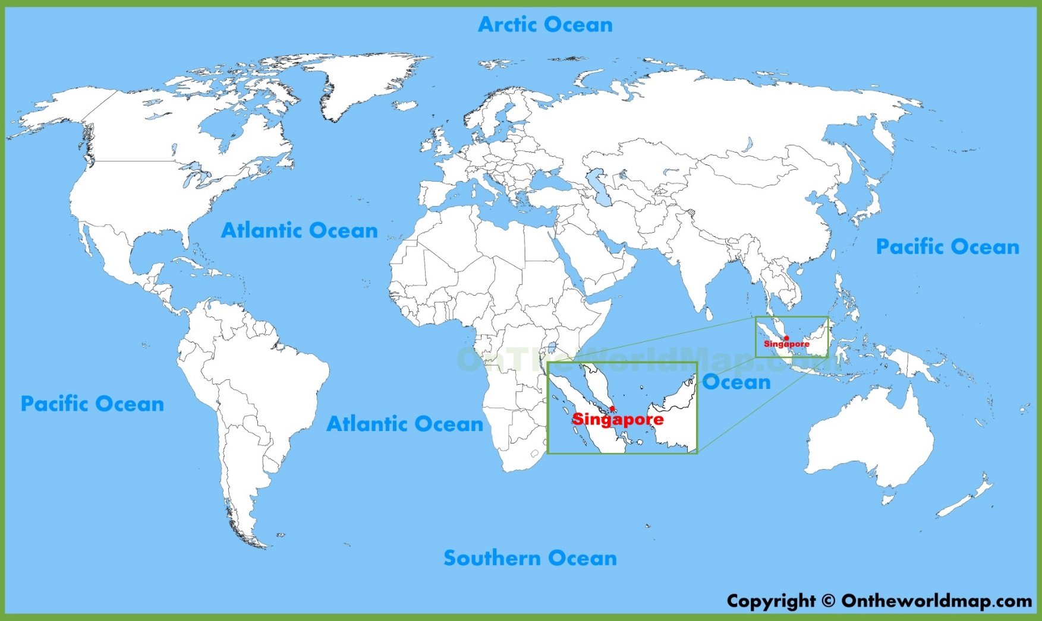
What about Singapore?

Slide 23
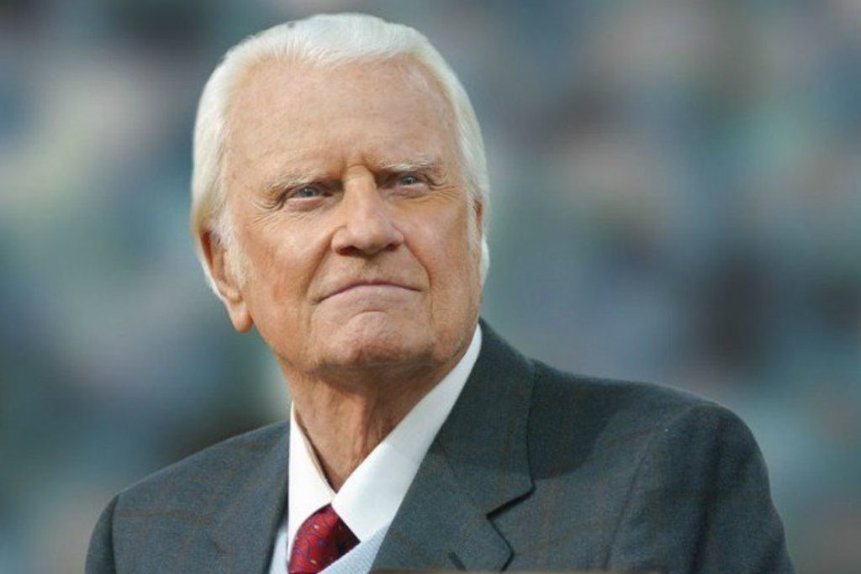
(1918 – 2018)
Billy Graham

Slide 24
Singapore (1970s to 1990s)
Revival in ACS, Dunearn Seconday School and St. Andrew’s Sec Sch in 1973 & 1974
1978 Billy Graham Crusade. A total of 337,000 attended and more than 19,600, people gave their lives to Christ.
Thousands of young people entered into God’s kingdom in the 80s and 90s.
Christianity grew from 12.7% in 1990 to 14.6% in 2000 to 18.8% in 2015

Slide 25
Where is the Singapore Church at today?

Slide 26
Major Challenges in our Churches today
New waves of self centered worship
Easy discipleship
Optional Obedience
Walking away from basic Christian disciplines instead relying on activities ( solitude, silence, fasting, Sabbath, secrecy, submission)
Bible illiterate – lack of the fear of the Lord
Adapting to changes in our society without considering what the Bible says.

Slide 28
All Scripture is God-breathed and is useful for teaching, rebuking, correcting and training in righteousness, so that the servant of God may be thoroughly equipped for every good work. 2 Timothy 3:16-17

Slide 29
For the word of God is alive and active. Sharper than any double-edged sword, it penetrates even to dividing soul and spirit, joints and marrow; it judges the thoughts and attitudes of the heart. Nothing in all creation is hidden from God’s sight. Everything is uncovered and laid bare before the eyes of him to whom we must give account. Hebrews 4:12-13

Slide 30
Mission
eleven:30
Vision
Real. Rooted. Reaching.
With God
With Ourselves
With One Another
In Christ
In the Word
In Community
Our spheres of influence
The next generation
The unloved
Belong – Welcoming, Accessible, Positive
Values
Believe – Evangelistic, Prophetic, Relevant
Behave – Authentic, Vibrant
Welcome Home

Slide 31
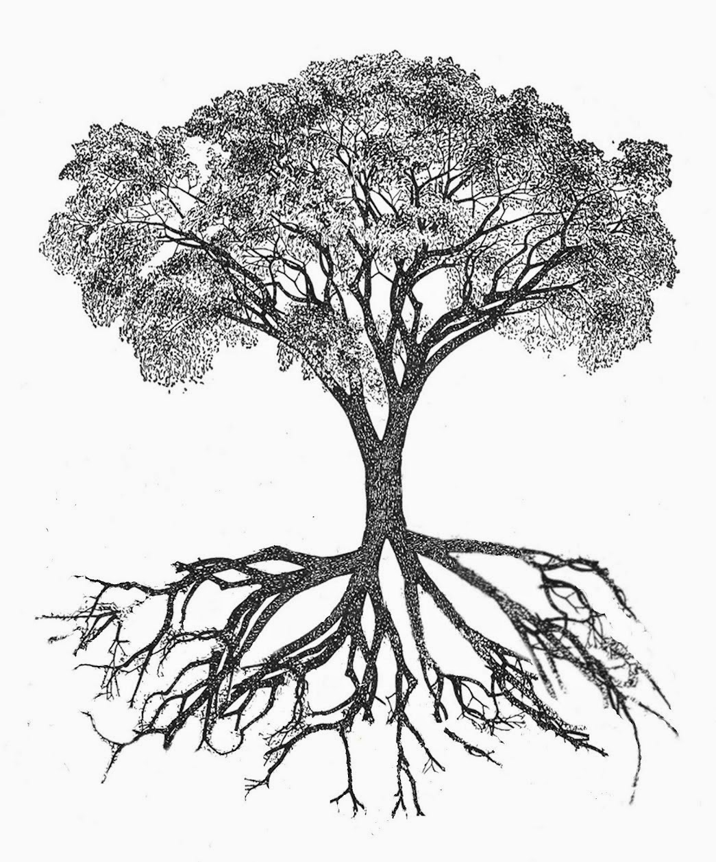
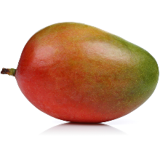
How do we know whether we are deeply ROOTED?

