Slide 1
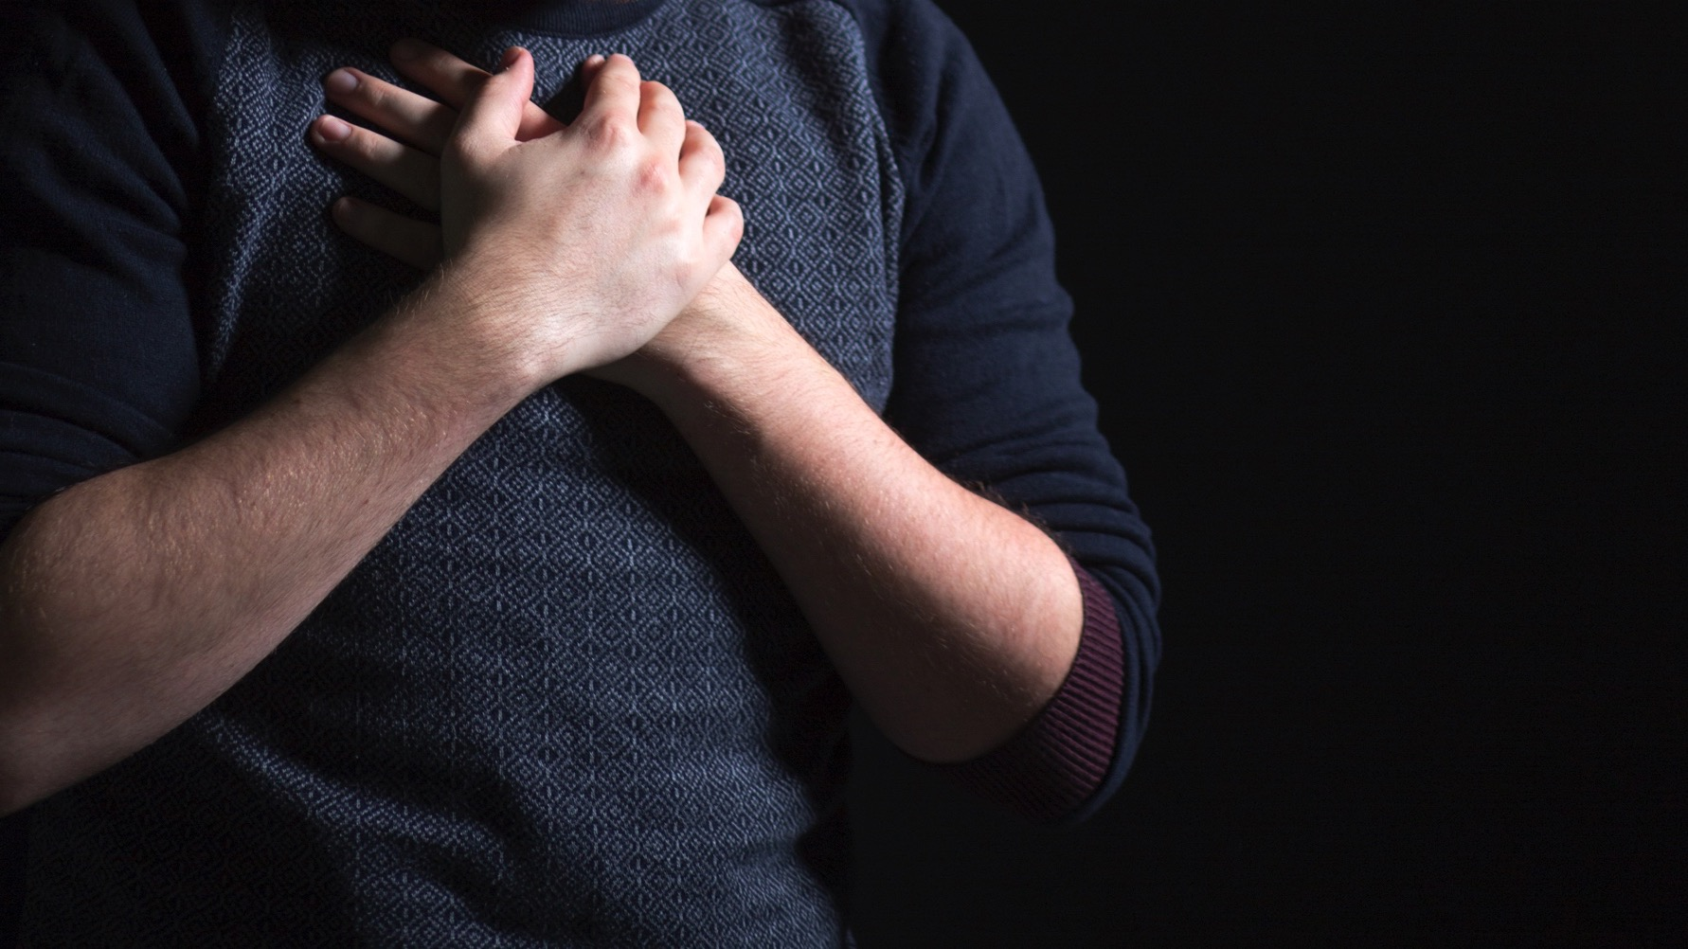
ST ANDREW’S CATHEDRAL
2018 – YEAR OF PRAYER

Slide 2
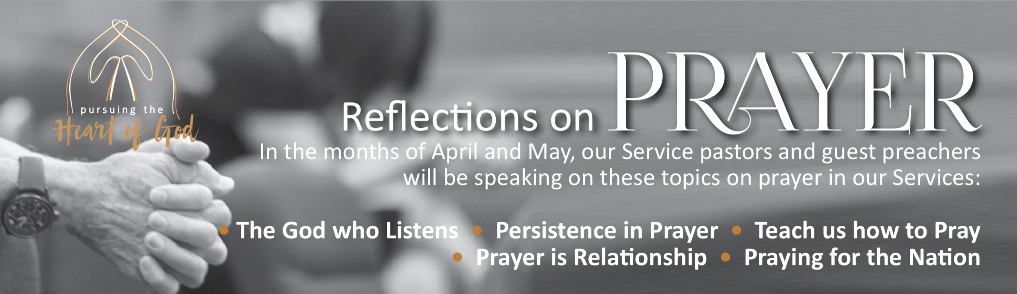
ST ANDREW’S CATHEDRAL
2018 – YEAR OF PRAYER

Slide 3
Praying for the Nations
8.00 & 11.15 am, 13th May 2018

Slide 4
Pay to
Pray for
the Authorities

Slide 5
1 Timothy 2:1-4
First of all, then, I urge that supplications, prayers, intercessions, and thanksgivings be made for all people, ² for kings and all who are in high positions, that we may lead a peaceful and quiet life, godly and dignified in every way. ³ This is good, and it is pleasing in the sight of God our Savior, ⁴ who desires all people to be saved and to come to the knowledge of the truth.

Slide 6
1. Of First Priority
First of all, then, I urge that supplications, prayers, intercessions, and thanksgivings be made for all people, ² for kings and all who are in high positions…

Slide 7
ALL prayers for ALL peoples

Slide 8
Let every person be subject to the governing authorities. For there is no authority except from God, and those that exist have been instituted by God. - Romans 13:1
“he who is the blessed and only Sovereign, the King of kings and Lord of lords,…”- 1 Tim 6:15

Slide 9
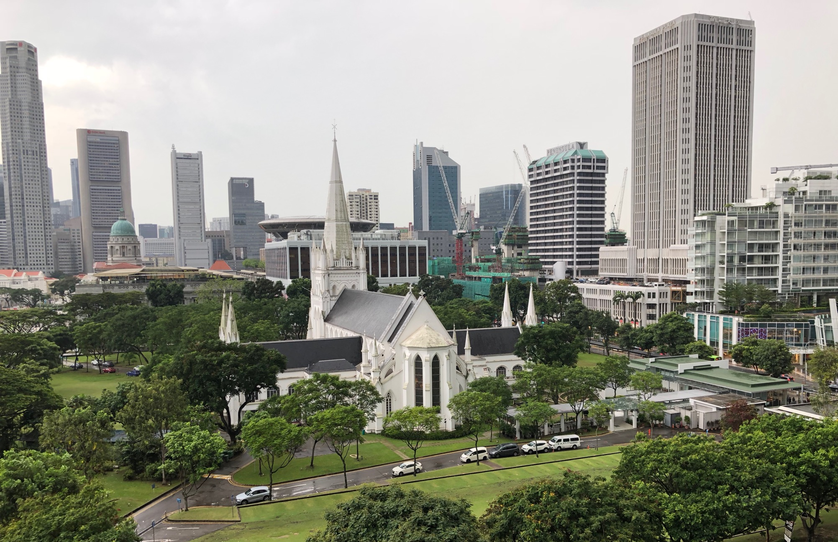
First of all, then…

Slide 10
2. That we may have a peaceful society
that we may lead a peaceful and quiet life, godly and dignified in every way. This is good, and it is pleasing in the sight of God our Savior…1 Timothy: 2-3

Slide 11
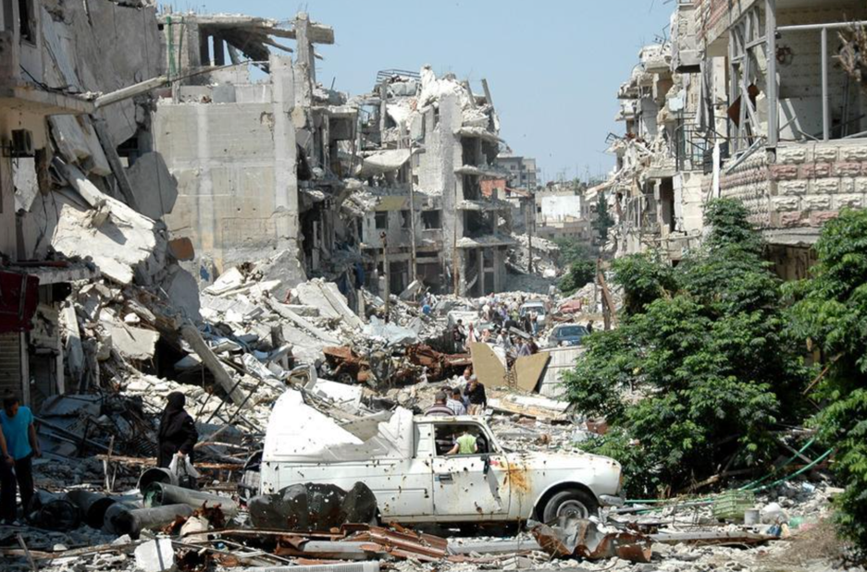
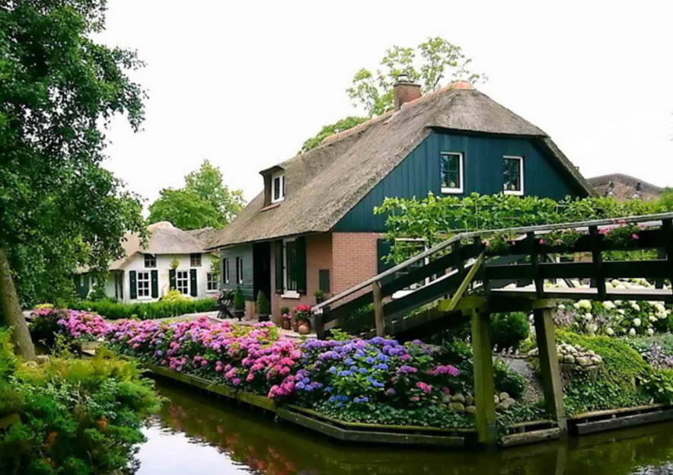
2. That we may have a peaceful society

Slide 12
William Tyndale (1494-1536)
“To preach God’s Word is too much for half a man. And to minister a temporal kingdom is too much for half a man also. One need the other as a “whole man”. The king is to enforce the law as it is written in scripture. The king is not more important than the church: he is its facilitator and supreme authority. The king is to ensure that ministers are preaching properly and to maintain the integrity of the church. (The Obedience of a Christian Man)

Slide 13
The heavens themselves, the planets and this centre
Observe degree, priority, and place,
Insisture, course, proportion, season, form
Office and custom in all line of order…
Take but degree away, untune that string,
And hark! What discord follows!
Shakespeare in Troilus and Cressida

Slide 14
Robert Woodberry’s 2012 study
“The Missionary Roots of Liberal Democracy”
“Areas where Protestant missionaries had a significant presence in the past are on average more economically developed today, with comparatively better health, lower infant mortality, lower corruption, greater literacy, higher educational attainment (especially for women), and more robust membership in nongovernmental associations.”

Slide 15
3. That People may know their God
“…who desires all people to be saved and to come to the knowledge of the truth. For there is one God, and there is one mediator between God and men, the man Christ Jesus, who gave himself as a ransom for all, which is the testimony given at the proper time.”
1 Tim 2:4-6

Slide 16
“Grace enabled human political community to achieve its natural potential, to function rightly within its own limitations, and to point beyond itself to the operations of grace that transcended those limitations.”
- Richard Hooker

Slide 17
All Prayers for All Peoples
that All may be saved.

Slide 18
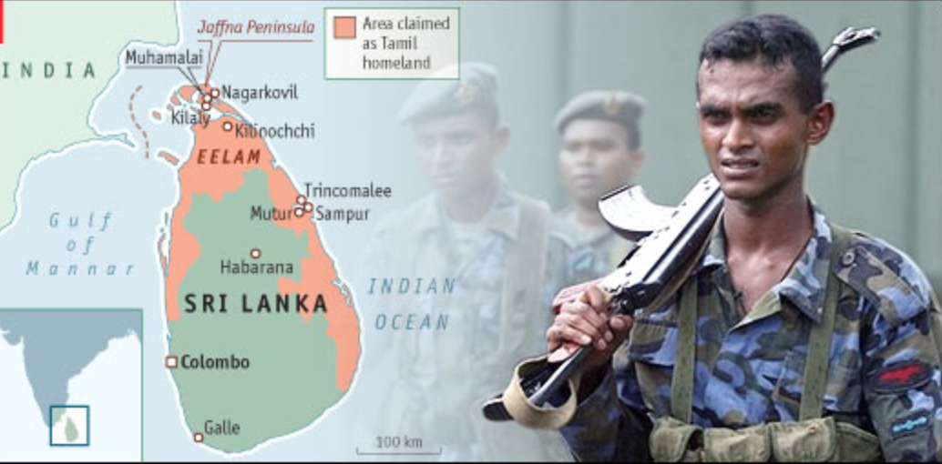

Slide 19
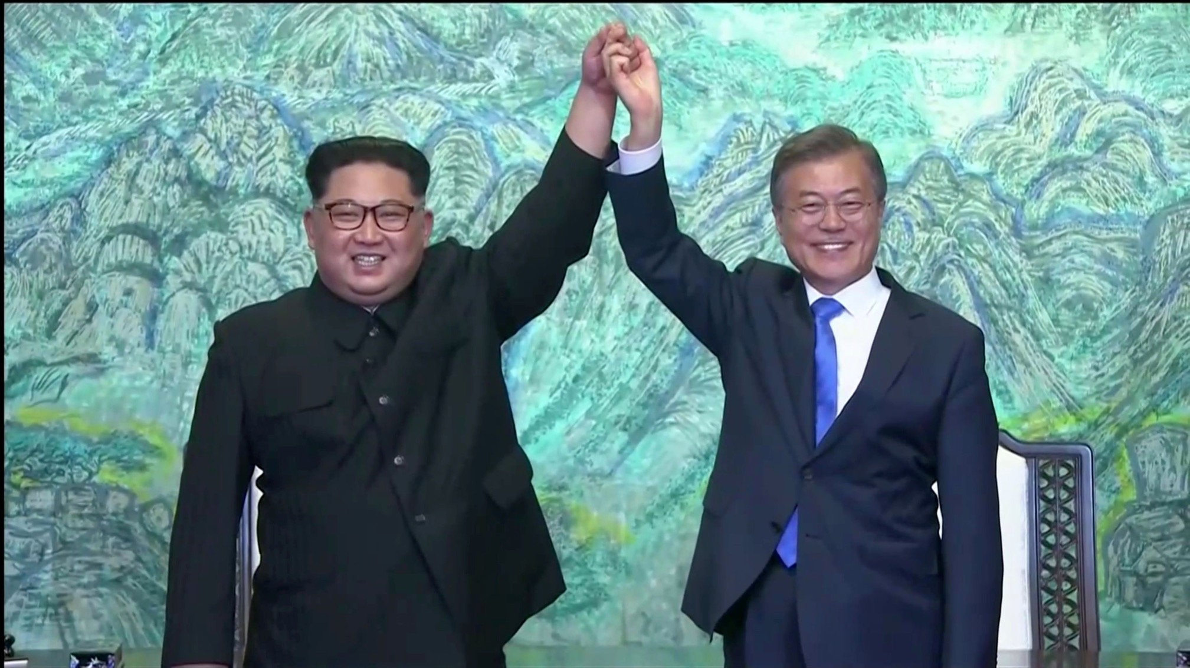

Slide 20
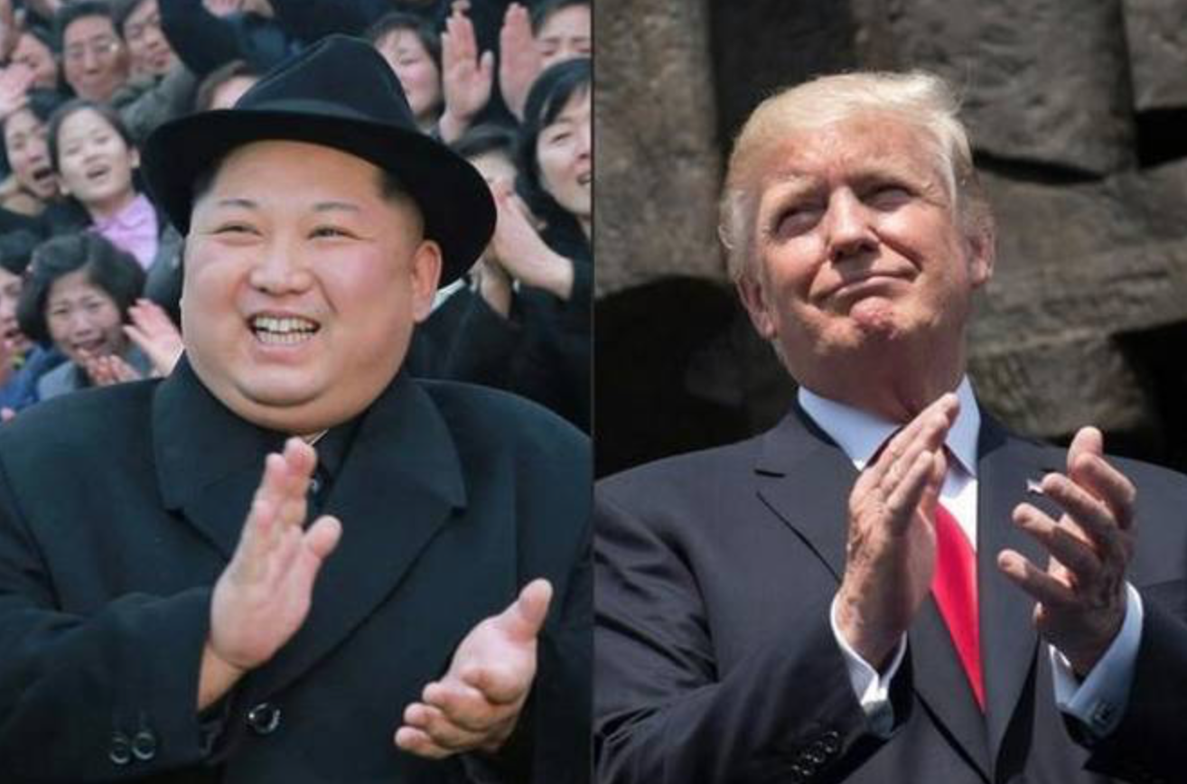
June 12 @Singapore

Slide 21
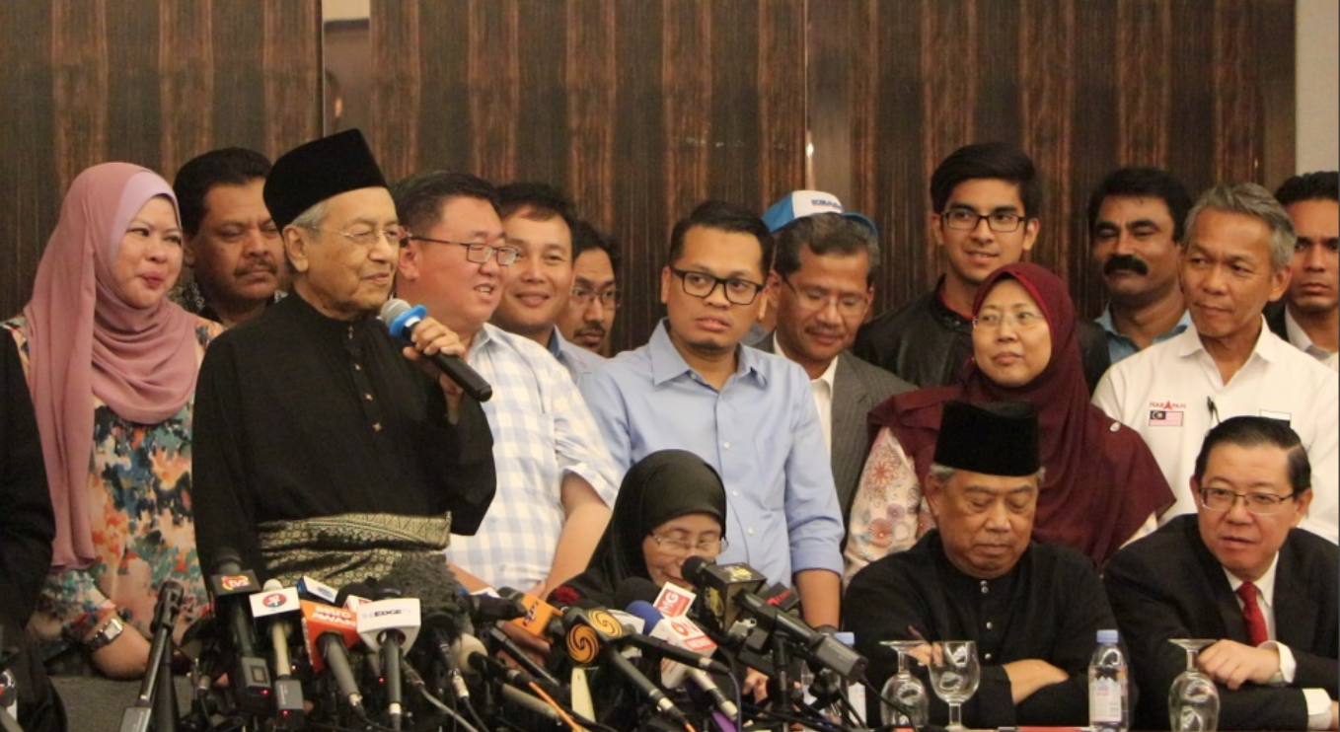

Slide 22
ST ANDREW’S CATHEDRAL
2018 – YEAR OF PRAYER

