Slide 1
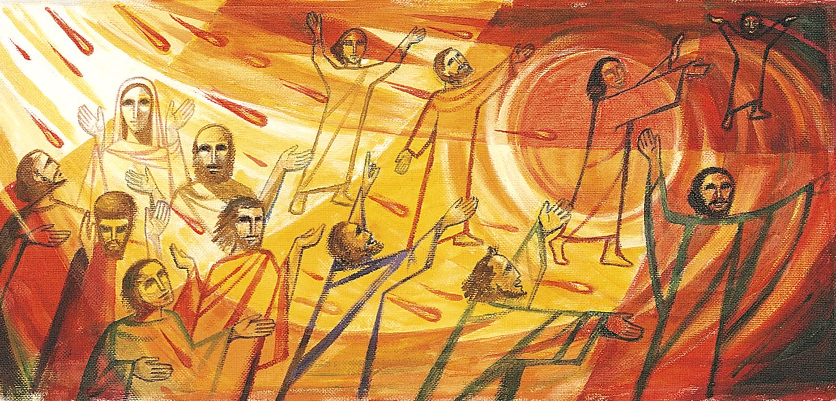
Power from on High
Power from on high (Sat. Service)

Slide 2

The theme of the Bible:
Creation – Fall – Crucifixion – Resurrection – Accession – Pentecost – Second Coming.
We are in the era of Pentecost
Man’s Birthday (HWS)
Power from on high (Sat.service)

Slide 3
The Purpose of Pentecost:
Empowerment from God to be witnesses of the gospel of Christ.
Fulfillment of the Promise of God
Man’s Birthday (HWS)
Power from on high (Sat.service)

Slide 4
The Results of Pentecost:
Boldness to Preach.
Church Growth.
Warmer Fellowship
The Spread of the Gospel.
Miracles – Signs and wonders.
Man’s Birthday (HWS)
Power from on high (Sat.service)

Slide 5
Two things before the day of Pentecost:
The Promise (1:8)
The Waiting (2:1)
Man’s Birthday (HWS)
Power from on high (Sat.service)

Slide 6
Three things happened on the day of Pentecost:
Sound of a violent wind blowing (v.2)
Tongues of fire (v.3)
Filled with the New Wine (v.13)
Man’s Birthday (HWS)
Power from on high (Sat.service)

Slide 7

Power from on High –
A New Happening
Power from on high (Sat. Service)

