Slide 1
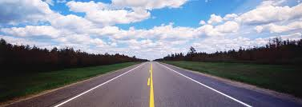
THE JOURNEY
WALK WAY
ֶלִדרוֹ
רֶדך
darak derek
ISAIAH 35:8
“A HIGHWAY SHALL BE THERE, AND A WAY
מסלול (maslul) דֶרֶך (derek)
AND IT SHALL BE CALLED THE WAY OF HOLINESS
דֶרֶך (derek)
Slide 1

Slide 2
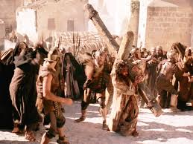
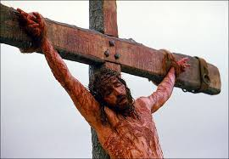
THE JOURNEY
ISAIAH 35:8
AND IT SHALL BE CALLED THE WAY OF HOLINESS
דֶרֶך (derek)
דֶרֶך(derek) = a prepared WAY,
prepared by the WAY OF THE CROSS

Slide 3
1. Deep Darkness
“And the earth was without form, and void; and darkness
was upon the face of the deep”. Gen 1:2
Deep Darkness = Dread
חשֶׁך תְהוֹם
tehom hoshek tardena
והבארץ היתה תהו ובהו וחשך על פני תהום ורוח אלהים
tehom hoshek
Slide 3

Slide 4
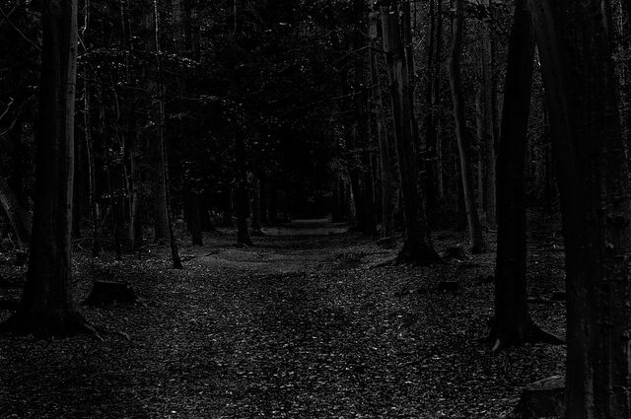
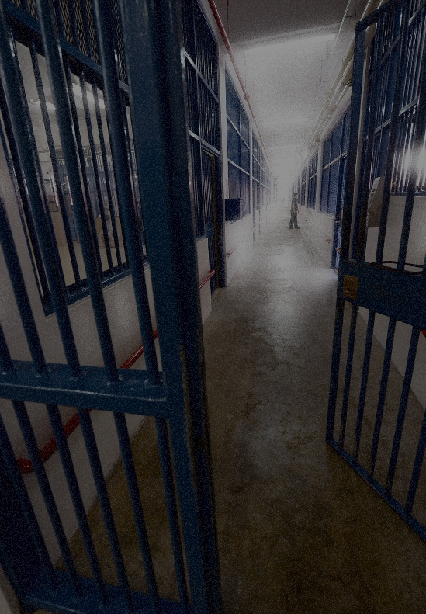
בוהארץ היתה תהו ובהו וחשך על פני תהום ורוח אלהים
tehom hoshek bohu tohu
tohu היתה= chaos & confusion (“without form”)
bohu ובהו = emptiness (“void”)
This is the stronghold of supernatural darkness that strives to withhold light, leads to misery, destruction, violence, terror, sorrow & wickedness. -- “TARDENA”
Slide 4

Slide 5
2. THE WORD
“In the beginning was the Word, and the Word was with God, and the Word was God. He was in the beginning with God. V4 In HIM was life; and the life was the light of men. And the light shineth in the darkness; and the darkness did not comprehend it.”
John 1:1-2,4-5
“Then GOD (Elohim) said, “Light be”, and there was light.”
Gen 1:3
Slide 5

Slide 6
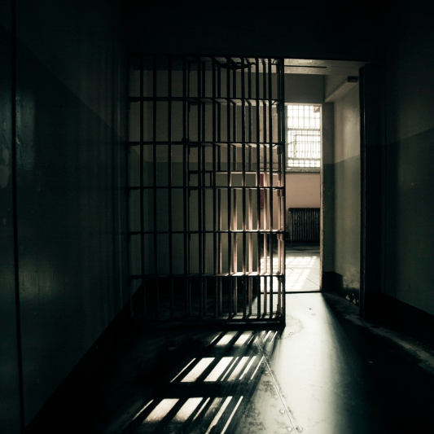
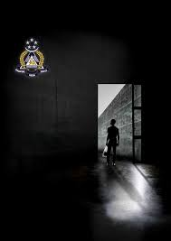

Where the LIGHT shines darkness leaves!
= CHRIST =
The LIVING WORD
drove the darkness away!
Slide 6

Slide 7
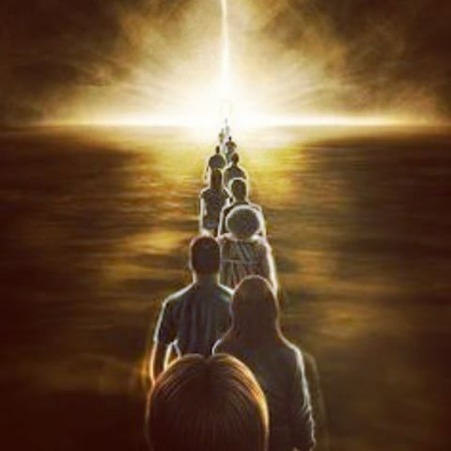
“Jesus said, I am the WAY (hodos), the truth, and the life:
no man cometh unto the Father, but by Me.”
John 14:6
hodos (Greek) = highway
ISAIAH 35:8
“A HIGHWAY SHALL BE THERE, AND A WAY
מסלול (maslul) דרֶֶך (derek)
AND IT SHALL BE CALLED THE WAY OF
HOLINESS” דרֶֶך (derek)
Slide 7
3. THE WAY

Slide 8
THE JOURNEY
“DD” DEEP DARKNESS
THE WORD (JESUS CHRIST)
* THE LIGHT
* THE LIVING WORD
THE WAY (JESUS CHRIST)
Slide 8

