Slide 1


Slide 2


Slide 3
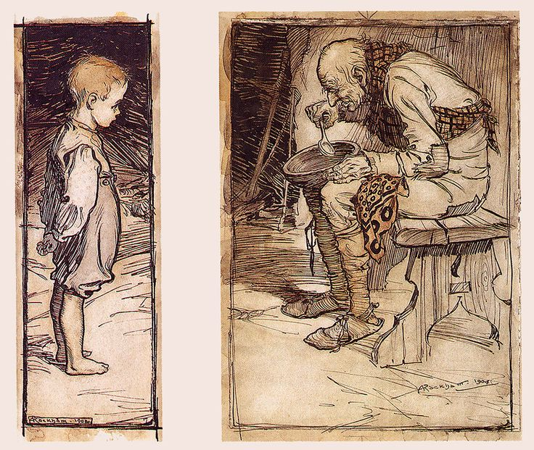
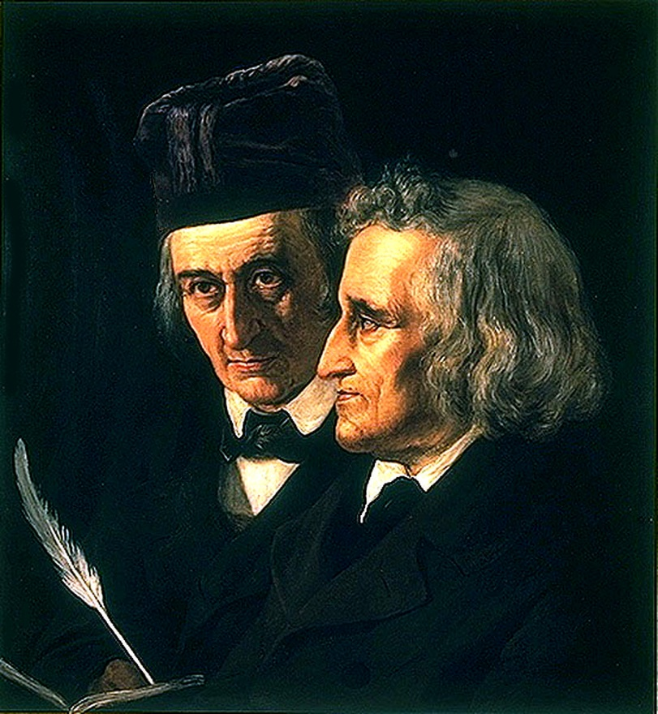
Brothers Grimm
The old man and his grandson

Slide 4
The 5th Commandment
Exodus 20:12 (ESV)
Honour your father and your mother,
that your days may be long in the land
that the Lord your God is giving you.

Slide 5
The 10 Commandments
GIN SP - MAS WC

Slide 6
Why obey the 5th commandment?
God said so
Ephesians 6:1 “Children, obey your parents
in the Lord, for this is right.”

Slide 7
Why obey the 5th commandment?
Jesus did it
Luke 2:51 “So Jesus went back with them to
Nazareth, where he was obedient to them.”

Slide 8
Why obey the 5th commandment?
Commandment with a promise
Proverbs 3:1-2 “My son, do not forget my
teaching, but let your heart keep my
commandments, for length of days and
years of life and peace they will add to you.”

Slide 9
Living out the 5th commandment
John 19:26-27 (ESV)
²⁶ When Jesus saw his mother and the disciple whom he loved standing nearby, he said to his mother, “Woman, behold, your son!” ²⁷ Then he said to the disciple, “Behold, your mother!” And from that hour the disciple took her to his own home.

Slide 10
Jesus’ 7 last words
1. "Father, forgive them, for they know not what they do.” (Lk 23:34)
2. "Truly, I say to you, today you will be with me in Paradise." (Lk 23:43)
3. "Woman, behold your son!" "Behold, your mother!” (Jn 19:26-27)
4. "My God, my God, why have you forsaken me?" (Mk 15:34)
5. "I thirst." (Jn 19:28)
6. "It is finished." (Jn 19:30)
7. "Father, into thy hands I commit my spirit!" (Lk 23:46)

Slide 11
Living out the 5th commandment
3. "Woman, behold your son!" "Behold, your mother!” (Jn 19:26-27)
Love for your parents
Responsibility for your parents

Slide 12
Living out the 5th commandment
Proverbs 23:22 (ESV)
²² Listen to your father who gave you life, and do not despise your mother when she is old.
Best Mother’s Day gifts:
Time, Patience, Understanding

Slide 13
