Slide 1
HAVING THE MIND OF CHRIST

Slide 2
Phil 2:1-11 (The Message)
If you’ve gotten anything at all out of following Christ, if his love has made any difference in your life, if being in a community of the Spirit means anything to you, if you have a heart, if you care— then do me a favor: Agree with each other, love each other, be deep-spirited friends.

Slide 3
Phil 2:1-11 (The Message)
Don’t push your way to the front; don’t sweet-talk your way to the top. Put yourself aside, and help others get ahead. Don’t be obsessed with getting your own advantage. Forget yourselves long enough to lend a helping hand.

Slide 4
Phil 2:1-11 (The Message)
Think of yourselves the way Christ Jesus thought of himself. He had equal status with God but didn’t think so much of himself that he had to cling to the advantages of that status no matter what. Not at all. When the time came, he set aside the privileges of deity and took on the status of a slave, became human!

Slide 5
Phil 2:1-11 (The Message)
Having become human, he stayed human. It was an incredibly humbling process. He didn’t claim special privileges. Instead, he lived a selfless, obedient life and then died a selfless, obedient death—and the worst kind of death at that—a crucifixion.

Slide 6
Phil 2:1-11 (The Message)
Because of that obedience, God lifted him high and honored him far beyond anyone or anything, ever, so that all created beings in heaven and on earth—even those long ago dead and buried—will bow in worship before this Jesus Christ, and call out in praise that he is the Master of all, to the glorious honor of God the Father.

Slide 7
HAVING THE MIND OF CHRIST

Slide 8
Phil 2:1-11 (The Message)
Christ’s Humility
Christ’s Incarnation
Christ’s exaltation

Slide 9
Christ’s Humility
“Christ did not empty Himself of deity, but of its outward manifestation. He emptied Himself by taking the form of a servant. .. To achieve the divine purpose of becoming the Savior, the divine glory needed to be veiled. Christ voluntarily, moment by moment, submitted to human limitations apart from sin.”
~ John Walvoord

Slide 10
Phil 2:1-11 (The Message)
Having the mind of Christ requires us to forego our sense of entitlement and pride. Instead, we are called to humble ourselves.

Slide 11
Phil 2:1-11 (The Message)
Christ’s Humility
We should be humble.

Slide 12
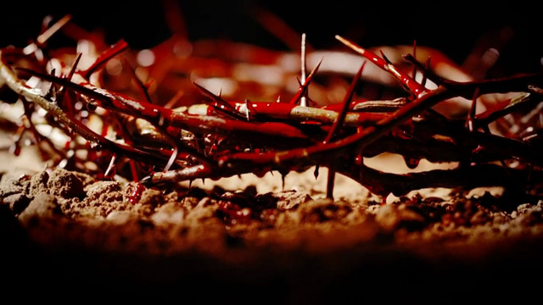
Christ’s Incarnation: Passion of Christ

Slide 13
Christ’s Incarnation
“Jesus came down from heaven to earth in the greatest stoop of all time. Instead of climbing the ladder, Jesus stepped down, one rung at a time…Jesus, being God, “emptied Himself” by adding humanity....The point that he is trying to make is that Jesus Christ practised self-denial and self-sacrifice for our sake and became “God-in-a-bod!” What an astounding, unfathomable thought. Jesus left the glory and splendor of heaven and came to dwell on earth to serve others.” ~ Keith Krell, Work your way down the ladder

Slide 14
Serve in an Incarnational Manner
Having the mind of Christ requires us to be self-sacrificial in the way we love others just as Christ loved us and came as the Incarnate God to reach out to us.
Serve others in an incarnational manner by coming as equals with them, and not from a higher position.

Slide 15
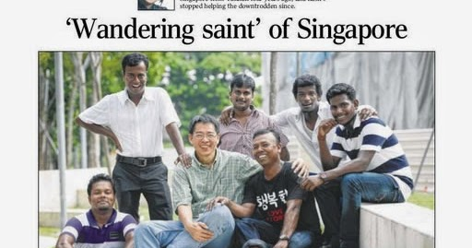

Slide 16
Incarnational Ministry
“I want to come in playing sports rather than parachute in as a doctor..
This way, you form a multi-layered relationship that builds community.”
~ Dr Tan Lai Yong

Slide 17
Phil 2:1-11 (The Message)
Christ’s Humility
We should be humble.
Christ’s Incarnation
We should serve others in an incarnational manner.

Slide 18
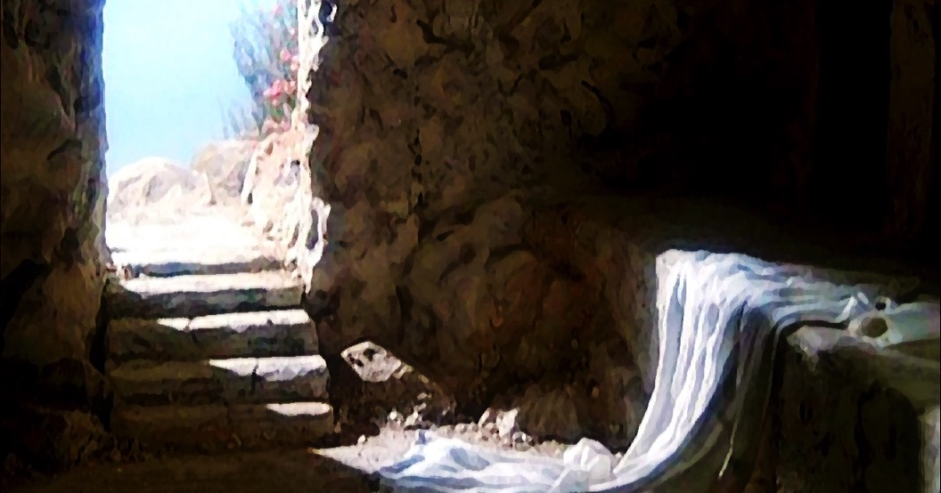
Christ’s Exaltation
JESUS CHRIST IS LORD

Slide 19
Let God be God
Having the mind of Christ means we do not promote ourselves, demand our rewards or take things into our own hands to vindicate ourselves.
God is the One who will honour good works, and vindicate the righteous in His perfect time and in His higher ways.

Slide 20
David’s Lament

Slide 21
Life is but a Weaving
“My life is but a weaving Between my God and me. I cannot choose the colors He weaveth steadily.

Slide 22
Life is but a Weaving
Oft’ times He weaveth sorrow; And I in foolish pride Forget He sees the upper And I the underside.

Slide 23
Life is but a Weaving
Not ’til the loom is silent And the shuttles cease to fly Will God unroll the canvas And reveal the reason why.

Slide 24
Life is but a Weaving
The dark threads are as needful In the weaver’s skillful hand As the threads of gold and silver In the pattern He has planned

Slide 25
Life is but a Weaving
He knows, He loves, He cares; Nothing this truth can dim. He gives the very best to those Who leave the choice to Him.”
― Corrie ten Boom

Slide 26
David’s Lament

Slide 27
David’s Lament

Slide 28
In the end it will be alright..
“All things work for the good of those who love Him, and who have been called according to His purpose.”
Rom 8:28

Slide 29
Phil 2:1-11 (The Message)
PALM SUNDAY

Slide 30
Phil 2:1-11 (The Message)
Christ’s Humility
We should be humble.
Christ’s Incarnation
We should serve others in an incarnational manner.
Christ’s Exaltation
We should let God
be God.

