Slide 1
They were wise because
they were expecting and searching

Slide 2
They were wise because
They followed God’s guidance

Slide 3
They were wise because
they recognised who this king was

Slide 4
GOLD - Kingship

Slide 5
FRANKINCENSE – Divine Priesthood

Slide 6
MYRRH – Sacrificial Death on the Cross

Slide 7
They worshipped Jesus
v2 ‘we saw his star in the east and we came to worship him’

Slide 8
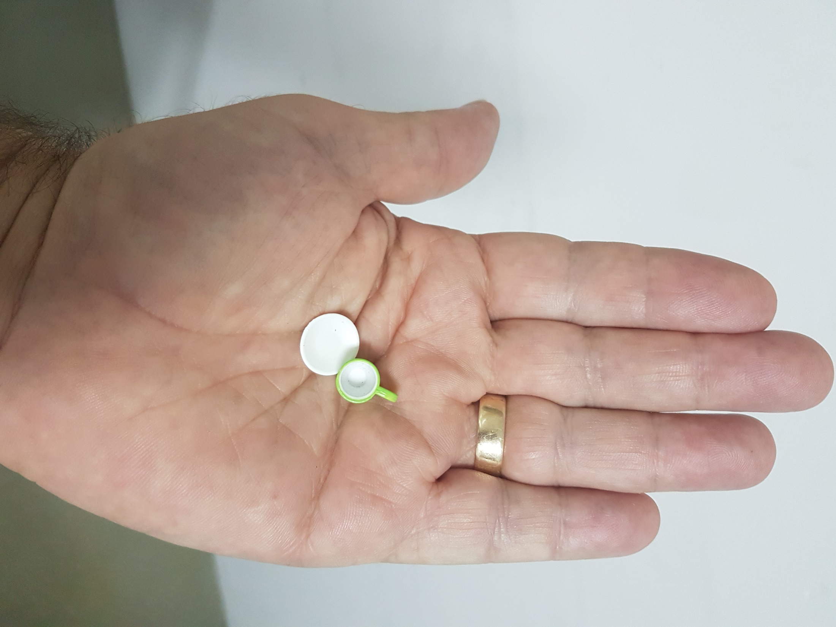

Slide 9
v11 on seeing the child they bowed down and worshipped him

Slide 10
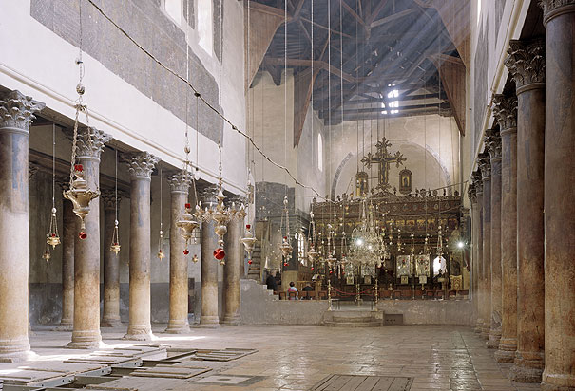

Slide 11
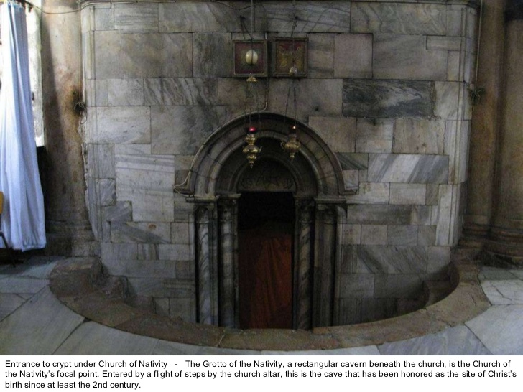

Slide 12
We bow in humble adoration

