Slide 1
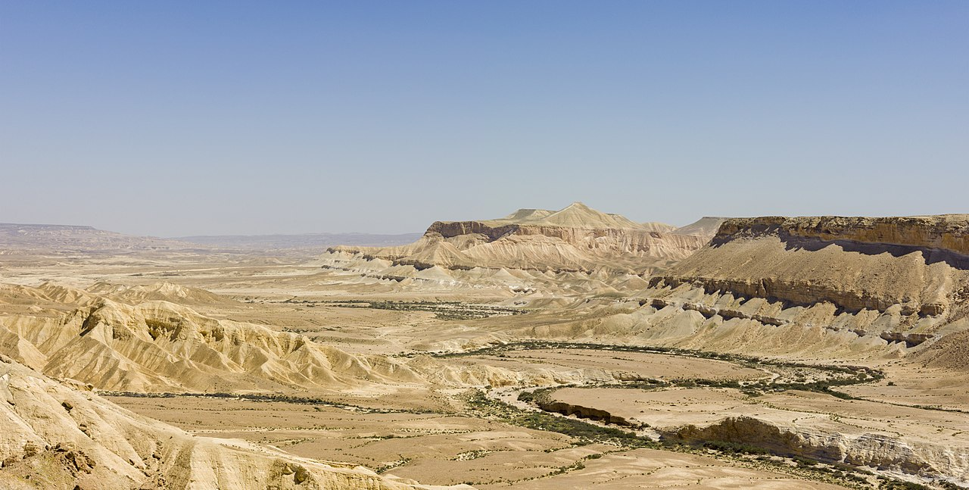
“WILDERNESS”

Slide 2
“WILDERNESS”
Uncultivated, uninhabited and inhospitable region.
A neglected or abandoned area undisturbed by human activity.
“WILDERNESS”

Slide 3
WILDerness
“with the wild animals”

Slide 5
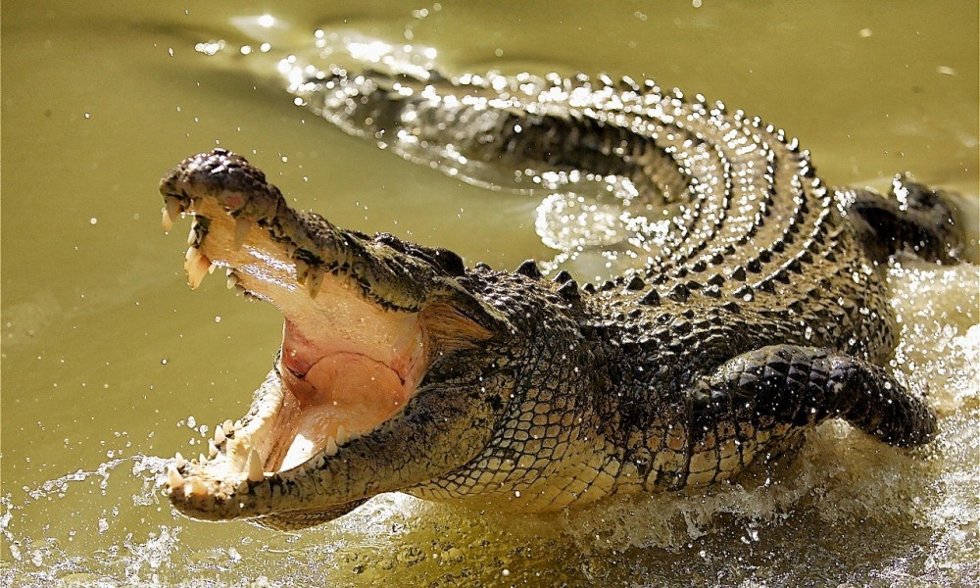
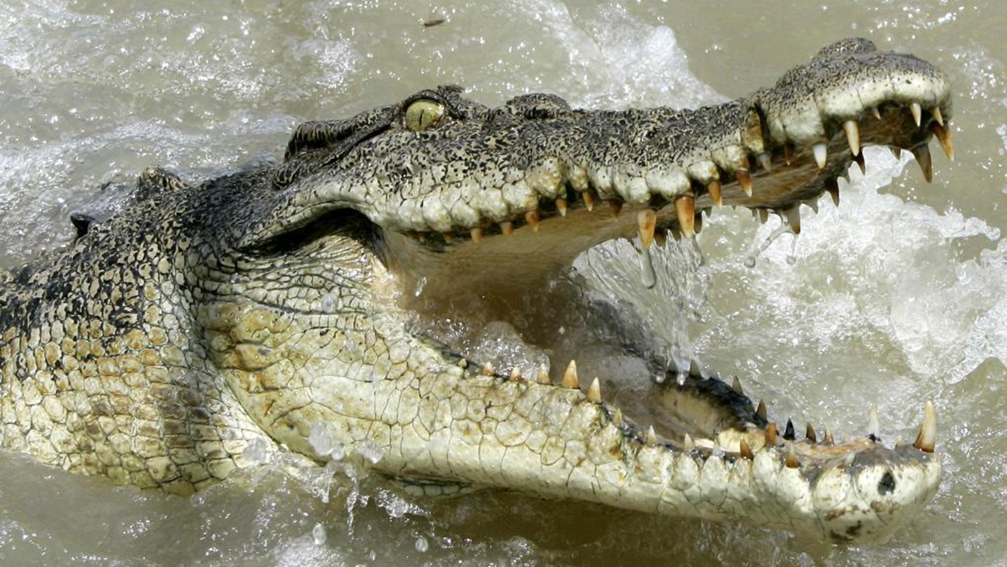

Slide 6
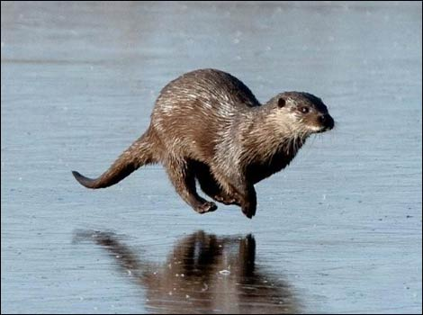

Slide 7
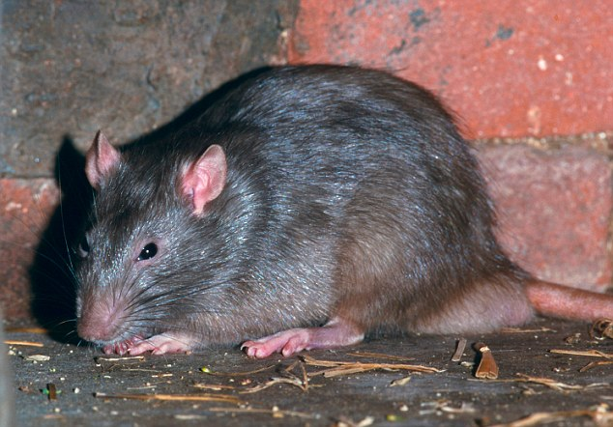

Slide 8
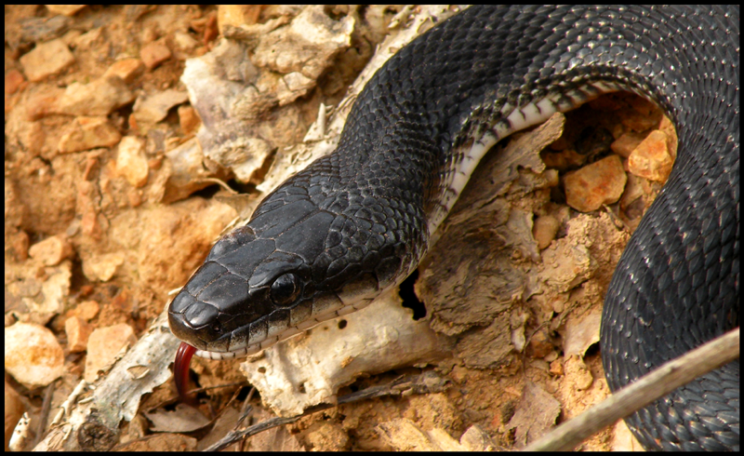

Slide 9
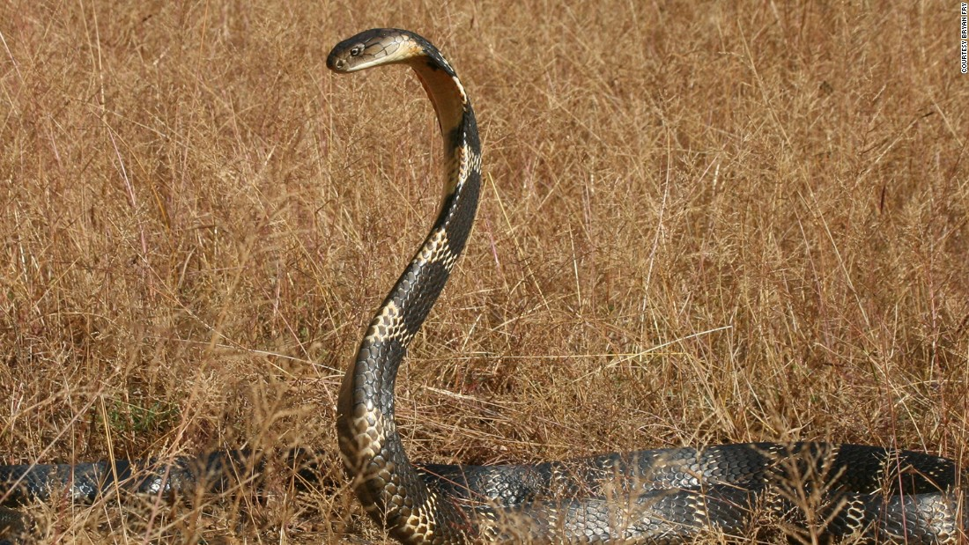

Slide 11
INTO THE DARKEST PLACE
18 For Christ also suffered once for sins, the righteous for the unrighteous, that he might bring us to God, being put to death in the flesh but made alive in the spirit,

Slide 12
INTO THE DARKEST PLACE
19-20 in which he went and proclaimed to the spirits in prison, because they formerly did not obey, when God's patience waited in the days of Noah…
4v6 “preached to those who were dead”
The Apostles Creed
“He descended into hell”

Slide 14
Agrizoophobia

Slide 15
hexakosiahexekontahexaphobia

Slide 16
homilophobia

Slide 17
He is the Saviour who saves us
from wild animals!
He has been into the place of our fears.

Slide 18
He is the Saviour who is to be found in our times of Wilderness

Slide 19
He is the Saviour who is to be found in our times of Wilderness and Lack

Slide 20
He is the Saviour who comes into
the pit of our suffering and despair

Slide 21
He is the Saviour who goes into
our sin and rebellion

Slide 22
He is the Saviour who brings in
God’s Kingdom of Peace

