Slide 1
L E N T Living for a higher purpose
Ephesians 2:1-10

Slide 2
Ephesians 2:1-10
Eph 2:1 And you were dead in the trespasses and sins
Eph 2:2 in which you once walked, following the course of this world, following the prince of the power of the air, the spirit that is now at work in the sons of disobedience—
Notes:
True vine

Slide 3
Ephesians 2:1-10
Eph 2:3 among whom we all once lived in the passions of our flesh, carrying out the desires of the body and the mind, and were by nature children of wrath, like the rest of mankind.
Eph 2:4 But God, being rich in mercy, because of the great love with which he loved us,

Slide 4
Ephesians 2:1-10
Eph 2:5 even when we were dead in our trespasses, made us alive together with Christ—by grace you have been saved—
Eph 2:6 and raised us up with him and seated us with him in the heavenly places in Christ Jesus,

Slide 5
Ephesians 2:1-10
Eph 2:7 so that in the coming ages he might show the immeasurable riches of his grace in kindness toward us in Christ Jesus.
Eph 2:8 For by grace you have been saved through faith. And this is not your own doing; it is the gift of God,

Slide 6
Ephesians 2:1-10
Eph 2:9 not a result of works, so that no one may boast.
Eph 2:10 For we are his workmanship, created in Christ Jesus for good works, which God prepared beforehand, that we should walk in them.

Slide 7
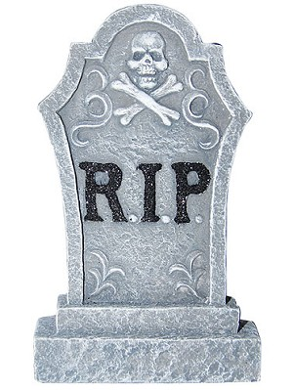
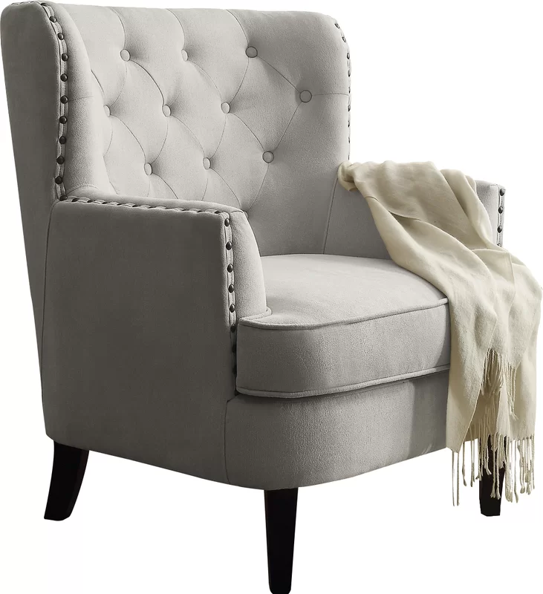
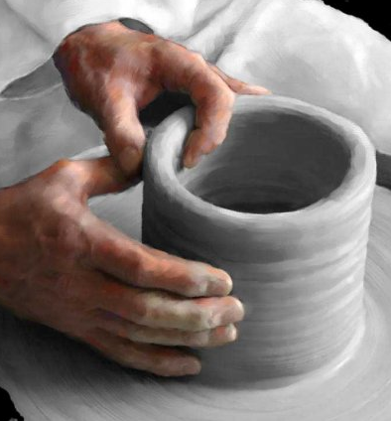
dead
saved
prepared
walk
We are HIS workmanship (v10)
Notes:
We are His workmanship, which translates the ancient Greek word poiema. The idea is that we are His beautiful poem. The Jerusalem Bible translates workmanship as “work of art.”

Slide 8
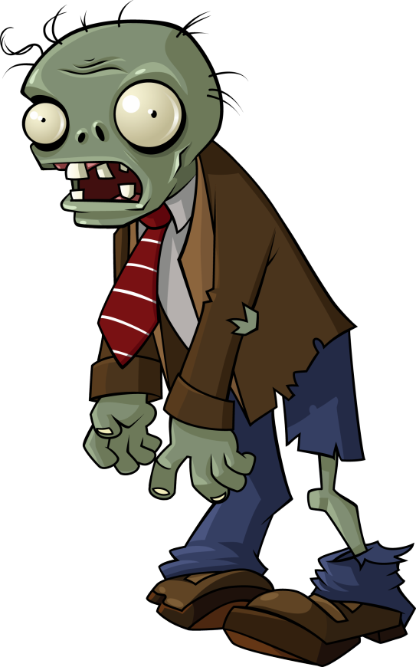
We were DEAD
Blind (2 Corinthians 4:3-4)
A slave to sin (Romans 6:17)
A lover of darkness (John 3:19-20)
Sick (Mark 2:17)
Lost (Luke 15)
An alien, a stranger, a foreigner (Ephesians 2:12, 2:19)
A child of wrath (Ephesians 2:3)
Under the power of darkness (Colossians 1:13)
Notes:
Eph 2:1 And you were dead in the trespasses and sins
Eph 2:2 in which you once walked, following the course of this world, following the prince of the power of the air, the spirit that is now at work in the sons of disobedience—
Eph 2:3 among whom we all once lived in the passions of our flesh, carrying out the desires of the body and the mind, and were by nature children of wrath, like the rest of mankind.

Slide 9
Live for a higher purpose
We are now saved
We are being prepared beforehand
We are created in Christ for good works

Slide 10
Saved!
Eph 2:5 even when we were dead in our trespasses, made us alive together with Christ—by grace you have been saved—
Eph 2:6 and raised us up with him and seated us with him in the heavenly places in Christ Jesus,
Notes:
Eph 2:1 And you were dead in the trespasses and sins
Eph 2:2 in which you once walked, following the course of this world, following the prince of the power of the air, the spirit that is now at work in the sons of disobedience—
Eph 2:5 even when we were dead in our trespasses, made us alive together with Christ—by grace you have been saved—
Eph 2:6 and raised us up with him and seated us with him in the heavenly places in Christ Jesus,
We don’t sit in the heavenly places with Christ Jesus, or at least not yet. Instead, we sit in the heavenly places in Christ Jesus. Since our life and identity is in Christ, as He sits in heavenly places, so do we.
Jesus became nothing so that we can become yes-thing. Yes to God’s love and forgiveness.
He humbled himself at the cross so we can exalted/lifted up

Slide 11
Saved!
Eph 2:7 so that in the coming ages he might show the immeasurable riches of his grace in kindness toward us in Christ Jesus.
Eph 2:8 For by grace you have been saved through faith. And this is not your own doing; it is the gift of God,
Notes:
What immeasurable riches of his grace in Christ?
What is this gift?
Security
Intimacy/access to God
Assurance/Acceptance
Freedom
Victory
Authority
Inheritance
Family
Do you know and live out the immeasurable riches of his grace?
Do we live richly or poorly?
Story of curise

Slide 12
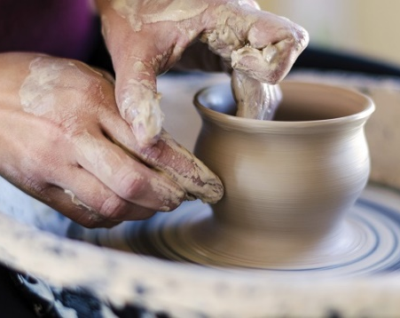
Prepared & Released!
Eph 2:10 For we are his workmanship, created in Christ Jesus for good works, which God prepared beforehand, that we should walk in them.
Notes:
GOD’S POIEMA: Beloved, if you are IN CHRIST by grace through faith (Eph 2:8,9), do you know what God says about you in Ephesians 2:10? You are God’s “WORKMANSHIP, created IN CHRIST JESUS for good works, which God prepared beforehand that we should walk in them.” The Greek word for “WORKMANSHIP” is POIEMA which gives us our English words POEM and POETRY. Poiema means “something made” and in context is something made by God Himself. As a new creation skillfully and artfully created IN CHRIST JESUS (2 Cor 5:17), have you ever thought of your new (supernatural) life as a work of “divine poetry?” Beloved, as believers “each of our lives is the papyrus on which the Master is producing a work of art that will fill the everlasting ages with His praise.” (S Gordon) You are God’s masterpiece. You are His poem. You are His work of art. When we look at ourselves this way, we begin to understand our incredible value in Christ. Indeed, as C S Lewis said “We are a divine work of art.” “If Rembrandt’s artistic masterpieces have great, undisputed value, would not God’s one-of-a-kind human masterpieces convey even greater value?” (D Robertson)
Timothy Keller asks “Do you know what it means that you are God’s workmanship? What is art? Art is beautiful, art is valuable, and art is an expression of the inner being of the maker, of the artist. Imagine what that means. You’re beautiful, you’re valuable, and you’re an expression of the very inner being of the Artist, the divine Artist, God Himself. You see, when Jesus gave Himself on the Cross, He didn’t say, “I’m going to die just so you know I love you.” He said, “I’m going to die, I’m going to bleed, for your splendor. I’m going to re-create you into something beautiful. I will turn you into something splendid, magnificent. I’m the Artist; you’re the art. I’m the Painter; you’re the canvas. I’m the Sculptor; you’re the marble. You don’t look like much there in the quarry, but I can see. Oh, I can see!” Jesus is an Artist!” And you beloved are His crowning achievement, His masterpiece!
https://preceptaustin.wordpress.com/2012/09/24/poiema-greek-word-study/

Slide 13
Live for a higher purpose
We are now saved
We are being prepared beforehand
We are created in Christ for good works
Notes:
For we are his workmanship, created in Christ Jesus for good works, which God prepared beforehand, that we should walk in them.
Ephesians 2:10

Slide 14
Are we living for HIS purpose?
Notes:
For we are his workmanship, created in Christ Jesus for good works, which God prepared beforehand, that we should walk in them.
Ephesians 2:10

