Slide 1
faith-filled disciples filling Jerusalem with faith?

Slide 2
Doubt was in the atmosphere …

Slide 3
Doubt was in the atmosphere …
Luke 24:11 … they did not believe her, because her words seemed to them like nonsense.

Slide 4
“No. I don’t believe it!”
John 20:25 “Unless I see in his hands the mark of the nails, and place my finger into the mark of the nails, and place my hand into his side, I will never believe..”
Doubting Thomas

Slide 5
Matt 28:17 When they saw him, they worshipped him; but some doubted

Slide 6
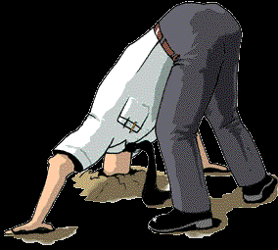
Building Faith - Own your Doubt

Slide 7
Building Faith - Ask Questions
Own your Doubt

Slide 8
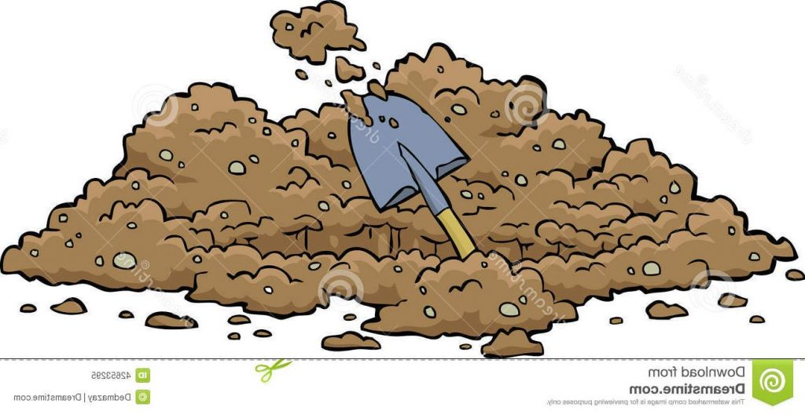
Building Faith - Investigate Faith
Ask Questions
Own your Doubt

Slide 9
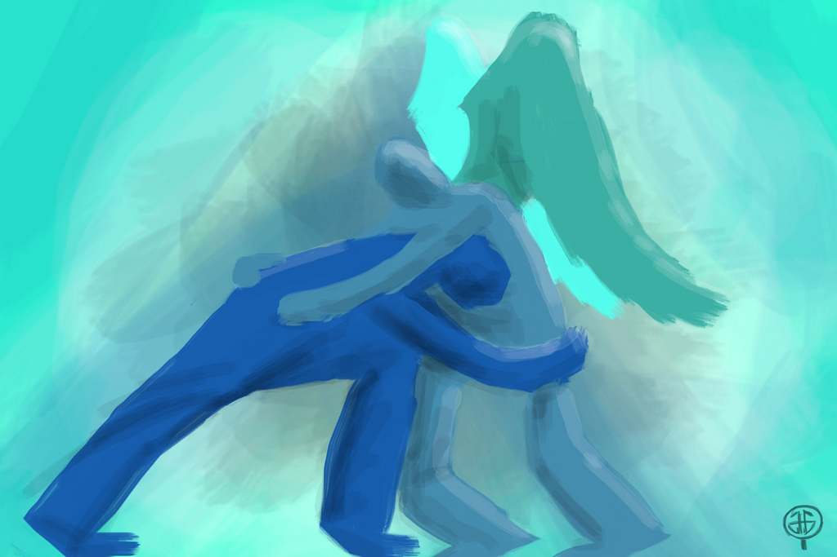
Building Faith - Struggle Deeply
Investigate Faith
Ask Questions
Own your Doubt

Slide 10
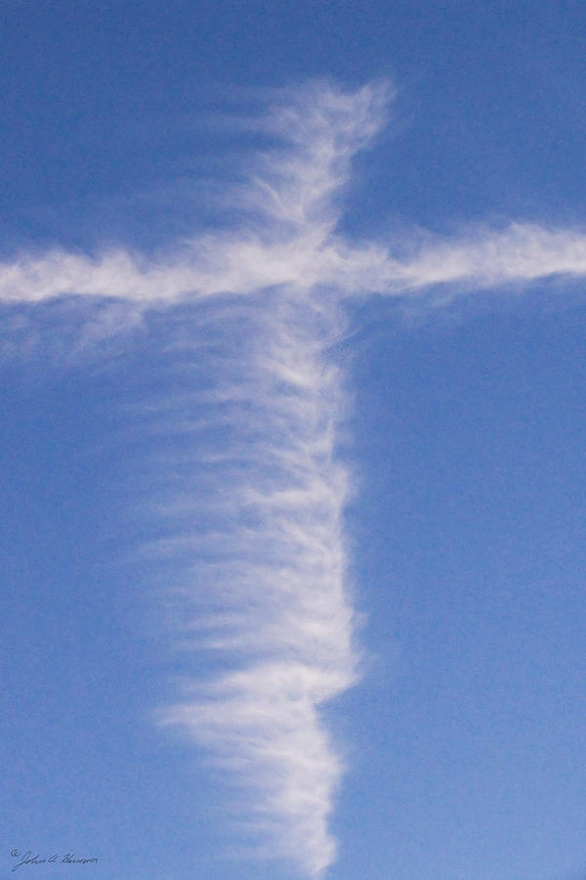
Building Faith - Beware Proofs
Struggle Deeply
Investigate Faith
Ask Questions
Own your Doubt

Slide 11
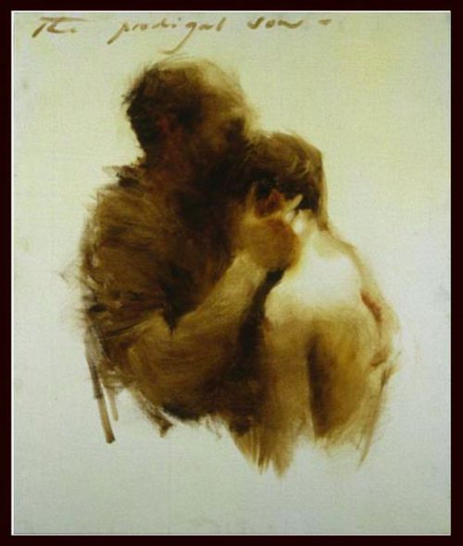
Building Faith - Learn Trust
Beware Proofs
Struggle Deeply
Investigate Faith
Ask Questions
Own your Doubt

Slide 12
Eight days later, his disciples were inside again, and Thomas was with them. Although the doors were locked, Jesus came and stood amongst them and said “peace be with you”. Then he said to Thomas, “Put your finger here, and see my hands; and put out your hand, and place it in my side. Do not disbelieve, but believe.” (John 20:26-28)

Slide 13
“Feed your faith and your doubts will starve to death”

Slide 14
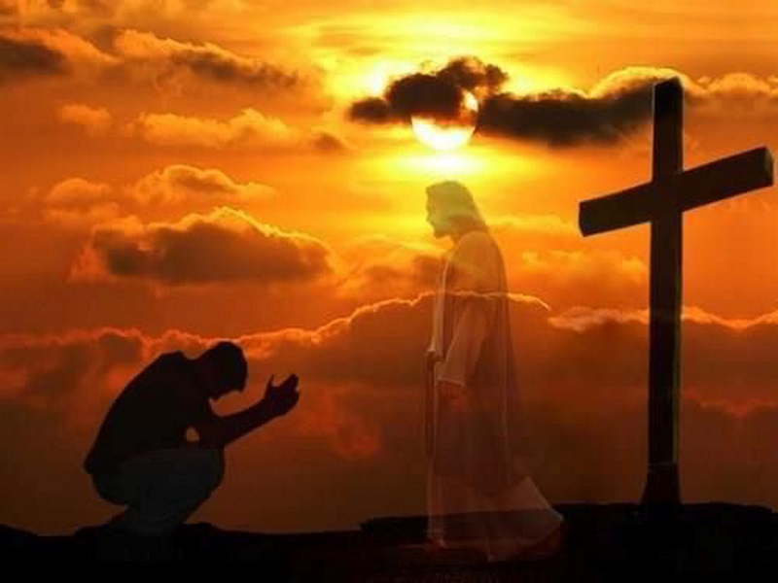
Building Faith - Posture of Worship
Learn Trust
Beware Proofs
Struggle Deeply
Investigate Faith
Ask Questions
“My Lord and
my God.”
Own your Doubt

Slide 15
Wear Faith Spectacles
Posture of Worship
fix your eyes on Jesus
Learn Trust
Beware Proofs
Struggle Deeply
Investigate Faith
Ask Questions
Own your Doubt

Slide 16
Fix your thoughts on Jesus, the apostle and high priest whom we confess.
(Hebrews 3 v1)

Slide 17
Let us fix our eyes on Jesus, the author and perfecter of our faith
(Hebrews 12 v2)

Slide 18
We fix our eyes not on what is seen, but on what is unseen
(2 Cor 4 v18)

Slide 19
Doubt
The Faith Builder
Wear Faith Spectacles
Posture of Worship
Learn Trust
Beware Proofs
Struggle Deeply
Investigate Faith
Ask Questions
Own your Doubt

