Slide 1
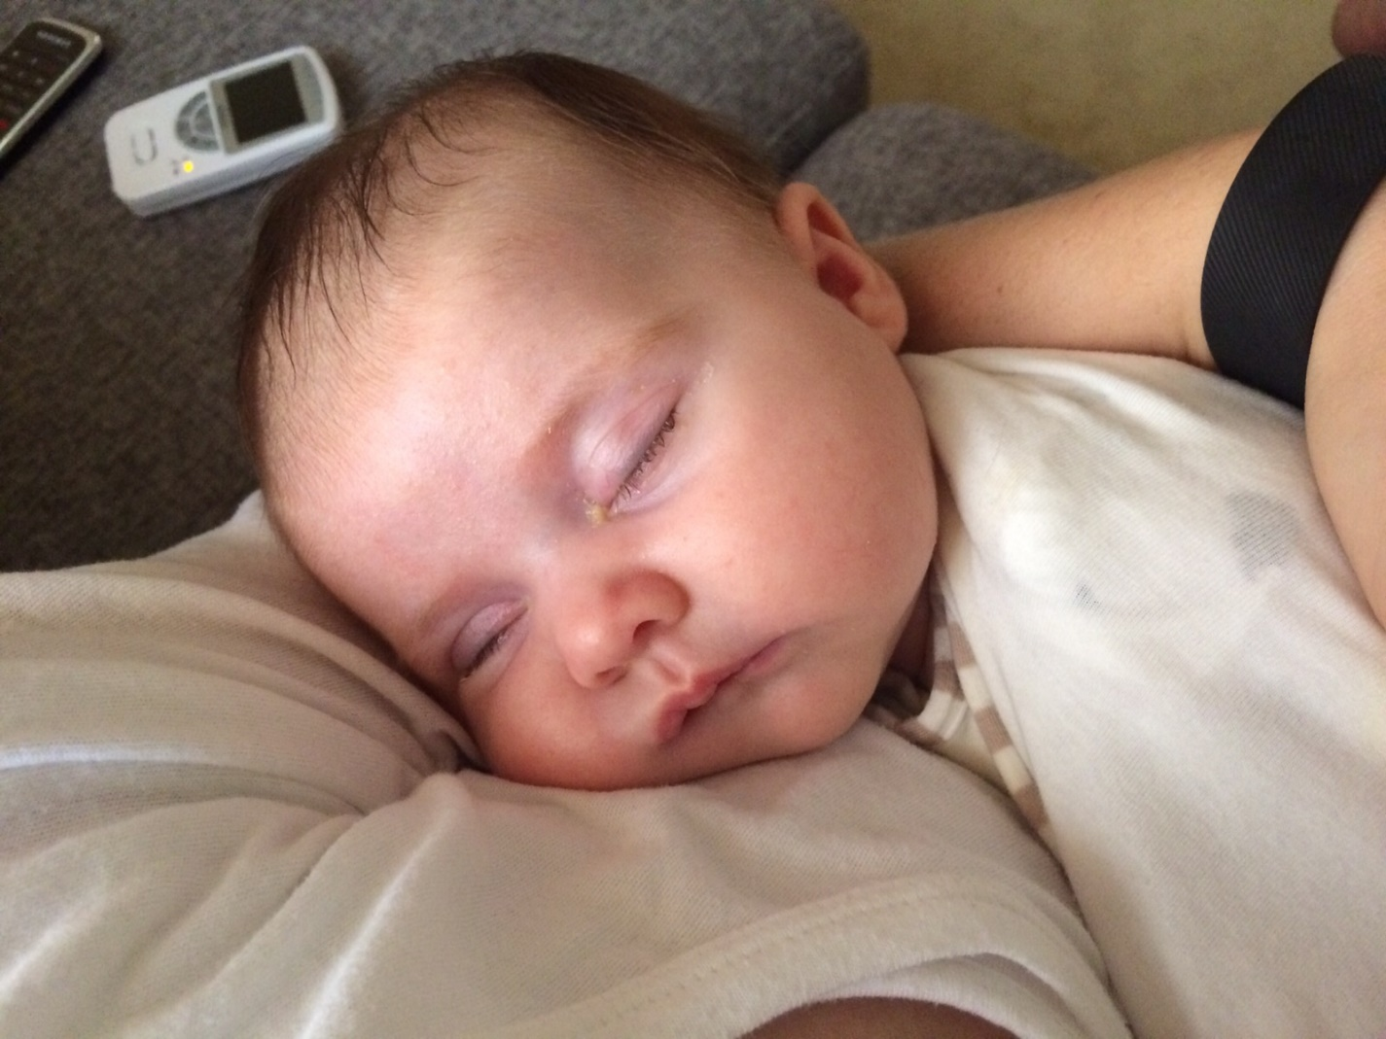
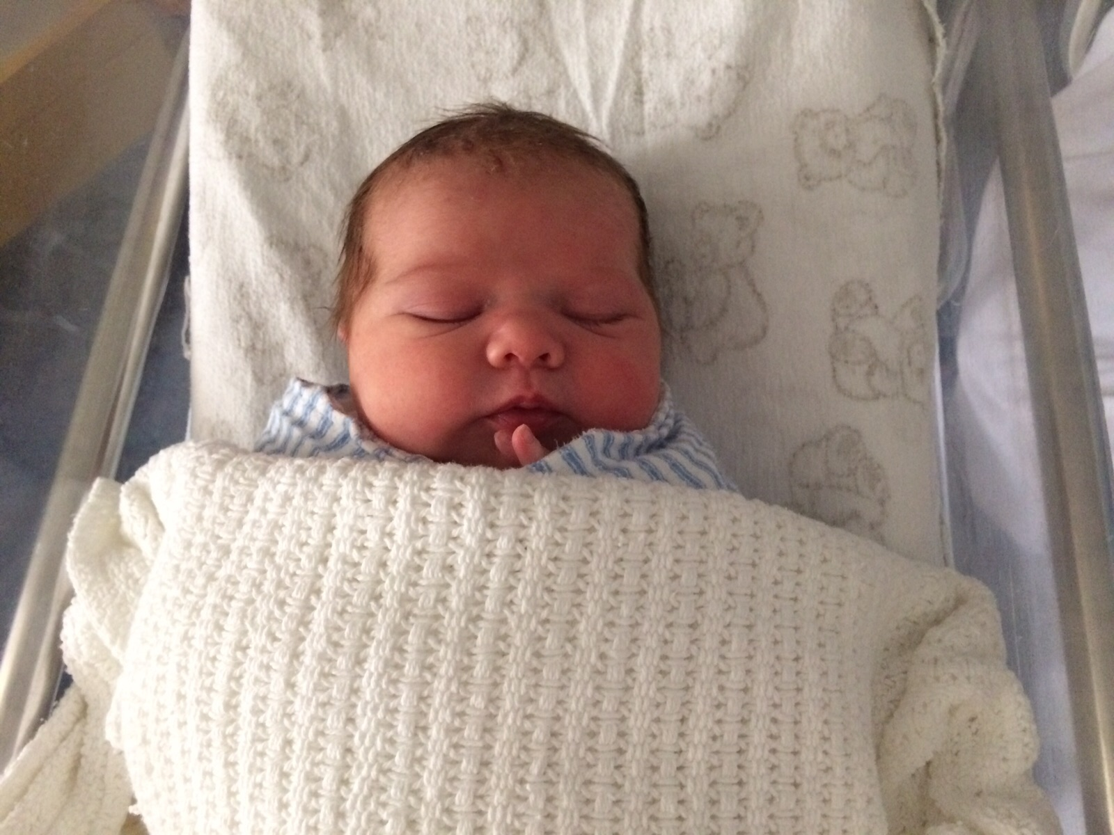

Slide 2


Slide 3
They do not sit still

Slide 4
They can be obstinate

Slide 5
They do not obey the rules
& push the boundaries

Slide 6
v22 “The hour has come for the Son of Man to be glorified”

Slide 7
The Obedience of Death
v24 unless a grain of wheat falls into the earth and dies, it remains alone; but if it dies, it bears much fruit.

Slide 8
The Obedience of Death
v27 “Now is my soul troubled. And what shall I say? ‘Father, save me from this hour’?

Slide 9
Phil 2:8 “he humbled himself by becoming obedient to death - even death on a cross!

Slide 10
v27 But for this purpose I have come to this hour. Father, glorify your name.”

Slide 11
The Obedience of Death
v24 unless a grain of wheat falls into the earth and dies, it remains alone; but if it dies, it bears much fruit.

Slide 12
v25-26 Whoever loves his life loses it, and whoever hates his life in this world will keep it for eternal life. If anyone serves me, he must follow me; and where I am, there will my servant be also.

Slide 13
Our own Obedience of Death

Slide 14
“If we want to see Jesus then we must look death in the face”

Slide 15
We must die to self – to live for Christ

