Slide 1
LikeWise Chosen
ISAIAH 56:1-8
MARK 11:15-19
1 PETER 2:9

Slide 2
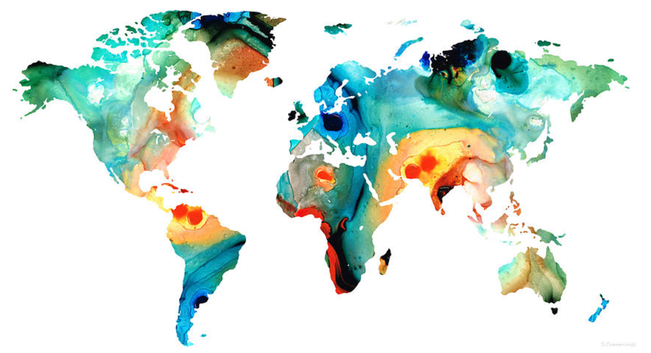
I. A House of Prayer for All Nations
Isaiah 56:1-8
For my house shall be called a house of prayer for all nations.
- Isaiah 56:7

Slide 3
The LORD said, “…Abraham shall surely become a great and mighty nation, and all the nations of the earth shall be blessed through him” (Gen 18:18)
Now therefore, if you will indeed obey my voice and keep my covenant, you shall be my treasured possession among all peoples… and you shall be for me a kingdom of priests and a holy nation.’ (Ex 19:5-6)

Slide 4
Isaiah 56: Salvation For the Foreigners
¹Thus says the LORD:
“Keep justice, and do righteousness,
for soon my salvation will come,
and my righteousness be revealed.

Slide 5
³ Let not the foreigner who has joined himself to the LORD say,
“The LORD will surely separate me from his people”;
and let not the eunuch say, “Behold, I am a dry tree.”
⁴ For thus says the LORD:
“To the eunuchs who keep my Sabbaths, who choose the things that please me and hold fast my covenant,
⁵ I will give in my house and within my walls a monument and a name better than sons and daughters; I will give them an everlasting name that shall not e cut off.

Slide 6
⁷ these I will bring to my holy mountain, and make them joyful in my house of prayer; their burnt offerings and their sacrifices will be accepted on my altar;
for my house shall be called a house of prayer for all peoples.”

Slide 7
⁸ The Lord GOD, who gathers the outcasts of Israel, declares,
“I will gather yet others to him
besides those already gathered.”
“Give praise to the Lord, proclaim his name; make known among the nations what he has done, and proclaim that his name is exalted.” (Isaiah 12:4 )

Slide 8
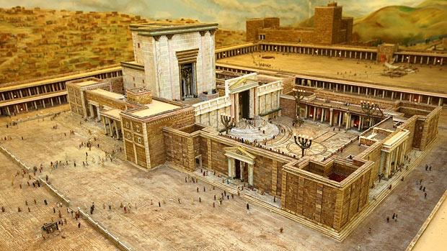
Court of the Gentiles

Slide 9
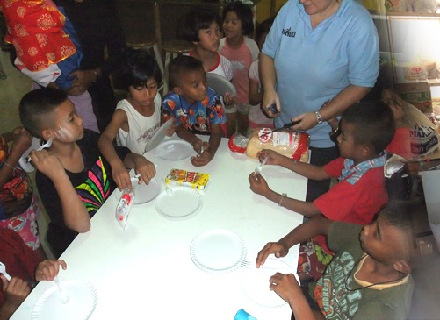
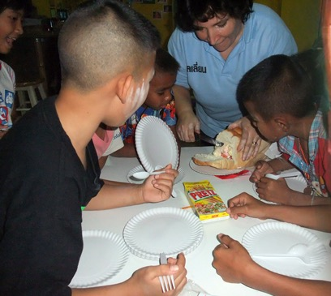
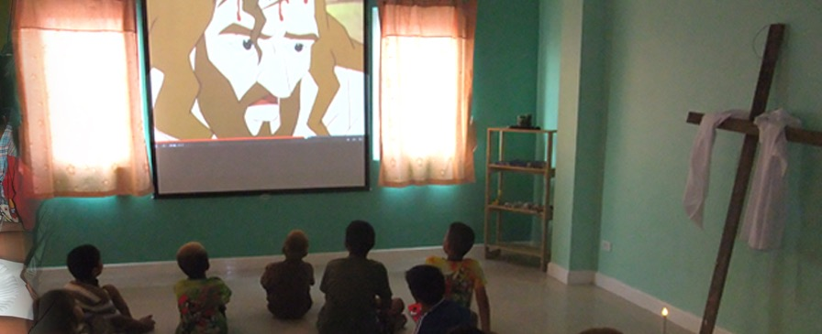

Slide 10
SPECIAL PEOPLE | vs | SPECIAL PURPOSE
Chosen People Treasured Possession | vs vs | Kingdom of Priests Holy Nation
House of Prayer | vs | House of Prayer for ALL NATIONS
Divine Privilege | Vs | Divine Responsibility

Slide 11
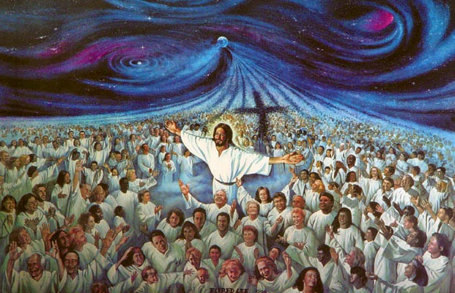
After this I looked, and behold, a great multitude that no one could number, from every nation, from all tribes and peoples and languages, standing before the throne and before the Lamb, clothed in white robes, with palm branches in their hands, and crying out with a loud voice, “Salvation belongs to our God who sits on the throne, and to the Lamb!” (Rev. 7:9-10)

Slide 12
II. Likewise Chosen
But you are
a chosen race,
a royal priesthood,
a holy nation,
a people for his own possession, that you may proclaim the excellencies of him who called you out of darkness into his marvellous light. (1 Peter 2:9)

Slide 13
Likewise Chosen
Go, therefore and make disciples of all nation…. (Matt 28:19)
But you will receive power when the Holy Spirit has come upon you, and you shall be my witnesses in Jerusalem, and in all Judea and Samaria, and to the ends of the earth (Acts 1:8)

Slide 14
Likewise Chosen
SPECIAL PEOPLE | vs | SPECIAL PURPOSE
Treasured Possession | vs | Kingdom of Priests
House of Prayer | vs | House of Prayer for ALL NATIONS
Divine Privilege | Vs | Divine Responsibility

Slide 15
III. God’s Sovereign Mission
⁴ As Paul and Silas went on their way through the cities (Lystra and Iconium).… ⁵the churches were strengthened in the faith, and they increased in numbers daily.
⁶ And they went through the region of Phrygia and Galatia, having been forbidden by the Holy Spirit to speak the word in Asia. ⁷ And when they had come up to Mysia, they attempted to go into Bithynia, but the Spirit of Jesus did not allow them. ⁸ So, passing by Mysia, they went down to Troas. (Acts 16:4-8)

Slide 16
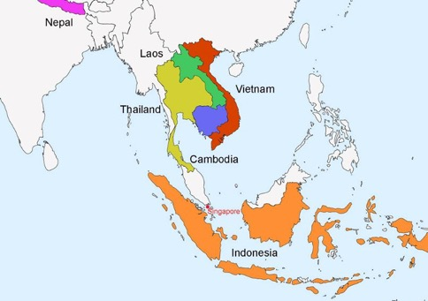
The 6 Deaneries of the Diocese of Singapore
Indonesia
Thailand
Cambodia
Vietnam
Laos
Nepal
470 million people
10/40 Window: Muslim, Hindu, Buddhist & Communist Blocs
Less than 5% Christians

Slide 17
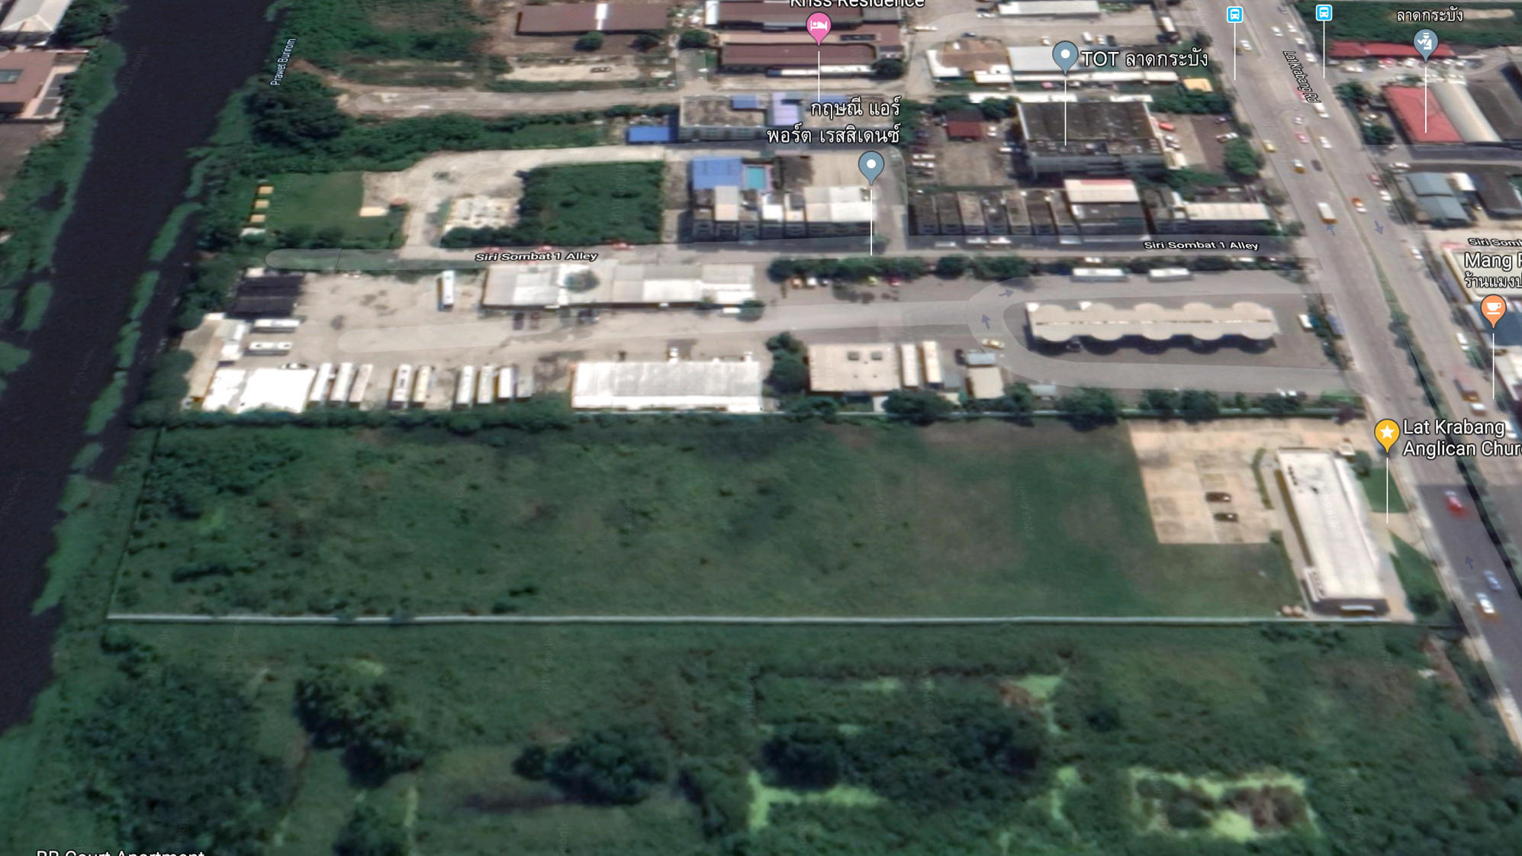
Lat Krabang

Slide 18
LAT KRABANG ANGLICAN CHURCH

Slide 19
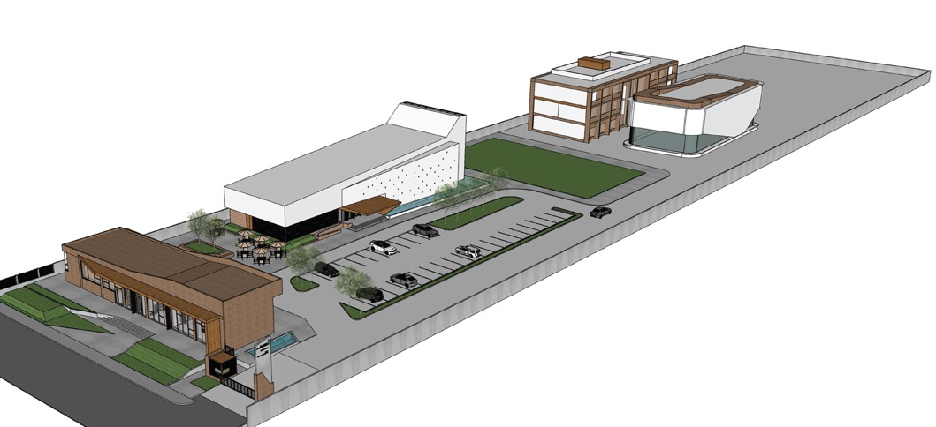
Lat Krabang Phase 1B
ACT HQ &
Accommodation Block
Kindergarten Block
Phase 1A
Welcome Centre
Church Building

Slide 20
Pray
Educate
Go
Give

Slide 21
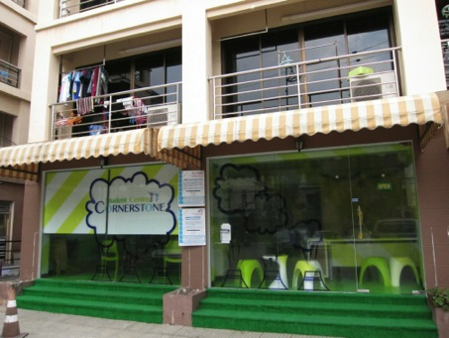
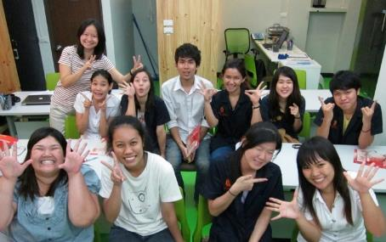
Cornerstone Student Centre

Slide 22
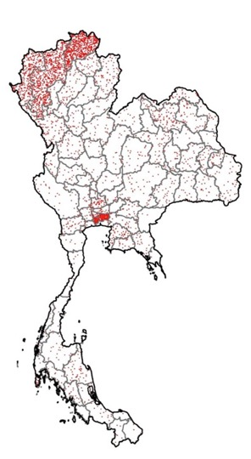
³⁵ And Jesus went throughout all the cities and villages, teaching in their synagogues and proclaiming the gospel of the kingdom and healing every disease and every affliction. ³⁶ When he saw the crowds, he had compassion for them, because they were harassed and helpless, like sheep without a shepherd. ³⁷ Then he said to his disciples,
“The harvest is plentiful, but the laborers are few;³⁸ therefore pray earnestly to the Lord of the harvest to send out laborers into his harvest.”
(Matthew 9:35-38)
= 1Church

