Slide 1
A Voice of Comfort
Isaiah 40:1-3a
Comfort, comfort my people, says your God. Speak tenderly to Jerusalem, and cry to her that her warfare is ended, that her iniquity is pardoned, that she has received from the LORD's hand double for all her sins. A voice cries: “In the wilderness prepare the way of the LORD;

Slide 2
Comfort, comfort my people

Slide 3
A Voice Calling for Preparation
v3 A voice cries: “In the wilderness prepare the way of the LORD make straight in the desert a highway for our God.

Slide 4
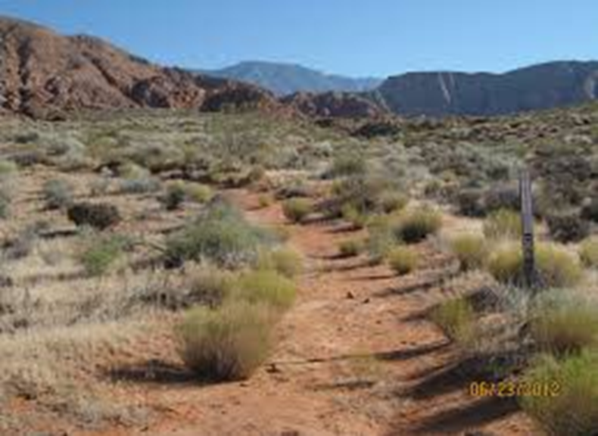
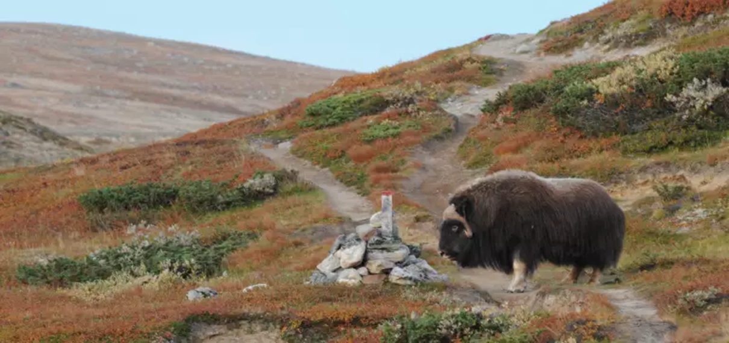
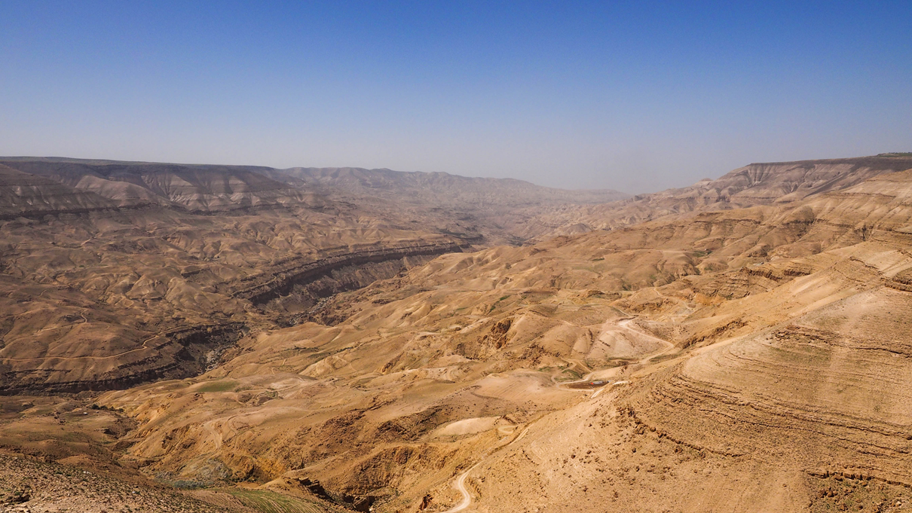

Slide 5
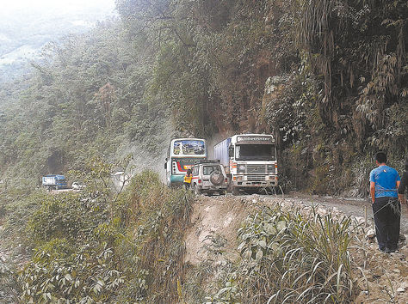

Slide 6
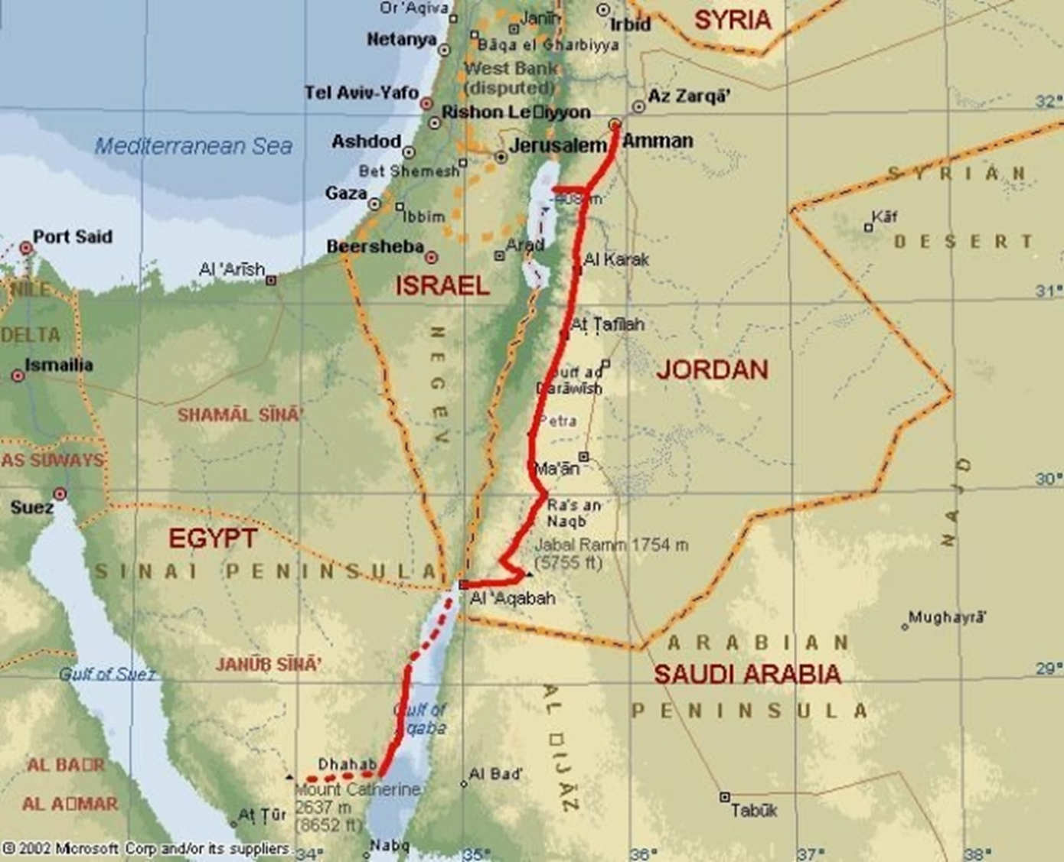
The Kings Highway

Slide 7
Prepare the road for the coming king
v4-5 Every valley shall be lifted up, and every mountain and hill be made low; the uneven ground shall become level, and the rough places a plain. And the glory of the Lord shall be revealed,

Slide 8
Mal 3:1
“Behold, I send my messenger, and he will prepare the way before me. And the Lord whom you seek will suddenly come to his temple;

Slide 9
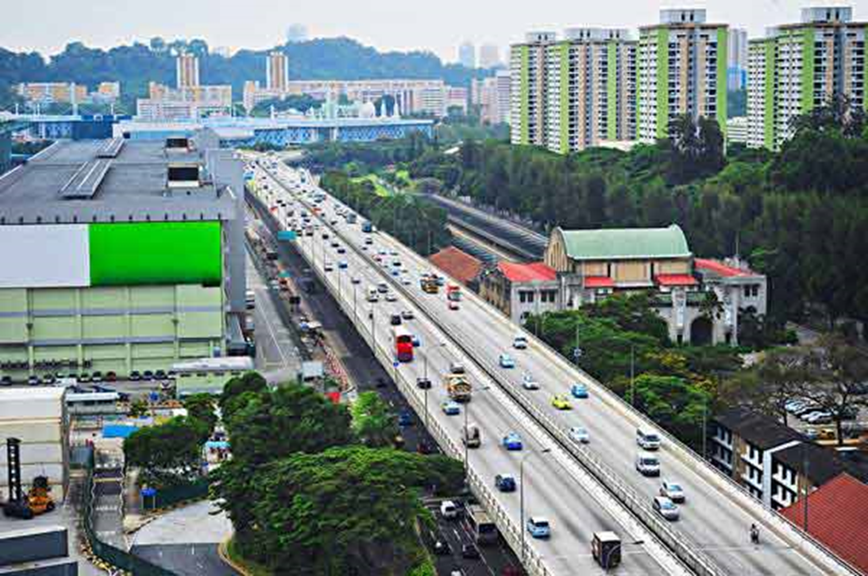
TKH - The Kings Highway

Slide 10


Slide 11
PREPARING THE WAY FOR KING JESUS

Slide 12
Make straight roads for the coming King (Mark 1:3)

Slide 13
the glory of the LORD shall be revealed - and all flesh shall see it

Slide 14
Be Announcers of Good News

Slide 15
v8 the word of our God will stand forever

