Slide 1

The God who Speaks and Relates (Hebrews 1-2)
Notes:
1- (God speaks through Jesus in the last days (he is the final revelation). a relational and living God who speaks through the son- direct access, who is Jesus?)
2- (Jesus in humanity, because he has once walked the path that we are now walking. he destroy death and free us, he can help those who are being tempted. He understands.)
Young adult struggles: God seem to be very far away and irrelevant in my Monday to Friday. I don't feel that he understands or cares about my minute insignificant life.

Slide 2
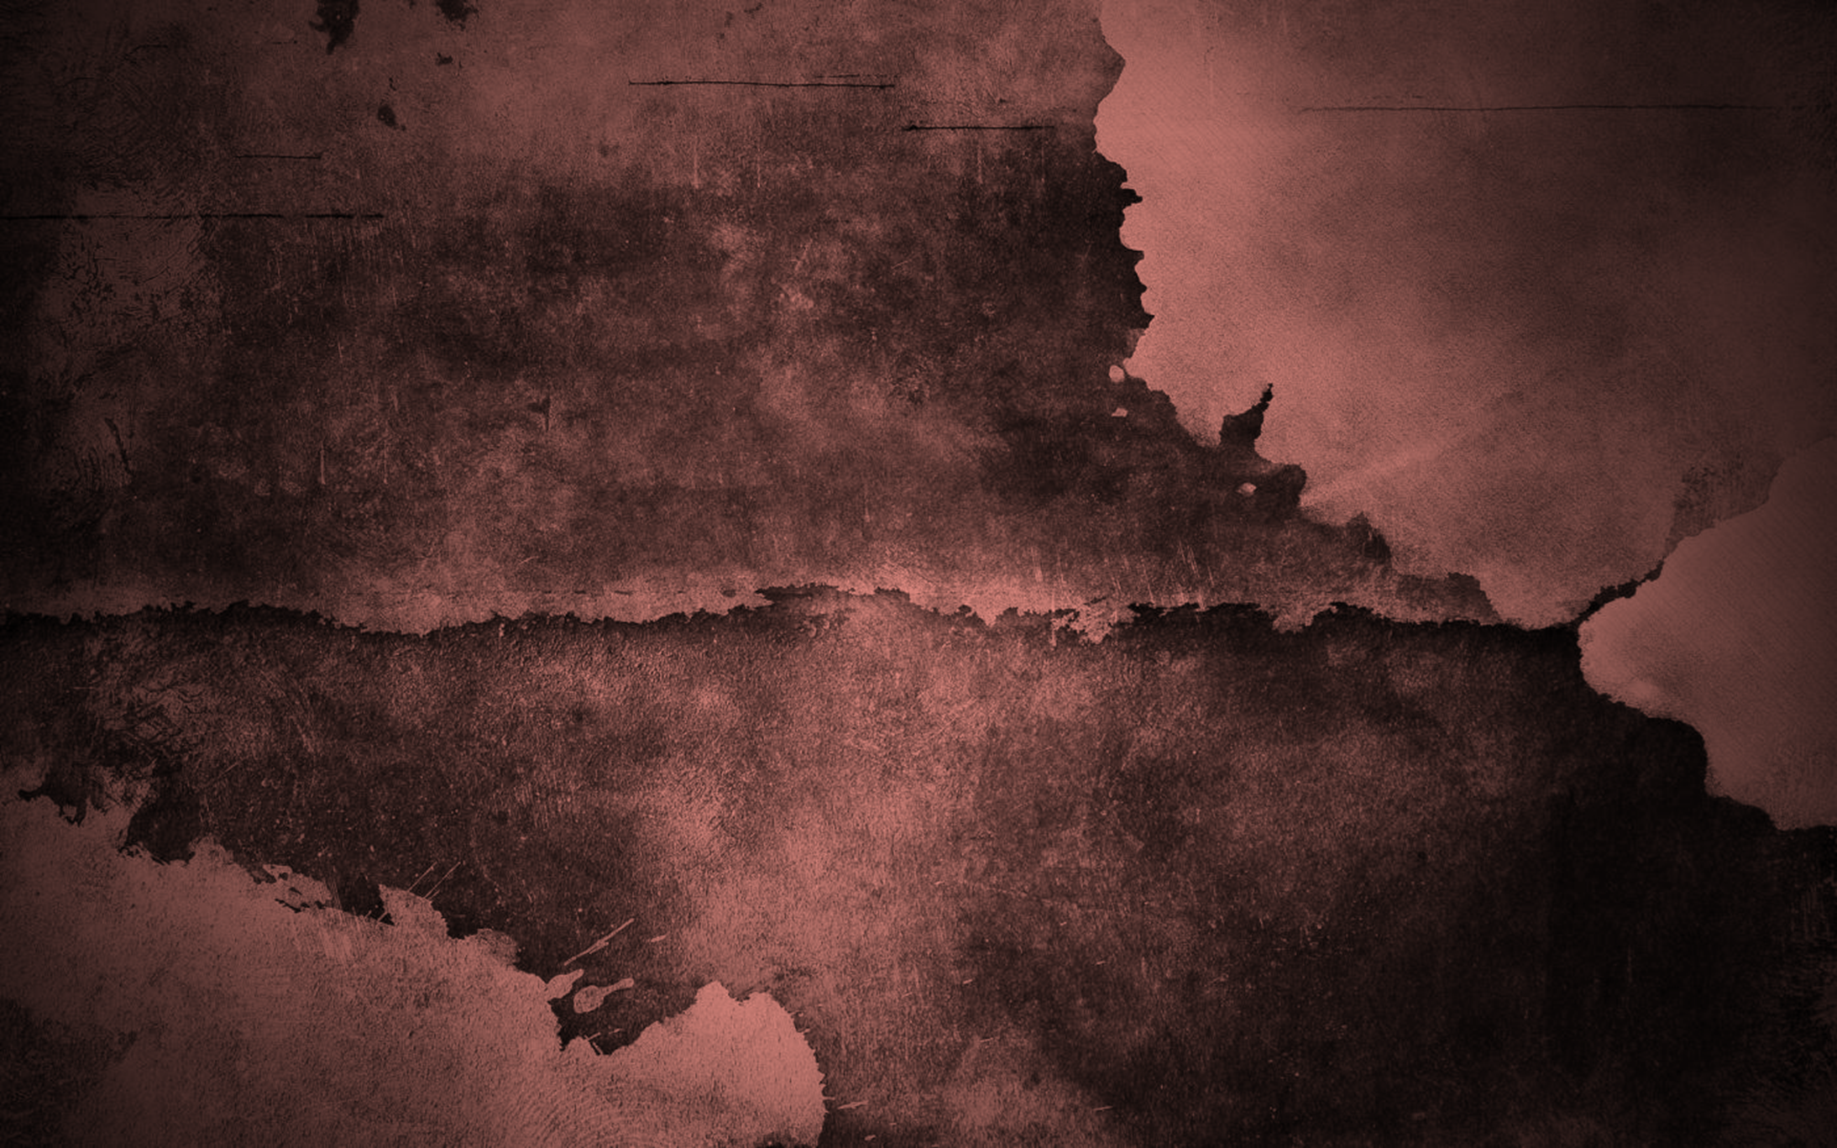
Book of Hebrews
Hebrews 1-2 - The God who speaks and relates
Hebrews 3-4 - Hardened and Restless Hearts
Hebrews 5-6 - A partnership of hope
Hebrews 7-9 - Who is God to you?
Hebrews 10 - It is finished
Hebrews 11-12:3 - How does Faith looks like?
Hebrews 12:4-13 - How do I make most out of my life?

Slide 3

Key Lessons
Jesus is the ultimate revelation
Jesus is the ultimate ruler
Jesus is the ultimate priest
Jesus is the ultimate saviour

Slide 4
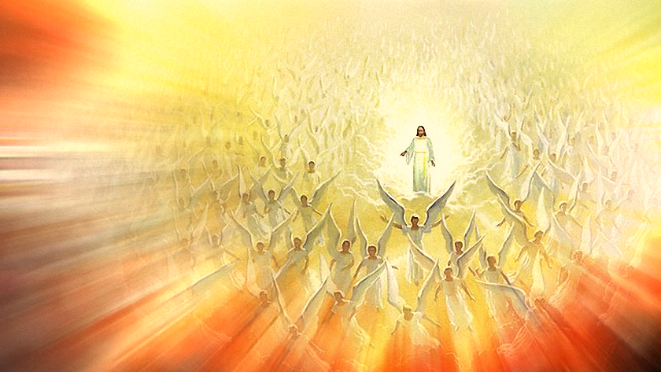
Jesus is the ultimate revelation
Heb 1:3 He is the radiance of the glory of God and the exact imprint of his nature, and he upholds the universe by the word of his power. After making purification for sins, he sat down at the right hand of the Majesty on high…
Notes:
Heb 1:1 Long ago, at many times and in many ways, God spoke to our fathers by the prophets,
Heb 1:2 but in these last days he has spoken to us by his Son, whom he appointed the heir of all things, through whom also he created the world.
Heb 1:3 He is the radiance of the glory of God and the exact imprint of his nature, and he upholds the universe by the word of his power. After making purification for sins, he sat down at the right hand of the Majesty on high,
Heb 1:4 having become as much superior to angels as the name he has inherited is more excellent than theirs.
Spoke by his Son
Not by angels or prophets by God’s begotten son
It is the final authority
It is trustworthy and reliable source
Why is Jesus the ultimate revelation from God?
Appointed the heir of all things - firstborn of all creation
Created the world
He is radiance of God – shines forth from God
Exact imprint of God’s nature - the image of God
Upholds the universe by the word of his power – all powerful. Even now, this world is upheld by Jesus’ powerful word and commands.
Making purification for sins – he cleanses us and make us righteous
He sat down on the right hand of the majesty on high – a position of great honour and finished work
We can trust in Jesus as the final authority and revelation from God. Let us not be easily swayed or moved by new age teachings and such.
The Apostle John wrote that Jesus is the Word who came to earth – “1 In the beginning was the Word, and the Word was with God, and the Word was God.” Jn 1:1

Slide 5
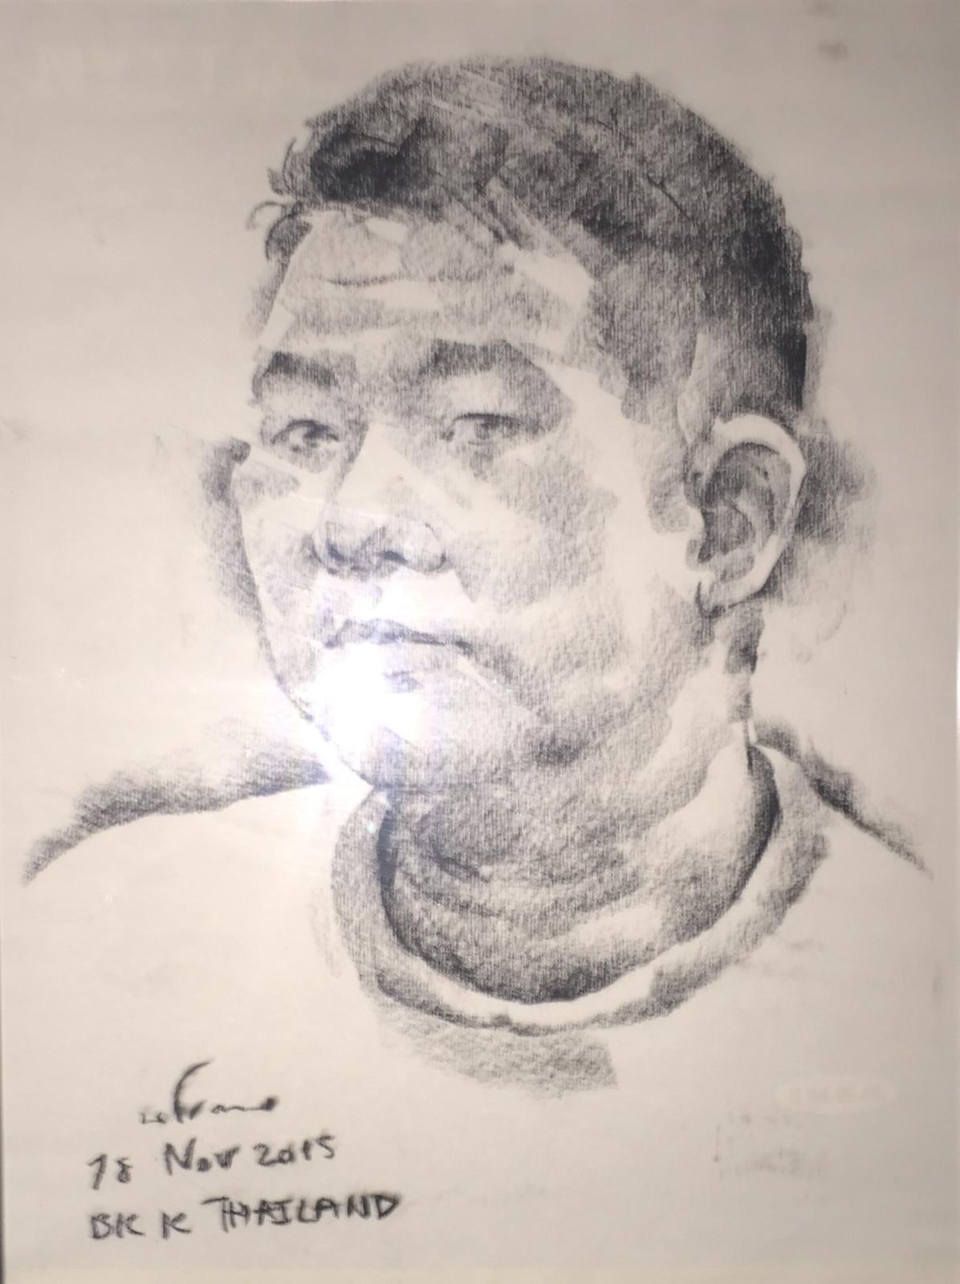

Notes:
Not a picture or representation.
I am physically here. You can shake my hand. You can talk to me and I can talk back.
Jesus is the exact imprint of God’s nature. He is the radiance of God’s glory.
Likewise, Jesus is here in spirit. He is revealing himself to us through His word and spirit. He is radiating his love to us. He is speaking and relating to us deeply.
We only need to receive and trust Jesus as God’s ultimate revelation.

Slide 6
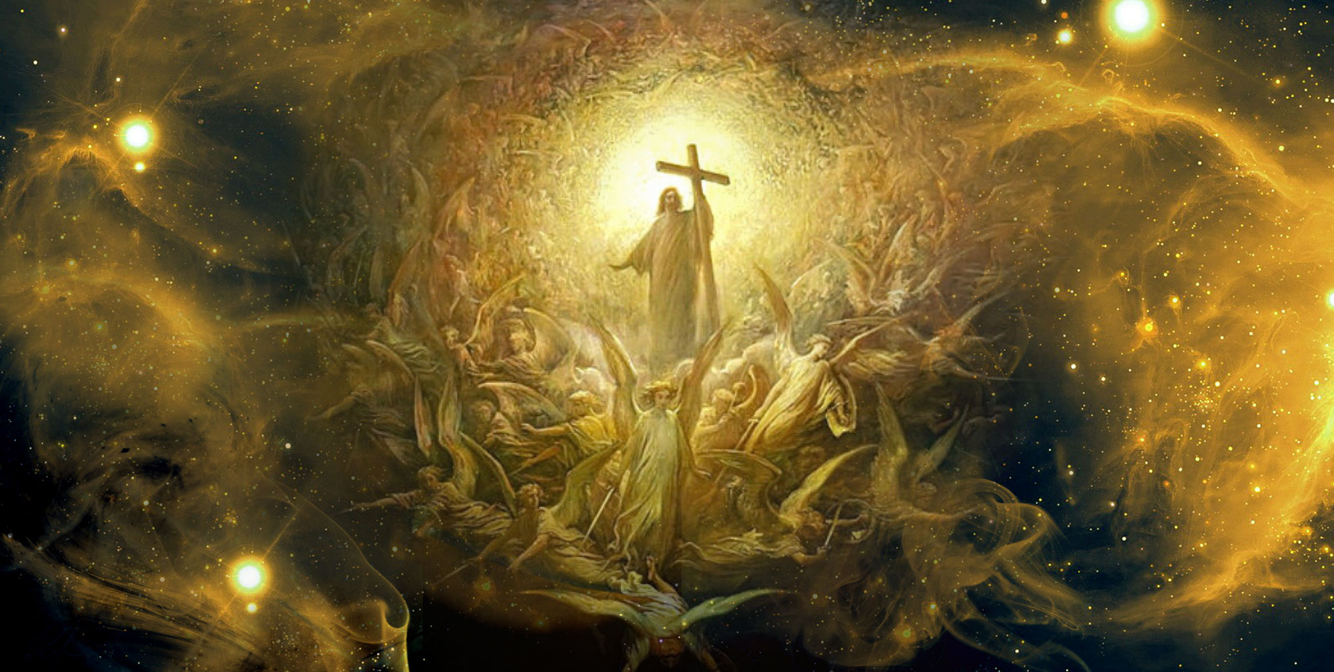
Jesus is the ultimate ruler
Heb 1:8 But of the Son he says, "Your throne, O God, is forever and ever, the scepter of uprightness is the scepter of your kingdom…”
Notes:
Heb 1:6 But when God was about to send his first-born Son into the world, he said, "All of God's angels must worship him."
1:6 let all God’s angel worship him
· There was a dangerous tendency to worship angels developing in the early Church (Colossians 2:18, Galatians 1:8), and Hebrews shows that Jesus is high above any angel.
· There was the heretical idea that Jesus Himself was an angel, a concept that degrades His glory and majesty.
· Understanding how Jesus is better than the angels helps us to understand how He is better than anyone or anything in our life.
1:8-9
Heb 1:8 But of the Son he says, "Your throne, O God, is forever and ever, the scepter of uprightness is the scepter of your kingdom.
“O God” recognition of Jesus’ divinity. He is more superior than angels. He is God himself.
Jesus’ throne is everlasting unlike earthly kingdoms and governments.
The scepter is a symbol of his authority which comes from his uprightness or righteousness.
Heb 1:9 You have loved righteousness and hated wickedness; therefore God, your God, has anointed you with the oil of gladness beyond your companions."
The marks of his rule is his love for righteousness and hate for wickedness. As God’s children, we want to be ruled by Jesus. We want him to be Lord of every aspect of our lives. Sometimes, we are afraid to let Jesus be the ruler because we doubt his goodness. Sometimes, we tell Jesus to be the ruler of us on a Sunday but not on a weekday. Be ruler of our spiritual life but not my financial or romantic life. Would you let Jesus be your ultimate ruler of you’re your life, identity, relationships, emotions, finances and destiny.
I decided to be ordained as a deacon after struggling about lordship. I have been running away from God and his lordship. It is ironic that a church worker may not allow God to be my ultimate ruler.

Slide 7
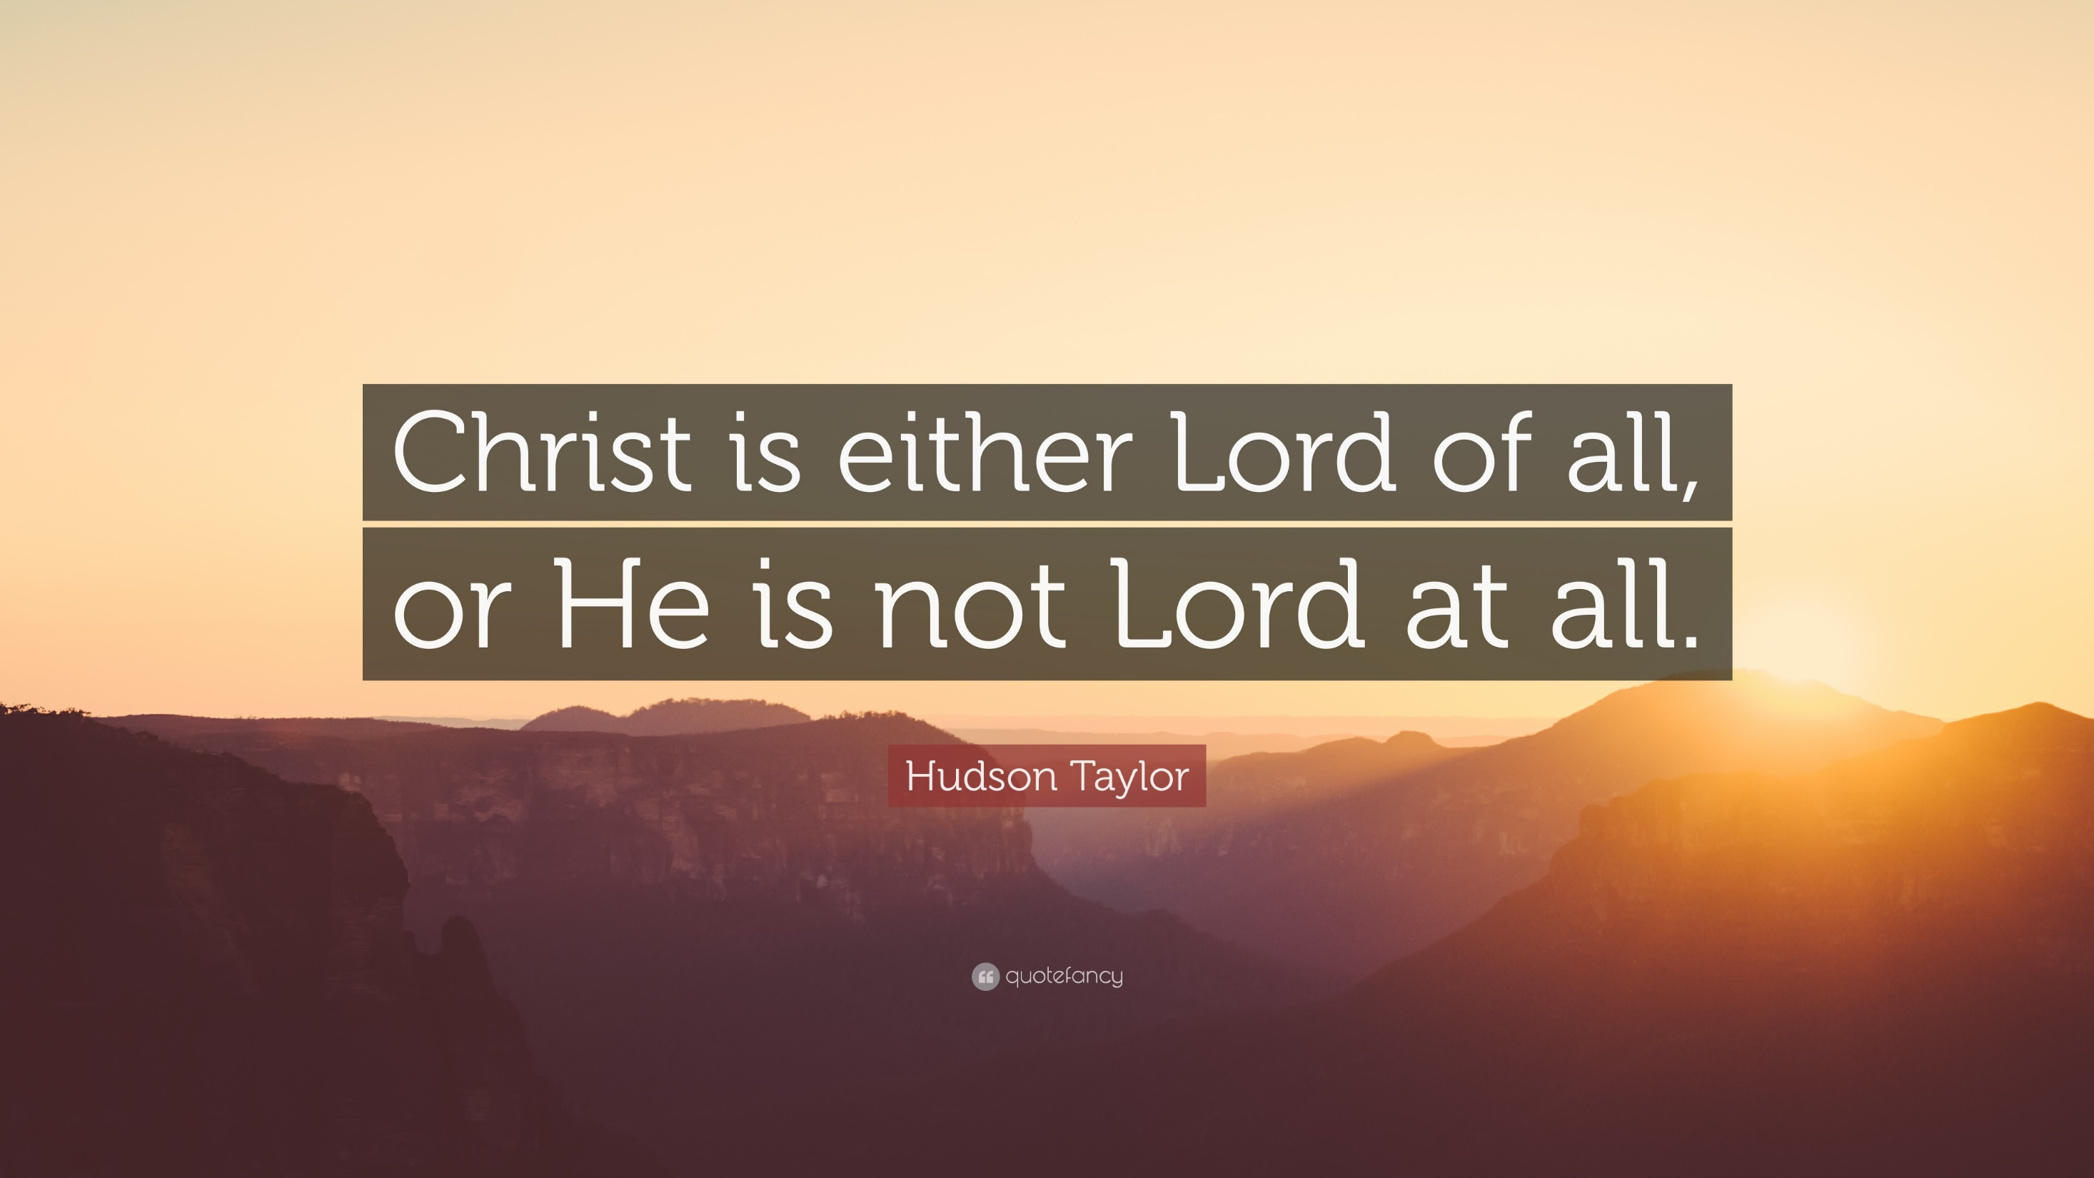
Notes:
Hudson Taylor
James Hudson Taylor was a British Protestant Christian missionary to China and founder of the China Inland Mission. Taylor spent 51 years in China.

Slide 8
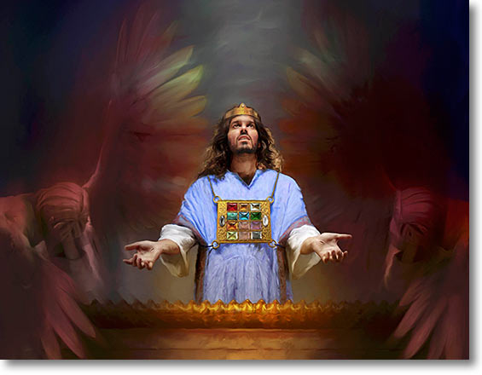
Jesus is the ultimate priest
Heb 2:17 Therefore he had to be made like his brothers in every respect, so that he might become a merciful and faithful high priest in the service of God, to make propitiation for the sins of the people.
Notes:
Heb 2:14 Since therefore the children share in flesh and blood, he himself likewise partook of the same things, that through death he might destroy the one who has the power of death, that is, the devil,
Heb 2:15 and deliver all those who through fear of death were subject to lifelong slavery.
Heb 2:16 For surely it is not angels that he helps, but he helps the offspring of Abraham.
Heb 2:17 Therefore he had to be made like his brothers in every respect, so that he might become a merciful and faithful high priest in the service of God, to make propitiation for the sins of the people.
Heb 2:18 For because he himself has suffered when tempted, he is able to help those who are being tempted.
Jesus knows us intimately. He is fully man. He knows our weaknesses and difficulties. He is able to intercede and make atonement for our sins.
In a way, he is the ultimate mediator and intercessor. Apostle Paul wrote:
Who is to condemn? Christ Jesus is the one who died—more than that, who was raised—who is at the right hand of God, who indeed is interceding for us.
Rom 8:34
Jesus is faithful and merciful. We have Jesus on interceding and ministering on our behalf.
Heb 2:18 And now he can help those who are tempted, because he himself was tempted and suffered. He suffered because Jesus faced the pressure of his temptations. Some of us give in to our temptation but Jesus never did. He prevailed and was victorious over the temptations that he faced. As such, he can help us. He also knows our struggles. He has deep empathy for what we are going through. This makes him the most ideal priest and intercessor for us.
Some of us may not be comfortable to approach fellow Christians because we fear being judged or misunderstood. For me, people are afraid to approach me because I have a stern face.
We can go to Jesus with our struggles and weaknesses. We do not need to run away from Jesus or hide our sins and struggles. He is a faithful and merciful high priest who can help us.

Slide 9
LOVE SINGAPORE Solemn Assemblies 1 July – 9 August 2018
5-7 August, 8 pm - 10 pm St Andrew’s Cathedral
8 Aug |DAY OF HIS POWER| 7.30 pm
Singapore Indoor Stadium
Notes:
The Solemn Assemblies is a wonderful opportunity for Christians to come together to pray for the impending harvest next year. To prepare ourselves for the harvest, we must first prepare ourselves in holiness.
The assemblies are for us to seek the Lord with one heart, one soul, one mind, one purpose.
Return to God in repentance for person, corporate, and national sins.
Consecrate ourselves to seek first the Kingdom of God and his righteousness.
Cry out to God for salvation among the 80% unsaved in our land
Set apart this generation, the next generation, and every generation to fulfill Singapore’s destiny as the Antioch of Asia.
As such we encourage you to encourage the members under your charge to join these assemblies in the location and time convenient to them.
Would you also consider how to tie-in your congregation’s monthly prayer meeting with these Solemn Assemblies. Let us make every effort to move on bended knee as one body!
A summary slide of the Solemn Assemblies is attached for your use.
Consecrate a fast; call a solemn assembly.
Gather the elders and all the inhabitants of the land
to the house of the LORD your God, and cry out to the LORD. (Joel1:14)

Slide 10
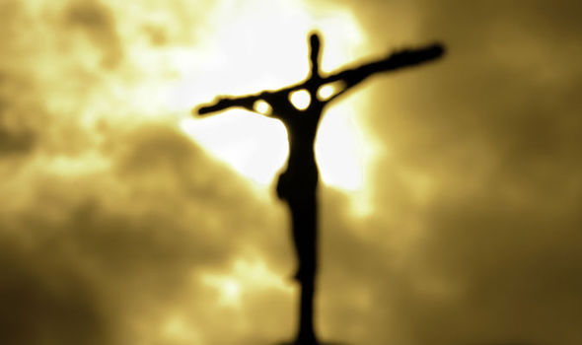
Jesus is the ultimate saviour
Heb 2:10 For it was fitting that he, for whom and by whom all things exist, in bringing many sons to glory, should make the founder of their salvation perfect through suffering.
Notes:
Heb 2:9 But we see him who for a little while was made lower than the angels, namely Jesus, crowned with glory and honor because of the suffering of death, so that by the grace of God he might taste death for everyone.
Heb 2:10 For it was fitting that he, for whom and by whom all things exist, in bringing many sons to glory, should make the founder of their salvation perfect through suffering.
Heb 2:11 For he who sanctifies and those who are sanctified all have one source. That is why he is not ashamed to call them brothers,
Heb 2:12 saying, "I will tell of your name to my brothers; in the midst of the congregation I will sing your praise."
Heb 2:13 And again, "I will put my trust in him." And again, "Behold, I and the children God has given me."
Heb 2:14 Since therefore the children share in flesh and blood, he himself likewise partook of the same things, that through death he might destroy the one who has the power of death, that is, the devil,
Heb 2:15 and deliver all those who through fear of death were subject to lifelong slavery.
Jesus became the founder of our salvation for he has done on the cross. In other versions, the word founder is translated as captain or author. In a way, Jesus is our captain who leads in the salvation work for all of us. He does it because of his love us as we share in flesh and blood.
He does not give up being the founder of our salvation. He persevered right to the very end. In a way, he will see us through right to the end.
In the battle of souls, he takes the charge to rescue us and snatch us from the bondage and fear of death. Verse 14 tells us that he is able to destroy the devil who has power of death. His death on the cross brought us eternal and abundant life.

Slide 11
What is our response to the ultimate revelation, ruler, priest and saviour?
Notes:
Heb 2:1 Therefore we must pay much closer attention to what we have heard, lest we drift away from it.
Heb 2:2 For since the message declared by angels proved to be reliable, and every transgression or disobedience received a just retribution,
Heb 2:3 how shall we escape if we neglect such a great salvation?
This is our God.
We can put our trust in him. We worship and follow a great God.
He is the founder and captain of our lives.

