Slide 1



Slide 2


Slide 3
“Toilet out of order.
Please use the floor below”

Slide 4
“Automatic washing machines.
Please remove all your clothes when the light goes out”

Slide 5
We can repair anything.
(Please knock hard on the door – the bell doesn’t work).

Slide 6
The Importance of the
Old Covenant in God’s
Salvation Plan

Slide 7
Heb 10v1
The law is only a shadow of the good things that are coming –
not the realities themselves.

Slide 8
The Message vs 1-4 The old plan was only a hint of the good things in the new plan. Since that old “law plan” wasn’t complete in itself, it couldn’t complete those who followed it. No matter how many sacrifices were offered year after year, they never added up to a complete solution.

Slide 9
Heb 10:9-10 He sets aside the first to establish the second. And by that will, we have been made holy through the sacrifice of the body of Jesus Christ once for all.

Slide 10
The Self-Sacrifice of Jesus fulfils and ends all other sacrifices – “Once for all”

Slide 11
Jesus’ Work on the Cross Completes God’s Salvation Plan

Slide 12
V11-12 Day after day every priest stands and performs his religious duties; again and again he offers the same sacrifices, which can never take away sins. But when this priest had offered for all time one sacrifice for sins,
he sat down at the right hand of God.

Slide 13
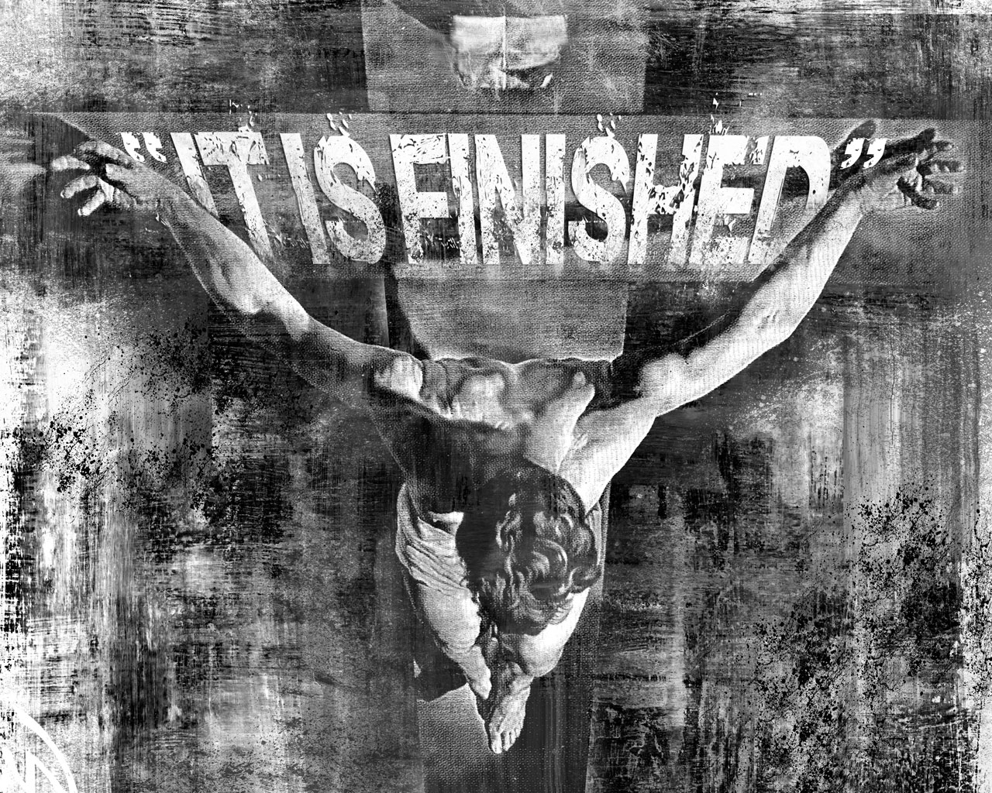

Slide 14
Therefore, since we have confidence to enter the Most Holy Place by the blood of Jesus, by a new and living way opened for us through the curtain, that is, his body, and since we have a great priest over the house of God,

Slide 15
let us draw near to God with a sincere heart in full assurance of faith, having our hearts sprinkled to cleanse us from a guilty conscience and having our bodies washed with pure water.

Slide 16
Let us hold unswervingly to the hope we profess,
for he who promised is faithful.
In Christ Alone I can have full Confidence

Slide 17

We can be confident and assured of sins forgiven – V17-18

Slide 18
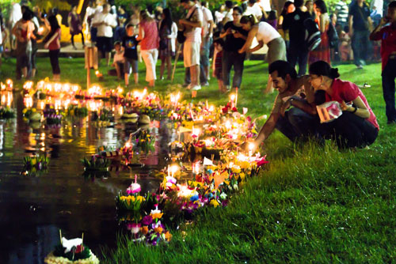

Slide 19


Slide 20

We can be confident that Jesus is the way into the presence of God v19 -20

Slide 21
We can have confidence in coming close to God v22

Slide 22
We can have a Confident Hope in Christ v23

Slide 23
Rom 12:1
“present your self as a living sacrifice”
PARISTEMI

