Slide 1
Hardship with Destiny in Mind
E30 Service 21st October 2018

Slide 2
Bible Reading
1 Samuel 24:1-11
1 Samuel 26:1-16

Slide 3
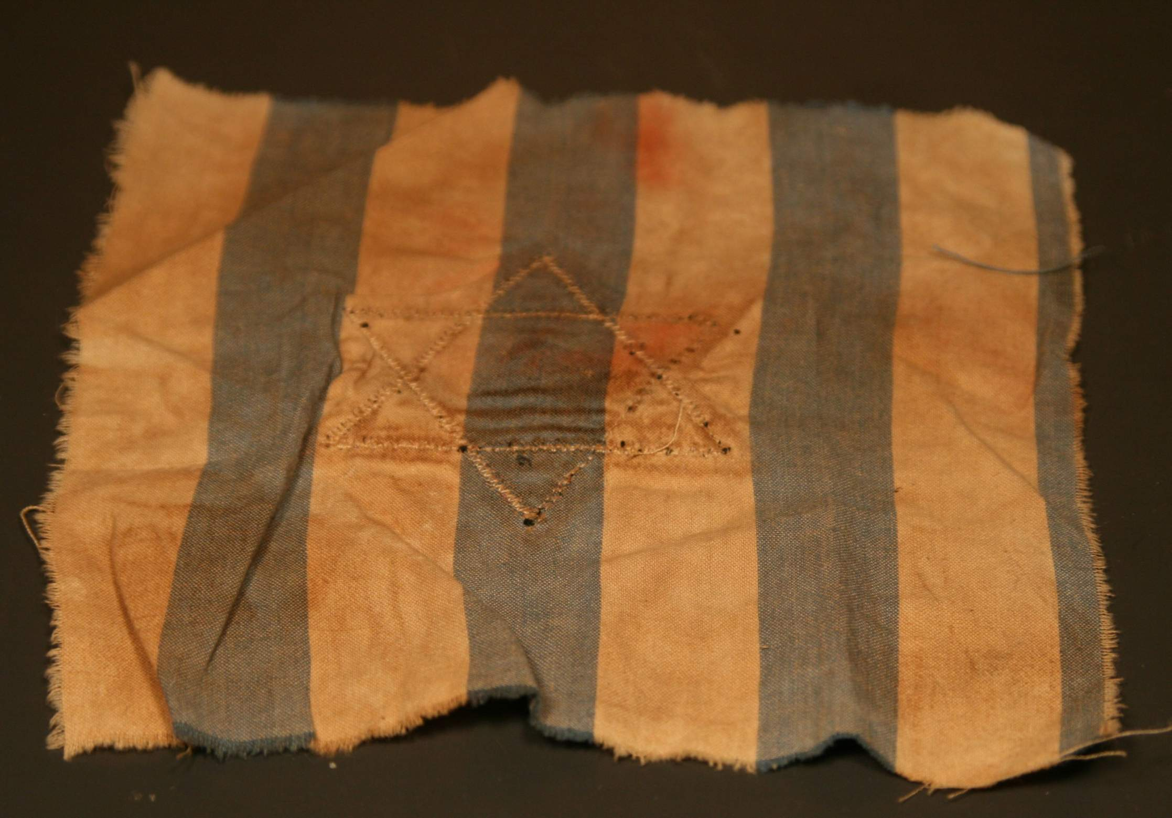
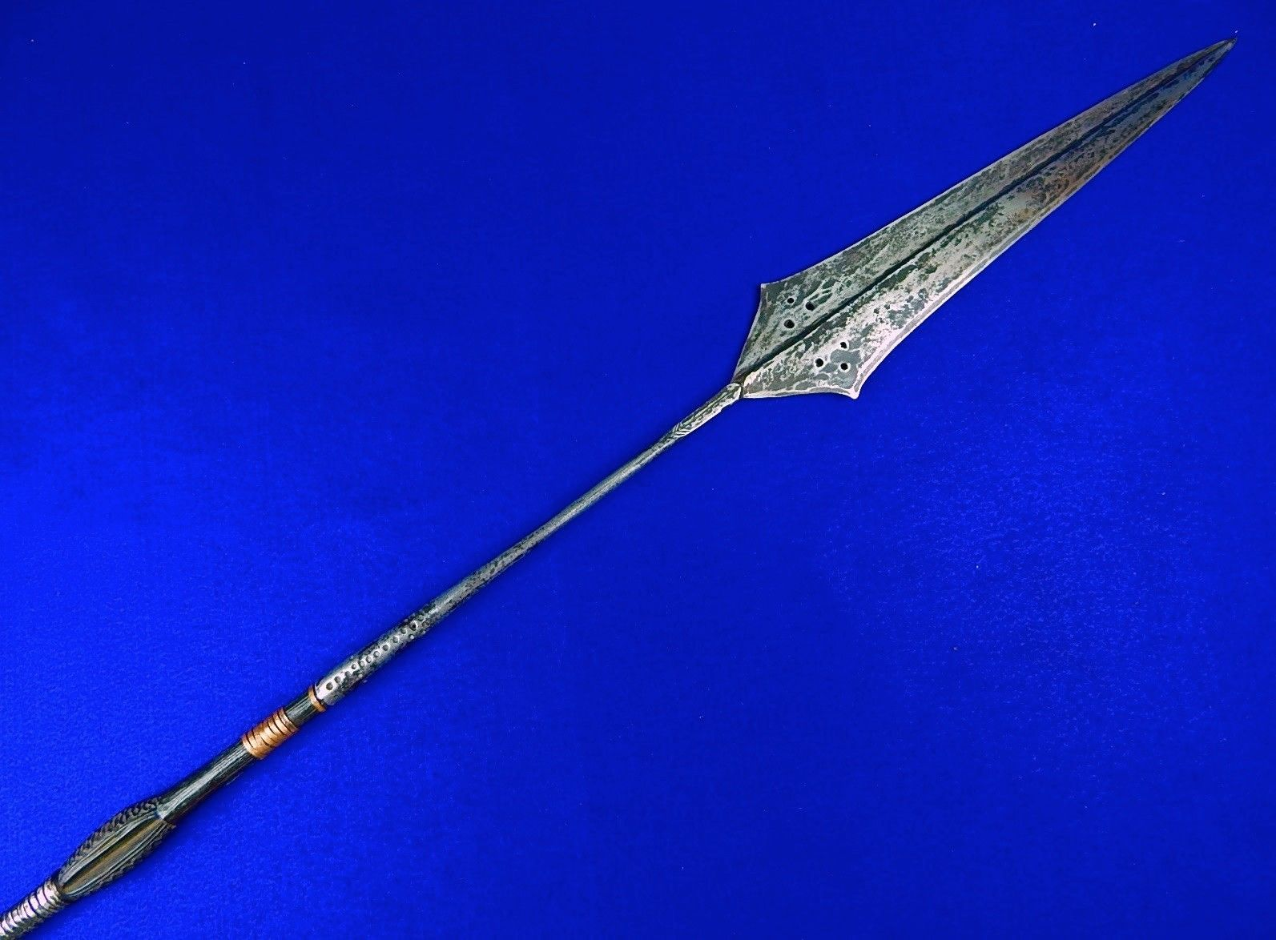
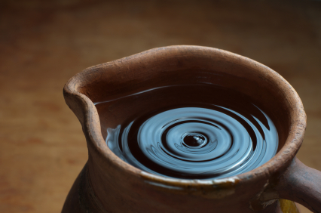
What does a Piece of Cloth, a Jar of water and a Spear have in common?

Slide 4
Character.
Pain
Stress
Anger
Frustration
Setbacks
Loss
Betrayal
Disappointments

Slide 5
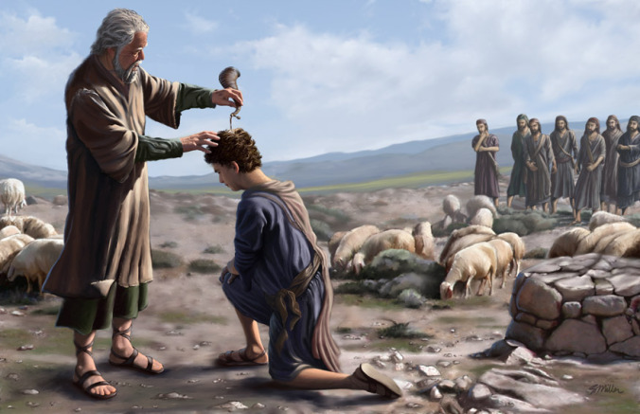
The outward display of faith means nothing without an inward alignment towards God.
Man judges with their eyes but God judges the heart.

Slide 6
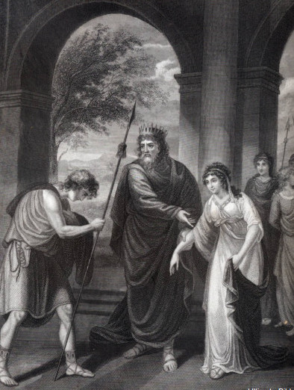
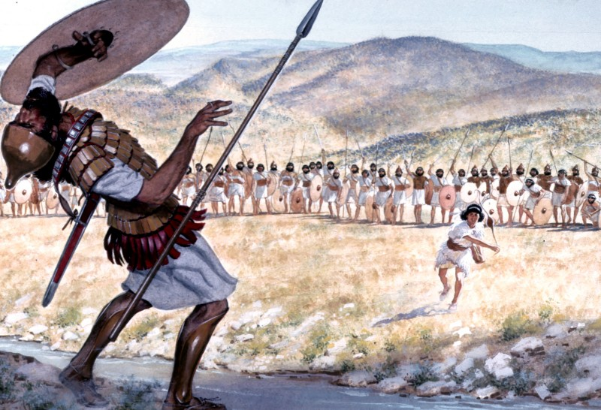
David the overnight Superstar

Slide 7
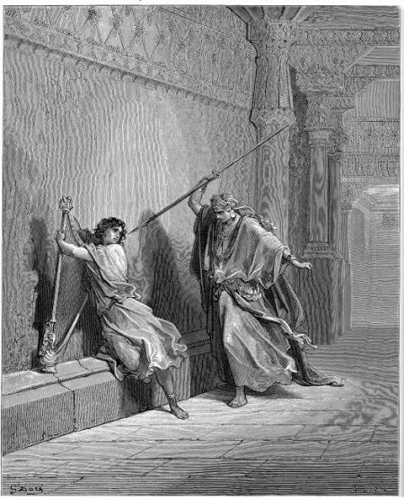
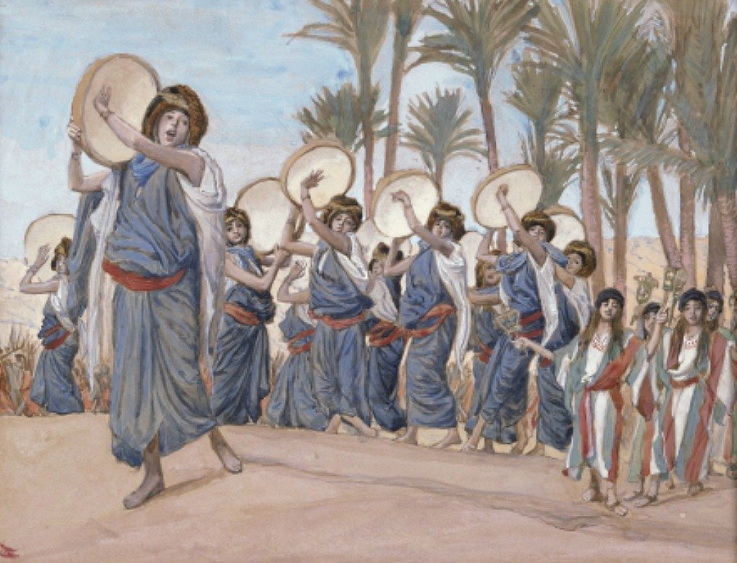
David’s eyes were on God and hence was his security.
Saul’s jealous eyes were on David came from insecurity.

Slide 8

“The worst thing to happen to a man, is to succeed before he is ready”
Dr Lloyd Jones

Slide 9
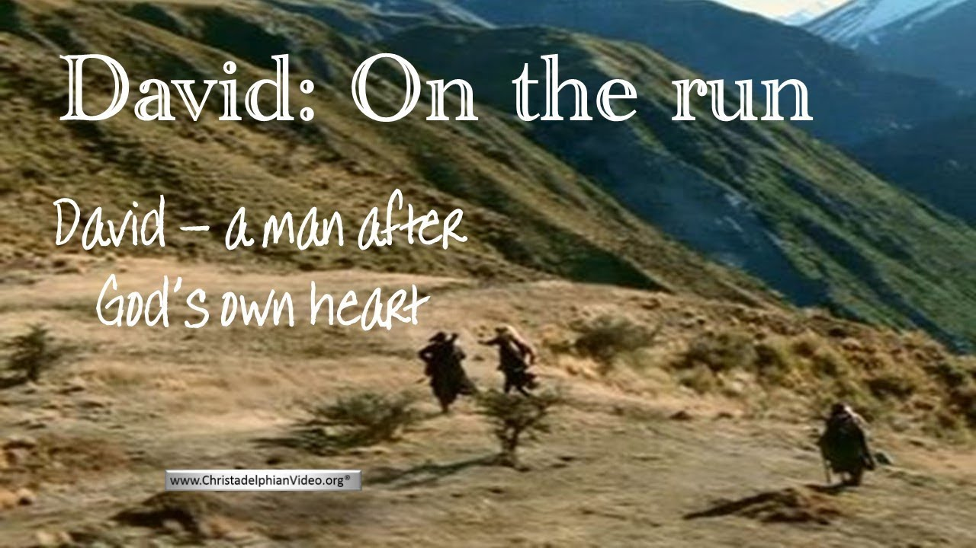
Run

Slide 10
10 years!

Slide 11
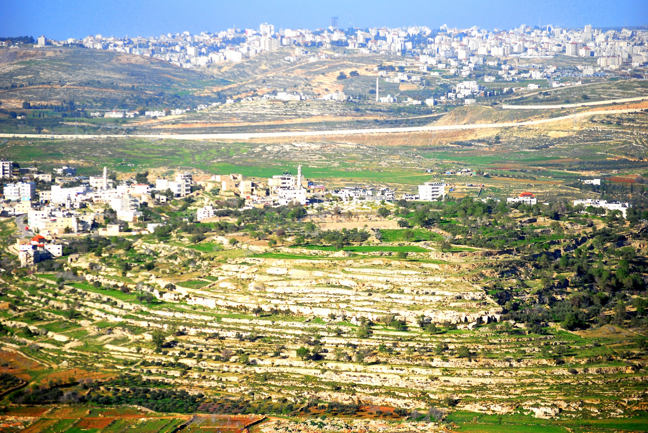
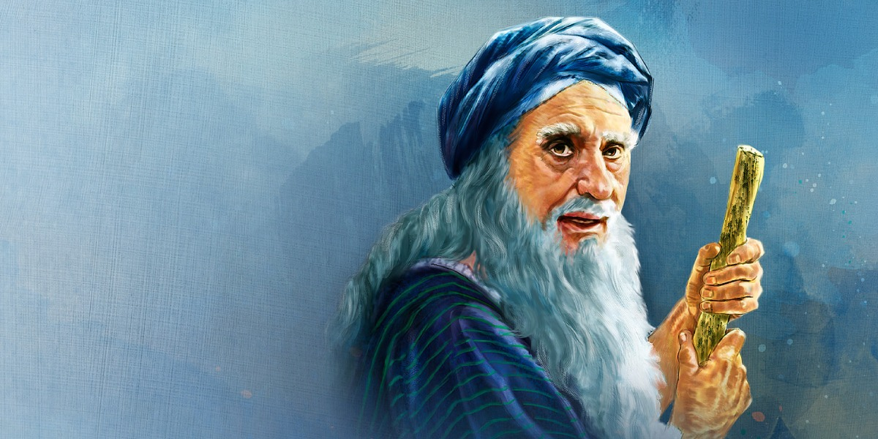
Samuel’s Home in Ramah

Slide 12
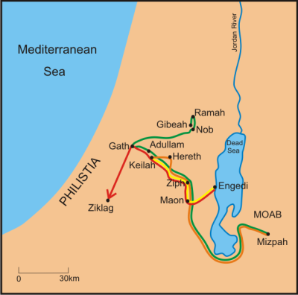
David runs into enemy territory
1 Samuel 21- 22

Slide 13
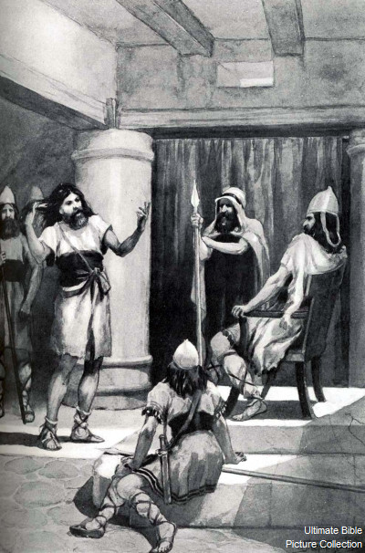
David took these words to heart and was very much afraid of King Achish of Gath. So he pretended to act like a madman, making marks on the doors of the gate and letting saliva run down his beard.
1 Sam 21:12-13

Slide 14

God does some of His best work in the “cave”, amidst the hardships we face.

Slide 15


Slide 16
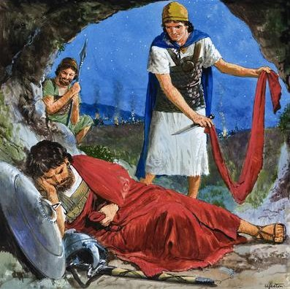
1 Samuel 24:11
“See, my father, see the corner of your robe in my hand. For by the fact that I cut off the corner of your robe and did not kill you, you may know and see that there is no wrong or treason in my hands. I have not sinned against you, though you hunt my life to take it.”

Slide 17
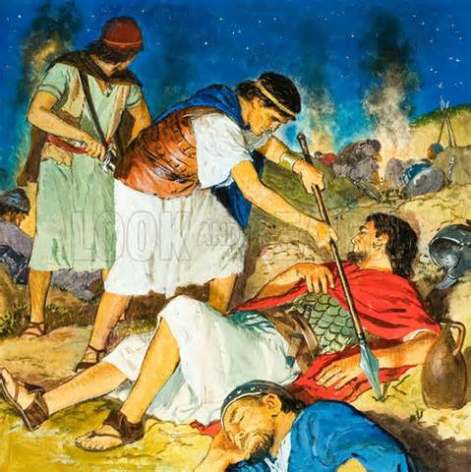
1 Samuel 26:10-12
And David said, “As the Lord lives, the Lord will strike him, or his day will come to die, or he will go down into battle and perish.
¹¹ The Lord forbid that I should put out my hand against the Lord's anointed. But take now the spear that is at his head and the jar of water, and let us go.”
¹² So David took the spear and the jar of water from Saul's head, and they went away. No man saw it or knew it, nor did any awake, for they were all asleep, because a deep sleep from the Lord had fallen upon them.

Slide 18
Saul went after David and tried to kill him and almost did, twice
David had a chance to kill Saul twice, but he spared the Lord’s anointed.
How do we know that David was ready?

Slide 19

We need the fear of the Lord to submit to His masterplan and timeline.

Slide 20
Recap/Reflection
“The worst thing to happen to a man, is to succeed before he is ready” Dr Lloyd Jones
Are we succeeding before we are ready?
God does some of His best work in the “cave”, amidst the hardships we face.
(Personal) How is God challenging you to count on His best work in your lives?
We need the fear of the Lord to submit to His masterplan and timeline.
(Personal) Do you have the fear of the Lord to wait upon Him for His best for you? (Church) Do we as a congregation have a renewed fear of the Lord that we will go nowhere without Him?

