Slide 1
God & the Arts

Slide 2
Who is an Artist?
An artist is a person engaged in an activity related to creating art, practicing the arts, or demonstrating an art.

Slide 3
Who is an Artist?
An artist is a performer such as a musician, actor, or dancer.

Slide 4
We are created in His image
Genesis 1:27
So God created man in his own image,
in the image of God he created him; male and female he created them.

Slide 5
Do you think God is creative?

Slide 6
YES !! God is creative!!

Slide 7
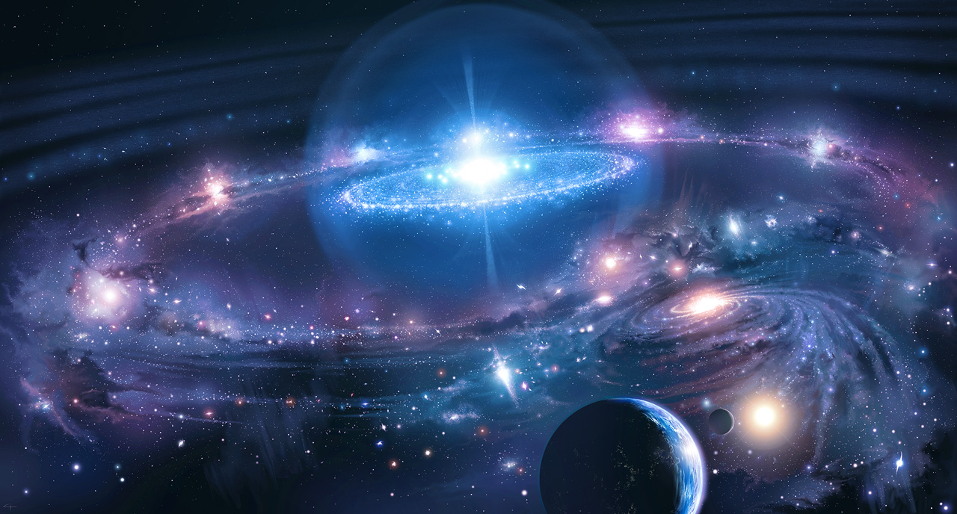

Slide 8
Each one of you are His master piece

Slide 9
Do you think you are an Artist?

Slide 10
What is Arts?

Slide 11
Arts is a form of expression of
worship

Slide 12
Arts in the Bible

Slide 13
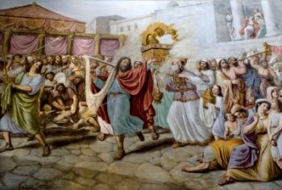
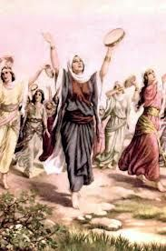
2 Samuel 6 - King David dancing before the Ark of the Covenant
Exodus 15:20 - Then Miriam dancing for the Lord.

Slide 14
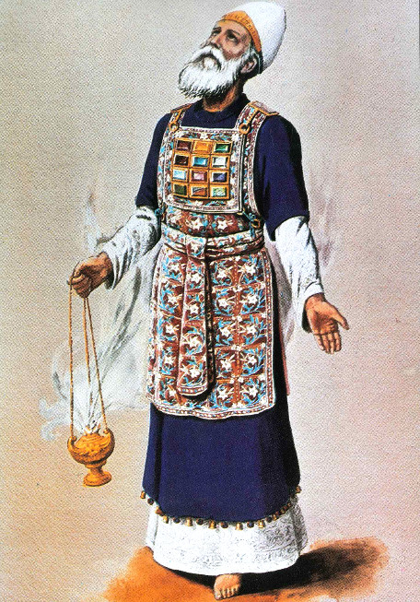
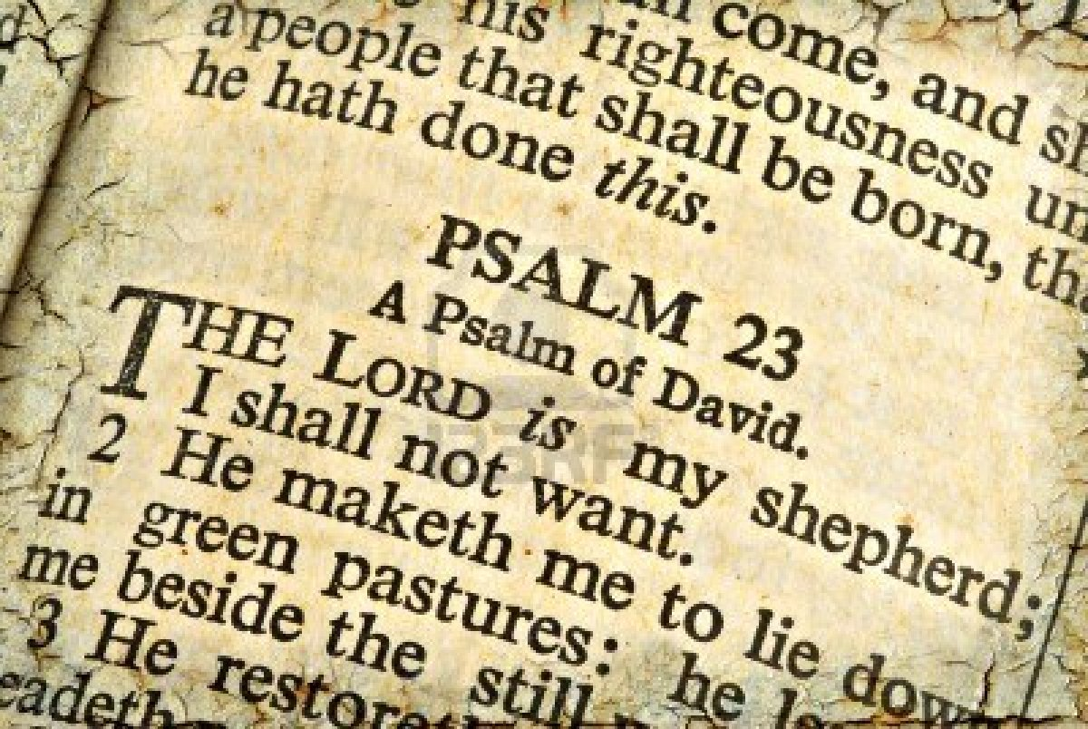
Psalm – David wrote 76 books of Psalm
High Priest garments

Slide 15
Arts in the fallen world

Slide 16
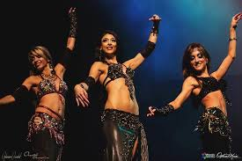
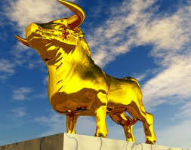
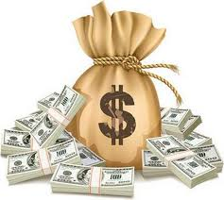
Entertainment
Money
Idol worship

Slide 17
Let’s redeem the Arts for God

Slide 18
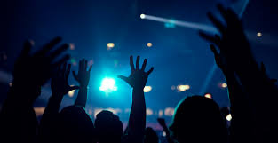
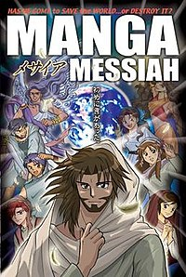
Church Worship
Manga Book

Slide 19
Christian Artist in the market place

Slide 20
Will you stand on your Christian values?

Slide 21
Conclusion:
No matter what gifting you are having, your gift is a celebration of God and a part of God’s call in your life.

