Slide 1


Slide 2

Loving someone “unlovable” is one of the challenges we face in life.

Slide 3


1. We should love one another because God is LOVE

Slide 4

1. We should love one another because God is LOVE (v7-11)
⁷ Beloved, let us love one another, for love is from God, and whoever loves has been born of God and knows God. ⁸ Anyone who does not love does not know God, because God is love. ⁹ In this the love of God was made manifest among us, that God sent his only Son into the world, so that we might live through him. ¹⁰ In this is love, not that we have loved God but that he loved us and sent his Son to be the propitiation for our sins. ¹¹ Beloved, if God so loved us, we also ought to love one another. 1 John 4:7-11 (ESV)

Slide 5

GOD
The closer we move upward in loving GOD; The closer we move in loving ONE ANOTHER
Closer
Closer
YOU
ME

Slide 6


1 Corinthians 13:4-7 (NIV)
⁴ Love is patient, love is kind. It does not envy, it does not boast, it is not proud. ⁵ It does not dishonor others, it is not self-seeking, it is not easily angered, it keeps no record of wrongs. ⁶ Love does not delight in evil but rejoices with the truth. ⁷ It always protects, always trusts, always hopes, always perseveres.

Slide 7
^{PASSIVE}

Slide 8
^{PASSIVE}
ACTIVE
DYNAMIC

Slide 9
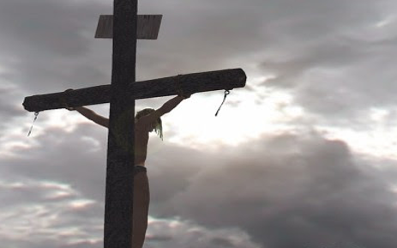
1 John 4:9-11 (ESV)
⁹ In this the love of God was made manifest among us, that God sent his only Son into the world, so that we might live through him. ¹⁰ In this is love, not that we have loved God but that he loved us and sent his Son to be the propitiation for our sins. ¹¹ Beloved, if God so loved us, we also ought to love one another.

Slide 10

THERE IS LOVE
God has sent his Son Into this world To die for you and me By His blood he shed on the cross That we might live
So give your hearts now And believe that Jesus Is the Lord and Saviour of all And he promised He will cleanse away your sins

Slide 11
THERE IS LOVE
Chorus There is love There is love for you, for me And that’s what I know There is love There is love for this world And it’s spreading all around There is love There is love so rich, so free I just can’t understand There is love (x2)

Slide 12

2. We should love one another because God’s spirit dwells in us

Slide 13
2. We should love one another because God’s Spirit dwells in us (V12-16)
¹² No one has ever seen God; if we love one another, God abides in us and his love is perfected in us.¹³ By this we know that we abide in him and he in us, because he has given us of his Spirit. ¹⁴ And we have seen and testify that the Father has sent his Son to be the Savior of the world. ¹⁵ Whoever confesses that Jesus is the Son of God, God abides in him, and he in God. ¹⁶ So we have come to know and to believe the love that God has for us. God is love, and whoever abides in love abides in God, and God abides in him. - 1 John 4: 12-16 ( ESV)

Slide 14
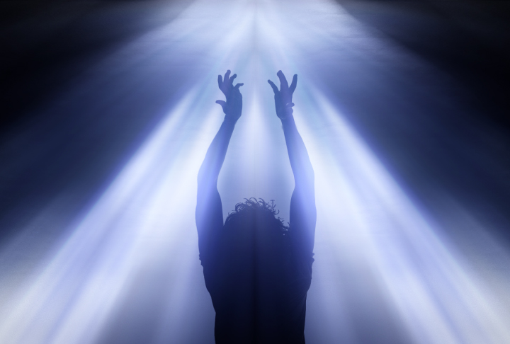
1 Cor 3:16 (ESV)
¹⁶ Do you not know that you are God's temple and that God's Spirit dwells in you?
^{Romans 5:5 (ESV)}
⁵ and hope does not put us to shame, because God's love has been poured into our hearts through the Holy Spirit who has been given to us.

Slide 15

Galatians 5:22-23 (ESV)
²² But the fruit of the Spirit is love, joy, peace, patience, kindness, goodness, faithfulness ²³ gentleness, self-control; against such things there is no law.

Slide 16
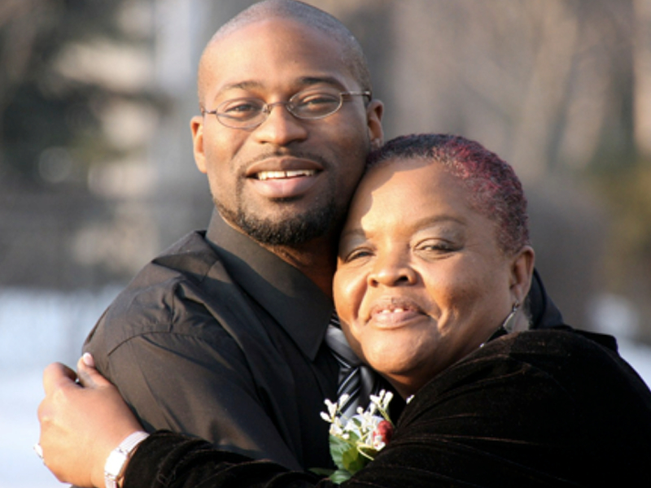

Oshea Israel
& Mary

Slide 17

3. We should love one another because He first loved us

Slide 18
3. We should love one another because He first loved us (v19)
¹⁷ By this is love perfected with us, so that we may have confidence for the day of judgment, because as he is so also are we in this world. ¹⁸ There is no fear in love, but perfect love casts out fear. For fear has to do with punishment, and whoever fears has not been perfected in love. ¹⁹ We love because he first loved us. ²⁰ If anyone says, “I love God,” and hates his brother, he is a liar; for he who does not love his brother whom he has seen cannot love God whom he has not seen. ²¹ And this commandment we have from him: whoever loves God must also love his brother. 1 John 4:17-21 (ESV)

Slide 19
Romans 5 :8
“ but God shows his love for us in that while we were still sinners, Christ died for us. (ESV)

Slide 20


Slide 21

LOVING THE UNSEEN

