Slide 1
Cultivating the Heart
Mark 7:1-7, 14-23
21st -22nd Sept 2018, 4.30 pm, 9 am SAC

Slide 2
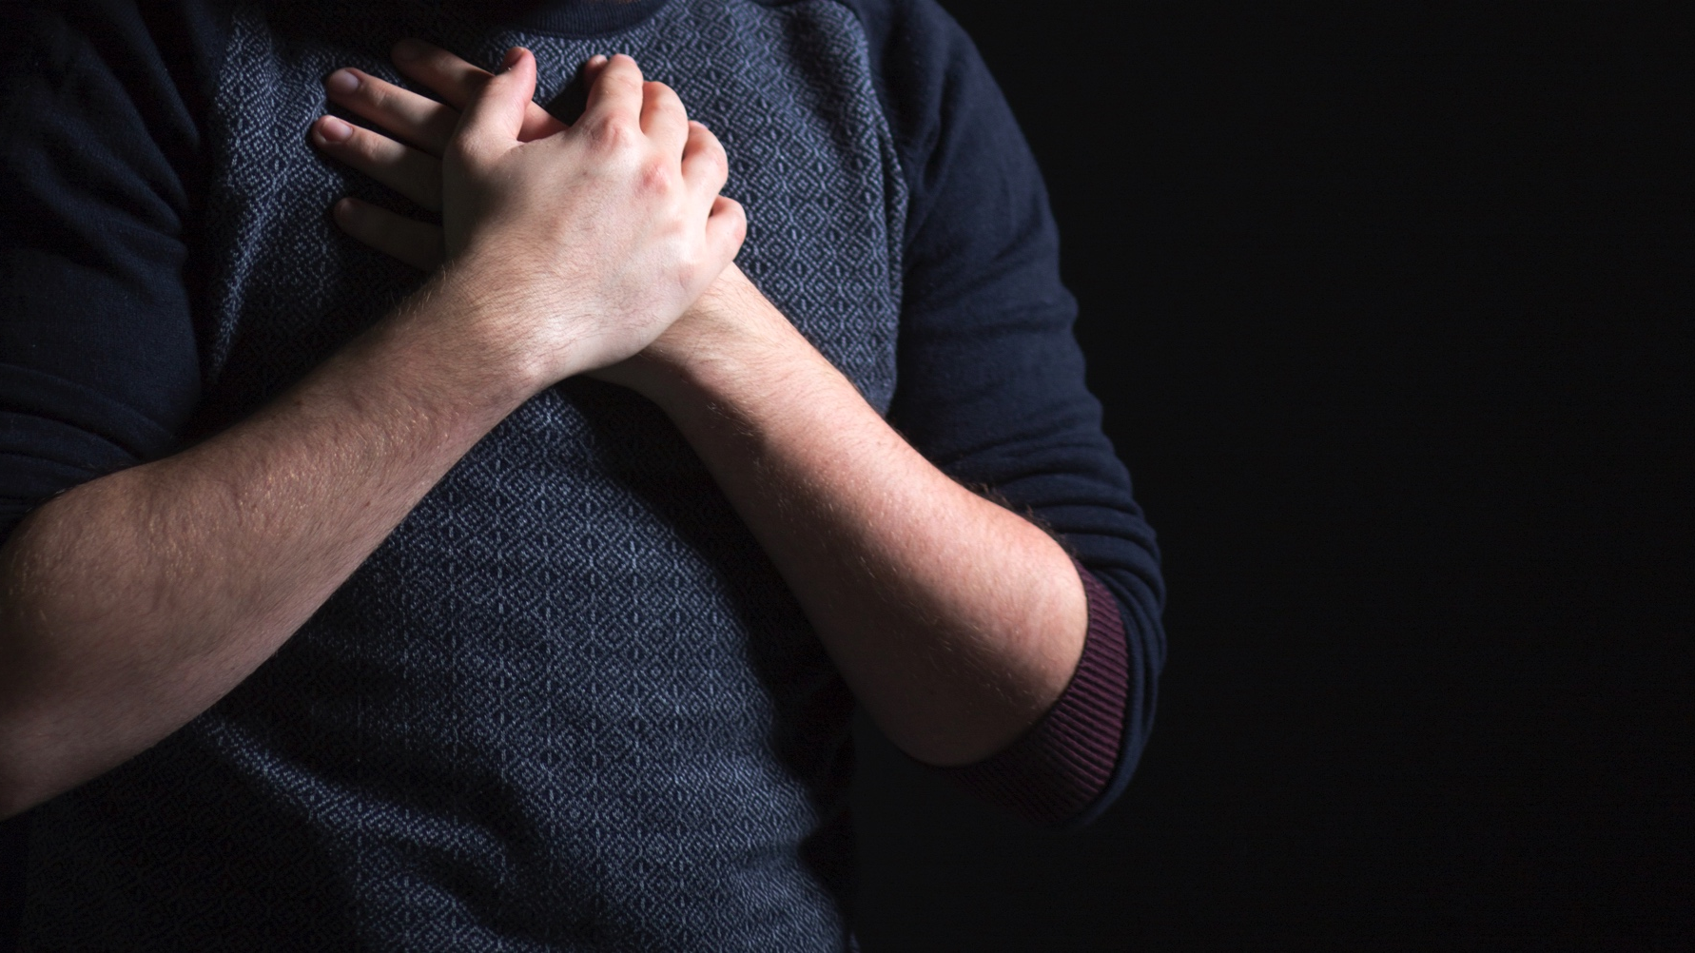
ST ANDREW’S CATHEDRAL
2018 – YEAR OF PRAYER

Slide 3
Criticised for breaking the oral law by failing to
to fast (2:18)
to observe the Sabbath law (2:24)
to wash (7:20)
Jesus’s reply; “This people honors me with their lips, but their heart is far from me; in vain do they worship me, teaching as doctrines the commandments of men.’ (v6,7)

Slide 4
Jesus’s explanation to the disciples (v 17-20)
…Do you not see that whatever goes into a person from outside cannot defile him, since it enters not his heart but his stomach, and is expelled.. “What comes out of a person is what defiles him. For from within, out of the heart of man, come evil thoughts, sexual immorality, theft, murder, adultery, coveting, wickedness, deceit, sensuality, envy, slander, pride, foolishness. All these evil things come from within, and they defile a person.”

Slide 5
The Hearts is the seedbed of evil actions
²¹ For from within, out of the heart of man, come evil thoughts, sexual immorality, theft, murder, adultery, ²² coveting, wickedness,deceit, sensuality, envy, slander, pride, foolishness. ²³ All these evil things come from within, and they defile a person.”

Slide 6
The Hearts is the seedbed of evil actions
“The line separating good and evil passes not through states, nor between classes, nor between political parties either -- but right through every human heart …” Alexander Solzhenitsyn
“The human heart is the fountainhead of corruption in the universe.”

Slide 7



Slide 8
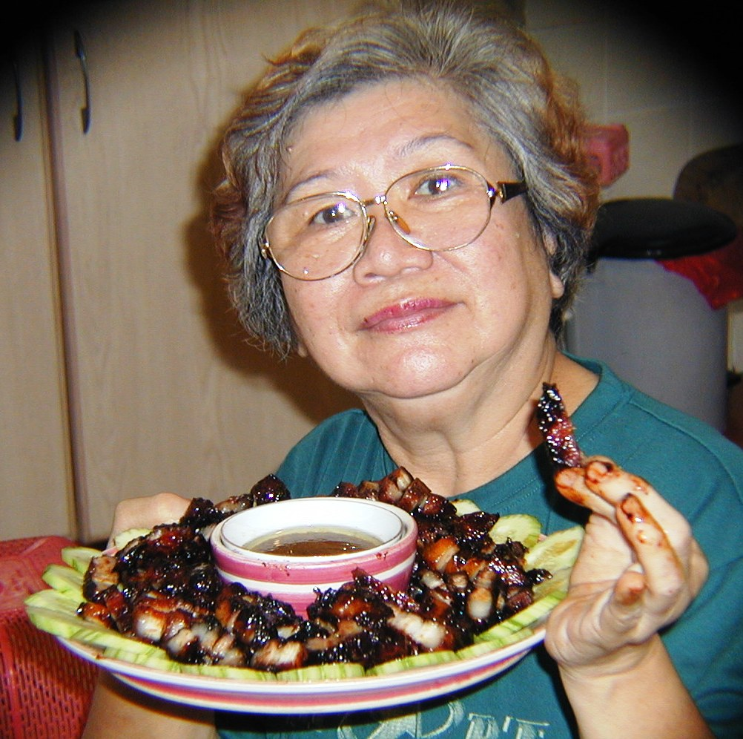

Slide 9
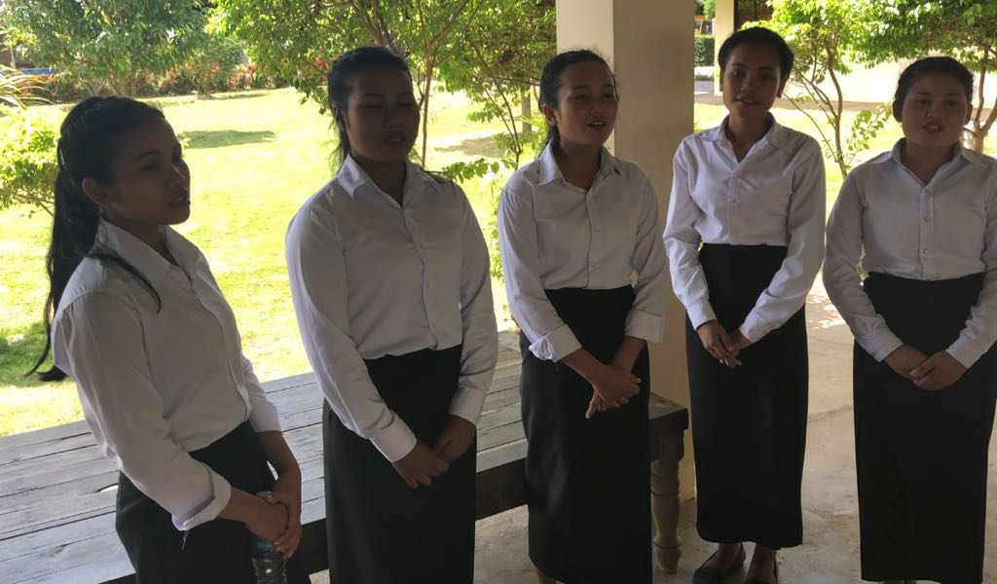

Slide 10
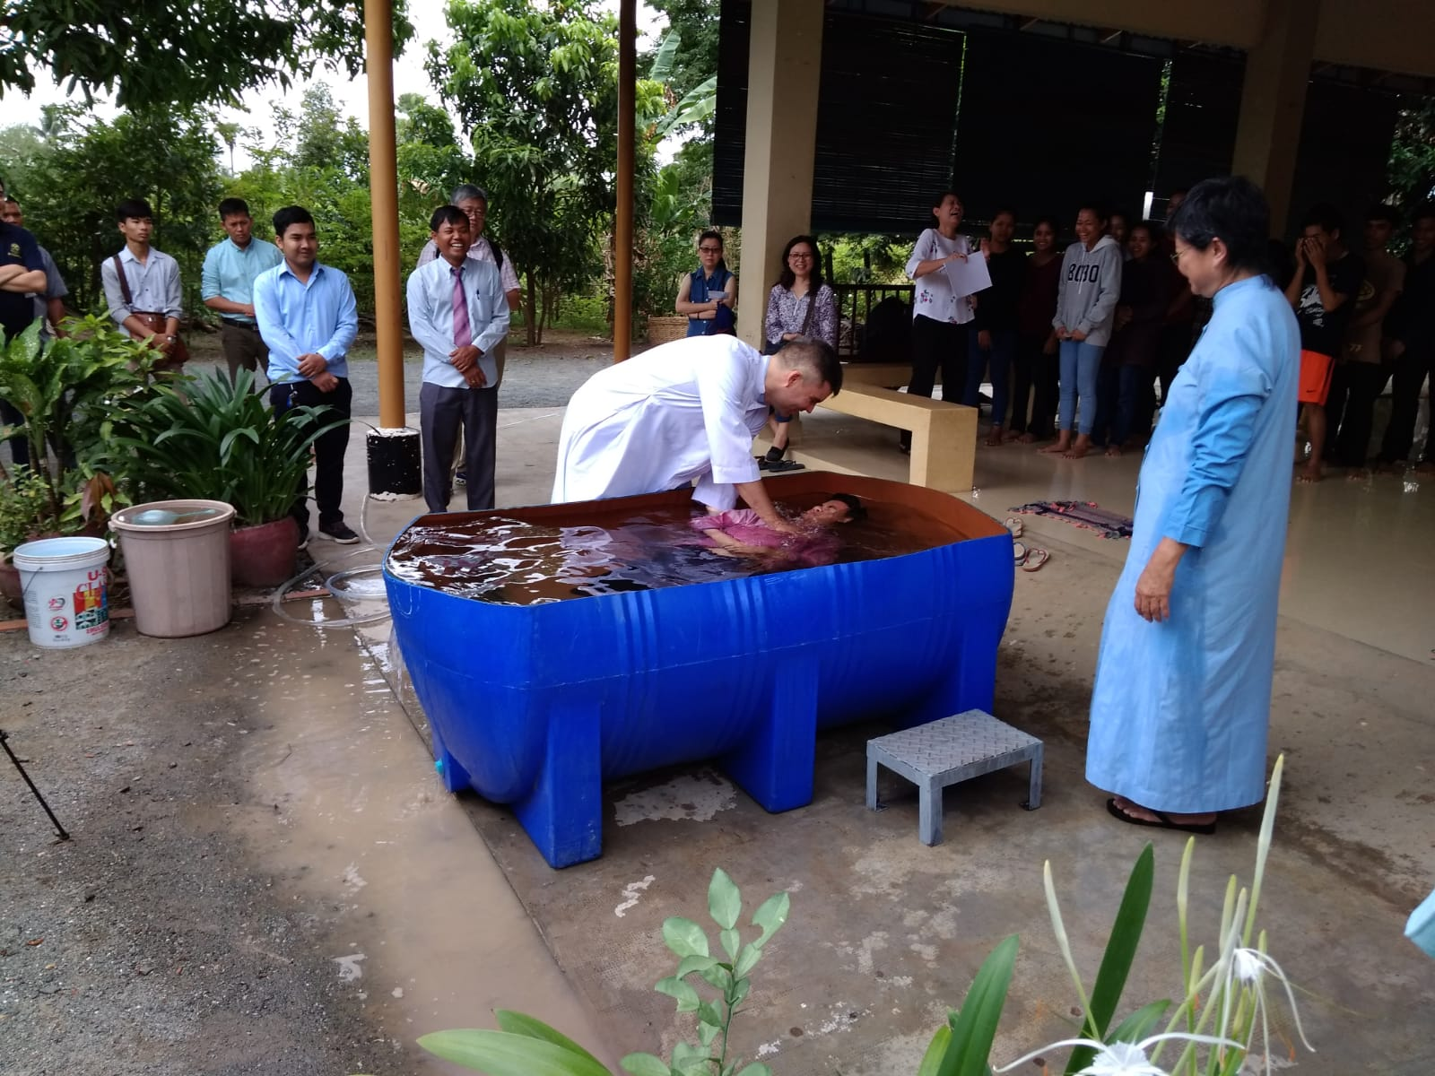

Slide 11
Search me O God, and
know my heart today
- Psalm 139:23

Slide 12
For the word of God is living and active, sharper than any two-edged sword, piercing to the division of soul and of spirit, of joints and of marrow, and discerning the thoughts and intentions of the heart.
- Hebrews 4:12

Slide 13
I am guilty
Ashamed of what I've done, what I've become
These hands are dirty
I dare not lift them up to the Holy one
You plead my cause
You right my wrongs
You break my chains
You overcome
You gave Your life
To give me mine
You say that I am free
How can it be
How can it be

Slide 14
Lord, I want to be a
Christian in my heart

Slide 15
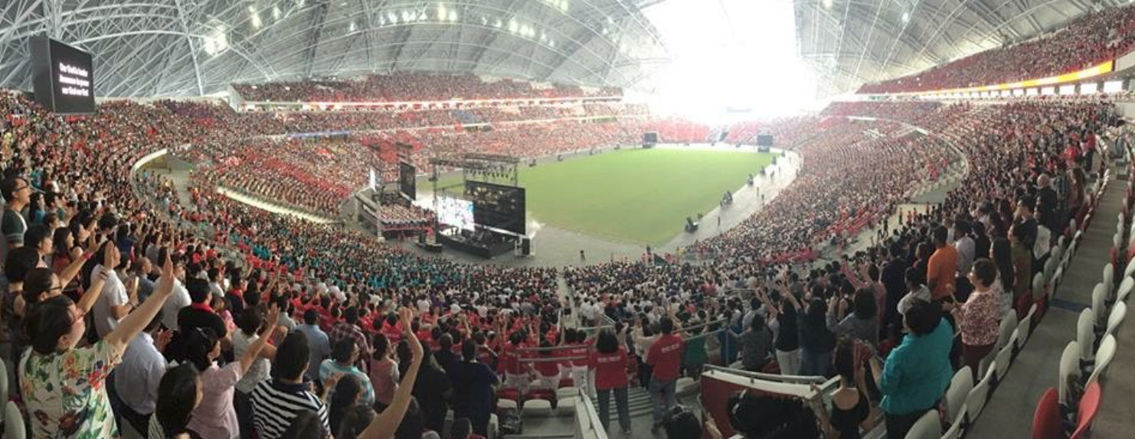
Celebration of Hope, 17-19 May 2019

Slide 16
“You have made us for yourself, and our hearts are restless until they find their rest in you.”
St Augustine

