Slide 1

THE CHURCH’S MISSION
is to present Christ
to the world while He presents to the same world,
His rescuing work in and through the church

Slide 2
“… in spite of itself,
(St Andrew’s must) become a missionary congregation –
a centre of diffusing to others the light and comfort and peace of the knowledge of Christ and Him crucified.”
Pentecost Sunday, 1856

Slide 3

‘LIVING IN THEIR MIDST’
Bishop Raphael Samuel, our missionary who has been serving in Bolivia, South America for 24 years.

Slide 4
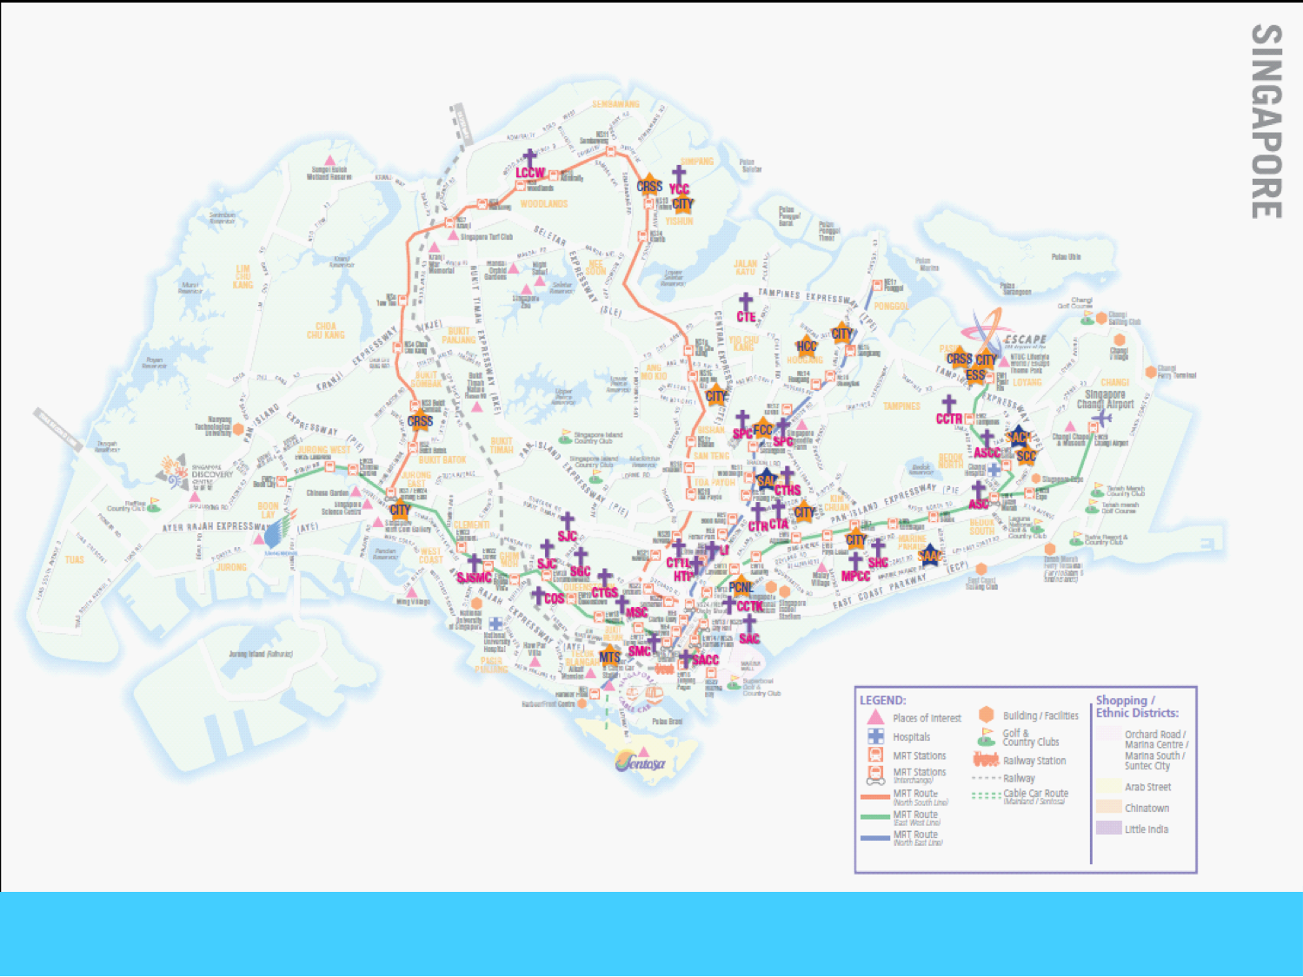
27 Anglican parishes in Singapore but none, yet,
in the West.

Slide 5


Slide 6
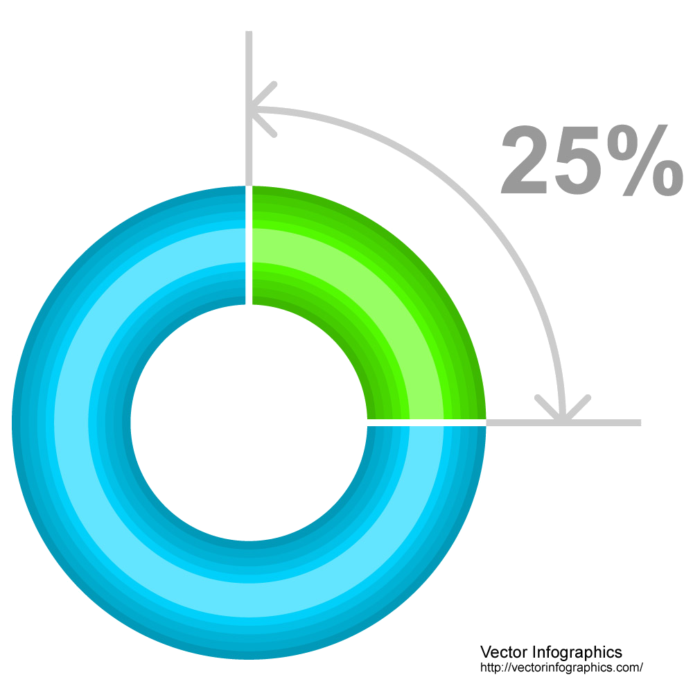
In 2016,
25% of the Cathedral’s general income was used for the works of missions
About half of this amount plus donations received for specific projects were used for the Cathedral’s missions ministries,
and the rest for the support of works carried out by
the Diocese of Singapore
and missions agencies
SAC MISSIONS
EXPENDITURE

Slide 7
Let us touch the dying, the poor, the lonely and the unwanted according to the graces we have received and
let us not be ashamed or
slow to do the humble work.
- Mother Teresa
DO NOT HIDE
YOURSELF FROM YOUR OWN FLESH

Slide 8


Slide 9
Street kids in Phnom Penh,
Cambodia

Slide 10
DO NOT HIDE
YOURSELF FROM YOUR OWN FLESH
The fast that God has appointed involves reaching the poor and needy, and to help them.

Slide 12
DO NOT HIDE
YOURSELF FROM YOUR OWN FLESH

Slide 13
Are we in touch with the poor?

Slide 14
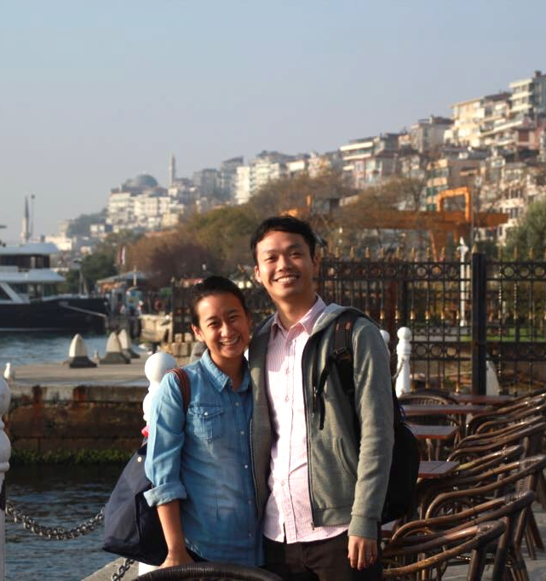
“Just imagine –
if each of us befriended
one person in need today,
how many more people
would experience Jesus’
love, care and compassion,
and receive the invitation
to be part of His family!”
Mrs Cheryl Tan grew up in the Cathedral and now worships with her husband, Joel, at the 9am and 11.30am Services.

Slide 15

DO NOT WORRY
ABOUT THE OUTCOME
JOYFULLY DISPLAY THE LORD TO OTHERS. EZEKIEL 33:1-8
God appointed Ezekiel as a watchman for the people of Israel.
He was commissioned to ‘warn the wicked to turn from their ways’.
In the same way,
we are called to bring the message of Christ to people, giving them an opportunity to turn to Him.

Slide 16
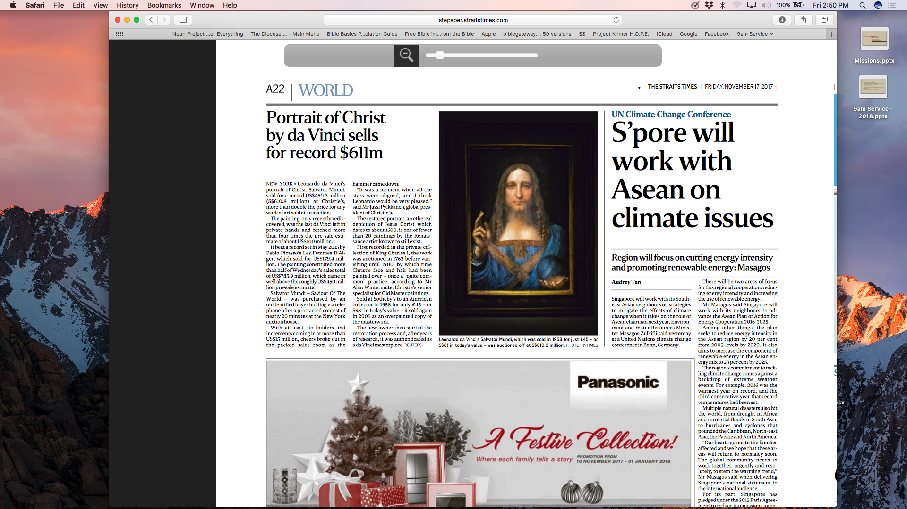
The Straits Times, Friday, 17 November 2017

Slide 18
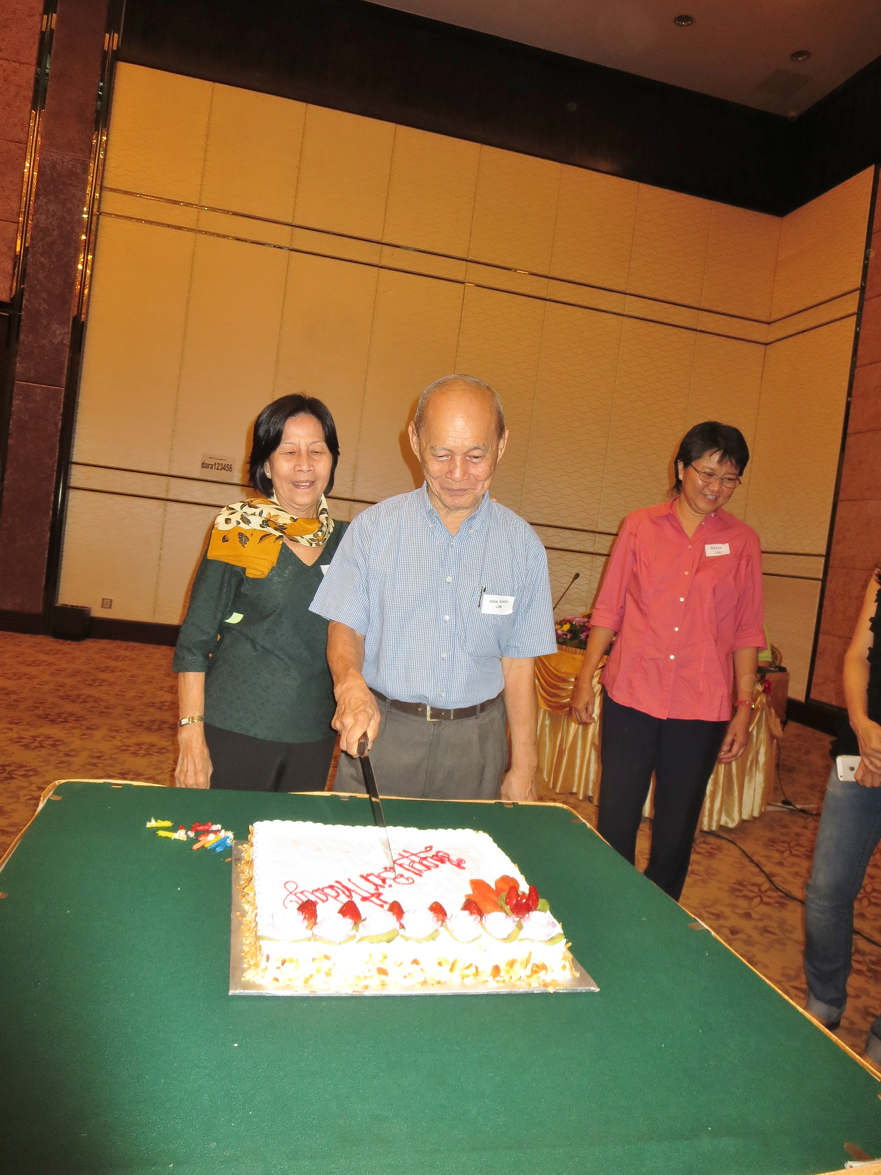
MR & MRS
LIM KENG BOON
In 2014, Keng Boon celebrated his 80th Birthday while he and Bee Leng were on a PKH Tour in Cambodia.
Bee Leng went home to the Lord on 5 Nov 2017.

Slide 19
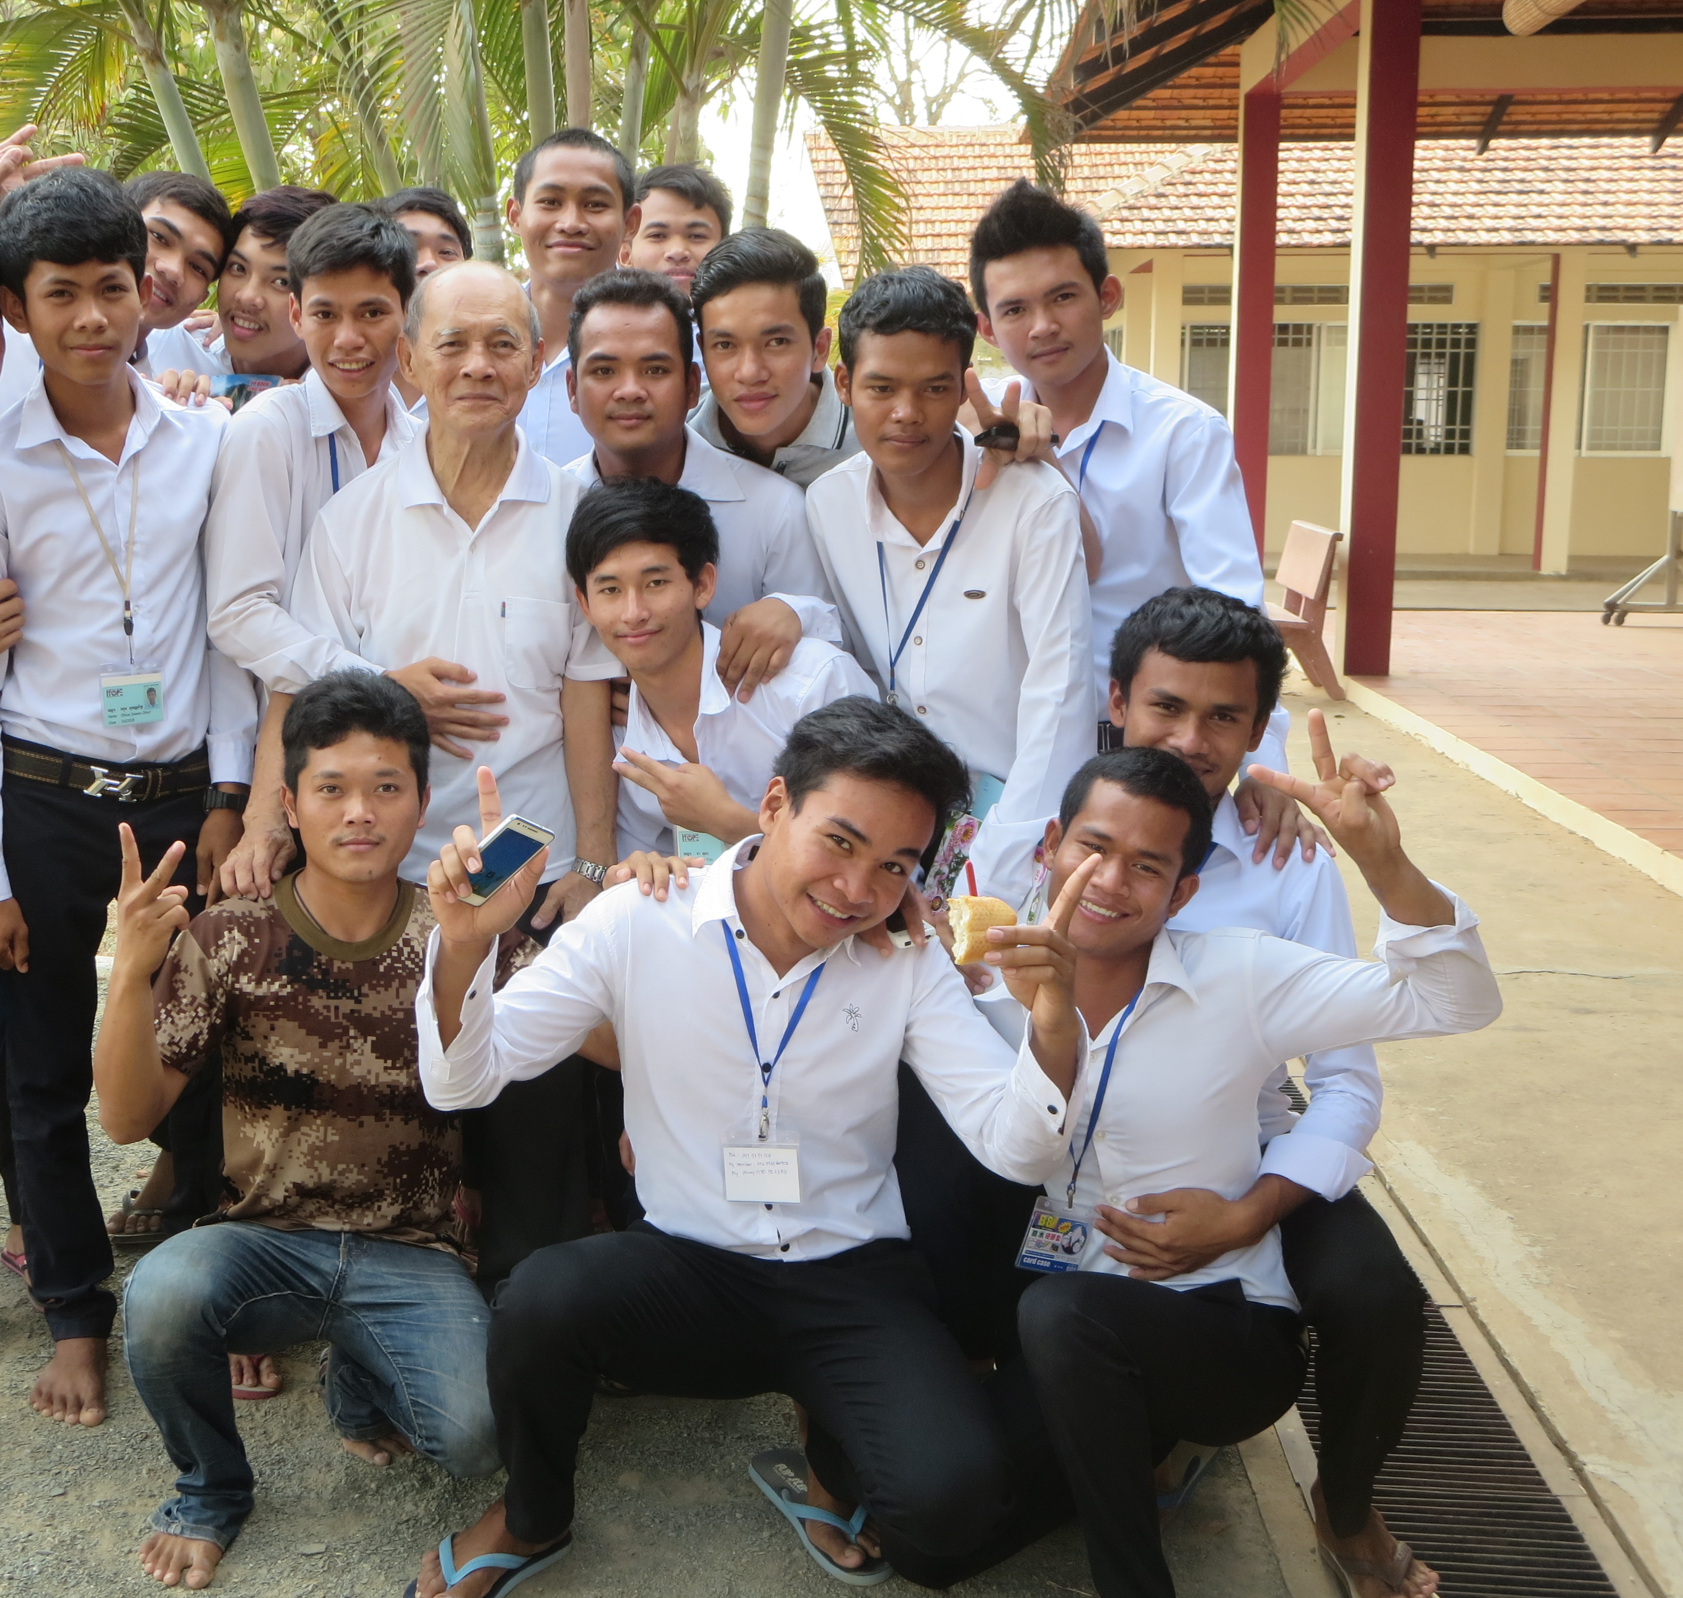
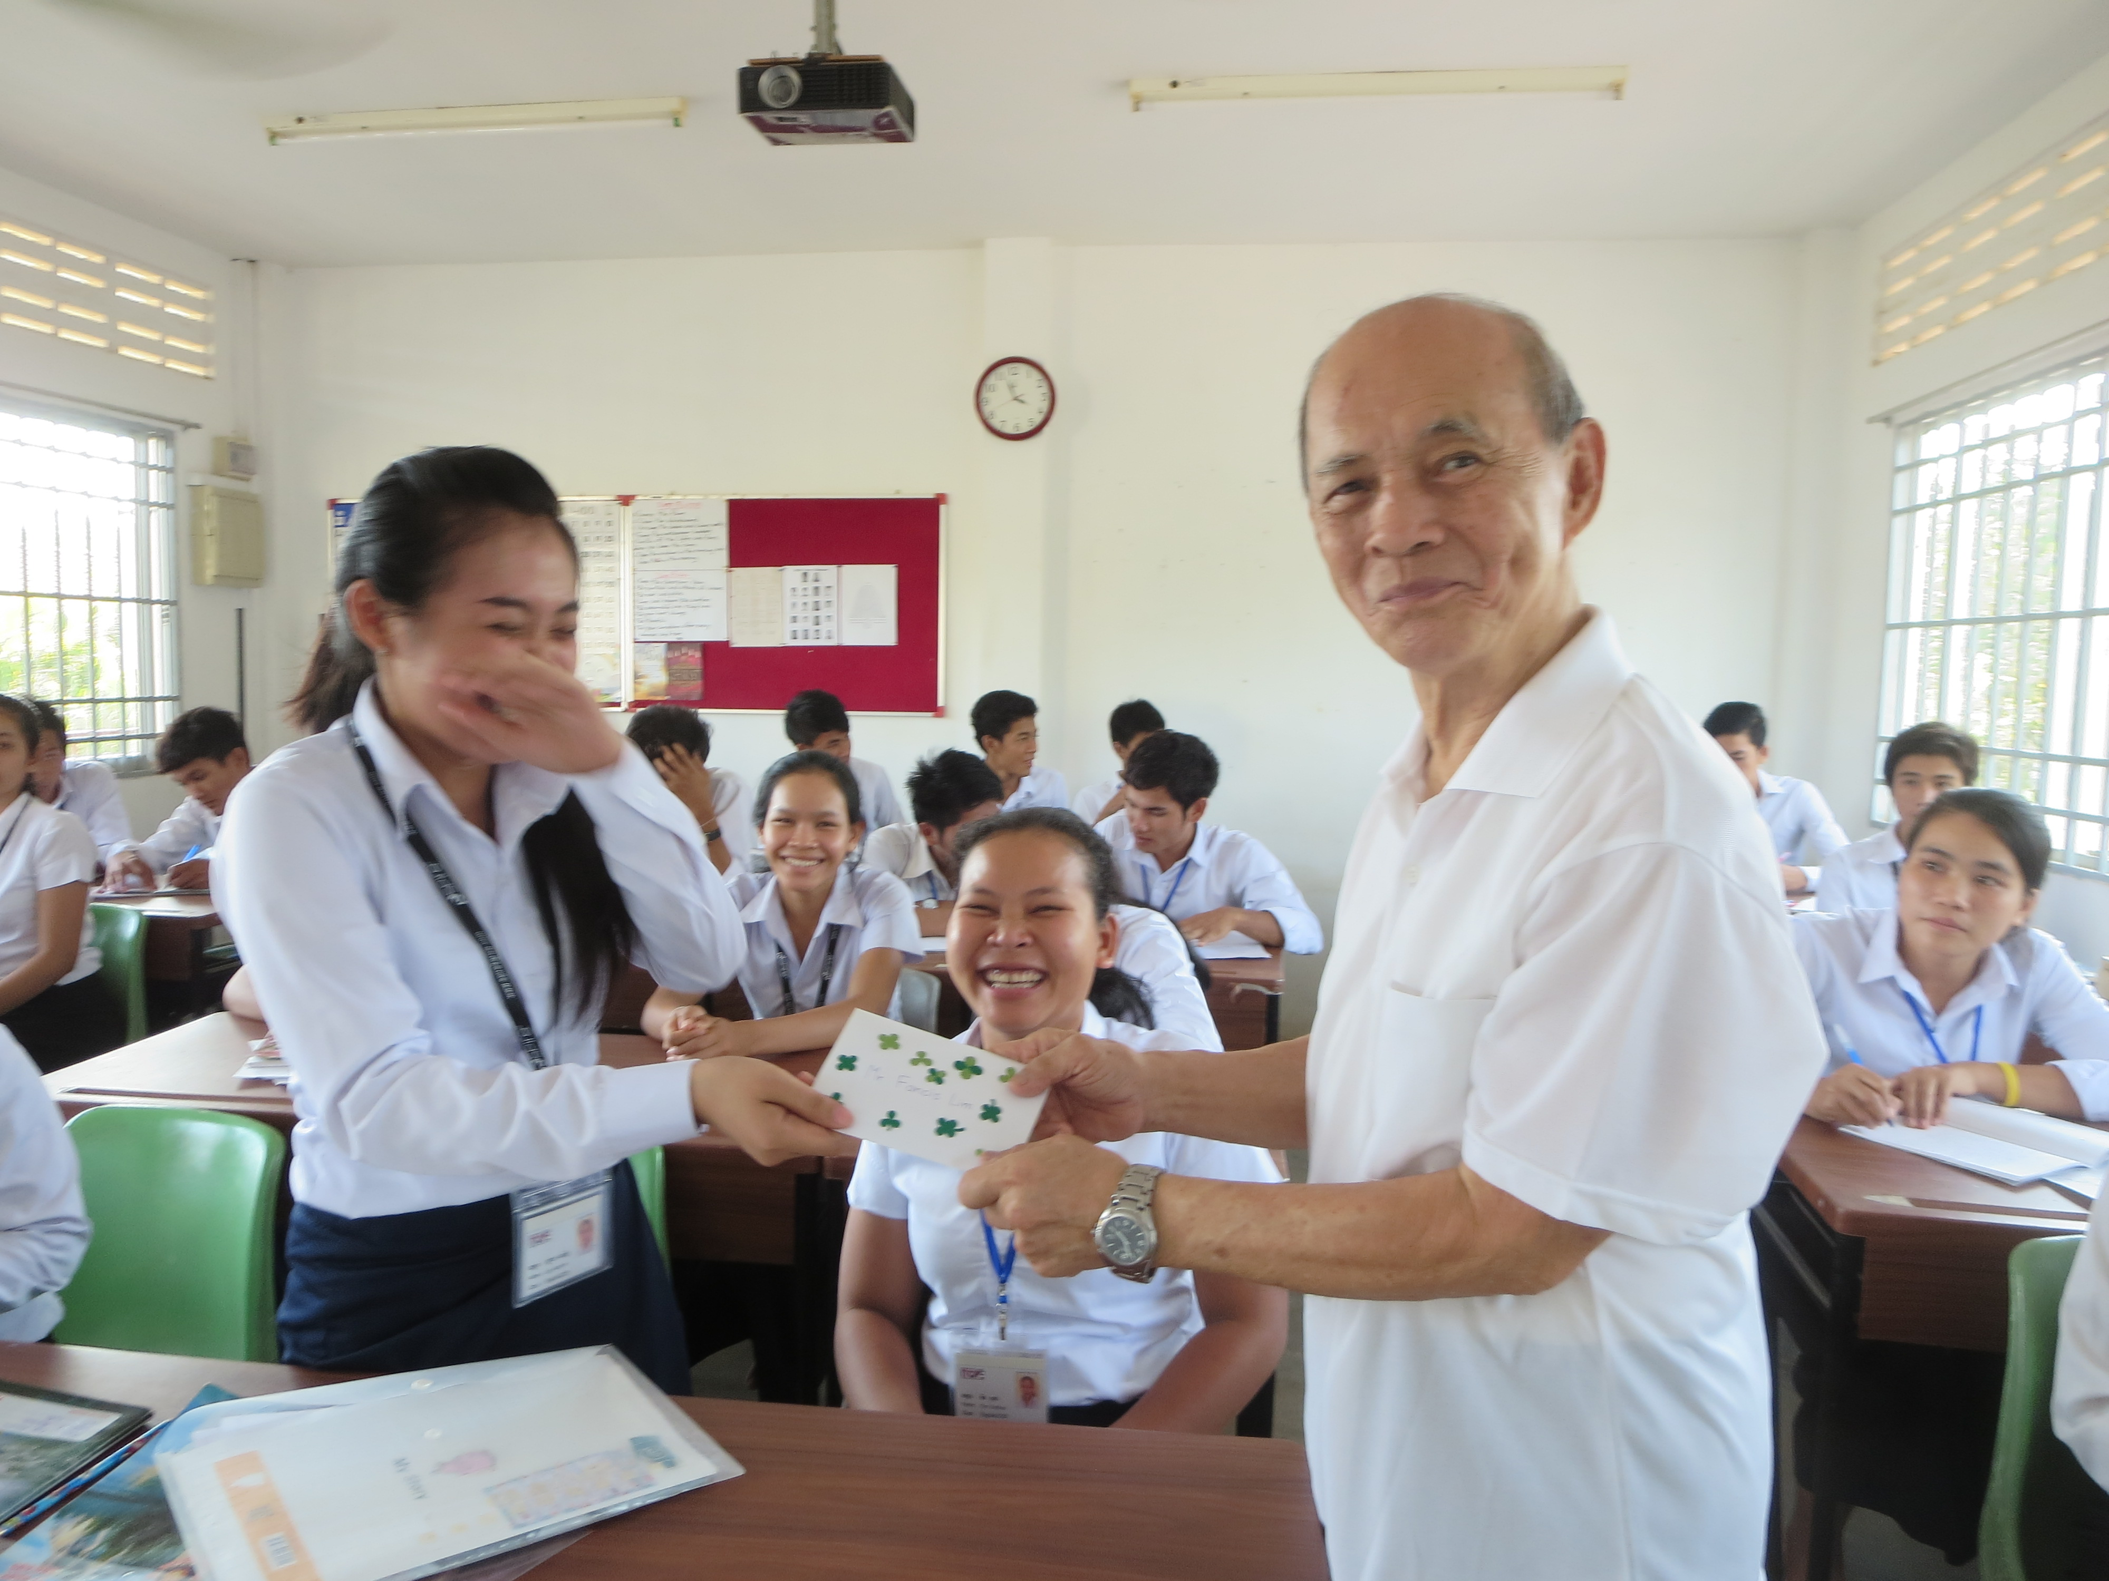
LIM KENG BOON
at the PKH Centre
in 2015

Slide 20
ANDREW
brought
his brother to Christ.
His example is most meaningful to ordinary Christians with a zeal in bringing people to the Lord.

Slide 21
WILLIAM COLGATE,
the soap and toothpaste manufacturer that was first
to put toothpaste
in a tube.

Slide 22

BE AN
ANDREW!
St Andrew’s Day on 30th November

