Slide 1
A DEVOTED COMMUNITY
v42 They devoted themselves to the apostles' teaching and to the fellowship, and to the breaking of bread and the prayers.

Slide 2
Devoted - ‘προσκαρτερέω’
‘proskarterountes’

Slide 3
THEY DEVOTED THEMSELVES TO THE APOSTLES TEACHING

Slide 4
A Community of the Spirit and the Word.
A Word and Spirit Church.

Slide 5
2 Tim 4:2-3 Preach the Word; be prepared in season and out of season; correct, rebuke and encourage - with great patience and careful instruction. 3 For the time will come when men will not put up with sound doctrine. Instead, to suit their own desires, they will gather around them a great number of teachers to say what their itching ears want to hear.

Slide 6
Preaching matters

Slide 7
Sound teaching matters

Slide 8
Beware legalism and moralism …..

Slide 9
Beware of itching ears…..

Slide 10
LIVE UNDER THE AUTHORITY OF THE WORD OF GOD

Slide 11
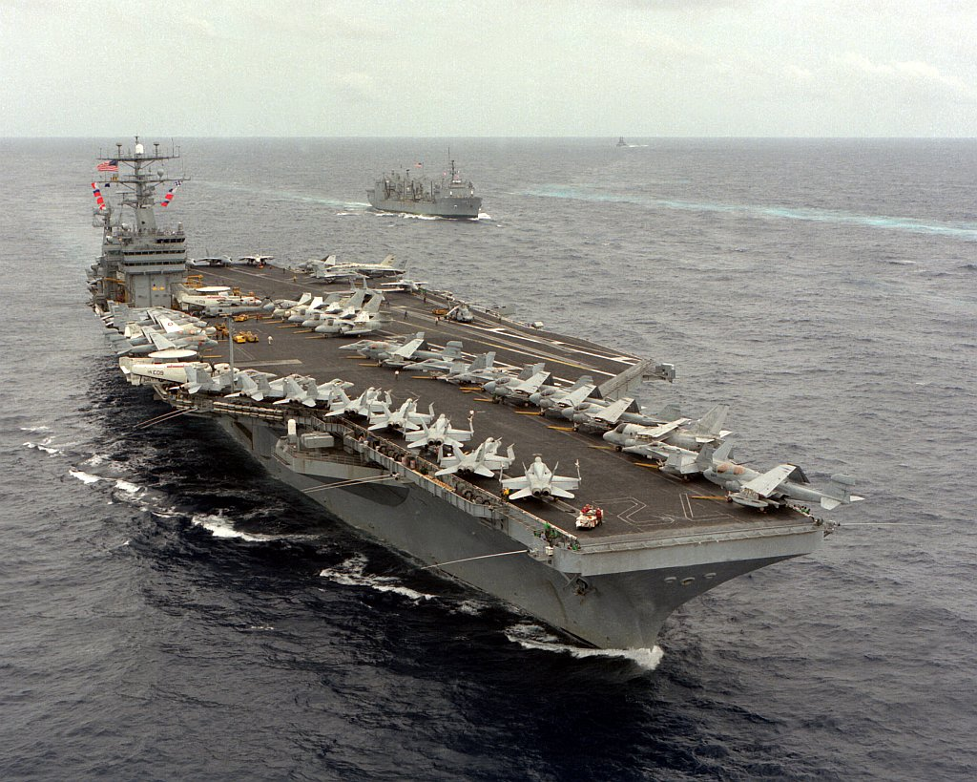

Slide 12


Slide 13
THEY APPLIED THE APOSTOLIC TEACHING TO THEIR LIVES

Slide 14
Heb 4:12 For the word of God is living and active. Sharper than any double-edged sword, it penetrates even to dividing soul and spirit, joints and marrow; it judges the thoughts and attitudes of the heart.

Slide 15
They devoted themselves to the apostles' teaching and to the fellowship
They were a people of the
Spirit and the Word IN Community

Slide 16
Col 3:16 Let the word of Christ dwell in you richly as you teach and admonish one another with all wisdom,

Slide 17
THEY WERE DEVOTED TO THE FELLOWSHIP

Slide 18
‘Koinonia’ - to ‘have in common’ –
to ‘share in’ - ‘participate in’

Slide 19
COMMON-UNITY
John 17:20-21 “I do not ask for these only, but also for those who will believe in me through their word, 21 that they may all be one,

Slide 20
John 17:21 I pray …that all of them may be one, Father, just as you are in me and I am in you. May they also be in us …

Slide 21
2 Cor 13:14
May, the grace of the Lord Jesus Christ and the love of God and the fellowship of the Holy Spirit be with you all.

Slide 22
Psalm 86:11
Teach me your way, Lord,
that I may rely on your faithfulness;
give me an undivided heart,
that I may fear your name.

Slide 23
O Lord give me an undivided heart
To follow You.
O Lord give me an undiminished love
To see what You see
To do what You do
O Lord give me an undivided heart

Slide 24
O Lord give me an unrelenting mind
To seek Your face
O Lord give me an undefeated faith
To see victory in all that I do
To worship in spirit and truth

Slide 25
To see less of me and much more of You
O Lord give me an undivided heart
O Lord give me an undivided heart

