Slide 1
29 Jul 2018 Creation and the Fall
5 Aug 2018 A Kingdom and Its Fall
12 Aug 2018 The Church and Her King
19 Aug 2018 God & Family
26 Aug 2018 God & Education
2 Sep 2018 God & Money
9 Sep 2018 God & the Arts
16 Sep 2018 God & Government
23 Sep 2018 God & Healthcare

Slide 2
“…the essence of sin is
man substituting himself for God…”
- John Stott

Slide 3
Man’s Essential Relationships
God
Self
World
Man
Creation
Work
Relationships
Societies

Slide 4
A Kingdom and Its Fall
Kingdom Here
Session 2

Slide 5
Adam and Eve
Abel and Cain

Slide 6
Adam and Eve
Seth
Abel and Cain

Slide 7
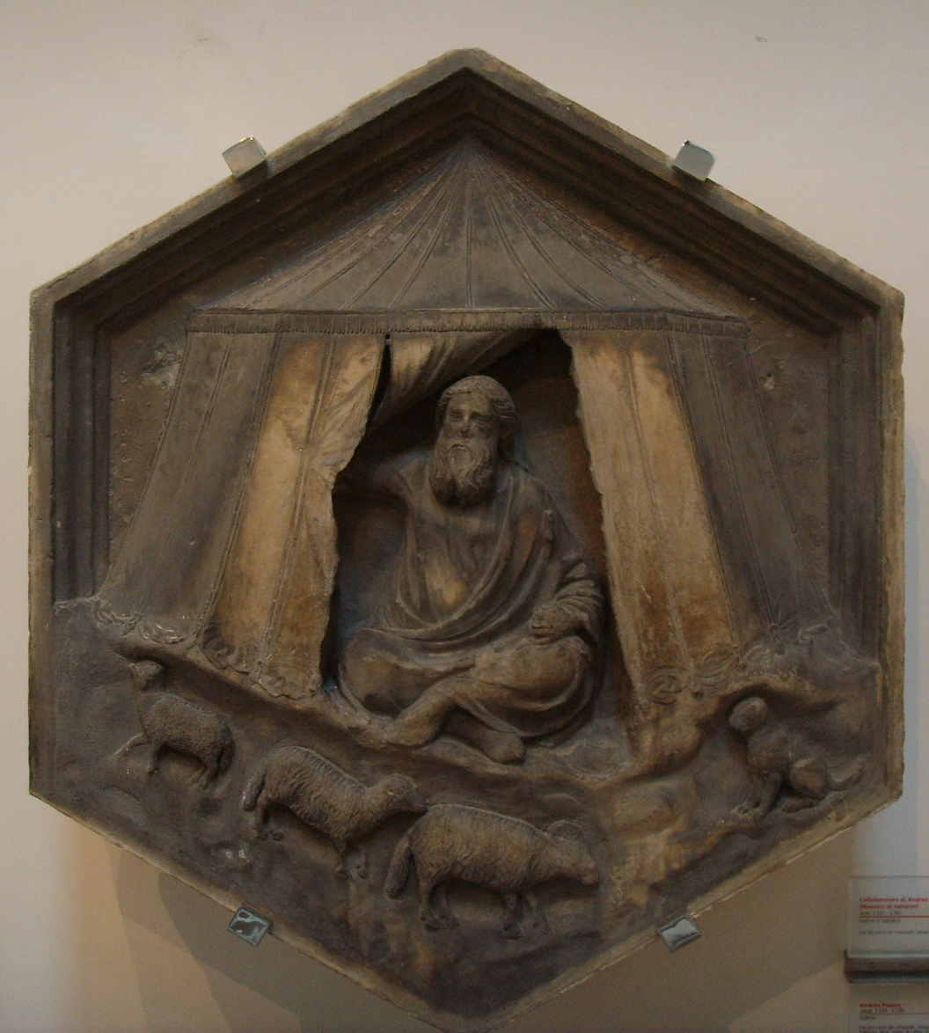
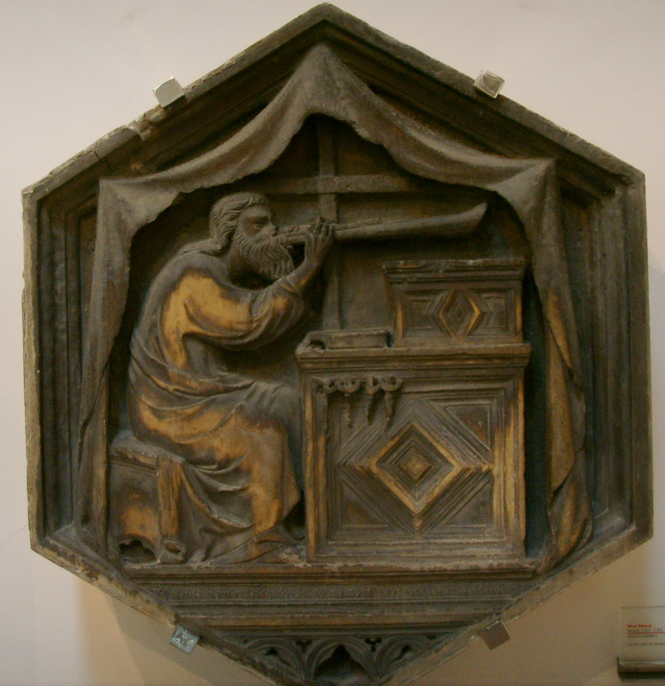
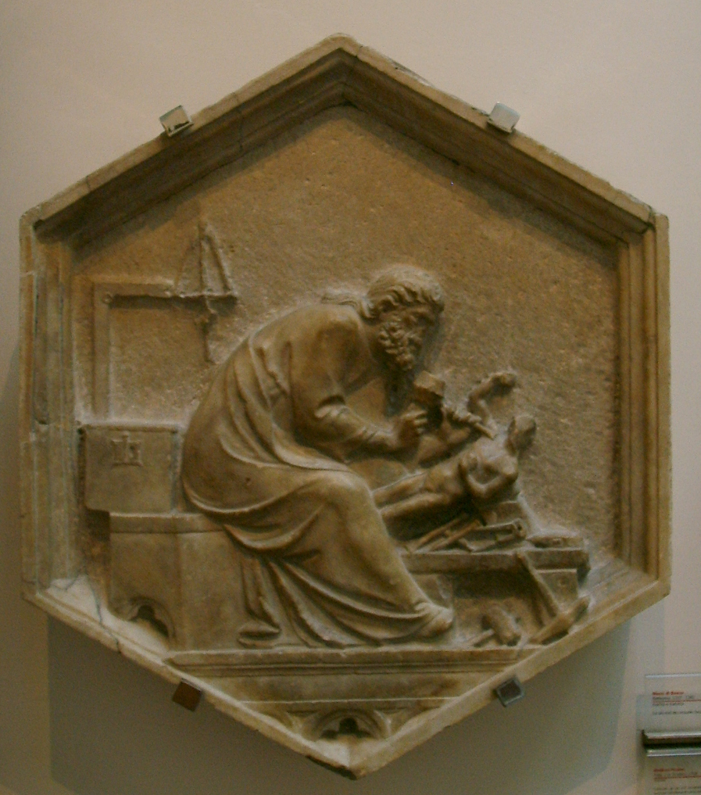
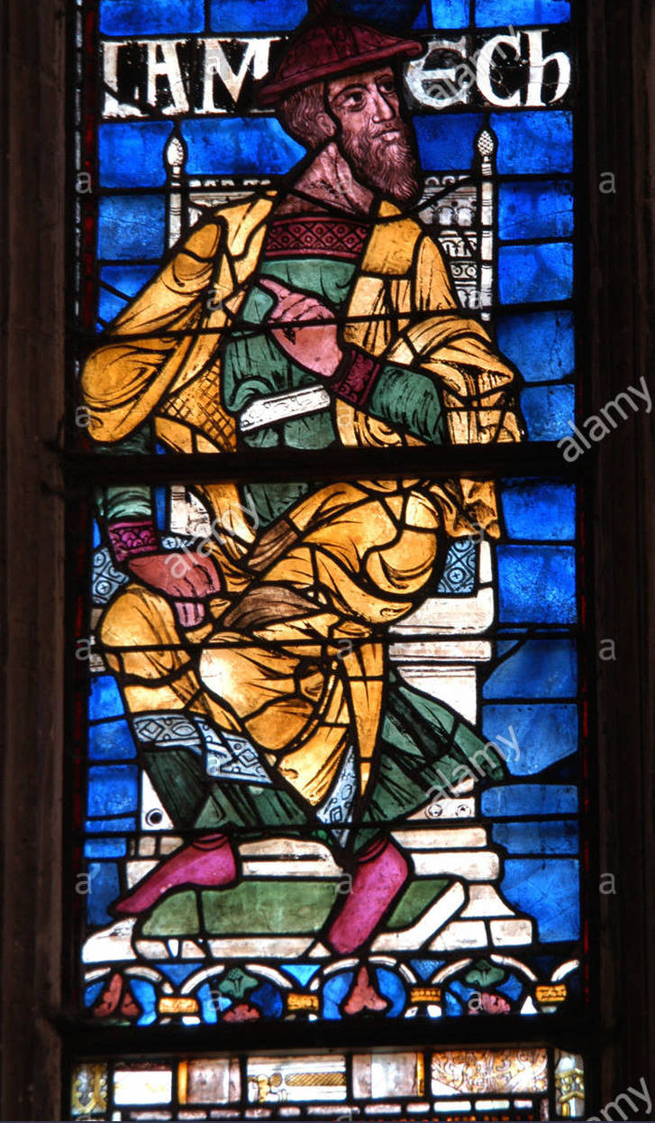
Jabal
Jubal
Tubal-Cain
Lamech
Genesis 4:20-24

Slide 8
Adam and Eve
Seth
Abel and Cain
Noah
Abraham
and Sarah
Isaac – Jacob – Joseph
Moses
Tower of Babel

Slide 9
Man’s Essential Relationships
God
Self
World
Man
Creation
Work
Relationships
Societies

Slide 10
Man’s Essential Relationships
Self
Man
World
Creation
Work
Relationships
Societies

Slide 11
“The LORD saw that the wickedness of man was great in the earth, and that every intention of the thoughts of his heart was only evil continually. ”
Genesis 6:5

Slide 12
“Come, let us build ourselves a city and a tower with its top in the heavens, and let us make a name for ourselves, lest we be dispersed over the face of the whole earth.”
Genesis 11:4

Slide 13
Adam and Eve
Seth
Abel and Cain
Noah
Abraham
and Sarah
Isaac – Jacob – Joseph
Moses
Tower of Babel

Slide 14
“Now the Lord said to Abram, “Go from your country and your kindred and your father's house to the land that I will show you. And I will make of you a great nation, and I will bless you and make your name great, so that you will be a blessing. I will bless those who bless you, and him who dishonors you I will curse, and in you all the families of the earth shall be blessed.”
Genesis 12:1-3

Slide 15
“Now the Lord said to Abram, “Go from your country and your kindred and your father's house to the land that I will show you. And I will make of you a great nation, and I will bless you and make your name great, so that you will be a blessing. I will bless those who bless you, and him who dishonors you I will curse, and in you all the families of the earth shall be blessed.”
Genesis 12:1-3

Slide 16
“Abraham, the father of faith for all three of the great monotheistic religions, discovered his purpose and exercised his faith in the simplest of life experiences.
He moved, and his wife had a baby.
In those two events, he realized his purpose.”
- Poe and Davis

Slide 17
Adam and Eve
Seth
Abel and Cain
Noah
Abraham
and Sarah
Isaac – Jacob – Joseph
Moses
Tower of Babel

Slide 18
“You yourselves have seen what I did to the Egyptians, and how I bore you on eagles' wings and brought you to myself. Now therefore, if you will indeed obey my voice and keep my covenant, you shall be my treasured possession among all peoples, for all the earth is mine; and you shall be to me a kingdom of priests and a holy nation.” Exodus 19:3-6

Slide 19
“You yourselves have seen what I did to the Egyptians, and how I bore you on eagles' wings and brought you to myself. Now therefore, if you will indeed obey my voice and keep my covenant, you shall be my treasured possession among all peoples, for all the earth is mine; and you shall be to me a kingdom of priests and a holy nation.” Exodus 19:3-6

Slide 20
All the people answered together and said, “All that the Lord has spoken we will do.” Exodus 19:8 When Moses came and told the people all the words and ordinances of the LORD, they all responded with one voice: “All the words that the LORD has spoken, we will do.” Exodus 24:3

Slide 21
Israel’s mission was to be something, not to go somewhere. Christopher Wright

Slide 22
But you are a chosen race, a royal priesthood,
a holy nation, a people for his own possession,
that you may proclaim the excellencies of him who called you out of darkness into his marvelous light.
1 Peter 2:9

Slide 23
1 Know God
People of
God
GOD
2 Represent God
3 Attract the world to God

Slide 24
Man’s Essential Relationships
God
Self
World
Man
Creation
Work
Relationships
Societies

Slide 25
1 Know God
People of
God
GOD
2 Represent God
3 Attract the world to God

Slide 26
1 Know God
People of
God
GOD
2 Represent God
3 Attract the world to God

Slide 27
When Israel was a child, I loved him, and out of Egypt I called my son. The more they were called, the more they went away; they kept sacrificing to the Baals and burning offerings to idols.
Hosea 11:1-2

Slide 28
Yet it was I who taught Ephraim to walk; I took them up by their arms, but they did not know that I healed them. I led them with cords of kindness, with the bands of love, and I became to them as one who eases
the yoke on their jaws, and I bent down to them and fed them.
Hosea 11:3-4

Slide 29
How can I give you up, O Ephraim? How can I hand you over, O Israel?
My heart recoils within me; my compassion grows warm and tender.
Hosea 11:8

Slide 30
Return, O Israel, to the LORD your God,
for you have stumbled because of your iniquity.
Hosea 14:1

Slide 31
Israel in the Promised Land
Return to Jerusalem
Exile – Assyria and Babylon
400 years of silence
Majority remained in exile

