Slide 1
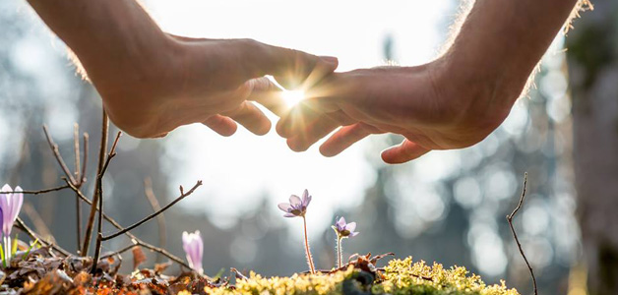
A Healing Community

Slide 2

The Spirit-Filled Community of Faith
7 July A Devoted Community
14 July A Healing Community
21 July A Bold Praying Community
28 July An Obedient Community
4 August A Forgiving Community
11 August A Serving Community
18 August An Evangelistic Community
25 August A Transformed Community
A Healing Community (Sat Service)

Slide 3
Five things that happened at the Beautiful Gate:
The Continuous Prayer.
The Miracle of Healing.
The Bold Proclamation in the Name of Jesus Christ.
The Disciples Went Into Action.
The Name of God was Glorified.
A Healing Community (Sat Service)

Slide 4
The Continuous Prayer. (v.1)
Now Peter and John were going up to the temple at the hour of prayer, the ninth hour.
A Healing Community (Sat Service)

Slide 5
The Miracle of Healing. (vv.2-8)
² And a man lame from birth was being carried, whom they laid daily at the gate of the temple that is called the Beautiful Gate to ask alms of those entering the temple.
³ Seeing Peter and John about to go into the temple, he asked to receive alms.
⁴ And Peter directed his gaze at him, as did John, and said, “Look at us.”
A Healing Community (Sat Service)

Slide 6
⁵ And he fixed his attention on them, expecting to receive something from them.
⁶ But Peter said, “I have no silver and gold, but what I do have I give to you. In the name of Jesus Christ of Nazareth, rise up and walk!”
⁷ And he took him by the right hand and raised him up, and immediately his feet and ankles were made strong.
A Healing Community (Sat Service)

Slide 7
⁸ And leaping up, he stood and began to walk, and entered the temple with them, walking and leaping and praising God.
A Healing Community (Sat Service)

Slide 8
The Bold Proclamation in the Name of Jesus Christ. (v. 6)
⁶ But Peter said, “I have no silver and gold, but what I do have I give to you. In the name of Jesus Christ of Nazareth, rise up and walk!”
A Healing Community (Sat Service)

Slide 9
The Disciples Went Into Action. (vv. 7-8)
⁷ And he took him by the right hand and raised him up, and immediately his feet and ankles were made strong.
⁸ And leaping up, he stood and began to walk, and entered the temple with them, walking and leaping and praising God.
A Healing Community (Sat Service)

Slide 10
The Name of God was Glorified. (vv. 8-10)
⁸ And leaping up, he stood and began to walk, and entered the temple with them, walking and leaping and praising God.
⁹ And all the people saw him walking and praising God,
¹⁰ and recognized him as the one who sat at the Beautiful Gate of the temple, asking for alms. And they were filled with wonder and amazement at what had happened to him.
A Healing Community (Sat Service)

Slide 11
A Healing Community (Sat Service)

Slide 12
Acts 28:1-9
After we were brought safely through, we then learned that the island was called Malta.
² The native people showed us unusual kindness, for they kindled a fire and welcomed us all, because it had begun to rain and was cold.
³ When Paul had gathered a bundle of sticks and put them on the fire, a viper came out because of the heat and fastened on his hand.
A Healing Community (Sat Service)

Slide 13
⁴ When the native people saw the creature hanging from his hand, they said to one another, “No doubt this man is a murderer. Though he has escaped from the sea, Justice has not allowed him to live.”
⁵ He, however, shook off the creature into the fire and suffered no harm.
A Healing Community (Sat Service)

Slide 14
⁶ They were waiting for him to swell up or suddenly fall down dead. But when they had waited a long time and saw no misfortune come to him, they changed their minds and said that he was a god.
⁷ Now in the neighborhood of that place were lands belonging to the chief man of the island, named Publius, who received us and entertained us hospitably for three days.
A Healing Community (Sat Service)

Slide 15
⁸ It happened that the father of Publius lay sick with fever and dysentery. And Paul visited him and prayed, and putting his hands on him, healed him.
⁹ And when this had taken place, the rest of the people on the island who had diseases also came and were cured.
A Healing Community (Sat Service)

Slide 16
⁸ It happened that the father of Publius lay sick with fever and dysentery. And Paul visited him and prayed, and putting his hands on him, healed him.
⁹ And when this had taken place, the rest of the people on the island who had diseases also came and were cured.
A Healing Community (Sat Service)

Slide 17
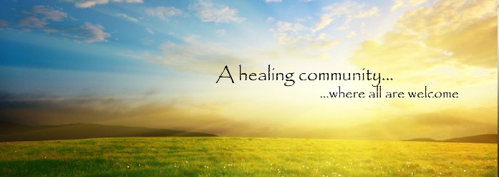
A Healing Community (Sat Service)

Slide 18
A Healing Community (Sat Service)

