Slide 1

4th Meditation: “My God, my God, why have you forsaken me?” (Mark 15:34)

Slide 2
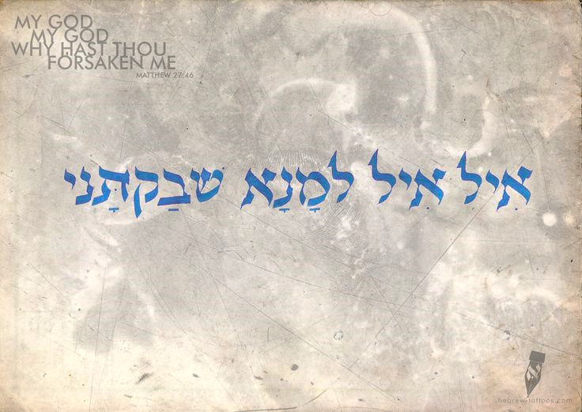
MY GOD, MY GOD,
WHY HAVE YOU FORSAKEN ME?

Slide 3
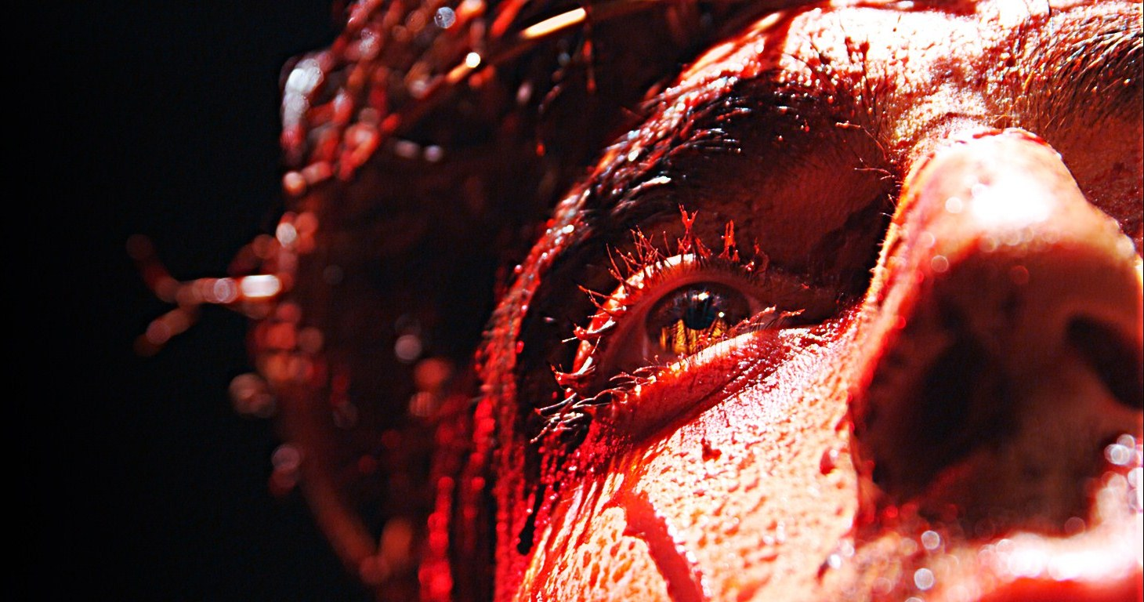
rejected

Slide 4
Gethsemane

Slide 5
You who are of purer eyes
than to see evil and cannot look at wrong - Habakkuk 1:13

Slide 6
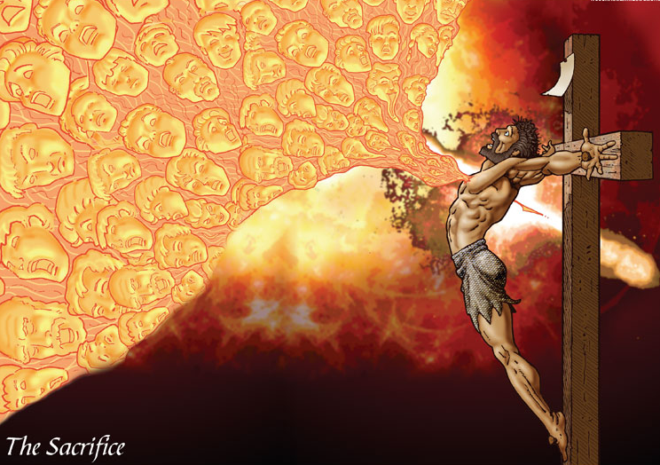
Christ who knew no sin, became sin for us.

Slide 7
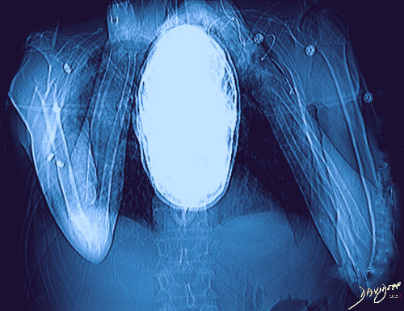

Slide 8
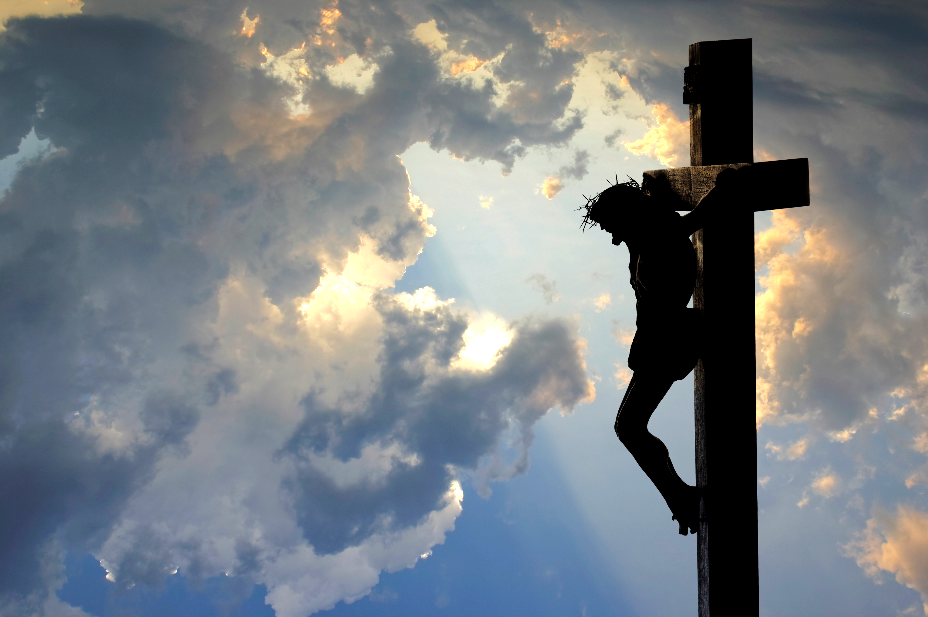
Psalm 22
OT Page 894

Slide 9
JESUS CHRIST - A FORSAKEN SAVIOUR
My God, My God,
Why have you forsaken me?
Psalm 22:1

Slide 10
JESUS CHRIST –
A HUMILIATED SAVIOUR
⁶ But I am a worm and not a man, scorned by mankind and despised by the people.
⁷ All who see me mock me; they make mouths at me; they wag their heads;
⁸ “He trusts in the Lord; let him deliver him; let him rescue him, for he delights in him!”

Slide 11
JESUS CHRIST –
A CRUCIFIED SAVIOUR
Verses 14-18
Piercing of his hands and feet
The dehydration; the thirst
The gambling for his clothes
The protrusion of his bone

Slide 12
JESUS CHRIST –
THE NAME ABOVE ALL NAMES!
²⁷All the ends of the earth shall remember and turn to the Lord, and all the families of the nations shall worship before you.
²⁸ For kingship belongs to the Lord, and he rules over the nations.

Slide 13

JESUS CHRIST –
TRUST IN HIM!
In you our fathers trusted;
they trusted, and you delivered them.
⁵ To you they cried and were rescued;
in you they trusted and were
not put to shame.

Slide 14
MY GOD, MY GOD,
WHY HAVE YOU FORSAKEN ME?

Slide 18
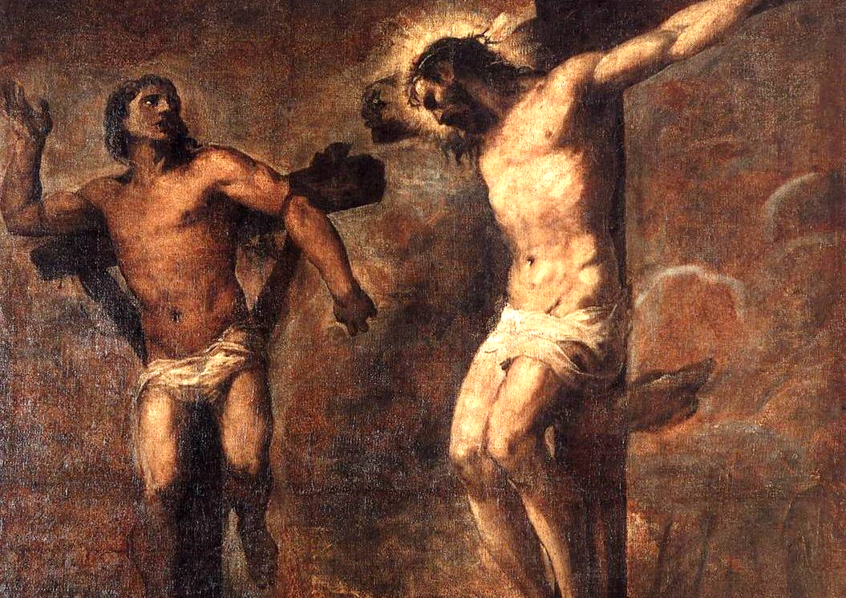

Slide 19
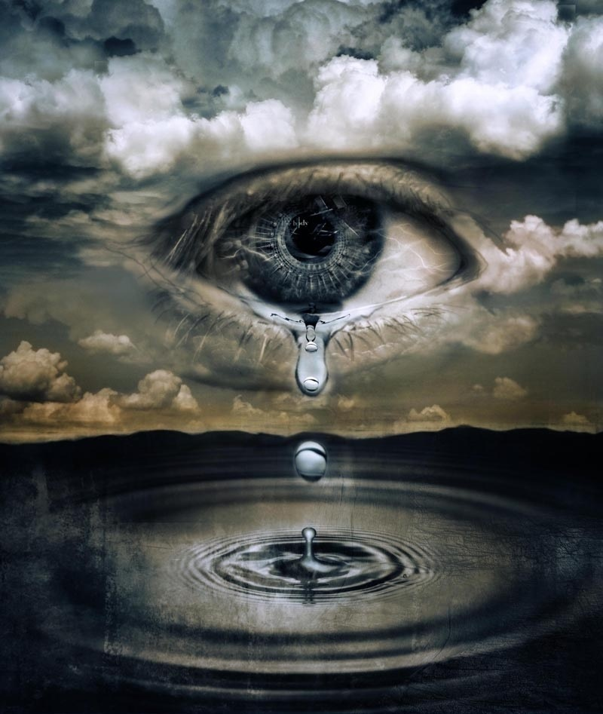

Slide 20
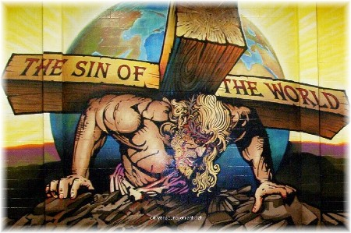

Slide 21
