Slide 2
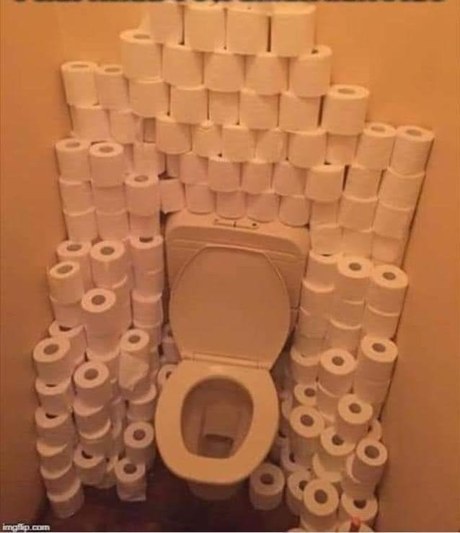
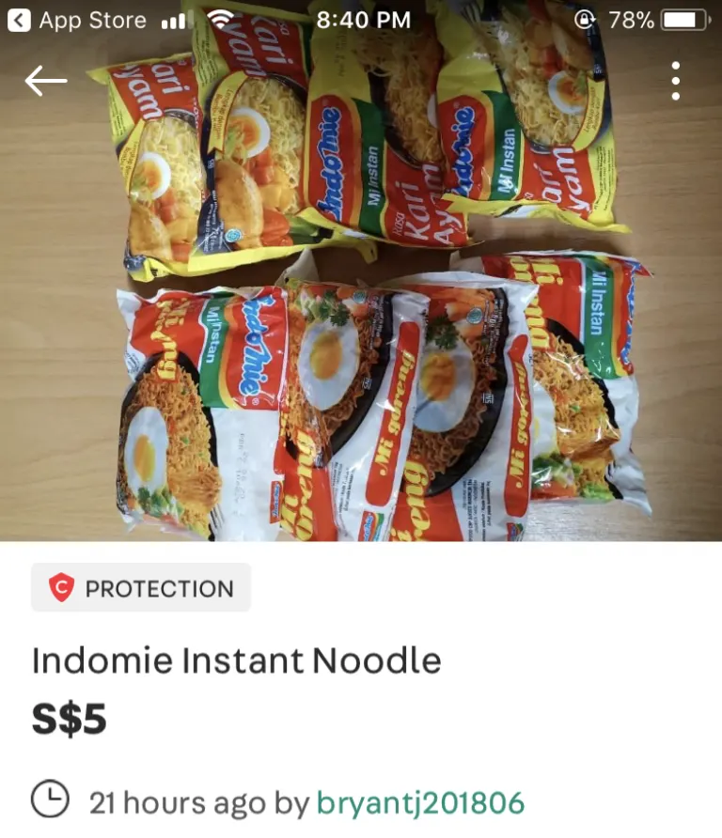
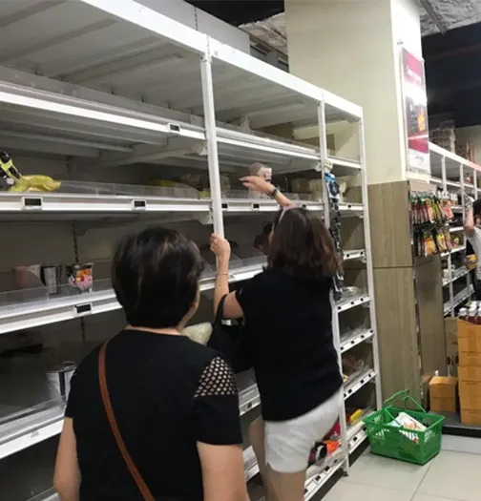

Slide 3
The Maturing Disciple - Reproduction 2 Timothy 2:1-7

Slide 4
If you abide in me, and my words abide in you, ask whatever you wish, and it will be done for you.
By this my Father is glorified, that you bear much fruit and so prove to be my disciples.
Joh 15:7-8

Slide 5
Teacher
Soldier
Athlete
Farmer

Slide 6
1. The Fruit of Teaching
Teacher
2Ti 2:1 You then, my child, be strengthened by the grace that is in Christ Jesus,
2Ti 2:2 and what you have heard from me in the presence of many witnesses entrust to faithful men, who will be able to teach others also.

Slide 7
1. The Fruit of Teaching
Teacher
Act 16:1 Paul came also to Derbe and to Lystra. A disciple was there, named Timothy, the son of a Jewish woman who was a believer, but his father was a Greek.
Act 16:2 He was well spoken of by the brothers at Lystra and Iconium.
Act 16:3 Paul wanted Timothy to accompany him, and he took him and circumcised him because of the Jews who were in those places, for they all knew that his father was a Greek.

Slide 8
2. The Fruit of Good Soldiering
Soldier
2Ti 2:3 Share in suffering as a good soldier of Christ Jesus.
2Ti 2:4 No soldier gets entangled in civilian pursuits, since his aim is to please the one who enlisted him.

Slide 9
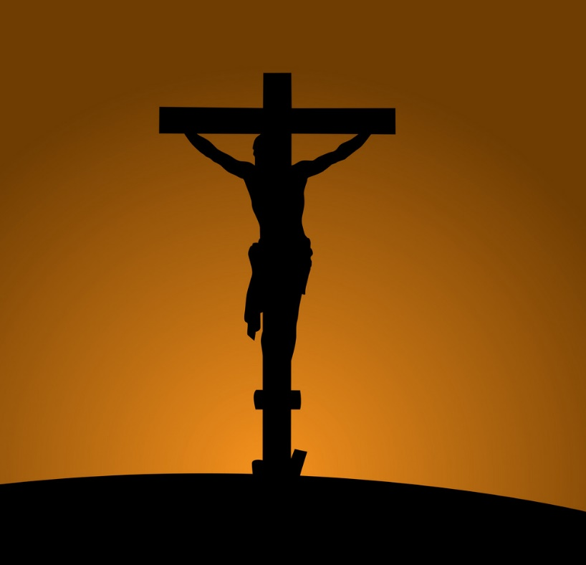
2. The Fruit of Good Soldiering
Soldier
Heb 12:3 Consider (Jesus) who endured from sinners such hostility against himself, so that you may not grow weary or fainthearted.

Slide 10
3. The Fruit of An Abiding Athlete
Athlete
2Ti 2:5 An athlete is not crowned unless he competes according to the rules.

Slide 11
3. The Fruit of An Abiding Athlete
Athlete
Isa 5:20 Woe to those who call evil good and good evil, who put darkness for light and light for darkness.
Judg 21:25 In those days there was no king in Israel. Everyone did what was right in his own eyes.

Slide 12
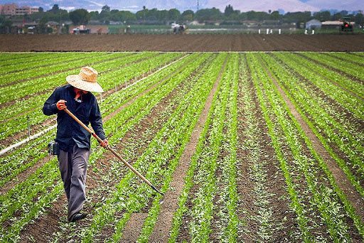
3. The Fruit of Diligent Farming
Farmer
2Ti 2:6 It is the hard-working farmer who ought to have the first share of the crops.

Slide 13
Teacher
Soldier
Athlete
Farmer

