Slide 1
FROM PLAN TO FULFILMENT: The Needed Steps
Luke 24: 44-53 Acts 1: 12-14

Slide 2
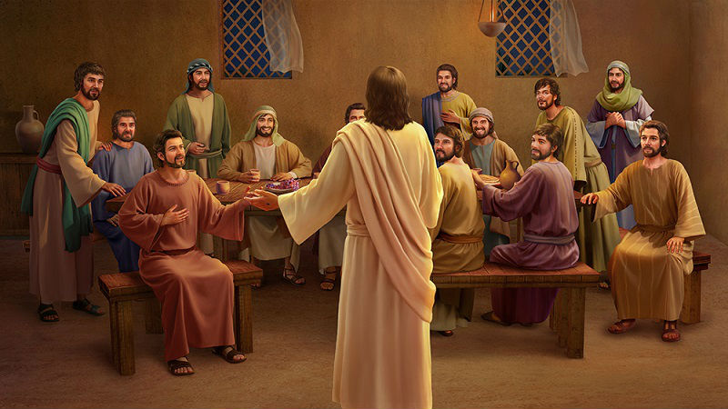
I. CORRECT PERCEPTION OF GOD’S PLAN (Luke 24:44-47)
Contained in Scripture
Revealed by the Lord

Slide 3

II. DIVINE POWER TO ACTUALISE THE PLAN (Luke 24: 48-49, Acts 2)
Miraculous signs
Anointed proclamation

Slide 4
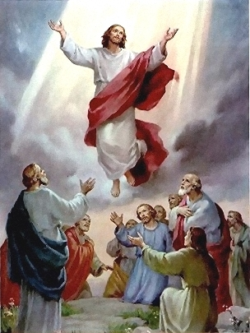
III. A SUSTAINING PICTURE OF JESUS EXALTED (Luke 24: 50-53, Acts 2: 32-33)
The uniqueness of Jesus reigning over all

Slide 5
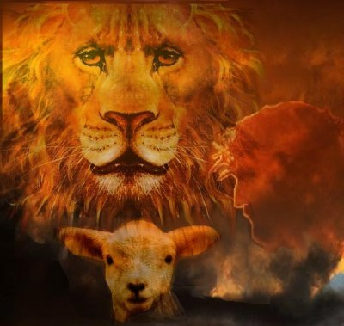
III. A SUSTAINING PICTURE OF JESUS EXALTED (Luke 24: 50-53, Acts 2: 32-33)
The uniqueness of Jesus reigning over all
No enemy can prevail against Him

Slide 6
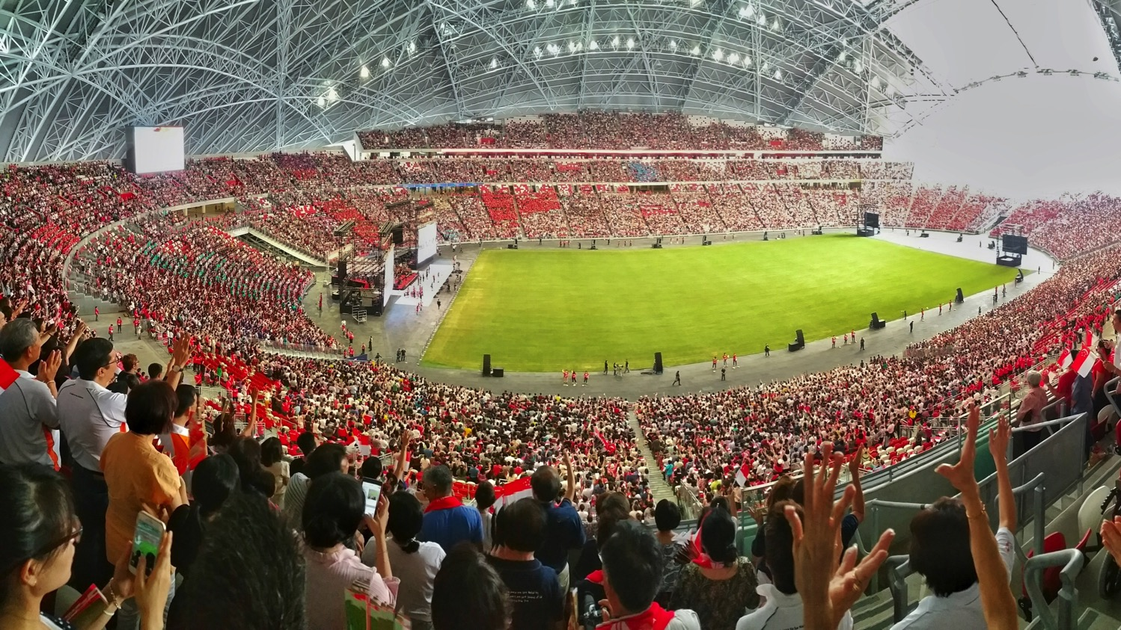
IV. THE UNITED PRAYER OF GOD’S PEOPLE (Acts 1: 12-14)
A wide spectrum, led by the church leaders
CELEBRATION OF HOPE
2018 Year of Prayer 2019 Year of Proclamation
2020 Year of Personal Discipleship

Slide 7

IV. THE UNITED PRAYER OF GOD’S PEOPLE (Acts 1: 12-14)
A wide spectrum, led by the church leaders
One accord, singular focus
CELEBRATION OF HOPE
2018 Year of Prayer 2019 Year of Proclamation
2020 Year of Personal Discipleship

Slide 8
Time to receive a fresh filling of the Holy Spirit

