Slide 1
Living in the Light of God’s Word
PSALM 119:105-112;
MATTHEW 6:25-33

Slide 2
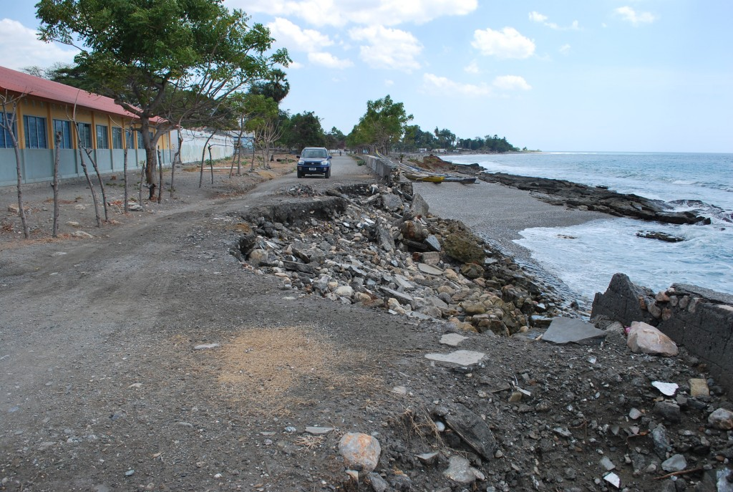
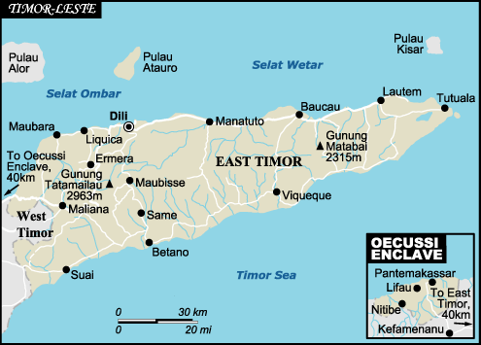

Slide 3
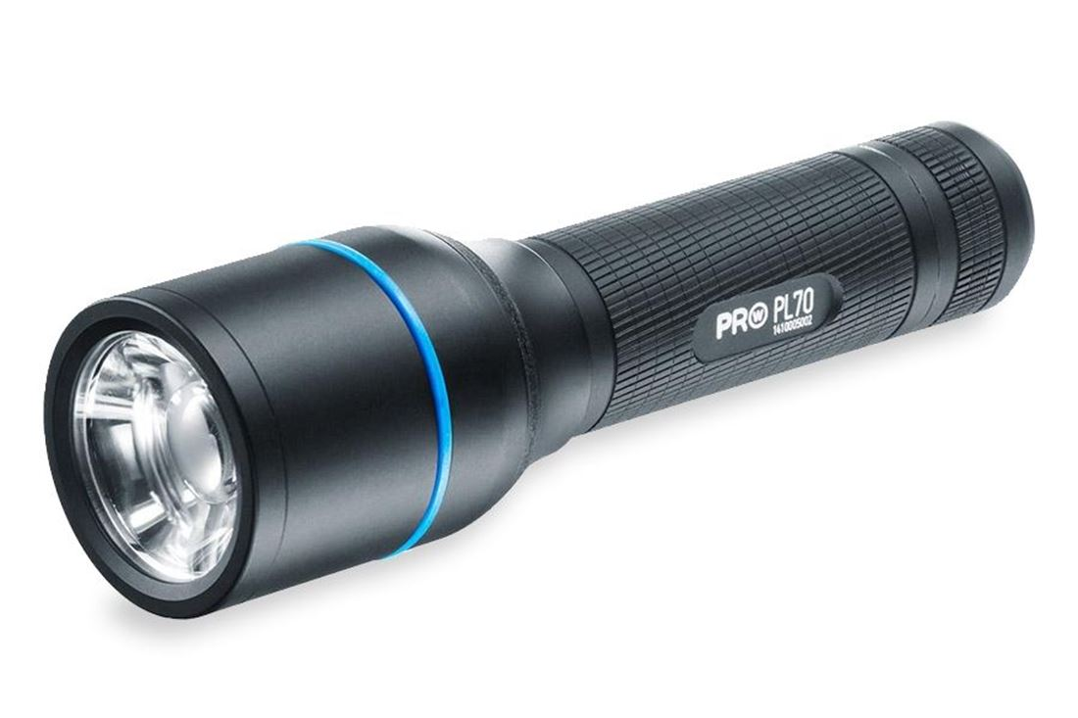

Slide 4
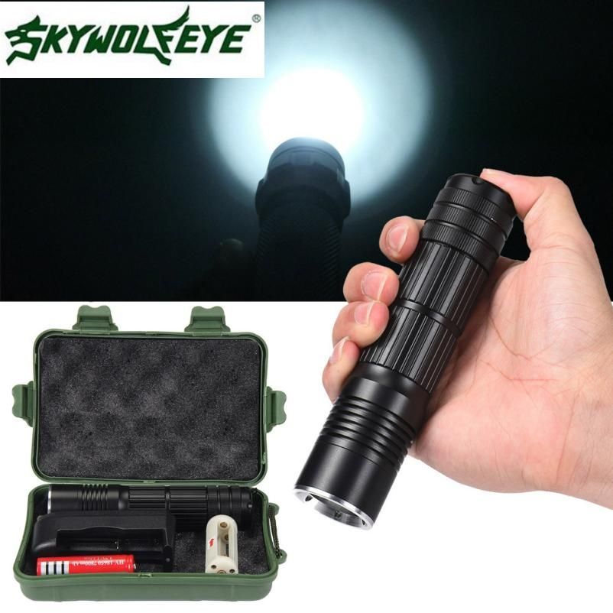
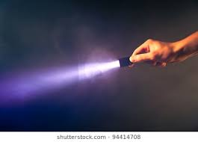

Slide 5
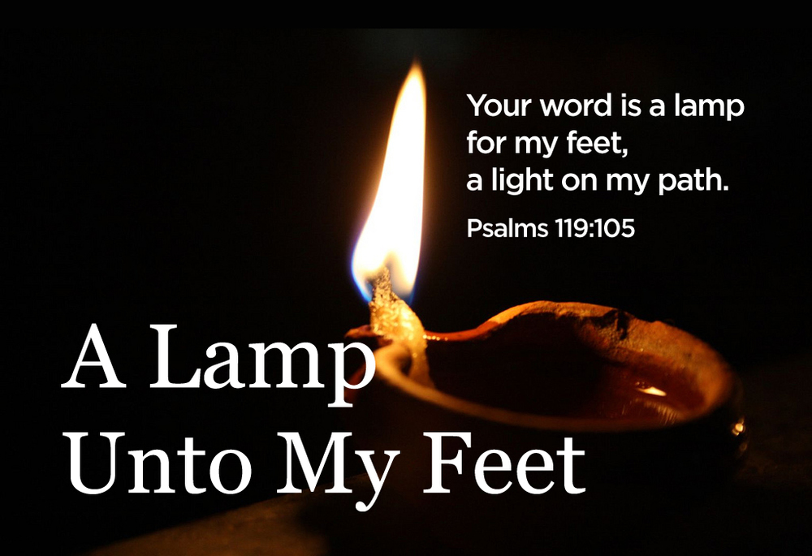

Slide 6
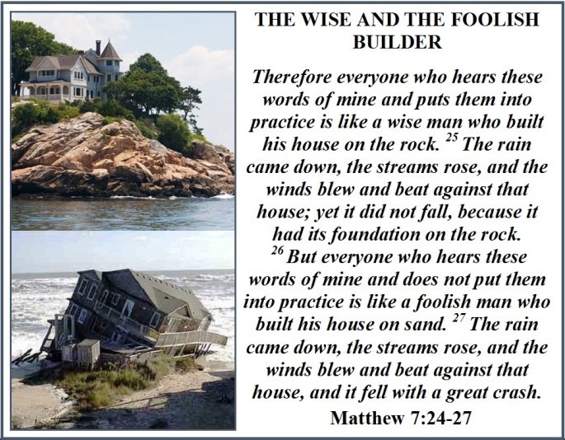

Slide 7
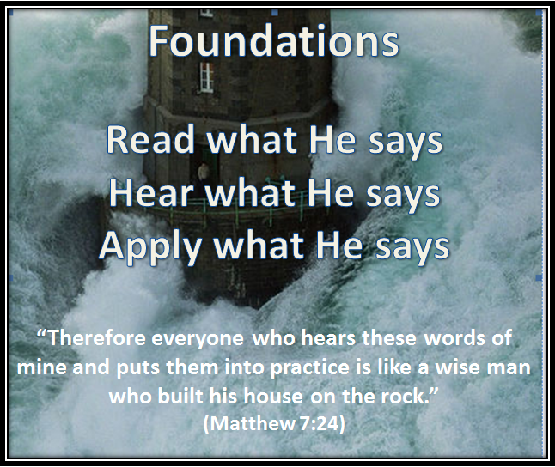

Slide 8
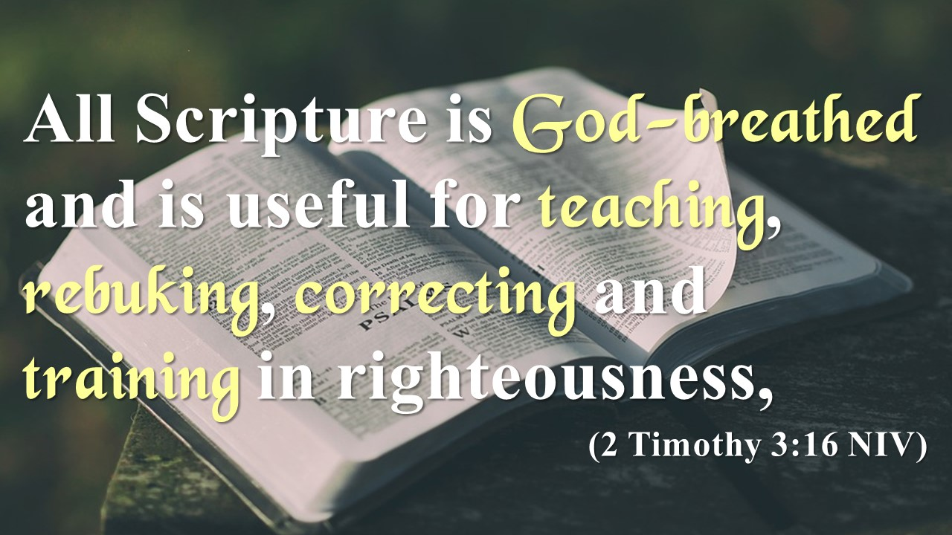

Slide 9
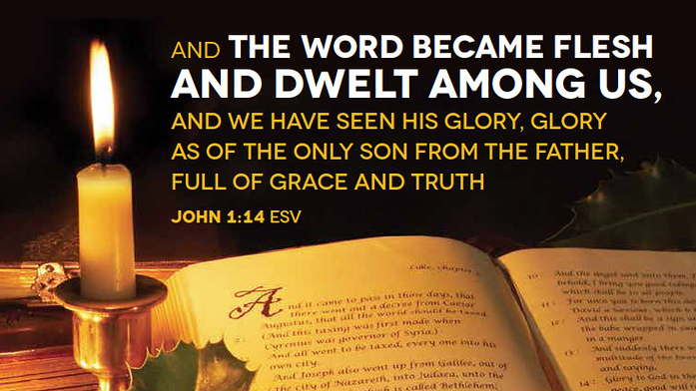

Slide 10
Come & See
Come & Dine
Come & Drink
Come Away with Me
Come to Me

Slide 11
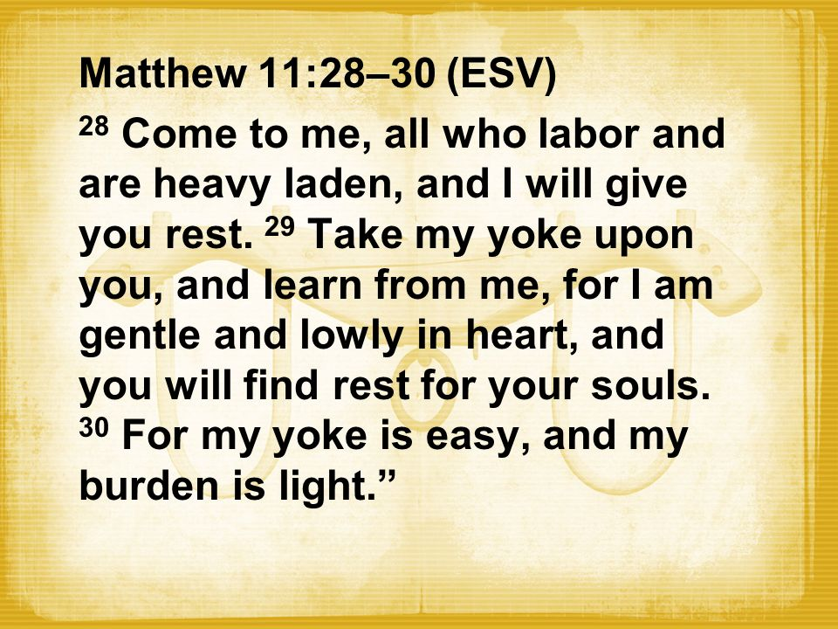

Slide 12
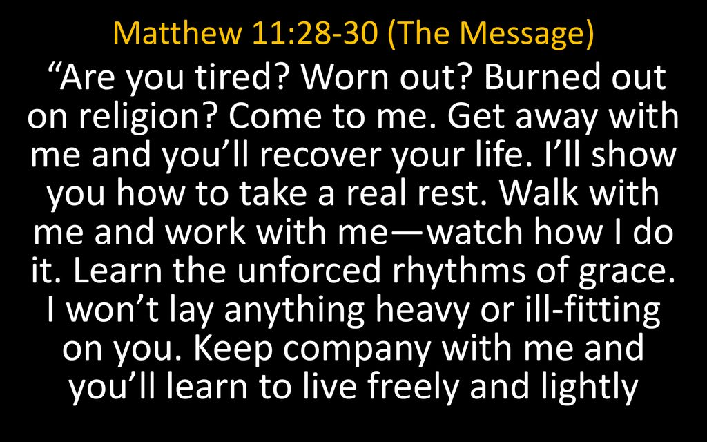

Slide 13
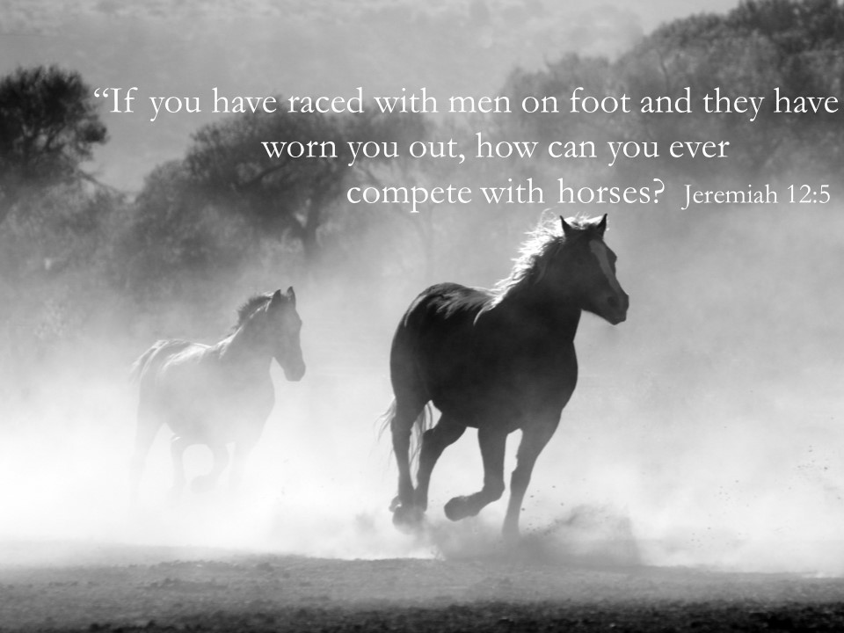

Slide 14
“LORD,
You are my refuge and my fortress,
my God, in whom I trust.
I will trust You
- to deliver me from the snare of the fowler
and from the deadly pestilence.
- to cover me with Your wings,
and under Your wings I will find refuge;

Slide 15
I choose not to fear the terror of the night,
- nor the arrow that flies by day,
- nor the pestilence that stalks in darkness,
- nor the destruction that wastes at noonday…
Because I have made You my dwelling place—
You the Most High, my refuge—
I trust that
- no evil will be allowed to befall me,
- no plague will come near my house…

Slide 16
"Because I hold fast to You in love,
I trust that You will deliver me;
I trust that You will protect me
I trust that with long life You will satisfy me
and show me Your salvation." Amen.

Slide 17
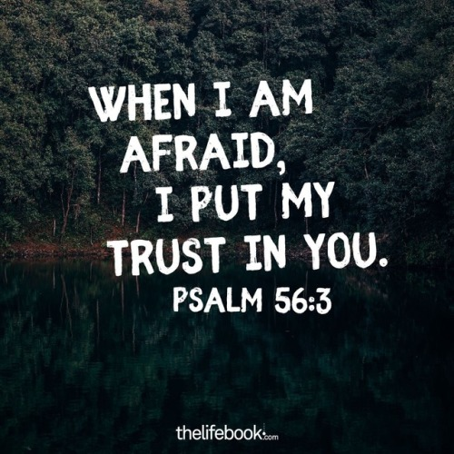

Slide 18
KNOW THE WORD
Hear
Read
Study
Memorise
Meditate
Apply

Slide 19
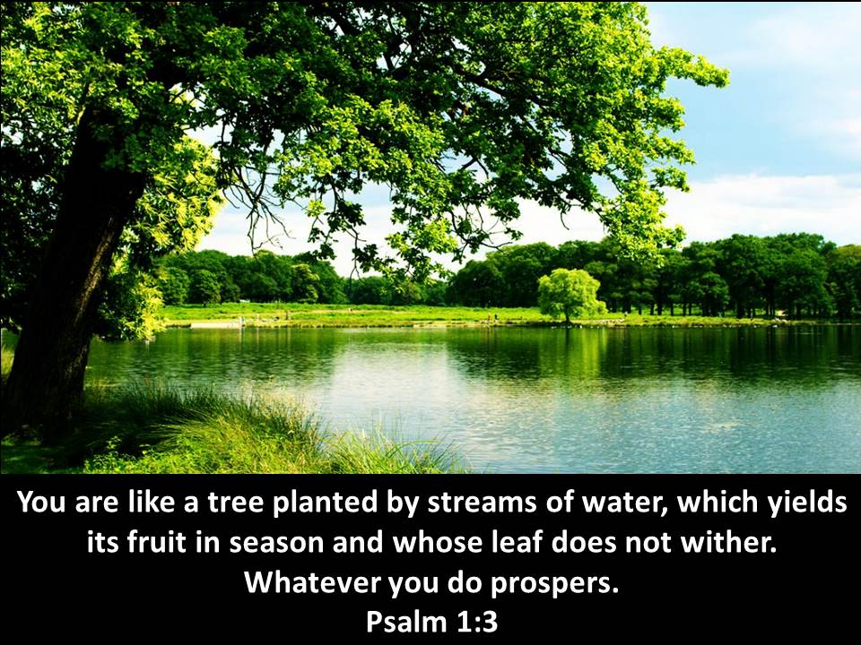

Slide 20
