Slide 1
GROWING CLOSE TO GOD THROUGH HIS WORD
PSALM 119:105; MATTHEW 6:25-33

Slide 2
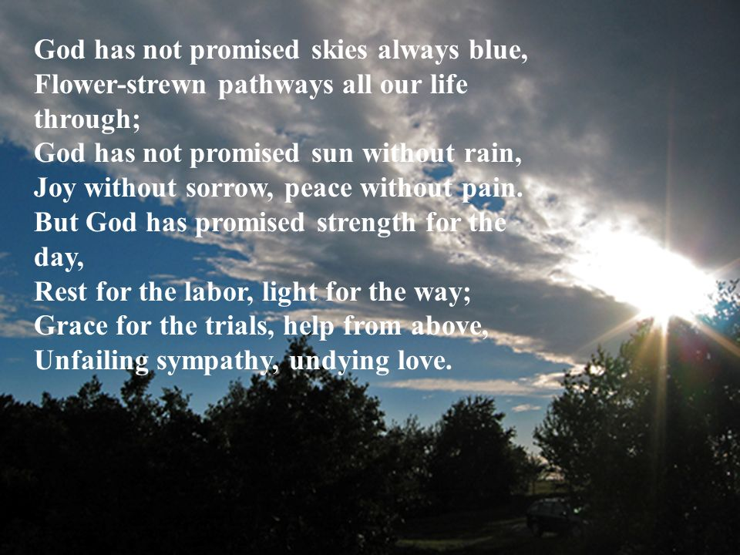

Slide 3


Slide 4
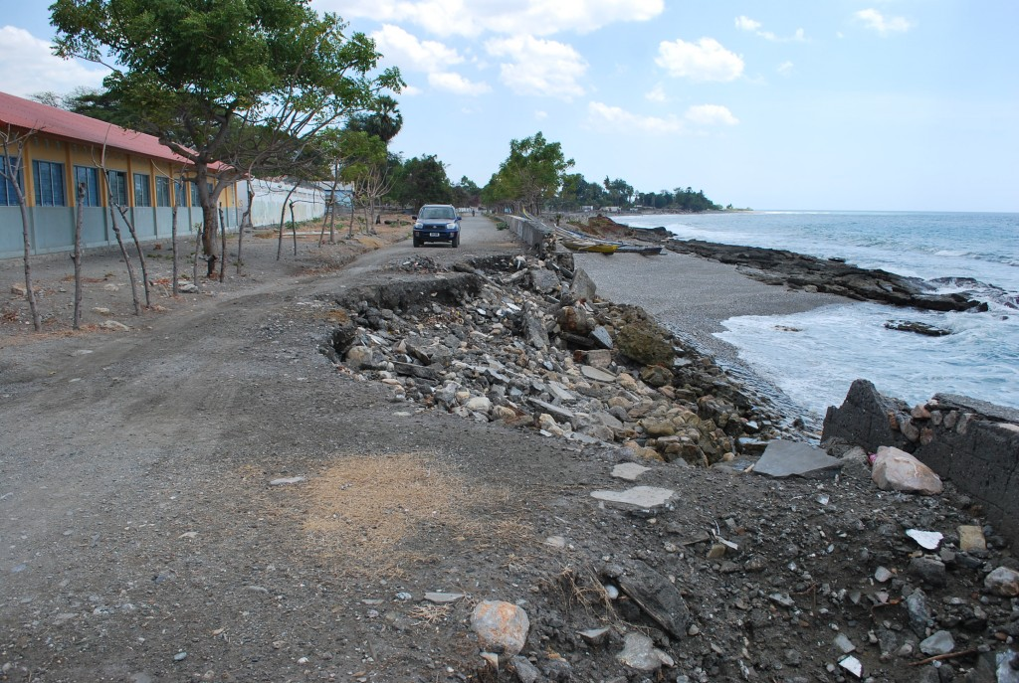
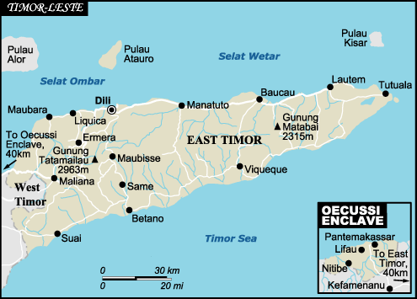

Slide 5
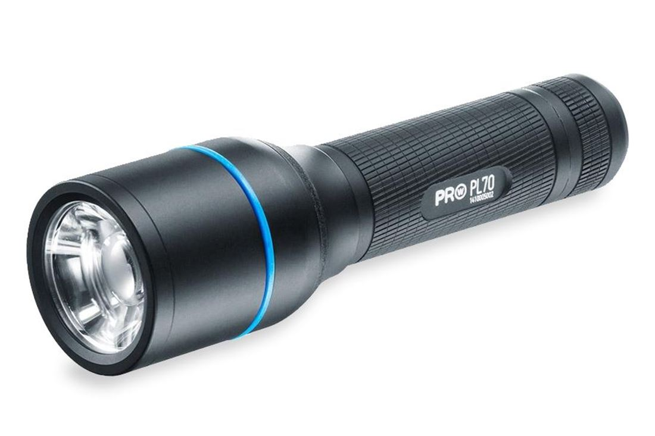

Slide 6



Slide 7


Slide 8
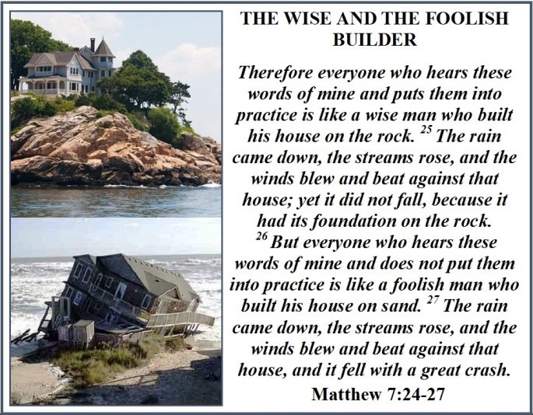

Slide 9



Slide 10
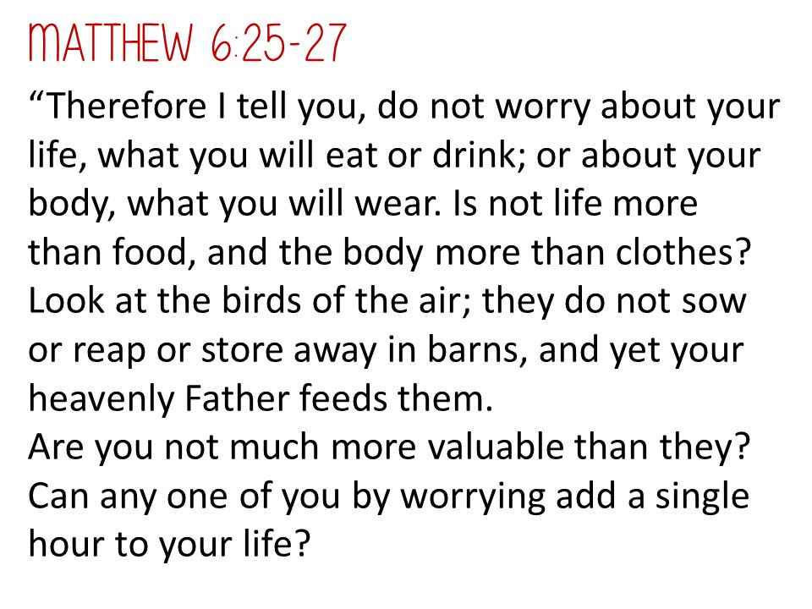

Slide 11
But seek first
the kingdom of God
and his righteousness,
and all these things
will be added to you.
(Matt 6:33 ESV)

Slide 12

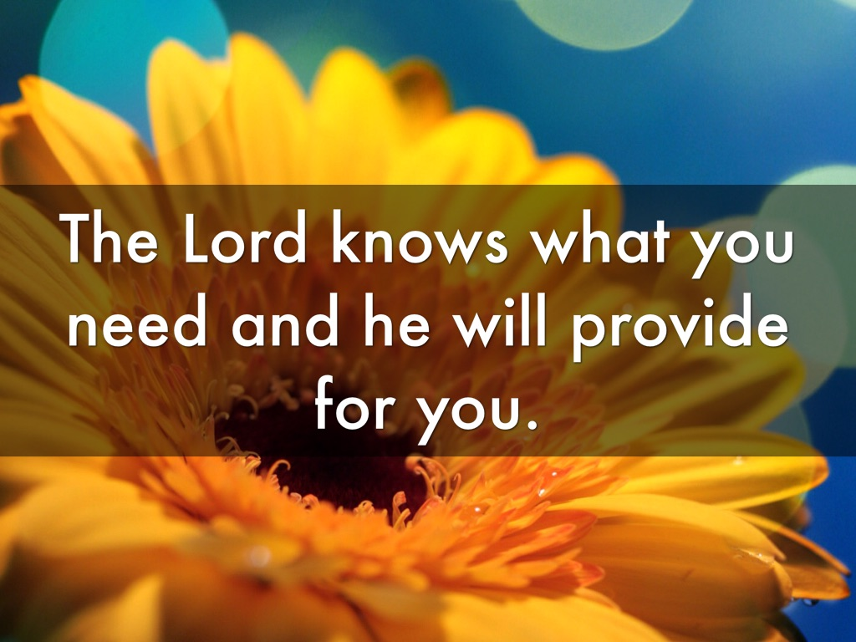

Slide 13
“even to your old age I am He, and to gray hairs I will carry you…” (Isa 46:4 ESV)
‘I have been young, and now am old, yet I have not seen the righteous forsaken or his children begging for bread.’
(Psa 37:25 ESV)

Slide 14
“When life is heavy and hard to take,
Go off by yourself. Enter the silence.
Bow in prayer. Don’t ask questions:
Wait for hope to appear… …
His stockpiles of loyal love are immense.”
(Lam 3:28, 32, The Message)

Slide 15
Now when Jesus heard this,
he withdrew from there in a boat
to a desolate place
by himself.
(Matt 14:13 ESV)

Slide 16
KNOW THE WORD
Hear
Read
Study
Memorise
Meditate
Apply

Slide 17
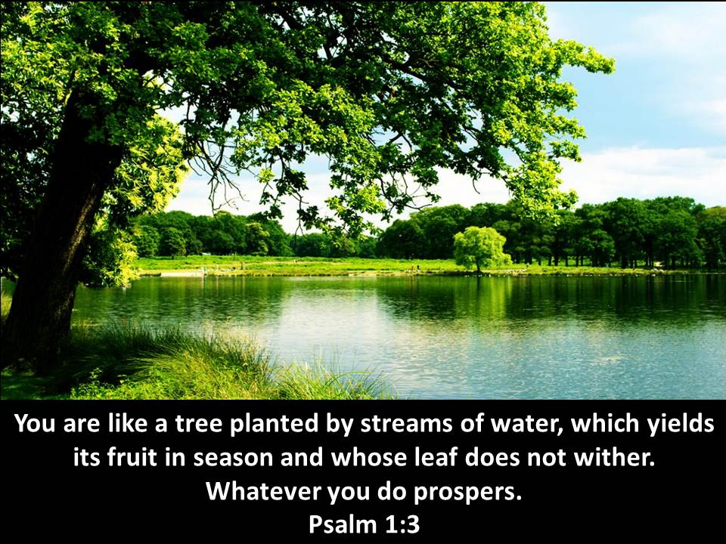

Slide 18
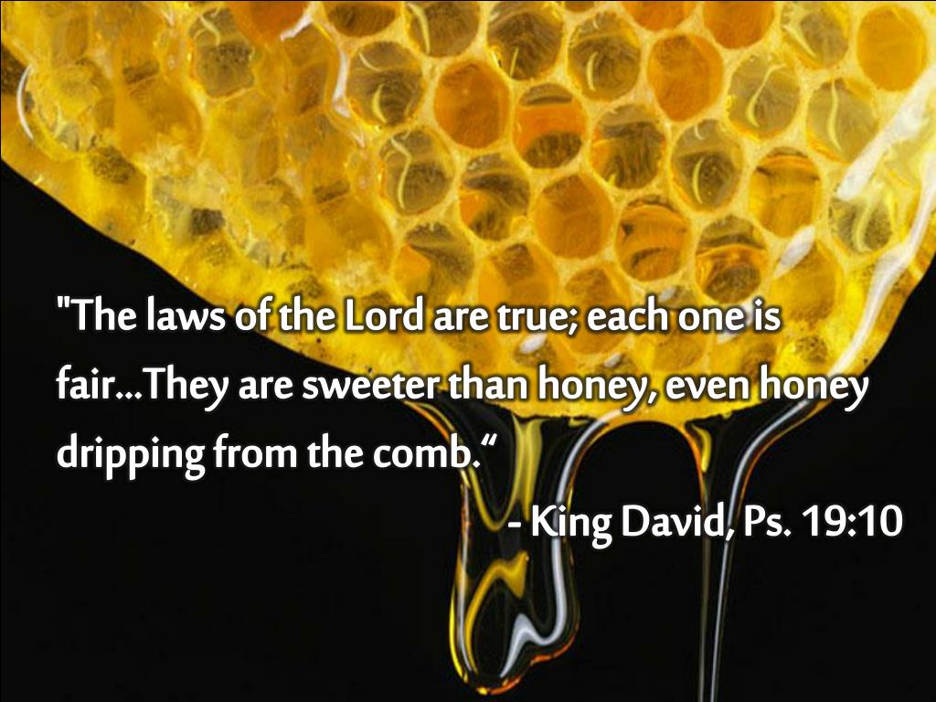

Slide 19

YOUR WORD is
a LAMP to my feet
and a LIGHT to my path
(Palm 119:105)

