Slide 1
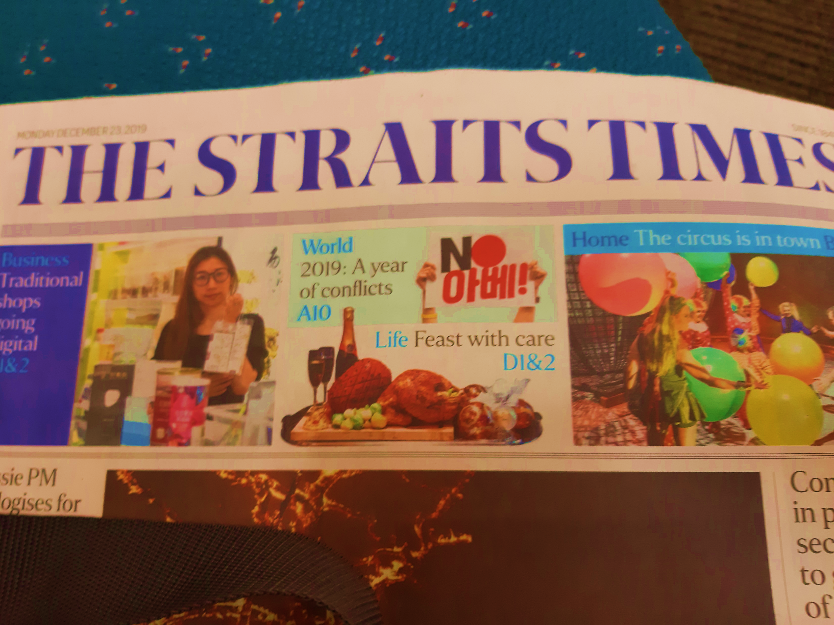

Slide 2

Bless the LORD, O my soul, and all that is within me, bless his holy name! Bless the Lord, O my soul, and forget not all his benefits
Ps 103:1-2

Slide 3

inner being
thoughts
emotions
will
nephesh

Slide 4
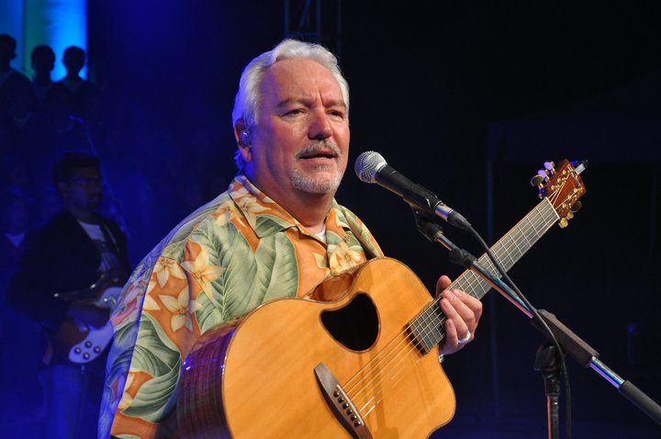
Paul Wilbur

Slide 5
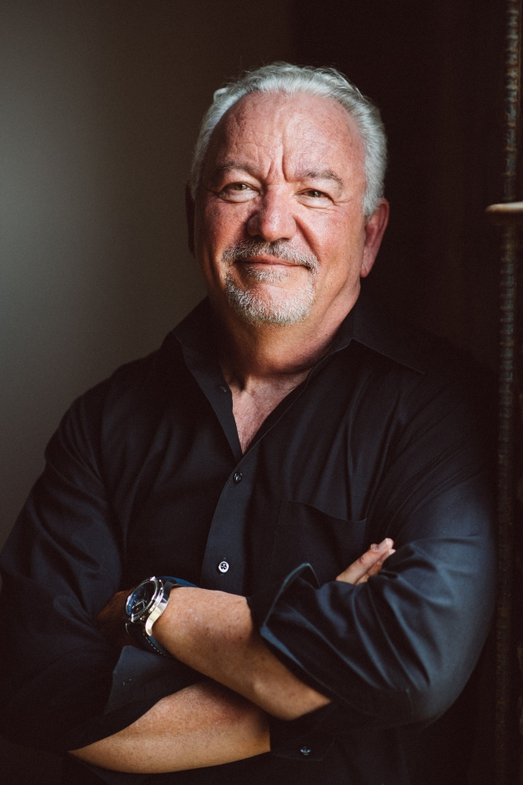
All that is within me” carries with it even the physical parts of a man’s core ... his organs.
Paul Wilbur,
Shalom in Psalms

Slide 6

Give thanks

Slide 7
Give thanks
Spiritual
blessings

Slide 8
I acknowledged my sin to you, and I did not cover my iniquity; I said, “I will confess my transgressions to the LORD,” and you forgave the iniquity of my sin.
Ps 32:5

Slide 9
Sin : chattataath
falling away, missing the right path
Transgression : pesha
violation of Torah through ignorance
Iniquity : avon
perversity, depravity

Slide 10

Bless the Lord, O my soul, and forget not all his benefits, who forgives all your iniquity
Ps 103:2-3

Slide 11

Ps 103:12
As far as the east is from the west, so far does he remove our transgressions from us

Slide 12


Slide 13
Give thanks
Spiritual
blessings
Physical
blessings

Slide 14

who forgives all your iniquity,
who heals all your diseases
Ps 103:3

Slide 15
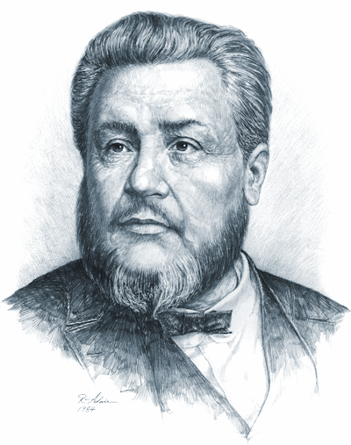
Charles Spurgeon

Slide 16
And Jesus went about all Galilee, teaching in their synagogues, and preaching the gospel of the kingdom, and healing all manner of sickness and all manner of disease among the people
I
Mat 4:23 KJV

Slide 17

Ps 103:5
who satisfies you with good so that your youth is renewed like the eagle's

Slide 18


Slide 19
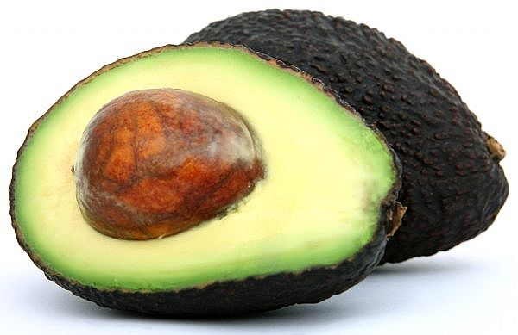

Slide 20
Ps 103:5
who satisfies you with good so that your youth is renewed like the eagle's

Slide 21
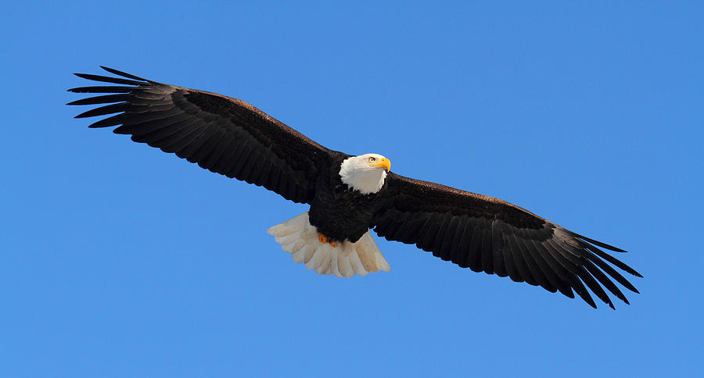

Slide 22
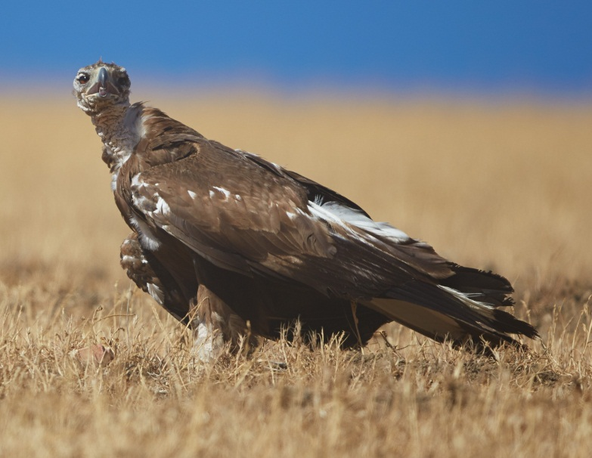

Slide 23
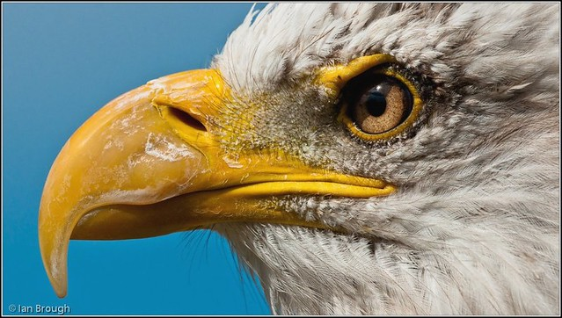

Slide 24
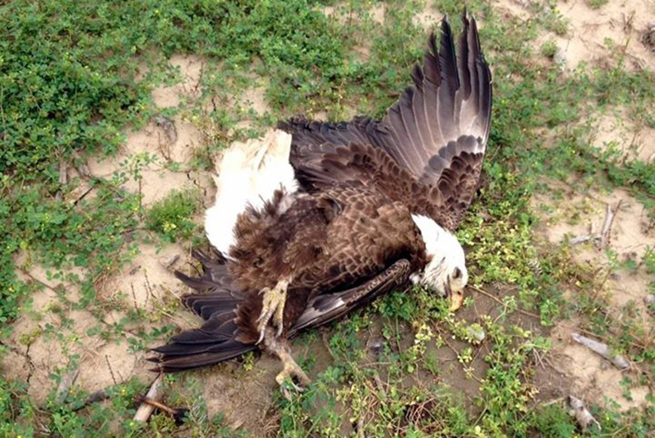

Slide 25


Slide 26
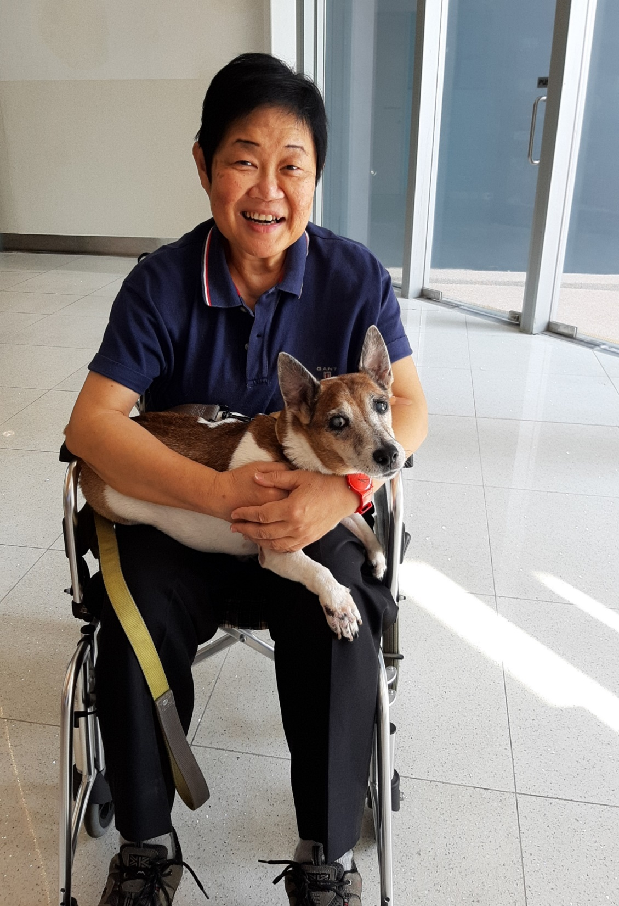

Slide 27


