Slide 1
If only it were mine!

Slide 2
You shall not covet your neighbor's house; you shall not covet your neighbor's wife, or his male servant, or his female servant, or his ox, or his donkey, or anything that is your neighbor's
Ex 20:17

Slide 3
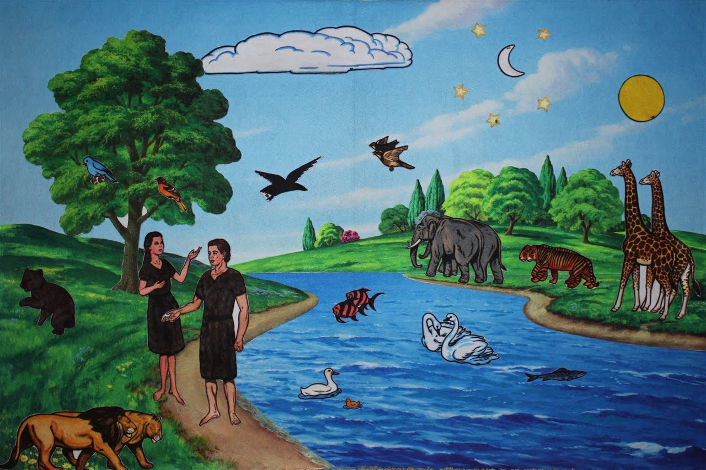

Slide 4
Take care, and be on your guard against all covetousness, for one's life does not consist in the abundance of his possessions
Lk 12:15

Slide 5
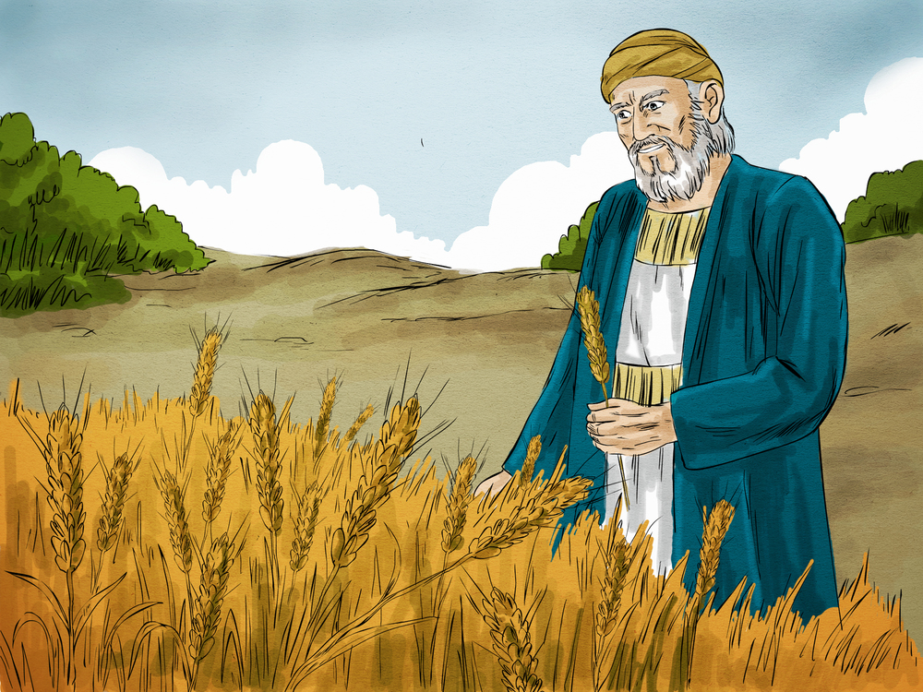
Parable of the rich fool

Slide 6
For the love of money is the root of all evil: which while some coveted after, they have erred from the faith, and pierced themselves through with many sorrows
1 Tim 6:10

Slide 7
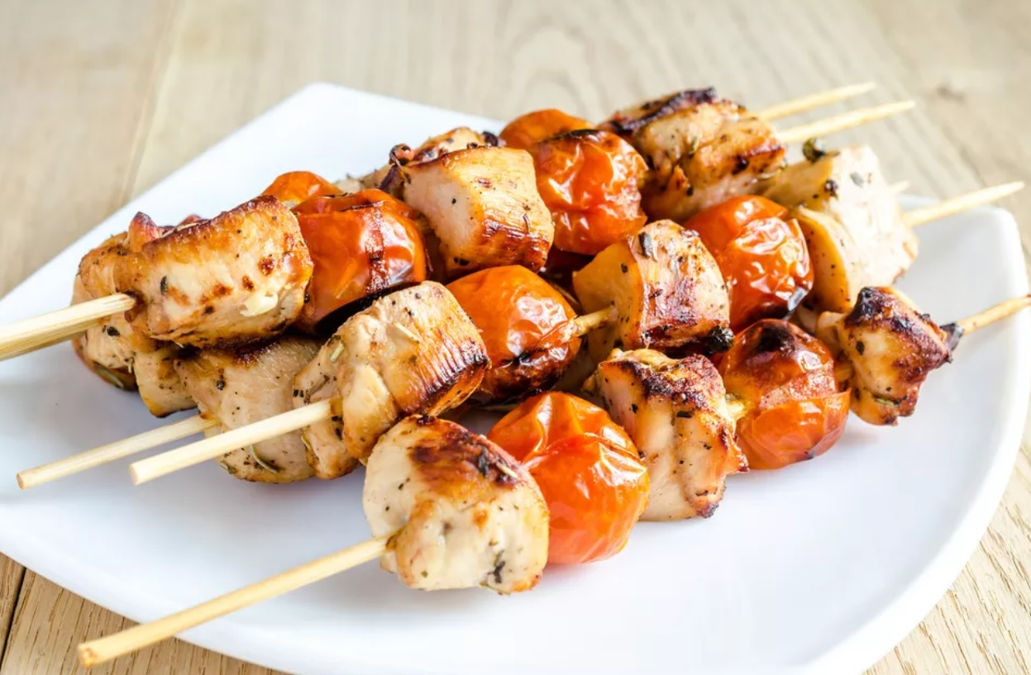
kebab

Slide 8
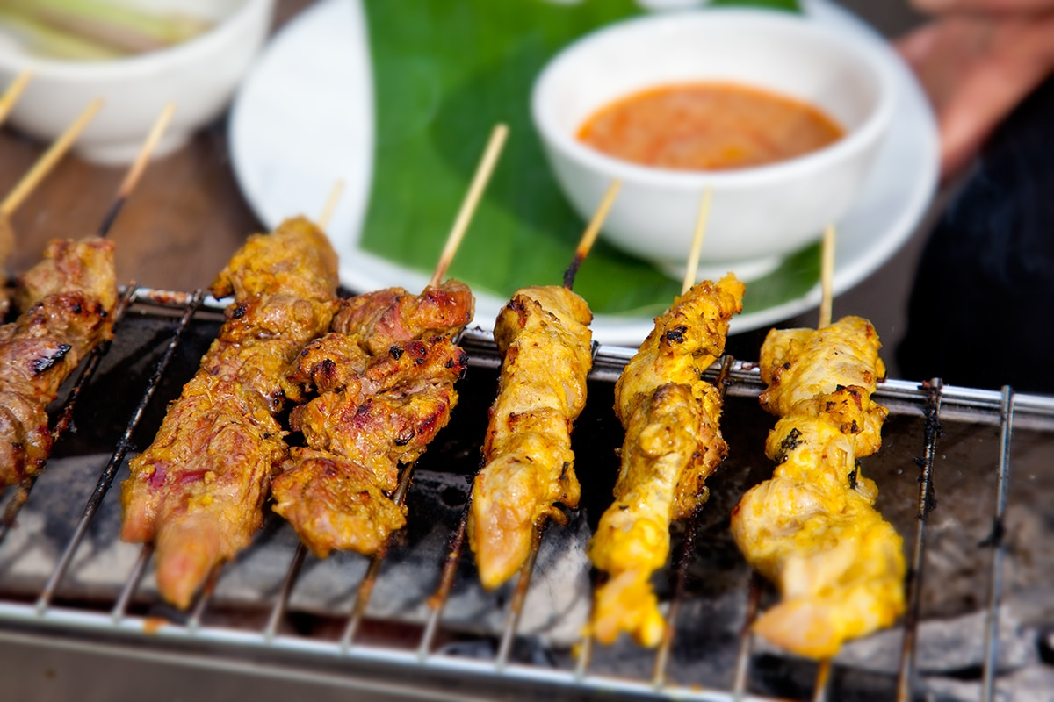
satay

Slide 9
Put to death therefore what is earthly in you: sexual immorality, impurity,
passion, evil desire, and covetousness, which is idolatry
Col 3:5

Slide 10
C1
Love God with all your heart, soul, mind and strength
C2
You shall have no idols

Slide 11
Deut 17:2-5
Death penalty
1 Cor 6:9-10
Can’t inherit the kingdom
of heaven

Slide 12
covetousness
No!
contentment
Yes!

Slide 13
Keep your life free from love of money, and be content with what you have, for he has said, “I will never leave you nor forsake you”
Heb 13:5

Slide 14
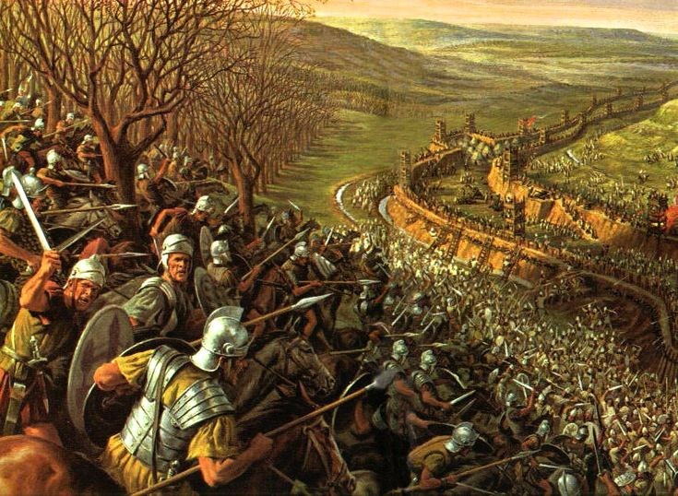

Slide 15
If we have food and clothing, with these we will be content
1 Tim 6:8

Slide 16
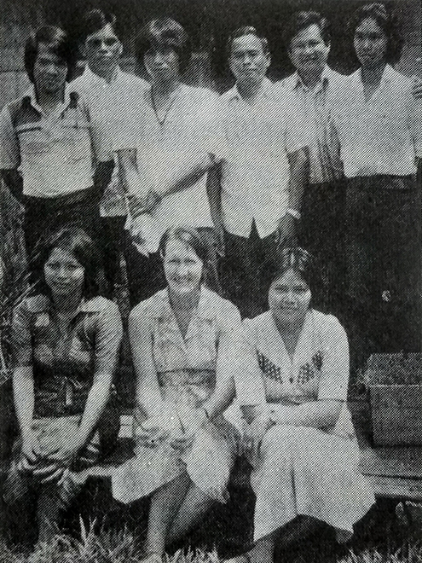
Sylvia Jeanes

Slide 17
sarong

Slide 18
Of course we would not dare classify ourselves or compare ourselves with those who rate themselves so highly
2 Cor 10:12

