Slide 1
Time to Rest and More

Slide 4
Six days of work
One day of rest

Slide 5
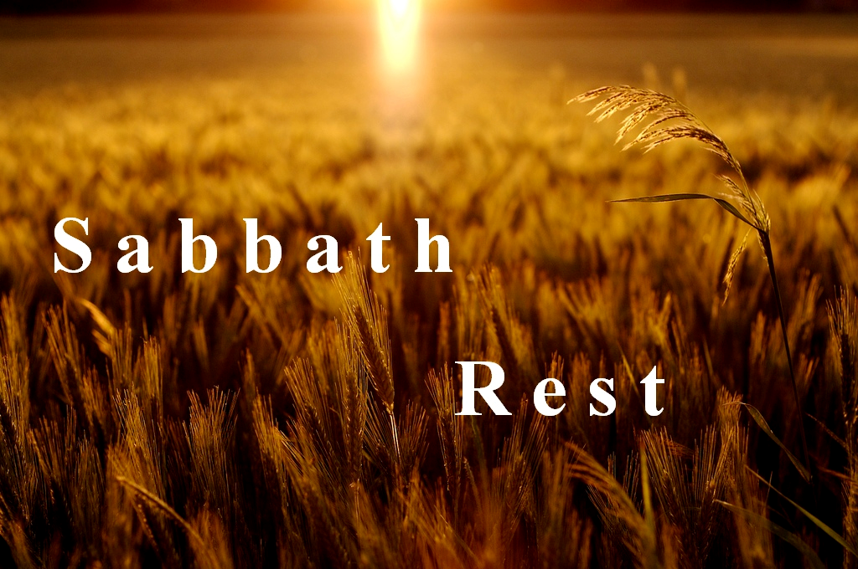
“A day of cessation for religious reasons, a day designed to interrupt the normal activity of work.” (John Durham)

Slide 7
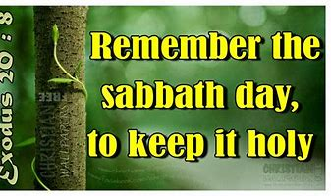

Slide 8
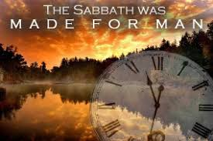
Six day you shall labor, and do all your work, but the seventh day is a Sabbath to the LORD your God.

Slide 9
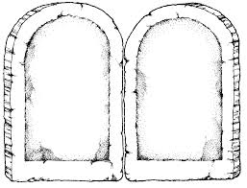
Love God only
No idols
Don’t abuse God’s Name
Keep the Sabbath Holy
Honour your father & mother
Do not murder
Do not commit adultery
Do not steal
Do not bear false witness
Do not covet.

Slide 10
“For in six days the LORD made heaven and earth, the sea and all that is in them, and rested the seventh day.”

Slide 11
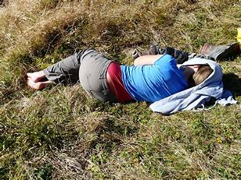
Physical rest

Slide 12
Emotional rest

Slide 13
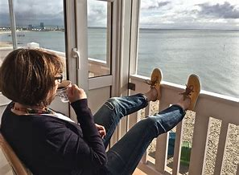
Mental rest

Slide 14
In Sabbath rest:
We re-order our priorities
God enables us to make choices that reflect His values, so that we become the people He designed us to be.

Slide 15
We are not enslaved to time but as we embrace time we squander less of it on the accumulation of material things and bring eternal values into all the days of our work (adapted from Marva Dawn).

