Slide 1
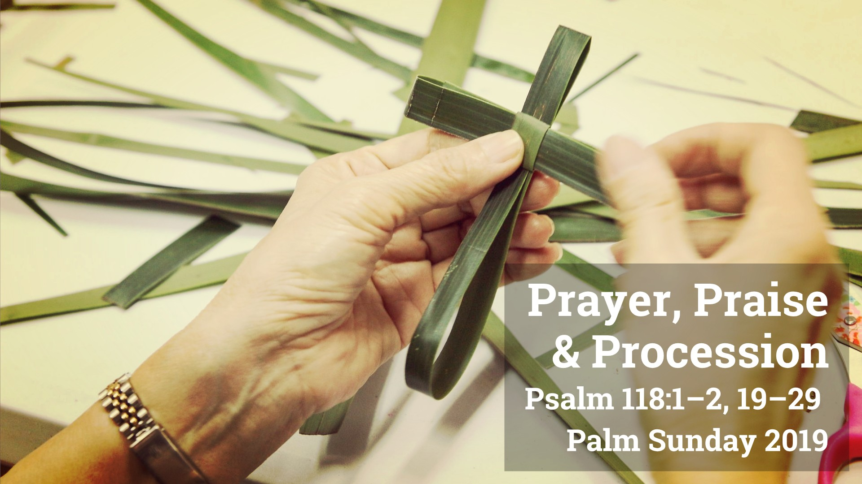

Slide 2
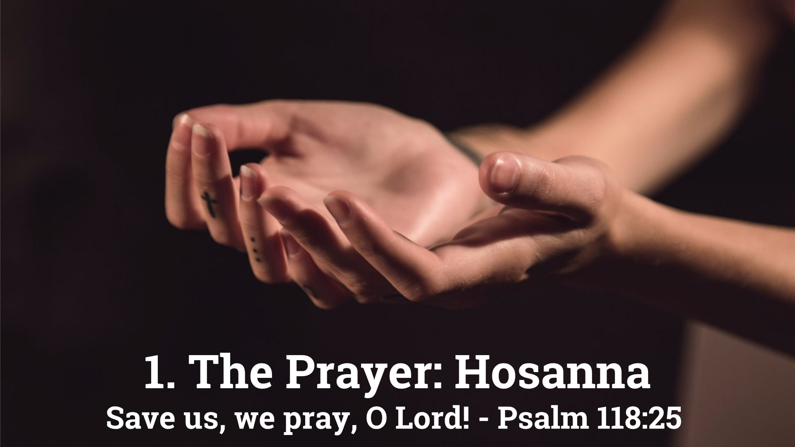

Slide 3
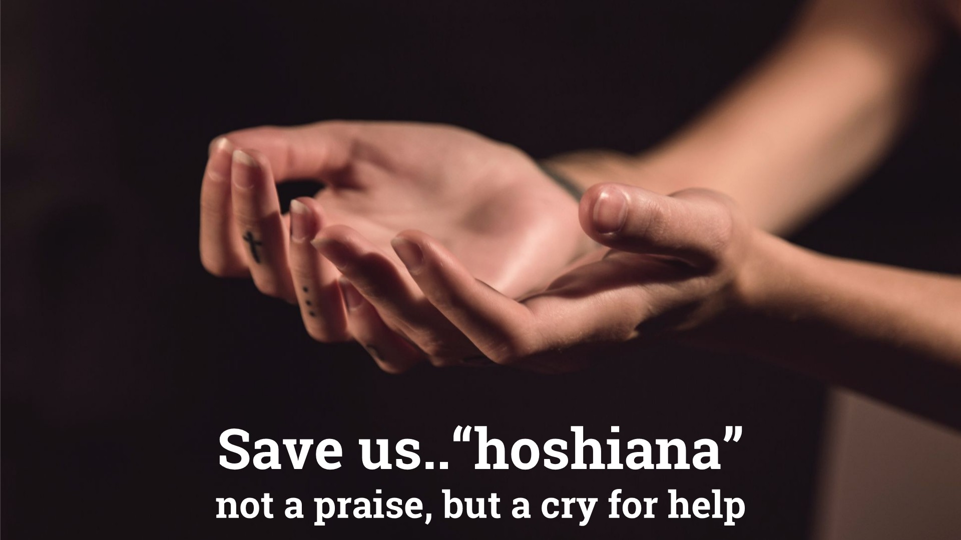

Slide 4
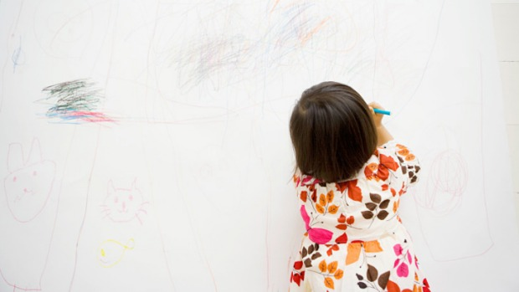
Can a child draw a bad picture?
Truly, I say to you, whoever does not receive the kingdom of God like a child shall not enter it.”
Mark 10:15

Slide 5
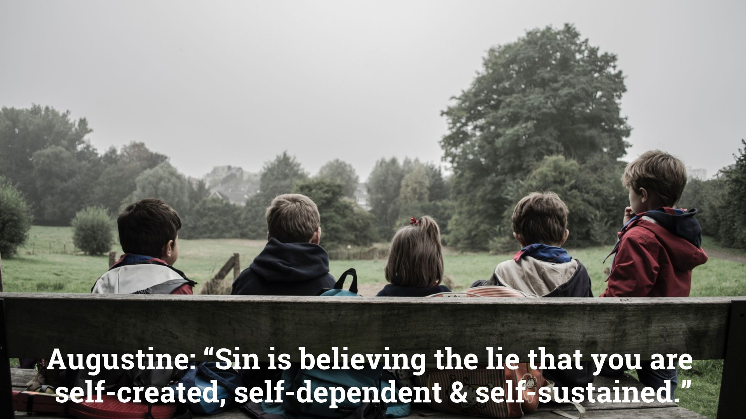

Slide 6
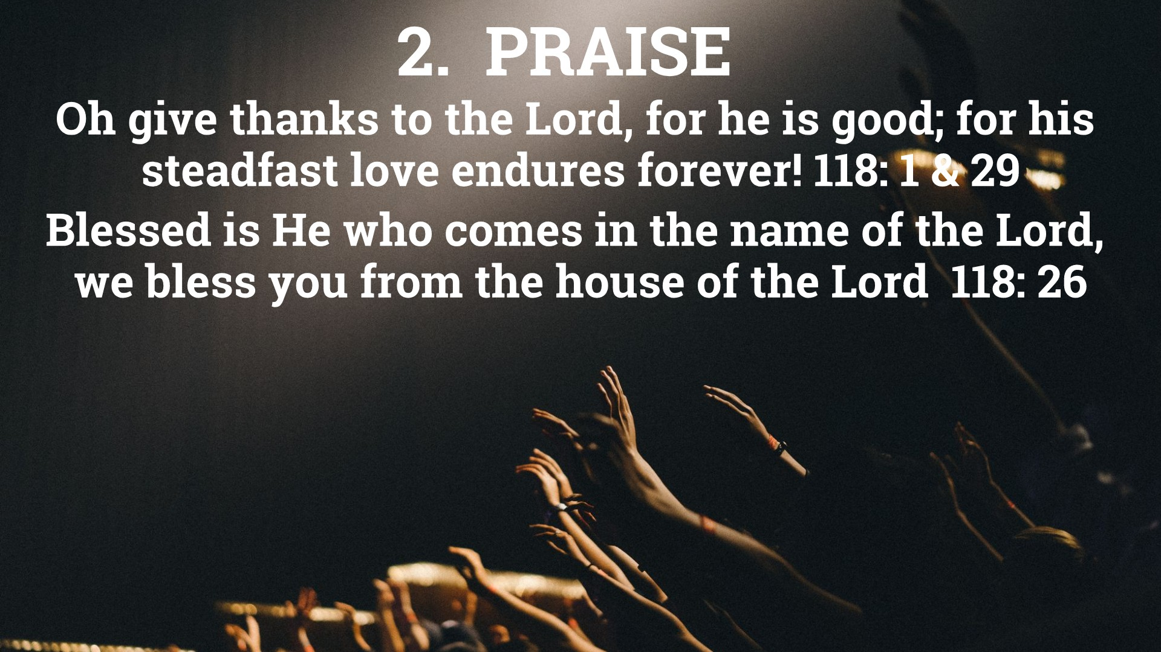

Slide 7
Oh Give thanks to the Lord for He is good,
for His steadfast love endures forever…

Slide 8
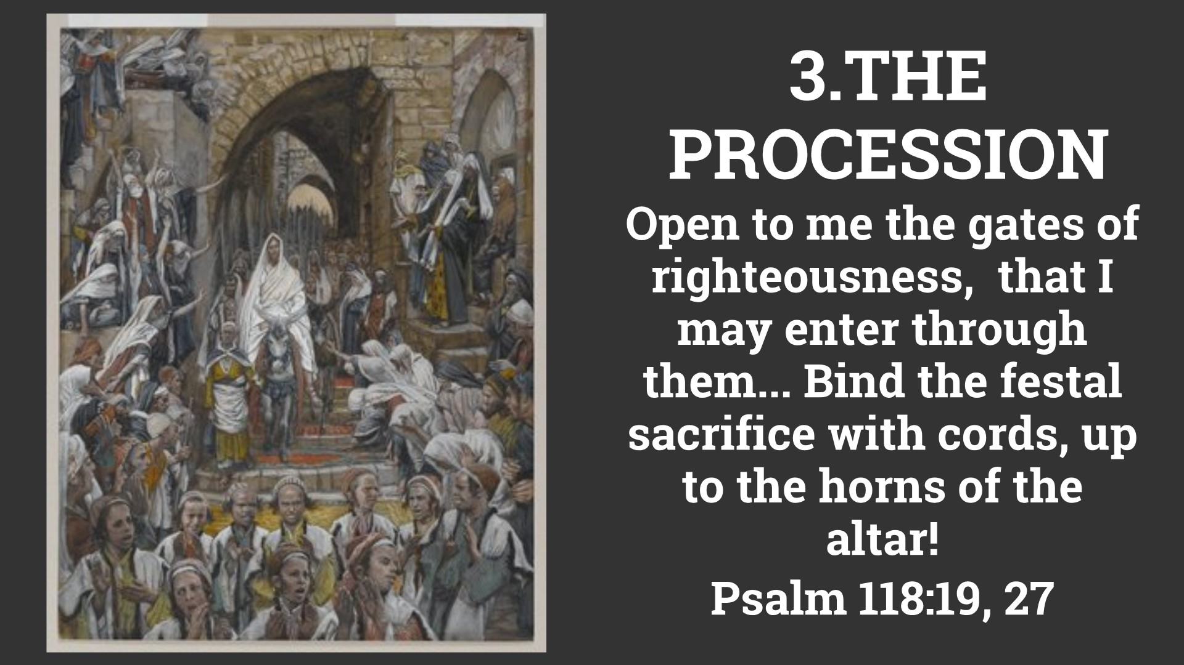

Slide 9
The stone that the builders rejected has become the cornerstone. This is the Lord's doing; it is marvelous in our eyes. Psalm 118:22,23

Slide 10
I appeal to you therefore, brothers, by the mercies of God, to present your bodies as a living sacrifice, holy and acceptable to God, which is your spiritual worship. St Paul in Romans 12:1

Slide 11
Do not be conformed to this world, but be transformed…
St Paul in Romans 12:2

Slide 12
