Slide 1
Faith and Science

Slide 2
Focus Question
How can we navigate our beliefs about the relationship between faith and science?
Two Takeaway Points

Slide 3
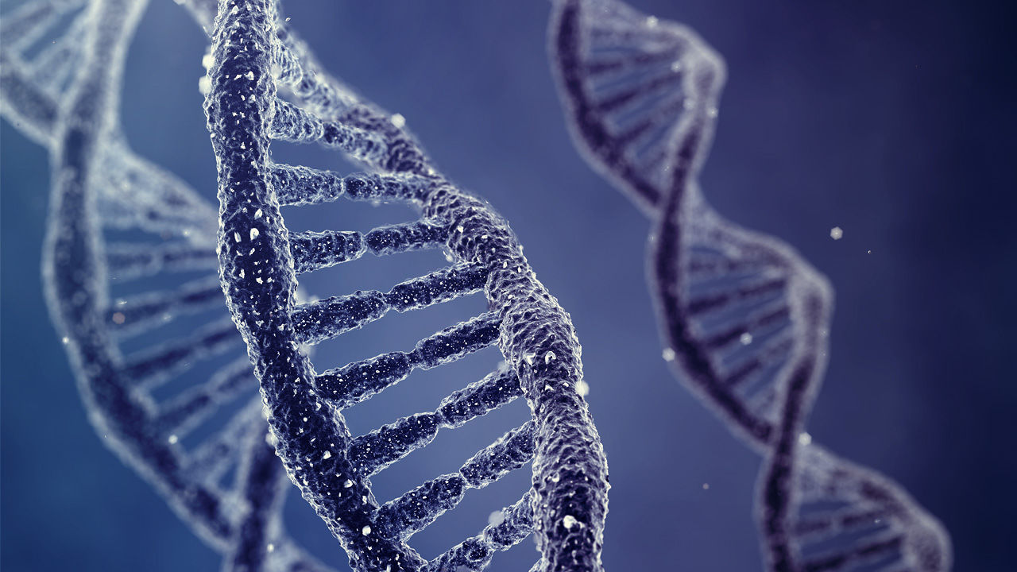
Creation versus Evolution

Slide 4
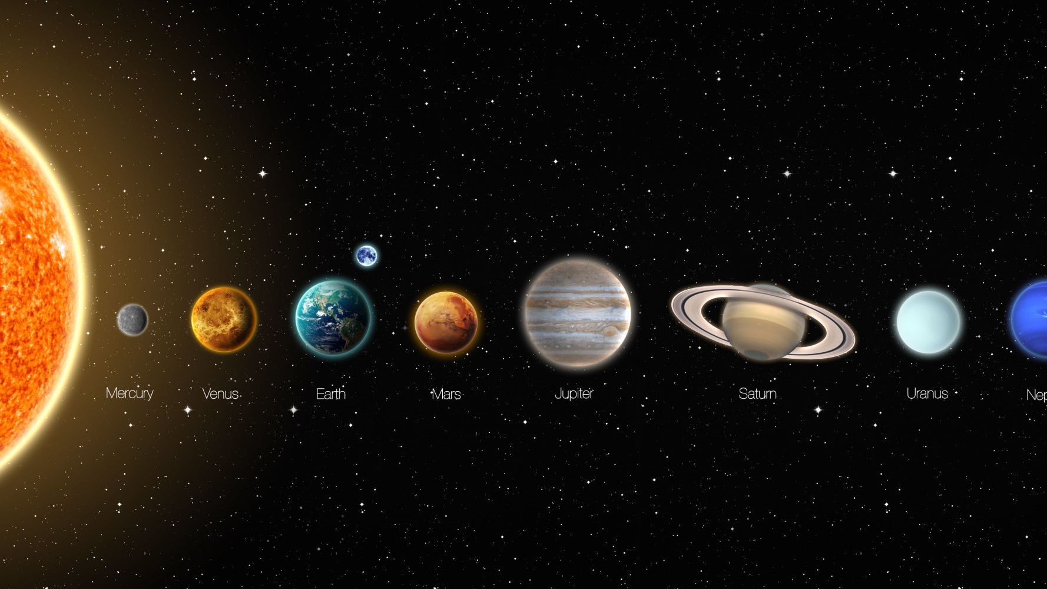
The Galileo Affair

Slide 5
Miracles

Slide 6
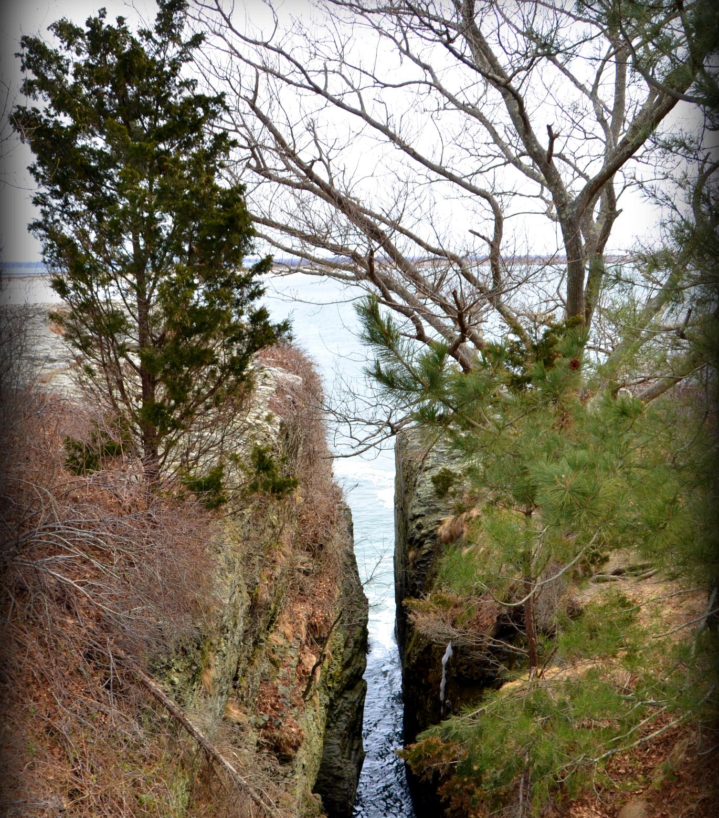
What has led to the perceived split between science and faith?

Slide 7
The Origin of Modern Science
Pioneer scientists assumed that there were regularities in nature which could be discovered.
They did not believe that things happened randomly.
God created the universe with intention. The universe reflects a rational pattern that that is discoverable.

Slide 8
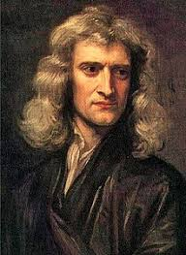
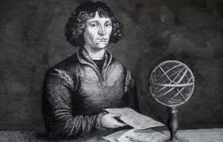
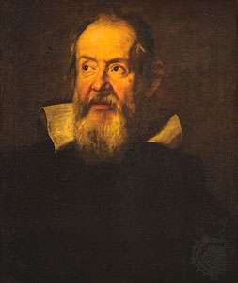
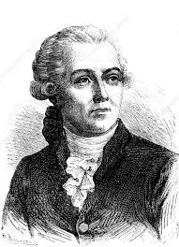
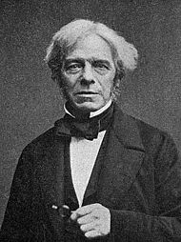
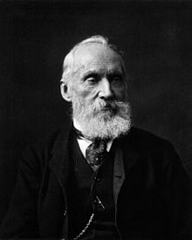

Slide 9
Theological Motivation
The fall damaged humanity’s intellectual capacities.
Science could restore to humanity some knowledge of the world that had been lost because of the fall so that they could once again obey God’s command to rule over the earth (Gen. 1:28)

Slide 10
Why does there seem to be such a great divide today?
1. Changes to the way scripture was read after the Protestant Reformation
2. Scientists discover things about the world that did not agree with Scripture

Slide 11
Literal versus Symbolic

Slide 12
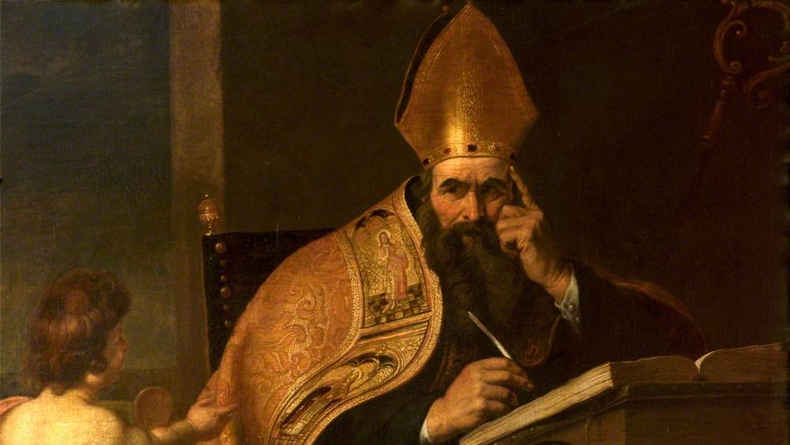
Saint Augustine
Creation happened at once, and then seeded with the potential to grow and change over time (De Genesi ad Litteram)
Separation of light and darkness = good and bad spirits
Heavenly lights = spiritual gifts
Trees = good works
The command to have dominion over the animals = command for people to control their passions (De Civitate Dei)

Slide 13
Noah’s Ark
A symbol of the Church, destined for salvation against the flood of sinful passions.
Measurements of the ark pointed to important events in the scriptures.
The breadth of the ark, fifty cubits, symbolizes the fifty days between the celebration of Passover and Pentecost

Slide 14
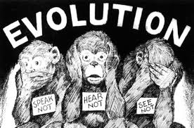
New Theories
Geological evidence for an old earth
Evidence that animals, including humans, have an evolutionary history

Slide 15
Recap
Science and faith were buddies
The literal reading of Scripture became more popular. Scripture and science now overlapped and could disprove one another
People assume that science disproves faith

Slide 16
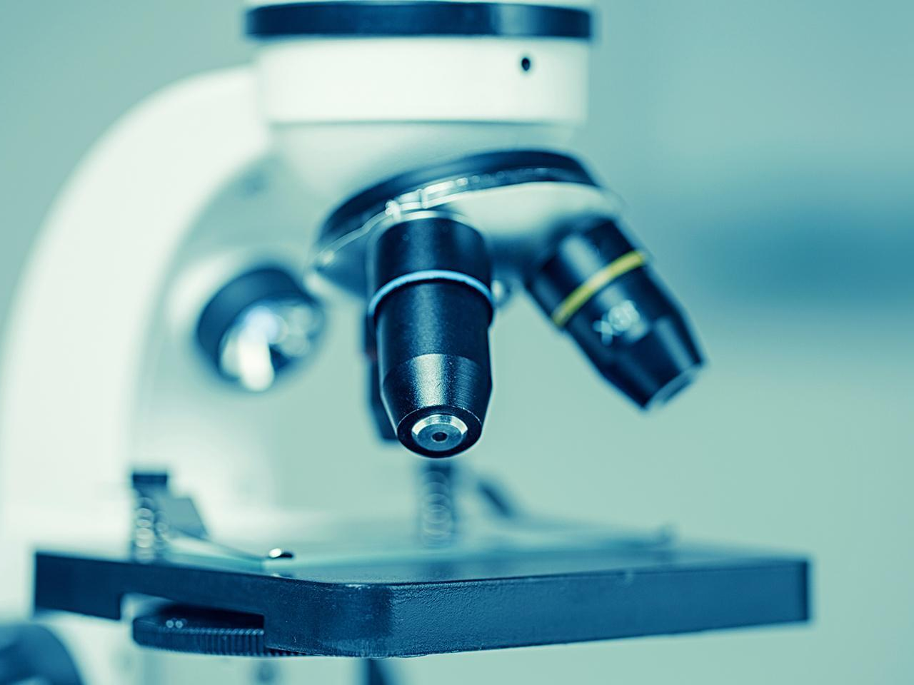
How can the faithful navigate their beliefs today?
Reading Scripture
Understanding Science

Slide 17
II Timothy 3:16
All Scripture is God-breathed and is useful for teaching, rebuking, correcting and training in righteousness, so that the servant of God may be thoroughly equipped for every good work.

Slide 18
First Takeaway
The scriptures contain timeless truths. But they do not use scientific language to convey those truths.

Slide 20
Psalm 96.10
“The Lord reigns.” The world is firmly established, it cannot be moved; he will judge the peoples with equity.
Psalm 104.5
He set the earth on its foundations; it can never be moved.
Ecclesiastes 1.5
The sun rises and the sun sets, and hurries back to where it rises.
I Chronicles 16.30
Tremble before him, all the earth! The world is firmly established; it cannot be moved.

Slide 21
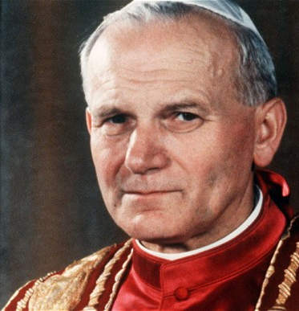
Pope John Paul II
“The new science, with its methods and the freedom of research that they implied, obliged theologians to examine their own criteria of scriptural interpretation. Most of them did not know how to do so. Paradoxically, Galileo, a sincere believer, showed himself to be more perceptive in this regard than the theologians who opposed him.”

Slide 22
Psalm 96.10
“The Lord reigns.” The world is firmly established, it cannot be moved; he will judge the peoples with equity.
Psalm 104.5
He set the earth on its foundations; it can never be moved.
I Chronicles 16.30
Tremble before him, all the earth! The world is firmly established; it cannot be moved.
Earth will find firm and lasting peace
Creation is solid and purposeful

Slide 24
I Kings 7:23 The Molten Sea
He made the Sea of cast metal, circular in shape, measuring ten cubits from rim to rim and five cubits high. It took a line of thirty cubits to measure around it.
C = πD
But
30 ≠ π10
π ≠ 3

Slide 26
First Takeaway (again)
The scriptures contain timeless truths. But they do not use scientific language to convey those truths.

Slide 27
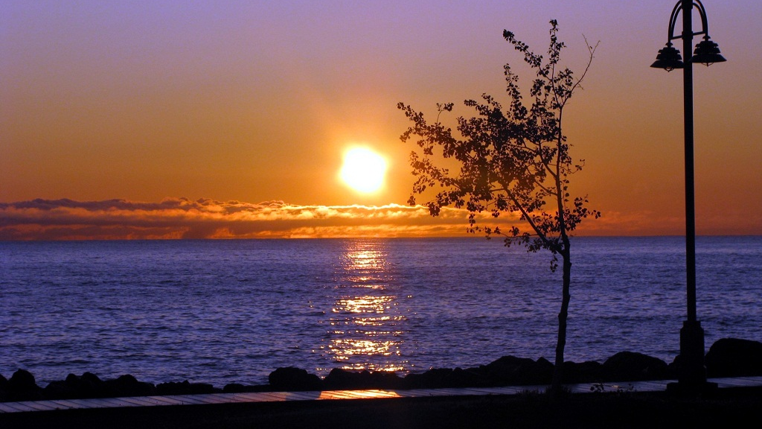
Phenomenology, the Language of Appearances
Ecclesiastes 1.5
The sun rises and the sun sets, and hurries back to where it rises.
The sun looks to us like its rises and sets. This is phenomenological language.
Common experiences are useful for making theological points that readers can understand.

Slide 28
Without Science
No cheap and clean sources of energy
No modern agriculture
No germ theory of disease
No antibiotics or vaccines

Slide 29
Source: 80000 Hours (2016)

Slide 30
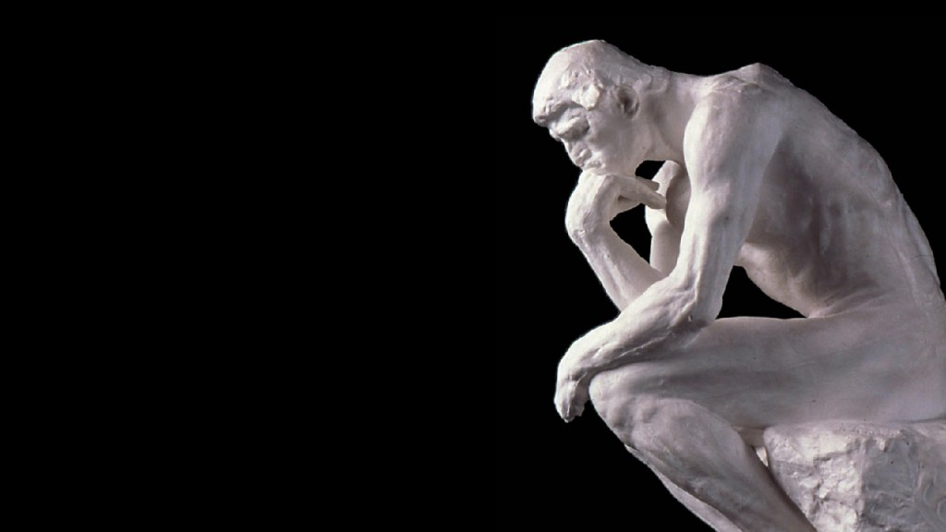
The Argument
Science is powerful
(2) Science is powerful enough to explain everything
(3) Faith is a kind of explanation
Therefore, science replaces faith as an explanation.

Slide 31
Definition of Science
The intellectual and practical activity encompassing the systematic study of the structure and behaviour of the physical and natural world through observation and experiment.

Slide 32
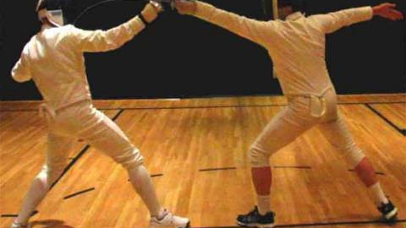
The Counter-Argument
(1) Science is limited to the physical world
(2) Faith pertains to things beyond the physical world
Therefore, science can neither confirm nor deny the reality of faith

Slide 33
Second Takeaway
Science is great! But it cannot explain everything

Slide 34
Summing Up
How can we navigate our beliefs about the relationship between faith and science?
The scriptures contain timeless truths; but they do not convey those truths in scientific language.
Science is great, but it cannot explain everything.

