Slide 1




17-19 MAY 2019
NATIONAL STADIUM
Hope of Everlasting Life John 11:17-44, 3rd March 2019 Sermon Series: Hope for All

Slide 2
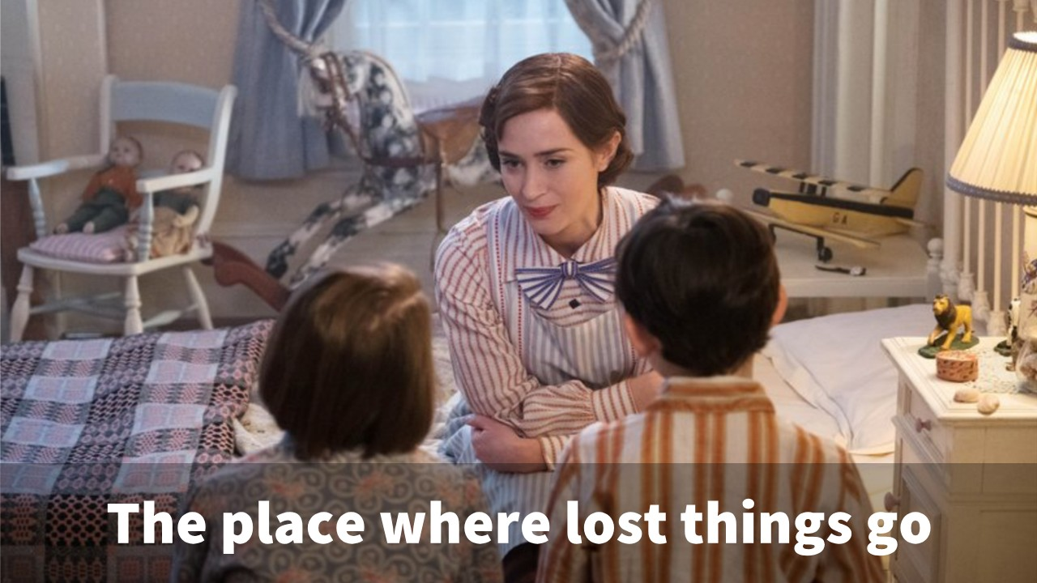

Slide 3
1. Love and friendship “Lord, he whom you love is ill.” John 11:3

Slide 4
And if I go and prepare a place for you, I will come again and will take you to myself, that where I am you may be also. - John 14:3

Slide 5
2. Grief and Loss When Jesus saw her weeping…he was deeply moved in his spirit and greatly troubled. And he said, “Where have you laid him?” They said to him, “Lord, come and see.” Jesus wept.

Slide 6
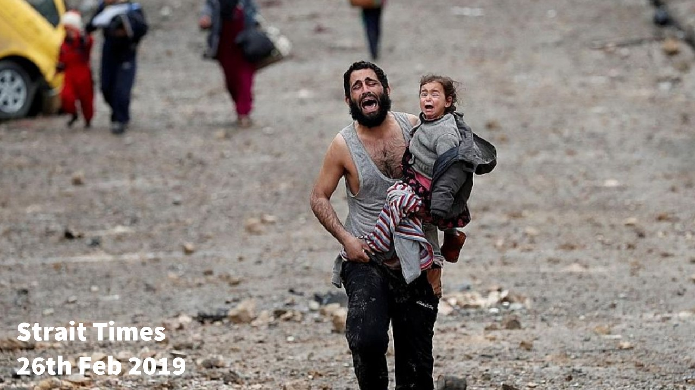

Slide 7
“See how he loved him.” John 11:36

Slide 8
He will wipe away every tear from their eyes, and death shall be no more, neither shall there be mourning, nor crying, nor pain anymore, for the former things have passed away.” - Rev 21:4

Slide 9
3. I am the resurrection and the life. (Jn 11:25)

Slide 10
“I am the Way the Truth and the Life.” John 14:6

Slide 11


Slide 12
