Slide 2
Notes:
Thank your Vicar, Canon Terry Wong
For giving me this opportunity to share God’s word with you
Some of you may not be aware, but I am also an Anglican
Have been so since I accepted Christ in SAJC over 30 years ago
Worship at Light of Christ Church Woodlands
We hold the chaplaincy ministry to CHR
So, as an Anglican, my privilege, honour and joy
to be able to share God’s word with you in this magnificent Cathedral
Because this is the home church for all Anglicans in Singapore
Today, here representing Prison Fellowship S’pore
I will be sharing about what we do in PFS
More importantly, how you can partner us
The text I have chosen today is ->
===

Slide 3
Philemon 1:8-21
Notes:
One of the shortest books
3rd shortest by word count in original language
But contain an important spiritual lesson ->
Welcome strangers
===

Slide 4

Stranger
Notes:
Someone we don’t know
Someone who is not part of our group
E.g.
Many of us would have groups of friends that we usually hang out with
Do fun things together
Perhaps we usually go out for lunch together after church
We know each other well
Someone new to the group may be considered as a stranger of sort
Oftentimes it’s not easy to gain access
Important lesson here:
Welcome strangers into our midst
Therefore, I have entitled my sermon:
Welcome him ->
===

Slide 5

Welcome him
Philemon 1:8-21
Notes:
Deliberately use a lowercase “h”
Referring to a person, not Christ/God
This person is the stranger in our midst
First, let’s take a look at the background to Philemon ->
===

Slide 6
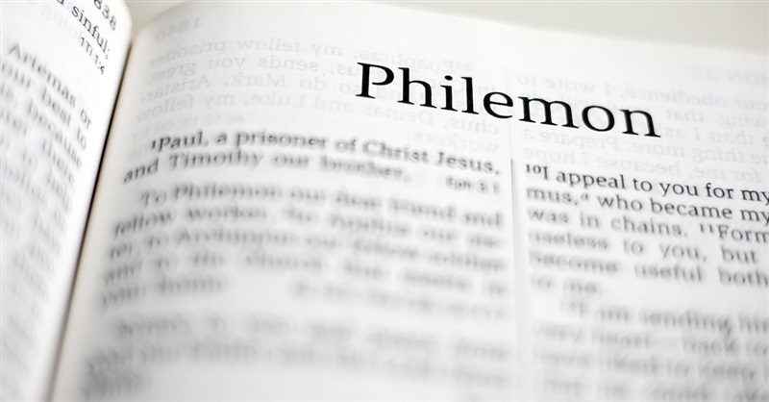
Notes:
Written by Paul, addressed to Philemon
V1:
Paul & Philemon: friends and co-workers
Like many of you here
Known each other for a long time and you are friends with each other
You also serve together in ministry
V2:
Philemon hosted a house church
Owned a house
Owned some slaves – one of them Onesimus
Onesimus: committed an offence & ran away
By divine arrangement, he met Paul and became a Christian
Paul decided to send Onesimus back to Philemon
That’s when Paul wrote this letter to urge Philemon to accept Onesimus back
Not as a slave, but as a brother
Share Two thoughts with you
->
===

Slide 7
Welcome him
Once Useless,
Now Useful
Notes:
->
===

Slide 8
Formerly he was useless to you, but now he has become useful both to you and to me.
– Philemon 1:11
Notes:
You see, Onesimus was a slave
Slave – no status
Master has absolute power over him
Absolute control over his destiny
Traded like commodities
Speaking of slaves…
How many of you remember an old US TV series, “Roots”? ->
===

Slide 9

Notes:
Adapted from a book with the same name
Written by Alex Hailey
Traced his own ancestry
Can’t remember the detailed plot
But a scene was edged deeply into my mind
Kunta Kinte (main character) was taken to America
Arrived at a port
Put in a wooden cage
Hands and legs were chained
Auctioneer doing the auction cry, or bid calling
Traded like commodities
Onesimus was a slave not unlike Kunta Kinte
No power, no rights
Worse, he did something wrong in Philemon’s household
So ran away
He went to Rome, hoping to lose himself
He was a fugitive
BY divine arrangement,
Paul met Onesimus
Brought him to Christ
Paul sent Onesimus back to Philemon
And he said to Philemon ->
===

Slide 10
If he has done you any wrong or owes you anything, charge it to me.
– Philemon 1:18
Notes:
Paul says: Onesimus is a changed man
That’s why Paul was willing to vouch for him
In fact elsewhere in the Bible, Paul described Onesimus as….
->
===

Slide 11
He is coming with Onesimus, our faithful and dear brother, who is one of you. They will tell you everything that is happening here.
– Colossians 4:9
Notes:
Our faithful and dear brother
So we can see:
Paul considers Onesimus to have completely turned over a new leaf
He is now a useful person in Christ
Onesimus’ transformation
Is like that of many beneficiaries of PFS
Many people considers prisoners and ex-offenders useless
Because they go in/out of prisons many times
Many have wasted almost their entire life in prison
Let me share a Prison statistic with you…
===

Slide 12
2017 SPS Annual Statistics
12,394
12,219
11,691
2015
2016
2017
Total Prison Population

Slide 13
2017 SPS Annual Statistics
11,691
10,786
10,126
Total prison population
Total releases
Total admissions
Drug-related offences
8,241 (70.49%)
Notes:
There are roughly 12,000 inmates in Changi prison
Addiction
Hard to kick
You and I know that
Because prisoners wasted many years of their lives behind bars
We think they are useless
Yet God can use them
Let me share a testimony with you…
===

Slide 14
A TESTIMONY
Notes:
In PFS, our volunteers minister to inmates in death row.
Last year, we had an inmate who was executed. The night before execution, our volunteers were with him in the cell as they usually do. They talked, prayed and sang. The conversation invariably drifted to the final earthly journey ahead. When facing death, I can tell you even the hardest of criminals will break. But not our brother. He said this to our volunteers, and I am paraphrasing: “I do not fear death, because I know I am going home. As I walk the final steps, I know the journey is dark, but I also know Jesus is waiting at the end of that journey. I am not facing death itself, but only the shadow of the valley of death.” My volunteers recounted this to me later, and remarked that this brother had a deep understanding of God’s truth.
The sang, and one of his favourite hymns was “He Leadeth Me”. There is a verse in there that was his favourite of favourites, and it goes like this**:
And when my task on earth is done
When by Thy grace the victory’s won
Even death’s cold wave I will not flee
Since God through Jordan leadeth me!
Brothers and sisters, we sing many songs and hymns with great truth, we read many words from the Bible, but have we experienced them? Our brother had.
They continued to sing and it came to Amazing Grace. Two doors away was another death row inmate who heard it. He asked for a piece of paper and then penned a short note to our brother. It reads:
To: [..], this is [..] here.
Today is the first day I have tears in my eyes. No tears for sentencing to “PACP”, no tears when overgrammed. None, since 2011.
I heard you sing Amazing Grace. I will always remember you as the most funny and steady person here. Jesus walks with you. Remember “Footprints” the postcard? I will pass it on to other believers here too.
My friend, you are going to meet Jesus and God, aren’t you excited? The house of God is awaiting you. Thy Kingdom come!
Good bye, Sir!
You may think that a death row inmate is useless for Christ. But even in his last day on earth, our brother managed to touch someone’s life with his testimony.

Slide 15
Welcome him
Once Useless,
Now Useful
Notes:
->
===

Slide 16
Welcome him
Once Written-off,
Now Embraced

Slide 17
So if you consider me a partner, welcome him as you would welcome me.
– Philemon 1:17
Notes:
Paul and Philemon are friends
Not difficult to welcome our friends
Not difficult to embrace our friends
We do that every week in church
Exchange of the peace
Not easy for us to welcome and embrace a stranger
Much less an ex-offender or family of inmate
Society all too often write them off
Like we write off old office equipment
Last Oct, PFS moved office – Cluny Rd to Playfair Rd
Because of the layout of new office
We could not bring some equipment over
Still good, but had to be donated
In our books – write off
This is what good governance expected of us
The world expects us to behave in a certain way
But Jesus almost always teaches us to do
The Counterintuitive things
The exact opposite of what the world expects us to do
E.g., in the Sermon on the Mount
If you are hit on one cheek
->

Slide 18

Notes:
Not to hit back!
But to offer the other cheek.
What about our enemies?
->
===

Slide 19


Notes:
We are to love our enemies
Tough call
But guess what?
Not just love, but pray too ->
===

Slide 20
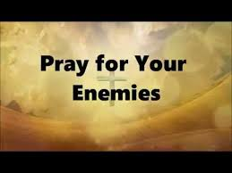
Notes:
Terrorist attack on the Coptic church of Egypt a few years ago
Parishioners gunned down
Just like that, the church lost many members
Imagine the pain of losing loved ones
During Holy Week no less
What amazes me
The sermon preached following the attack.
The priest exhorted his flock to love their attackers
Pray for them
Why? Because that is what the Lord would have us do
In the same way
We are called to embrace
Prisoners
Ex-offenders
Their families
->
===

Slide 21
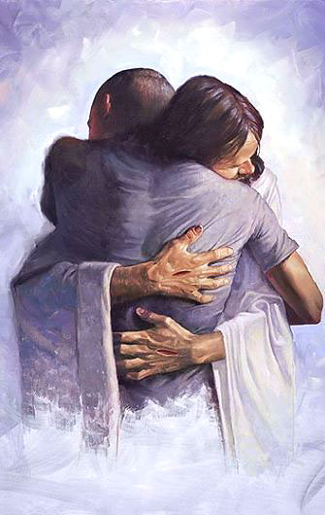
Embrace
Notes:
PFS’ mission is to help you embrace them:
Mobilise
Engage
Equip
So you can offer a new community for them
Welcome them into your fold
Do you know why prisoners relapsed and go back into prison?
One of the reasons is that
When they are down, the only people they could turn to
Old friends, old community
We therefore need to build new and godly communities for them
Let them make new friends that will not lead them astray
Let me show you how we accomplish that.
We have two frontline ministries ->
===

Slide 22

THROUGH CARE
Pre-Sentencing
In-Care
Prison Gate
After-Care
Journeying with the Prisoner
Notes:
Focus: The Prisoner
Journey with him all the way
From before he is imprisoned
To when he is incarcerated behind bars
Then welcome him back into the society at Prison Gate
Finally walk with him in aftercare until he is
Assimilated into a local church
Our volunteers journey with the prisoner every step of the way.
Aim: create a new community for our beneficiaries
Besides TCM, we also have the Family Care Ministry ->
===

Slide 23
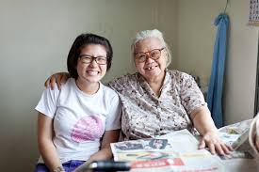
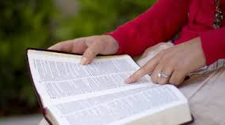
FAMILY CARE
Befriending Family members
& Sharing God’s love
Notes:
Focus: family of the inmate
Spouses
Parents
Children
Aim
Showing love in practical ways
Volunteers visit families
Befriend them
Share God’s love with them
Children are reached out to
Through Care Club
Every Saturday
Give them tuition
Organise enrichment activities for them
Hope: break the inter-generational cycle of offending
Besides TCM and FCM,
We also run a special project which you may be familiar with ->
===

Slide 24

SPECIAL PROJECT
Notes:
During Christmas each year
Inmates write letters of reconciliation to families
Volunteers deliver this letter along with a Christmas hamper
Many have a chance to engage families of inmates
But others may find shut doors, chase you away
Nonetheless, it’s a very meaningful project.
[Testimony of St John’s Chapel]
A volunteer from SJCP participated in AT2017
She was assigned to visit an inmate’s father
Found that the father is almost blind
So father asked her to read out the letter
The content of the letter was very moving and they cried together
Chance to minister to the father
Before she left, father asked her to let him know the hamper content
One by one held in his hand
To him, each item was lovingly sent by his son
Through this delivery, the father started attending SJCP
Later, when the inmate was released, they met him at prison gate
Then father and son started attending SJCP together
This past Easter, both were baptized in the church
Through our ministries and programmes
Hope: Beneficiaries can be welcomed and embraced into your churches
-> [Conclude]
===

Slide 25
Welcome him
Once Useless, Now Useful
Once Written-off, Now Embraced
Notes:
This morning, shared two thoughts from this passage with you:
1.
2.
Let me end by reminding us of
the Great Commission ->
===

Slide 26

Notes:
So,
Once useless, now useful
Once written-off, now embraced
Let me conclude my sharing by reminding us
Of the Great Commission ->
===

Slide 27
THE GREAT COMMISSION
All authority in heaven and on earth has been given to me. Go therefore and make disciples of all nations, baptizing them in the name of the Father and of the Son and of the Holy Spirit, teaching them to observe all that I have commanded you. And behold, I am with you always, to the end of the age.
MATTHEW 28:18-20
Notes:
Mandate:
Evangelism
Discipleship
Not just for overseas mission
Also for local mission
Prison is one such local mission
Urge you – partner us in prison ministry
Youth ministry
Children's ministry
Why not invest in prison ministry?
What can you do to partner us?
===

Slide 28
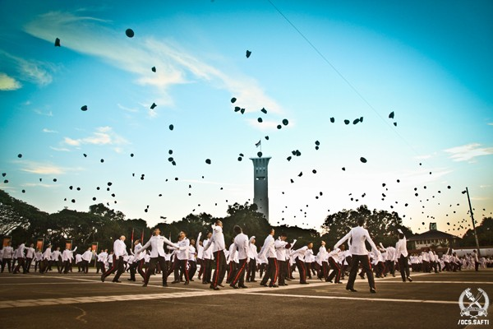

We are ALL Commissioned Officers
Notes:
Each of us has been entrusted the mission to
Evangelise
Disciple
You can accomplish these through
Prison Ministry
How can you partner us? ->
===

Slide 29



WAYS TO PARTNER US
P
Prayer
support
F
Financial
support
S
Serve
as volunteers
Notes:
Prayer
Spiritual endeavor
Beneficiaries are receptive
Satan is unhappy
Attack us, sow discord
Need to pray
Finance
Religious charity
Therefore receive no funding from govt for our programmes
That includes Yellow Ribbon Project
Rely heavily on the Christian community for financial support
Serve
The Cathedral has a small team of volunteers faithfully serving the prisoners for many years
Led by brother Eric Huber
We need more – esp. those who can serve during weekdays
Also serve to journey in the aftercare
Set up family visitation teams
These are ways to PARTNER US
How to start?
===

Slide 30
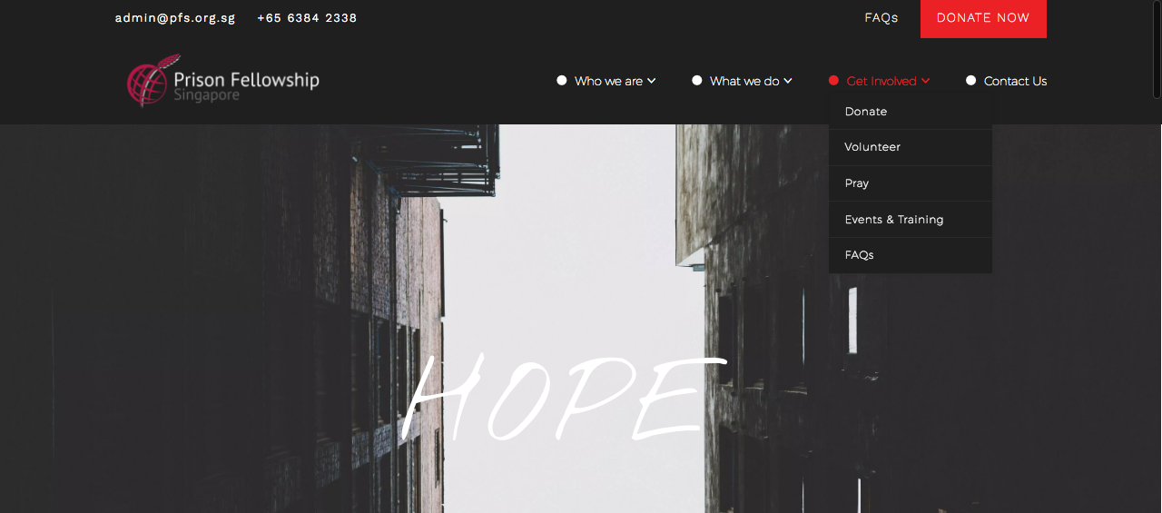
pfs.org.sg

Slide 31
For I was hungry and you gave me something to eat, I was thirsty and you gave me something to drink, I was a stranger and you invited me in, I needed clothes and you clothed me, I was sick and you looked after me, I was in prison and you came to visit me.’
OUR CALLING
MATTHEW 25:35-36
Notes:
NIV

Slide 32
THANK YOU

