Slide 1
LAZARUS AT THE GATE

Slide 2
RICHEST COUNTRIES IN THE WORLD
SINGAPORE
in 3rd position

Slide 3
ABSOLUTE POVERTY
RELATIVE POVERTY
10-12% of households
Household income :
$1250-$1500 per month
per family of 4
Level of survival:
Basic necessities
– food, shelter, clothing
23-26% of households
Household income:
$2500-$3000 per month
per family of 4
Level of social inclusion:
Basic necessities and others eg. computer, internet, handphone
ESTIMATES OF POVERTY IN SINGAPORE, 2008-2011

Slide 5
Whoever is generous to the poor lends to the Lord, and he will repay him for his deed.
Proverbs 19:17

Slide 6
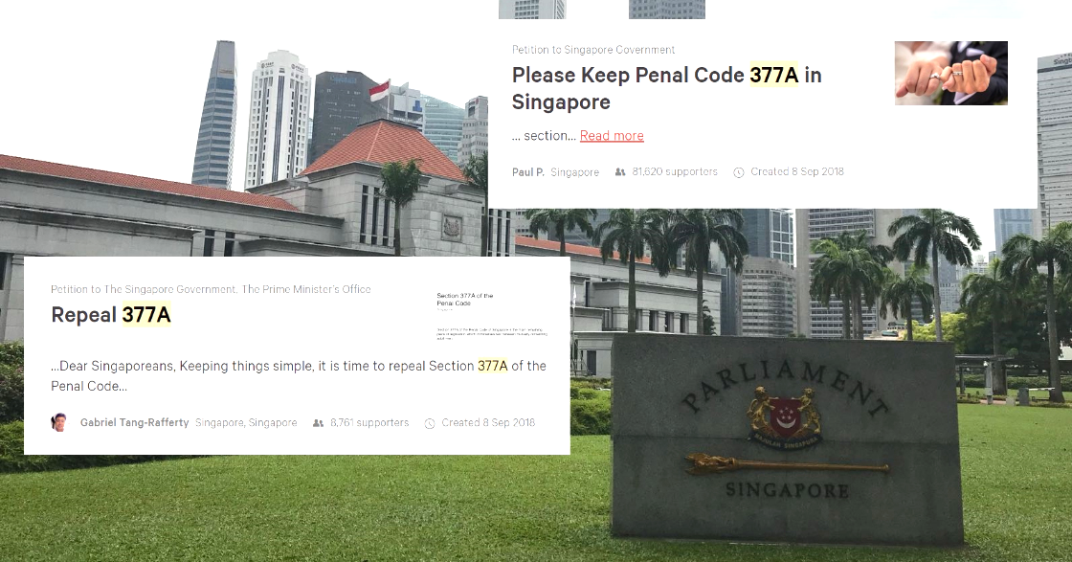

Slide 7
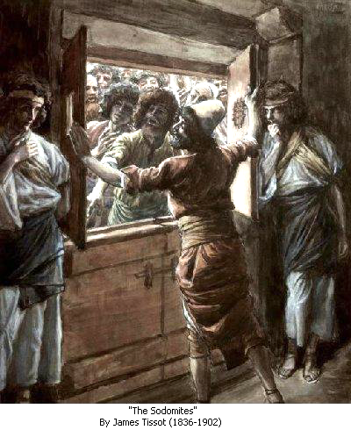
Behold, this was the guilt
of your sister Sodom:
she and her daughters had pride, excess of food, and prosperous ease, but did not aid
the poor and needy.
They were haughty and
did an abomination before me.
So I removed them when I saw it.
Ezekiel 16: 49-50.

Slide 9
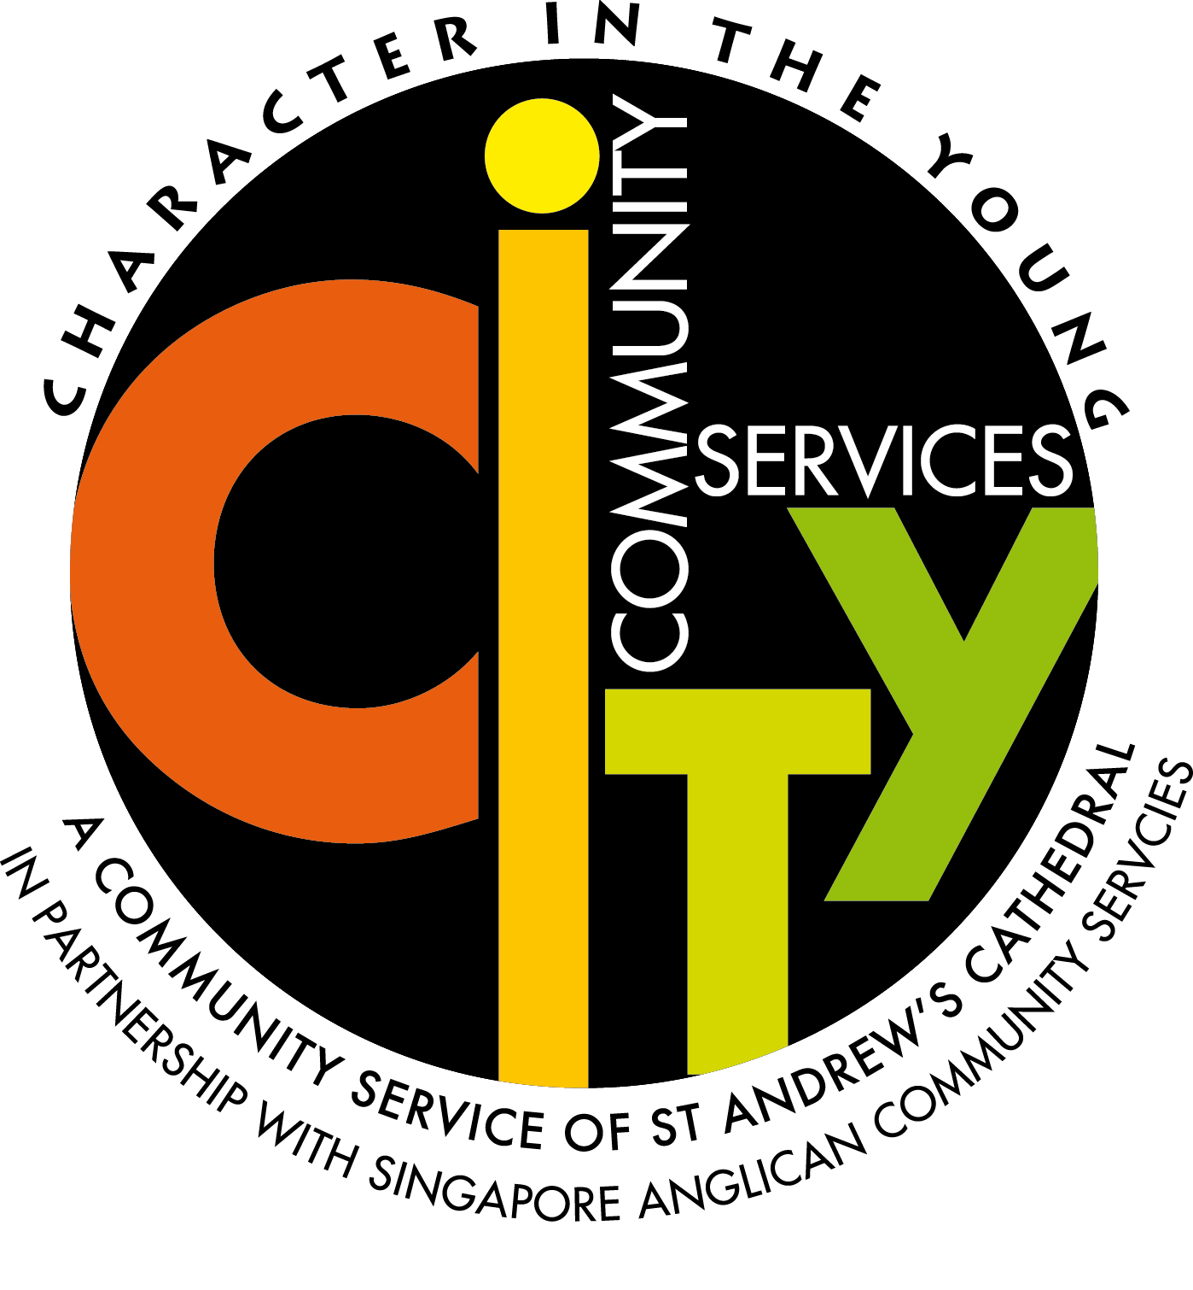

Slide 11


Slide 12
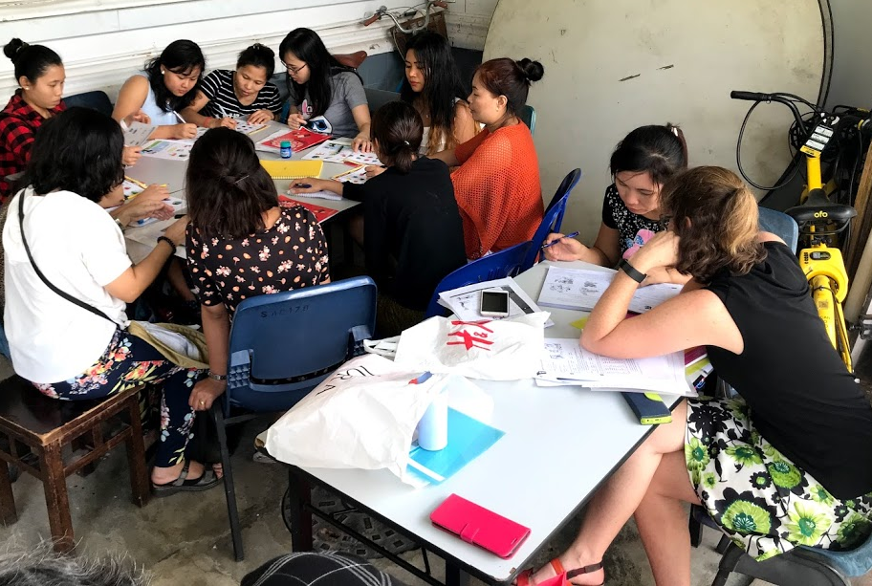
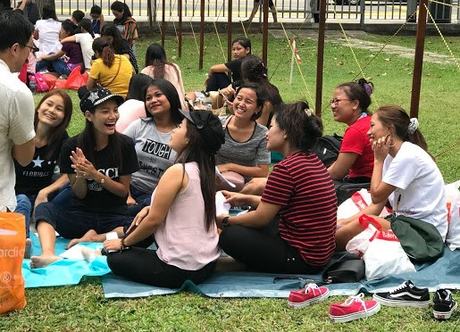
BMW
Befriending
Migrant Workers

Slide 14
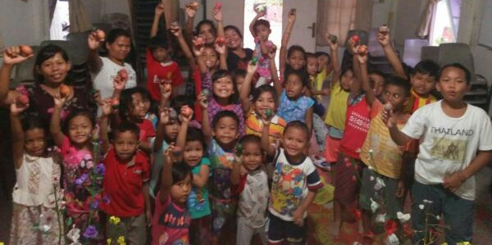
BMO & 289
on Batam

Slide 16
Matthew 25: 35-40
For I was hungry and you gave me food,
I was thirsty and you gave me drink, I was a stranger and you welcomed me, I was naked and you clothed me, I was sick and you visited me, I was in prison and you came to me. …
Truly, I say to you, as you did it to one of the least
of these my brothers, you did it to me.

Slide 17
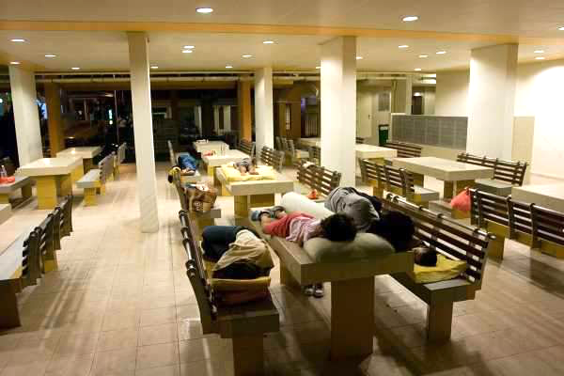

Slide 19
When you reap the harvest of your land, you shall not reap your field right up to its edge,
neither shall you gather
the gleanings after your harvest.
And you shall not strip your vineyard bare, neither shall you gather
the fallen grapes of your vineyard.
You shall leave them for the poor
and for the sojourner:
I am the Lord your God.
Leviticus 19:9-10

Slide 20
LEND A HELPING HAND
Serve with church and national projects
GIVE
Do it intentionally
BE THE VOICE FOR THE POOR
Talk about
the poor and speak
up for them
BEFRIEND
THE POOR
Socialise;
do not be class conscious.

Slide 21
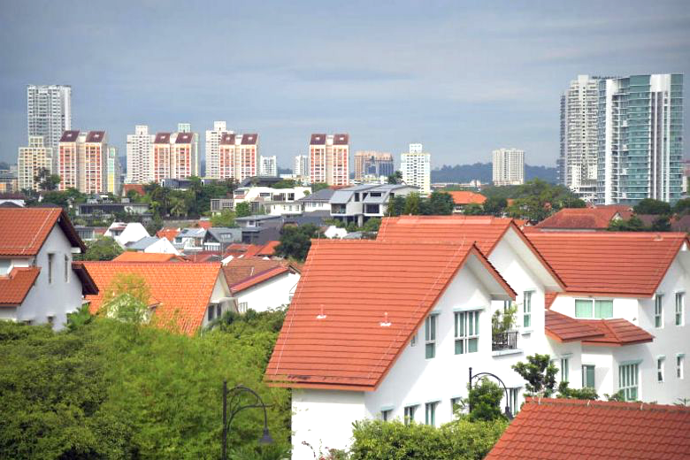
The Straits Times
December 28, 2017
SINGAPORE - The sharpest social divisions in Singapore may now be based on class, instead of race or religion, a study released on Thursday (Dec 28) suggests.
The Institute of Policy Studies' (IPS) Study On Social Capital In Singapore shows that on average, Singaporeans who live in public housing have fewer than one friend who
lives in private housing.

