Slide 1
The Example of Stephen
Acts 7:54-60

Slide 2
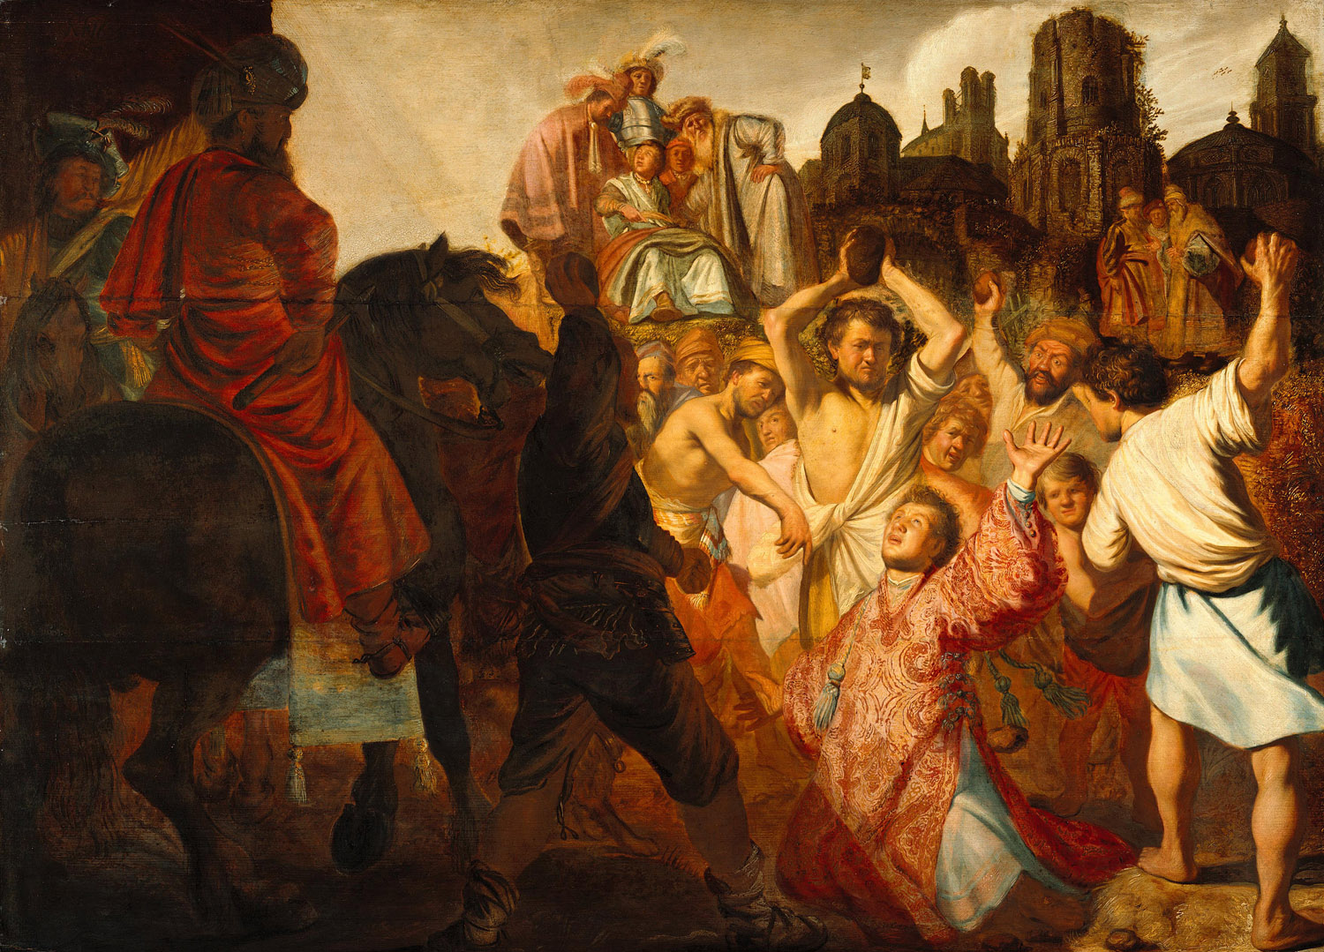
The Stoning of Stephen

Slide 3
“You stiff-necked people, uncircumcised in heart and ears, you always resist the Holy Spirit. As your fathers did, so do you. Which of the prophets did your fathers not persecute? And they killed those who announced beforehand the coming of the Righteous One, whom you have now betrayed and murdered..
Acts 7:51–52
ESV

Slide 4
But he, full of the Holy Spirit, gazed into heaven and saw the glory of God, and Jesus standing at the right hand of God. - Acts 7:55

Slide 5
Precious in the sight of the Lord is the death of his saints. Psalm 116:15

Slide 6
“The blood of martyrs is the seed of the church" Tertullian (2nd Century)

Slide 7
The Stoning of Saint Stephen is the first signed painting by Dutch artist Rembrandt, painted in 1625 at the age of 19.

Slide 8
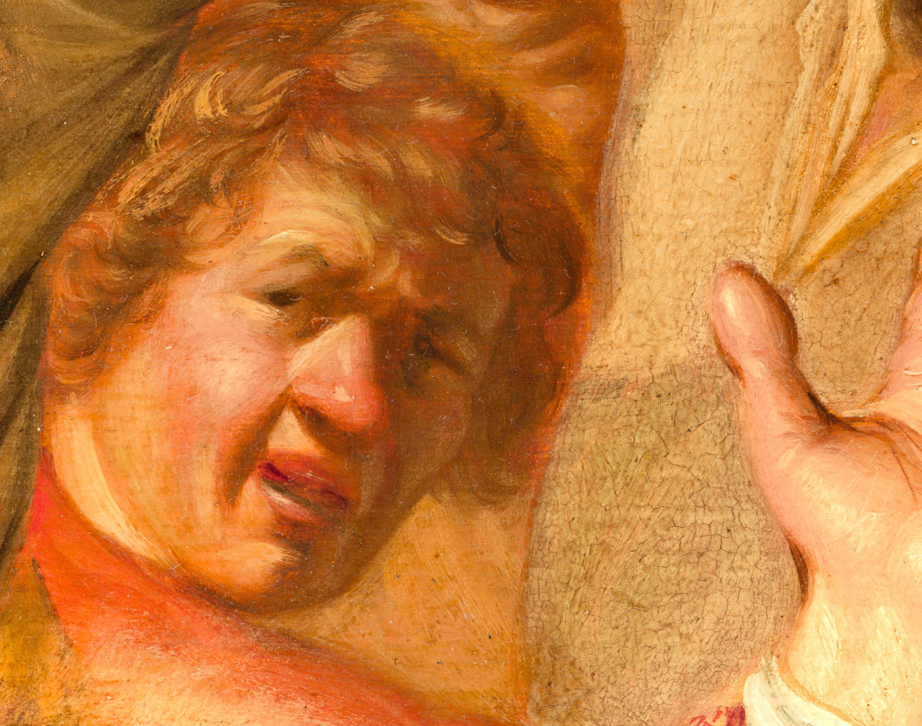
The Stoning of Saint Stephen is the first signed painting by Dutch artist Rembrandt, painted in 1625 at the age of 19.

Slide 9
And as they were stoning Stephen, he called out, “Lord Jesus, receive my spirit.” And falling to his knees he cried out with a loud voice, “Lord, do not hold this sin against them.” And when he had said this, he fell asleep.
Acts 7:59–60
ESV

Slide 10
“Lord, do not hold this sin against them.” – Forgiveness!

Slide 11
“You have heard that it was said, ‘You shall love your neighbor and hate your enemy.’ But I say to you, Love your enemies and pray for those who persecute you,
Matthew 5:43–44
ESV

Slide 12
“For God so love the world that He gave His only Son Jesus Christ to save us from our sins, to be our advocate in heaven, and to bring us to eternal life. John 3:16

Slide 13
Therefore he is able to save completely those who come to God through him, because he always lives to intercede for them. Hebs 7:25

Slide 14
The blood of martyrs is the seed of the Church

