Slide 1

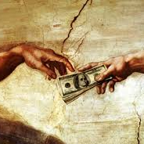
Dr Jeremy Gwee

Slide 2

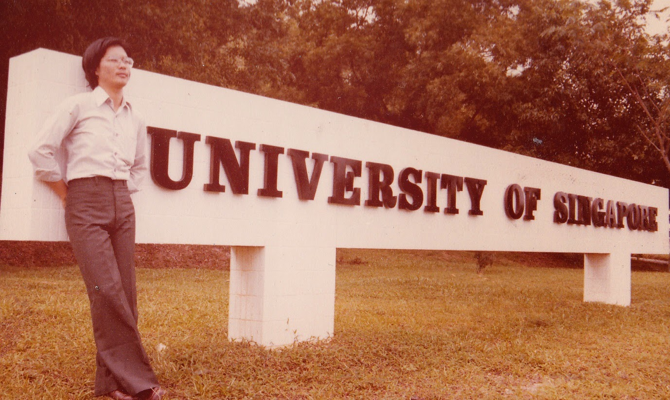

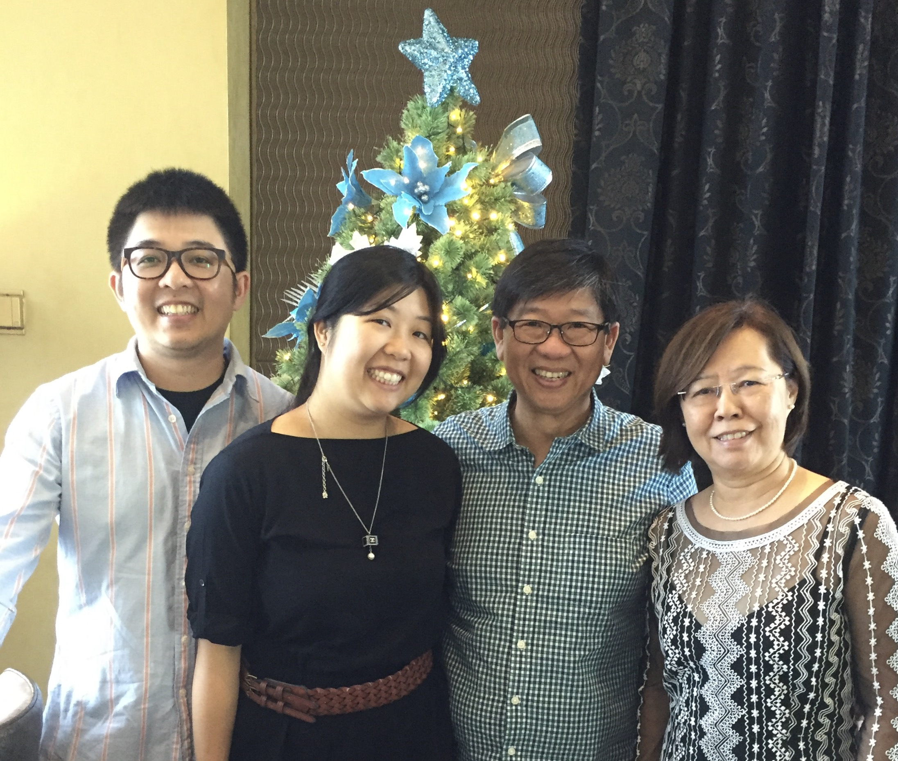
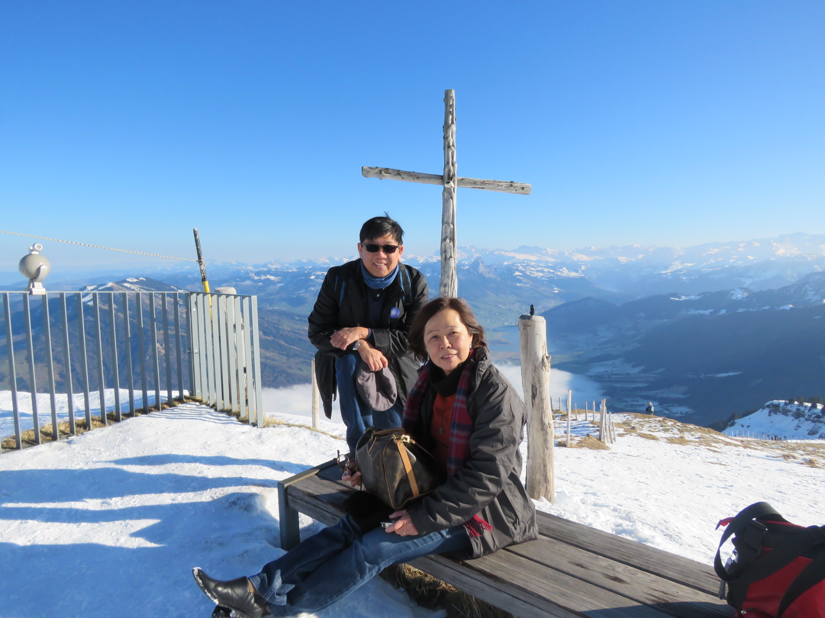

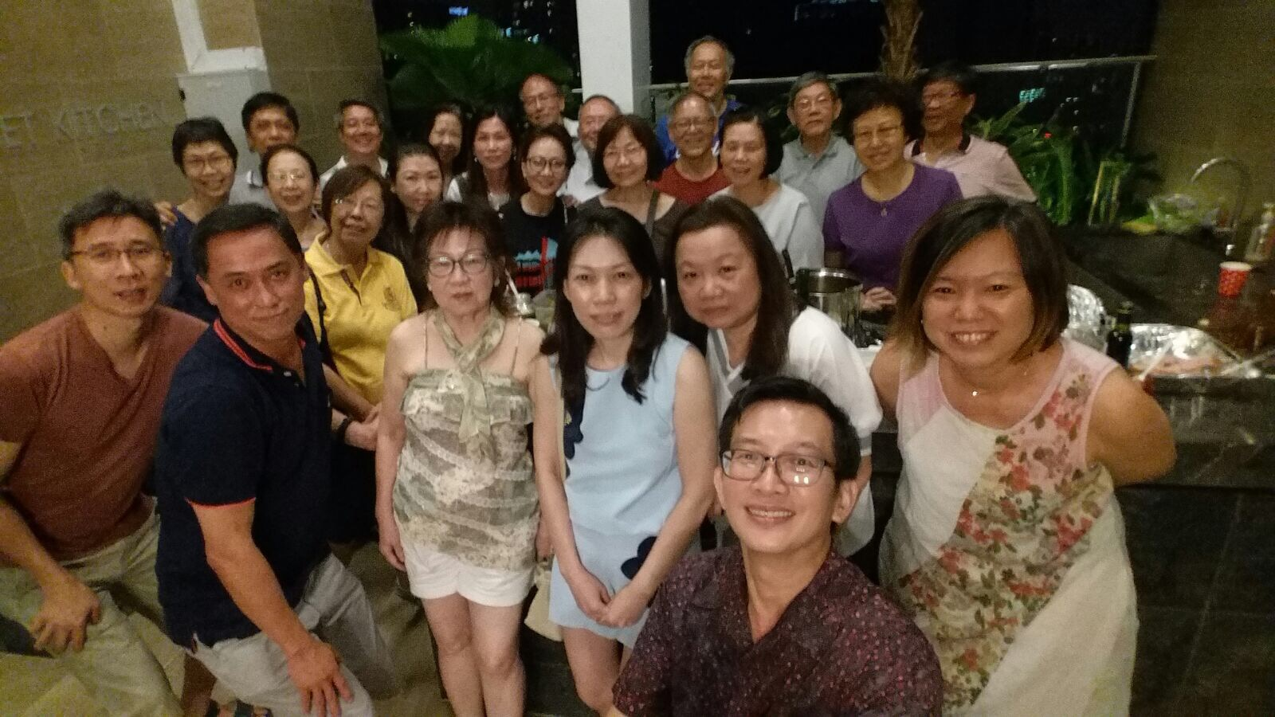
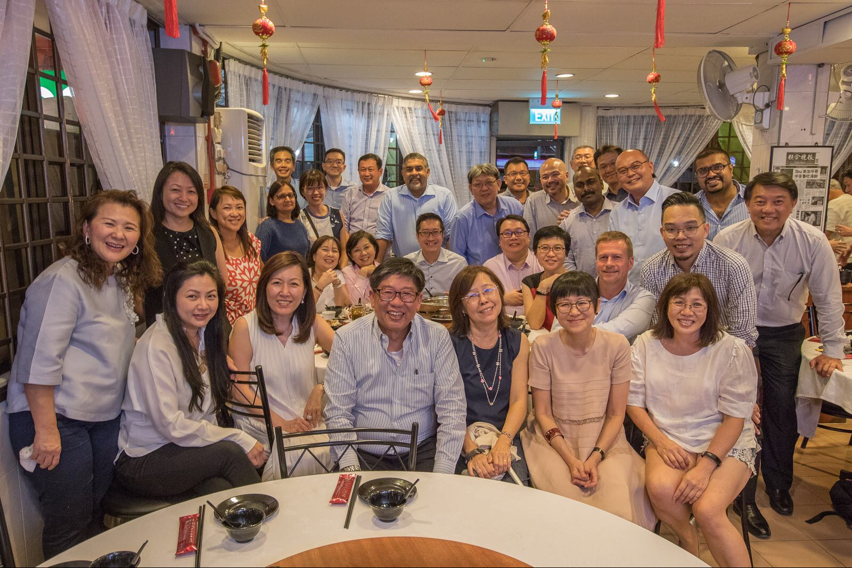
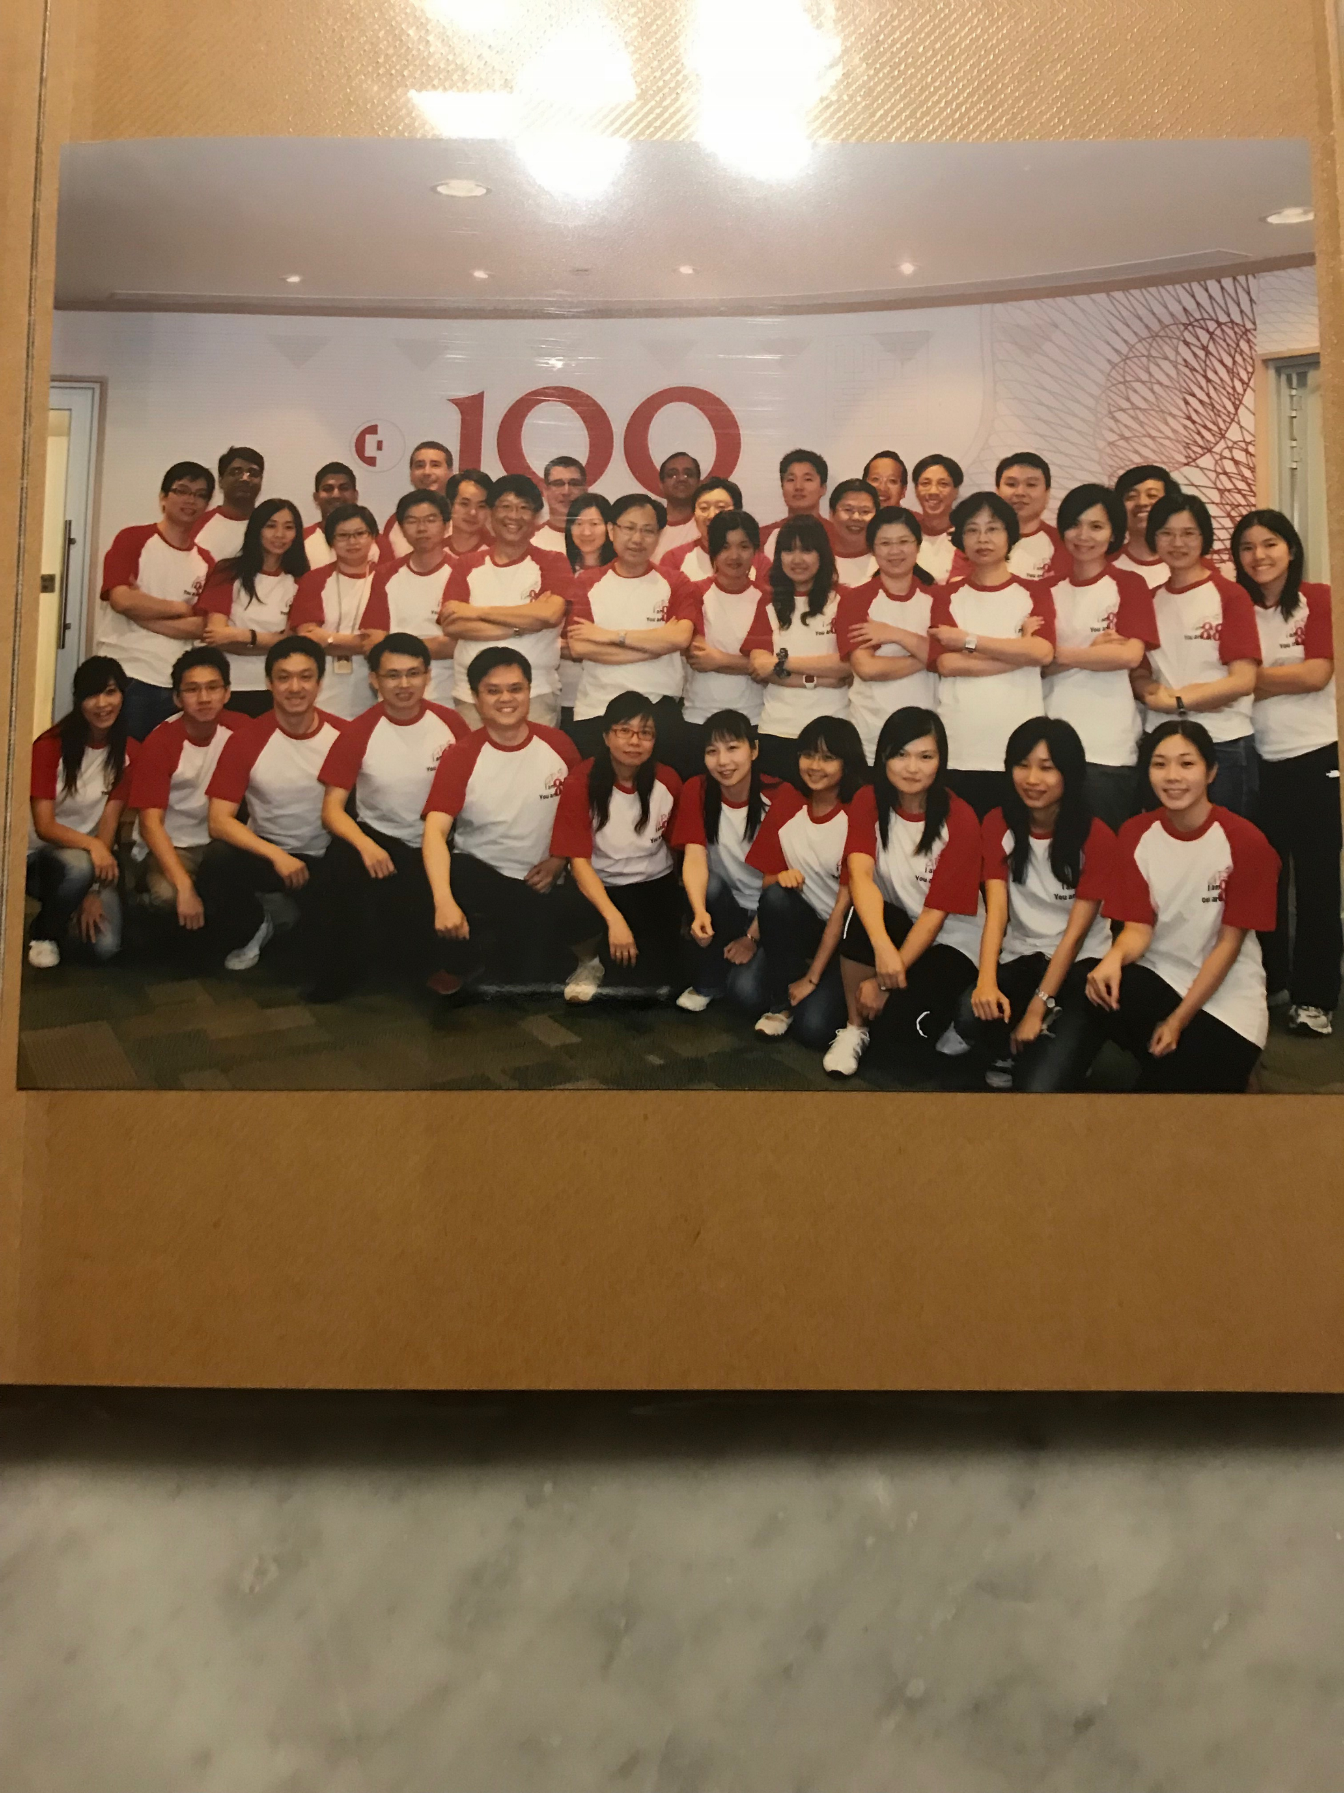









Slide 3
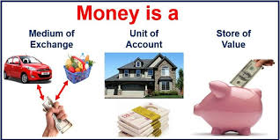
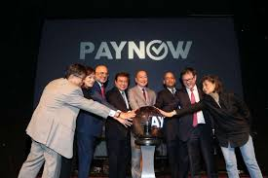
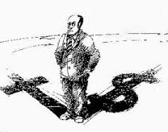
So What Is Wrong With Money?

Slide 4

The love for money is the root of all evil 1Timothy 6:10
“How hard it is for the rich to enter the kingdom of God! Indeed, it is easier for a camel to go through the eye of a needle than for someone who is rich to enter the kingdom of God.” Luke 18:24–25
Watch out and guard yourselves from every kind of greed; because your true life is not made up of the things you own, no matter how rich you may be.” (Luke 12:15)

Slide 5
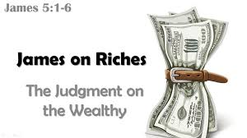
James 5:1-6 Now listen, you rich people, weep and wail because of the misery that is coming on you. Your wealth has rotted, and moths have eaten your clothes. Your gold and silver are corroded. Their corrosion will testify against you and eat your flesh like fire. You have hoarded wealth in the last days. Look! The wages you failed to pay the workers who mowed your fields are crying out against you. The cries of the harvesters have reached the ears of the Lord Almighty. You have lived on earth in luxury and self-indulgence. You have fattened yourselves in the day of slaughter. You have condemned and murdered the innocent one, who was not opposing you.

Slide 6
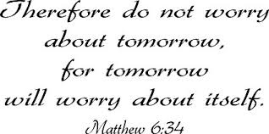

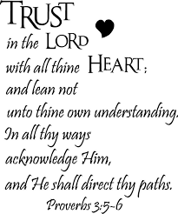
Luke 18:18-22
And behold, a man came up to him, saying, “Teacher, what good deed must I do to have eternal life?”¹⁷And he said to him, “Why do you ask me about what is good? There is only one who is good. If you would enter life, keep the commandments.”¹⁸He said to him, “Which ones?” And Jesus said, “You shall not murder, You shall not commit adultery, You shall not steal, You shall not bear false witness, ¹⁹Honor your father and mother, and, You shall love your neighbor as yourself.” ²⁰ The young man said to him, “All these I have kept. What do I still lack?” ²¹Jesus said to him, “If you would be perfect, go, sell what you possess and give to the poor, and you will have treasure in heaven; and come, follow me.”²² When the young man heard this he went away sorrowful, for he had great possessions.
Poverty Gospel

Slide 7
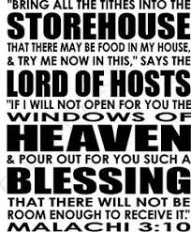
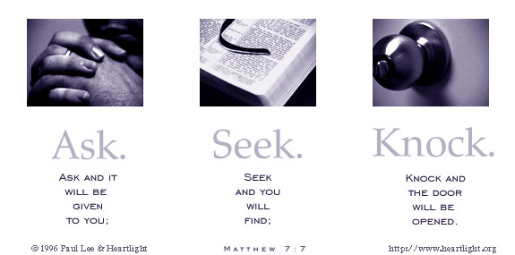
Prosperity Gospel

Slide 8
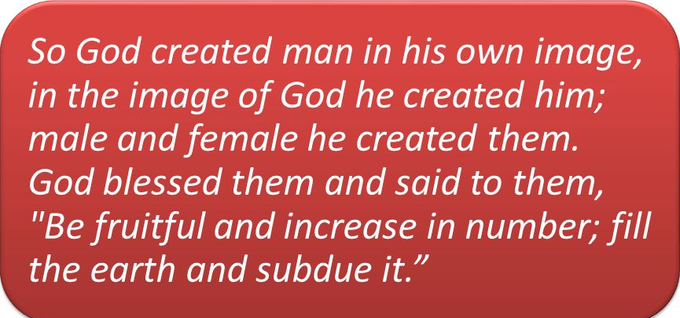
Stewardship
Psalms 24 1The earth is the Lord’s, and everything in it, the world, and all who live in it; 2 for he founded it on the seas and established it on the waters.
Genesis 1:27-28
The assignment of God-imaged humans was to multiply and care for creation and its resources, which has come to include money. (Brown, 2017) We are stewards of God’s creation.

Slide 9

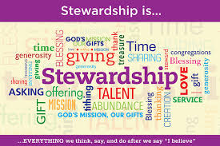
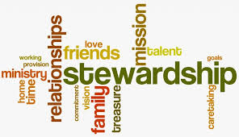

Slide 10
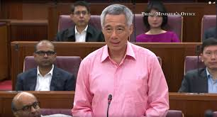
“the 4G Ministers understood that their deepest responsibility is to be a steward of Singapore. What does it mean steward? The Government is certainly not the owner of Singapore, but neither is it just the manager of Singapore. It is the steward, it’s responsible for taking good care of the country, for holding it in trust, building it up and handing it on in due time to future generations. The Government must keep faith with the past generations who gifted this country to us. It has to be responsible to the present generation who continue to build on what we have inherited. But above all, it must consider future generations, whose lives and whose futures depend on us, the present generation. Depend on us thinking of their interests, acting on their behalf, making wise and far-sighted decisions to cause Singapore to endure and flourish for many more years.” May 16 2018 Debate on the President's Speech

Slide 11
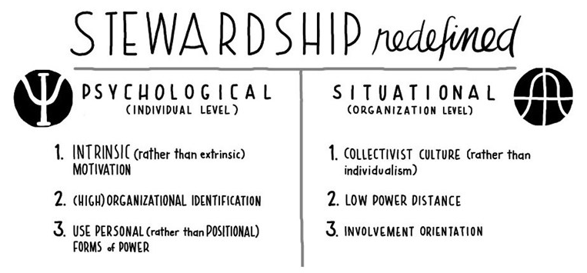
Craig, J. B. and Moores, K. (In Press) Leading a Family Business: Best Practices for Long-Term Stewardship. Praegar Publishing

Slide 12
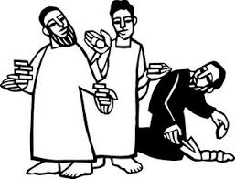
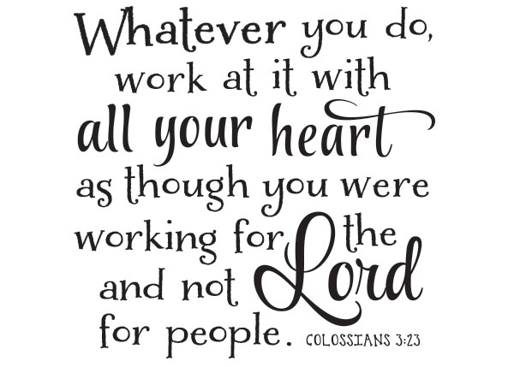
“God the creator chooses to become ‘dependent’ on the human being hand and makes human work a means of accomplishing his work in the world.” Miroslav Volf
The Parable of the Talents teaches us what we are supposed to do while we await the return of our King.
God expects us to generate a return by using our talents towards productive ends. The servants were given enough to produce more – it is the same with the gifts God has given us.
The Parable of the Talents teaches that we are not all created equal – The master gives to each servant talents, “…each according to his ability.” But the reward given by the master is the same because it takes just as much work for the five-talent servant to produce five more talents as it does the two-talent servant to produce two more talents. The master measures success by degrees of effort.
We work for the master.
We are accountable.
Parable of the Talent Matthew 25:14-30

Slide 13
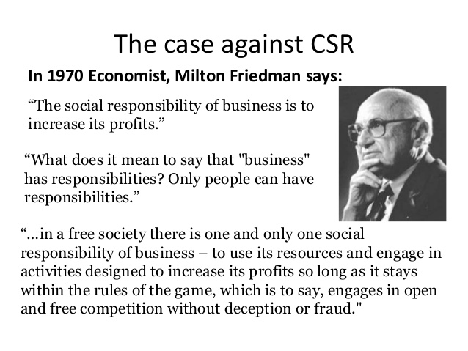

Slide 14
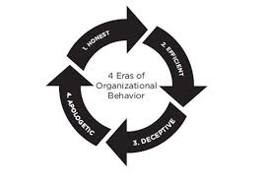
The last couple of decades have been dominated by companies and organizations that value profit more than the people they serve. From fashion to food, banking to advertising, we’re confronted with examples of how ugly capitalism can be.
Companies go through seasons of honesty, efficiency, deception, and redemption. This cycle drives companies from a period where they value people over profit to a time when they value profit people and then back again. Dale Partridge

Slide 15

Philippians 4:12 I know what it is to be in need, and I know what it is to have plenty. I have learned the secret of being content in any and every situation, whether well fed or hungry, whether living in plenty or in want.
13 I can do all this through him who gives me strength.

Slide 16
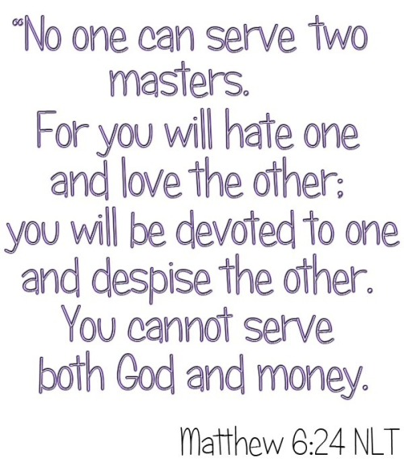
“To the Greeks, religion was more a matter of custom than a formal theology. Their gods stood for certain things and to a degree you chose your god because you shared the values and interest they represent.” (Handy, 1996)
So who is your God?

Slide 17

myothersix@gmail.com

