Slide 1
Turn your eyes upon Jesus
@ 9 am Service, 7th January
Isaiah 40:27-31

Slide 2
2018?
“Do not be conformed to this world, but be transformed by the renewal of your mind, that by testing you may discern what is the will of God, what is good and acceptable and perfect.”
- Romans 12:2

Slide 3
Isaiah 40:28-31
Have you not known? Have you not heard? The Lord is the everlasting God, the Creator of the ends of the earth.
He does not faint or grow weary; his understanding is unsearchable.
He gives power to the faint, and to him who has no might he increases strength.
Even youths shall faint and be weary, and young men shall fall exhausted;
but they who wait for the Lord shall renew their strength they shall mount up with wings like eagles;
they shall run and not be weary they shall walk and not faint.

Slide 4
Isaiah 40:27
Why do you say, O Jacob, and speak, O Israel,
“My way is hidden from the Lord,
and my right is disregarded by my God”?

Slide 5
Isaiah 40:28
Have you not known? Have you not heard?
The Lord is the everlasting God, the Creator of the ends of the earth.
He does not faint or grow weary; his understanding is unsearchable.

Slide 6
Isaiah 40:29-30
He gives power to the faint,
and to him who has no might he increases strength.
Even youths shall faint and be weary,
and young men shall fall exhausted;

Slide 7
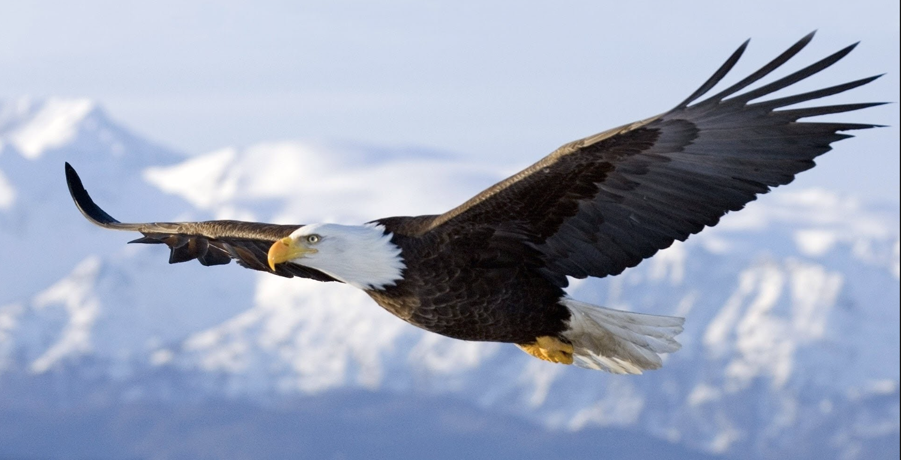
They who wait for the Lord shall renew their strength they shall mount up with wings like eagles;
they shall run and not be weary
they shall walk and not faint. Isaiah 40:31

Slide 8
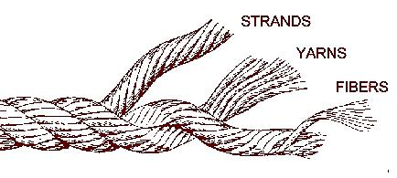
“Waiting”
In Hebrew: “qavah” translated “wait”
Literal meaning: “to bind together like a cord.”
Normative use: to wait for, to hope , to expect
…a threefold cord is not quickly broken.” - Eccle 3:12

Slide 9
Blessed are those whose strength is in you… Psalm 84
“all things are possible through Christ who strengthens me.” Philippians 4:13

Slide 10
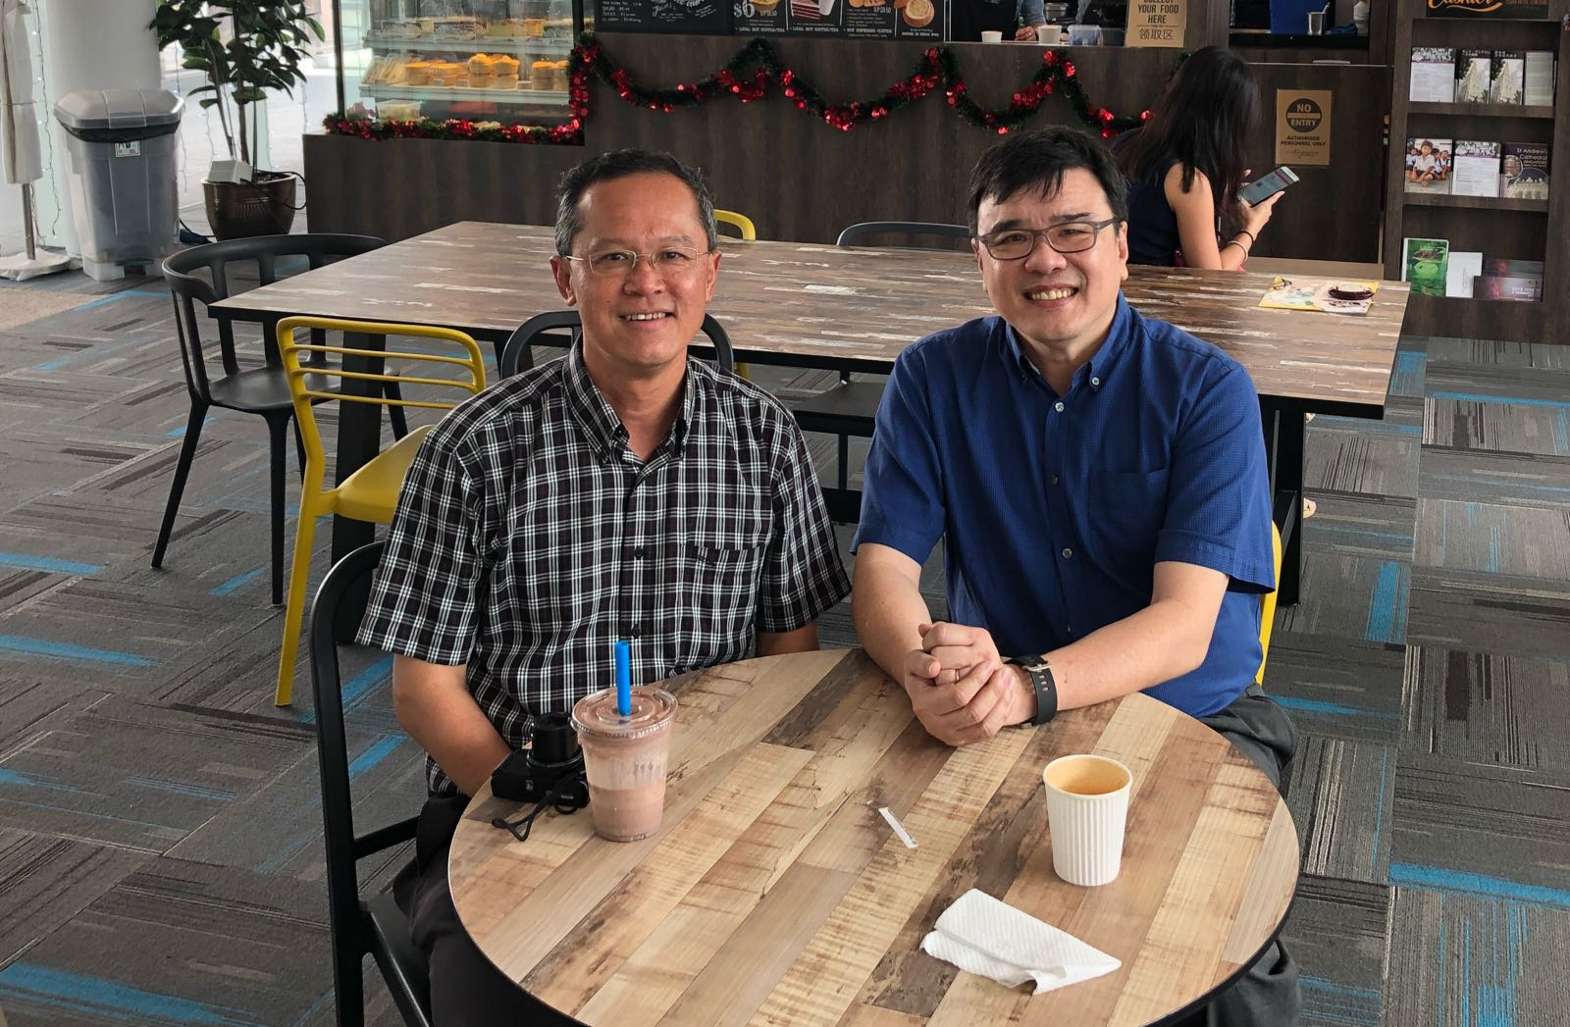

Slide 11
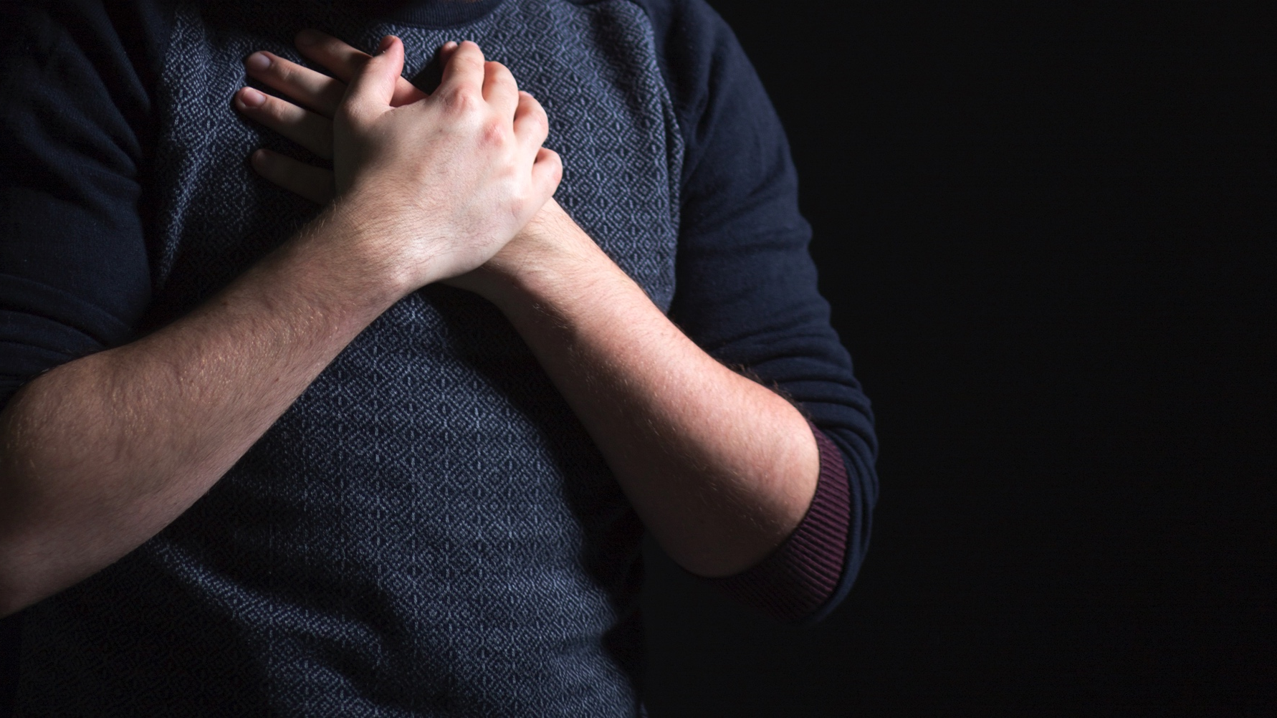
ST ANDREW’S CATHEDRAL
2018 – YEAR OF PRAYER

