Slide 1
John 10:11-16
I am the good shepherd. The good shepherd lays down his life for the sheep. He who is a hired hand and not a shepherd, who does not own the sheep, sees the wolf coming and leaves the sheep and flees, and the wolf snatches them and scatters them. He flees because he is a hired hand and cares nothing for the sheep.

Slide 2
John 10:11-16
I am the good shepherd. I know my own and my own know me, just as the Father knows me and I know the Father; and I lay down my life for the sheep. And I have other sheep that are not of this fold. I must bring them also, and they will listen to my voice. So there will be one flock, one shepherd.

Slide 3
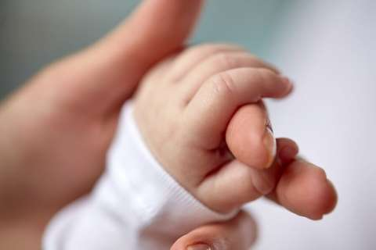
Birthing New Churches
John 10:11-16

Slide 4
Road Map
Why bother?
Why Jurong?
What’s the plan, boss?
Why should Cathedral be excited about this?

Slide 5
Why bother?

Slide 6
Why bother?
Birthing churches not our idea!
Purpose of Jesus’ first coming.
God’s chosen instrument?

Slide 7
What does the world say?
Relax, you only live once
Chiong, you only live once
It’s all about me!

Slide 8
The world behind me, the cross before me?
Louder
More visible
More insistent
More seductive
Main idea: Fight your way to the top

Slide 9
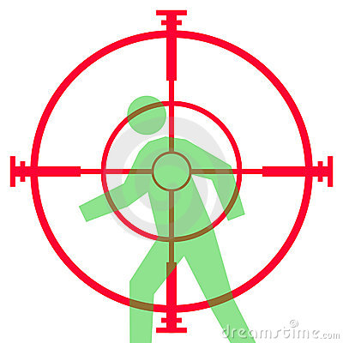
Problem?
The end-goal: Steal, Kill, & Destroy
You!

Slide 10
What does Jesus say?
Buyer beware!
If you want to listen to Jesus’ voice…
Counter-culture
Counter-intuitive
Lay your life down for others

Slide 11
What’s so different about Christians?
John 10:16a
And I have other sheep that are not of this fold. I must bring them also, and they will listen to my voice.

Slide 12
What’s so different about Christians?
The Christian community is the only one that exists for the sake of non-members!

Slide 13
2 dimensions to John 10:16
Personal
Corporate
Bring in the sheep that are “outside”!

Slide 14
Corporate response
Purpose of apple trees?
Purpose of churches?

Slide 15
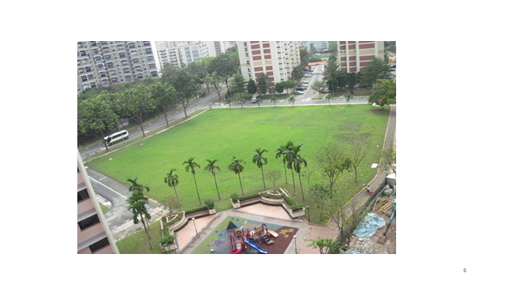
Why jurong?

Slide 16
† Location of 27 parishes
of the Diocese

Slide 17
Ta-da!

Slide 18
What else is brewing?
Tengah Estate (Straits Times, 12 April 2016)
Jurong as 2nd CBD
Increase in human traffic

Slide 19
What’s the plan, boss?

Slide 20
Day activity centre
Regional office
Nursing home?
Anglican Senior Centre
Staff offices
Office
Kindergarten
Western regional hub
Anglican Care Centre
Classrooms
(at least 4 classes)
Meeting/Training rooms
Church
(St Luke’s?)
Worship Halls
Staff offices
Multi-purpose rooms
Fellowship space
(Café?)

Slide 21
What do we need?
Target Funds To Be Raised
Available Funds As At 30 September
To Be Raised
S$30,000,000
S$7,000,000
S$23,000,000
Over 3 years

Slide 22
Why should Cathedral be excited about this?

Slide 23
Why should Cathedral be excited about this?
Pentecost Sunday, 1856.
What happened in 1884?
Will history repeat itself?

