Slide 1
Returning to the Garden
Embracing God’s Design for Sexuality
Ben KC Lee

Slide 2
RETURNING TO THE GARDEN Embracing God’s design for sexuality
The sexual revolution
The full consequences

Slide 3
Whole Life Inventory
Sexual Issues
Which of the following issues do you currently face?
(You may select more than one option)
Notes:
Figures as of Aug 2016
7 churches, 5,078 participants have completed the Whole Life Inventory.

Slide 4
1. The Christian Way of Thinking about Sex

Slide 5
Each human being is created in God’s image
“God created mankind in his own image, in the image of God he created them...” Gen 1:27a
God created one humanity - the male and female persons
“... male and female he created them.” Gen 1:27b

Slide 6
God gives sexual intimacy as a gift to strengthen a marriage relationship
“That is why a man leaves his father and mother and is united to his wife, and they become one flesh.”
Gen 2:24

Slide 7
God incarnated as man
Our Body is a Temple of God’s Spirit
“The Word became flesh and made his dwelling among us. We have seen his glory, the glory of the One and Only, who came from the Father, full of grace and truth.” John 1:14
“Do you not know that your body is a temple of the Holy Spirit, who is in you, whom you have received from God? You are not your own; you were bought at a price. Therefore honor God with your body.” I Cor. 6:19-20

Slide 8
2. Sexuality and Sexual Wholeness

Slide 9
Two concepts in tension
Affectionate
Sensual
Sexuality is our basic identity as males and females

Slide 10
Sexual Wholeness
A holistic view of man
“The LORD God formed the man from the dust of the ground and breathed into his nostrils the breath of life, and the man became a living being.” Gen. 2:7
Relational intimacy
“The LORD God said, "It is not good for the man to be alone..." Gen. 2:18

Slide 11
Sexual Wholeness
Sexual integrity
“Therefore, I urge you, brothers, in view of God's mercy, to offer your bodies as living sacrifices, holy and pleasing to God--this is your spiritual act of worship” Romans 12:1

Slide 12
3. The Garden as an Illustration

Slide 13
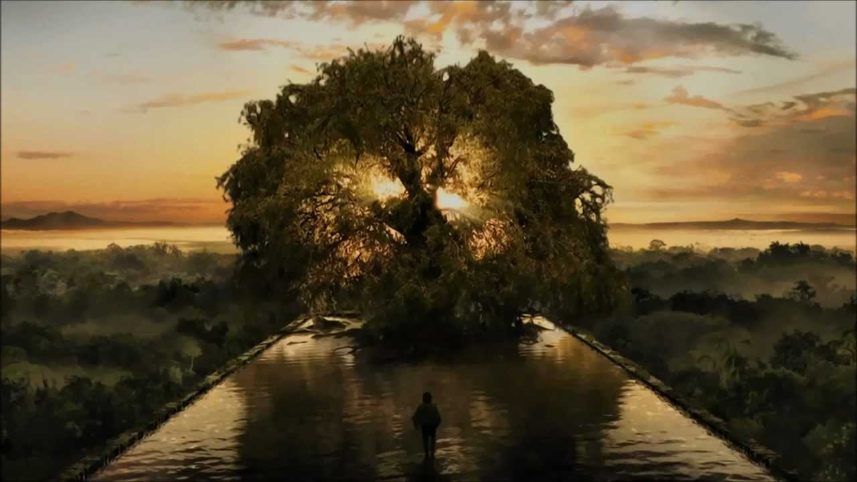
Scriptures begin with a couple in Eden and end with the descent of the New Jerusalem out of heaven as a Bride adorned for her husband.
“Then the angel showed me the river of the water of life, as clear as crystal, flowing from the throne of God and of the Lamb down the middle of the great street of the city. On each side of the river stood the tree of life, bearing twelve crops of fruit, yielding its fruit every month. And the leaves of the tree are for the healing of the nations. ” Rev. 22:1-2

Slide 14
Jesus affirmed the garden template
Jesus: "Moses permitted you to divorce your wives because your hearts were hard. But it was not this way from the beginning.” Matt 19:18
Paul pointed to the garden template
“Do you not know that he who unites himself with a prostitute is one with her in body? For it is said, "The two will become one flesh.” I Cor 6:16

Slide 15
The Bible provides word pictures of a walled garden (Job 1:10)
God’s instructions teach us how to prepare, plant, grow and reap sexual wholeness.
The life flow of the garden is healthy relationships.

Slide 16
4. Introducing the Sacred Garden

Slide 17
An Integrated Approach to Sexual Wholeness
The purpose is to build sexually-healthy disciples
It’s a structure to organise thinking and efforts to build up wholeness
This applies to both the home and the congregation

Slide 18
Sacred Garden
4 HEDGES define & protect the garden
COMMITMENT
Culture
FAMILY
Outreach
Leadership
7 NURSERIES nurture & sustain the garden
AUTHENTICITY
IDENTITY
INTIMACY
Maker
Me
Safety
Mates
Ongoing Conversations
DISCIPLESHIP
Special Care
Sexuality Education
WELLSPRING of 3 is the source of life for the garden
LOVE

Slide 19
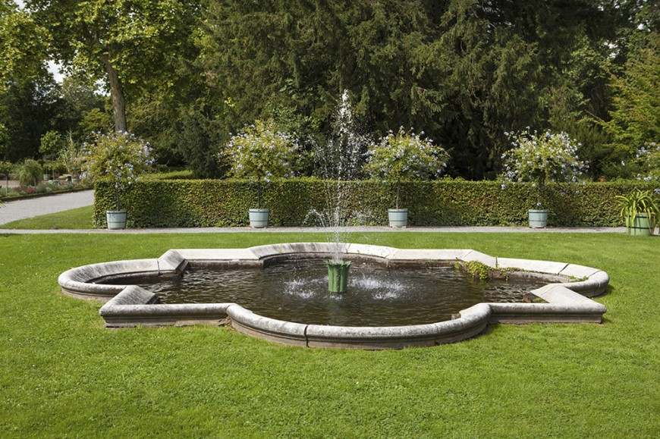
3 Layered Garden
Hedges define and protect the garden
Nurseries represent the gardening
The heart of the garden is a wellspring

Slide 20
5. My Garden in Disrepair

Slide 21
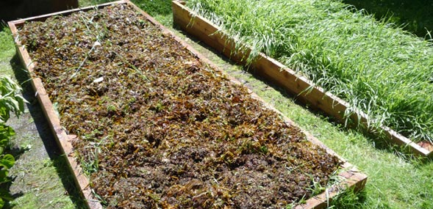
At any one time, 50-75% of the congregation could be facing sexuality issues.
"They made me caretaker of the vineyards, but I have not taken care of my own vineyard." Song of Solomon 1:6 (NAS)

Slide 22
Returning to the Garden
Embracing God’s Design for Sexuality
1
God-instilled hunger for wholeness.
2
Sexuality has to do with our spiritual longings for connection, intimacy, comfort, nurturing and love.
3
Take responsibility for our sexual feelings, acts, behaviours and attitudes so that we may embody this holistic vision of sexuality.

