Slide 1
When Love Came Down

Slide 2
(I) JESUS IS THE PROMISED KING

Slide 3
“ the birth of Jesus the Christ took place in this way “ ( v 18)

Slide 4
Christ= Messiah = The anointed King

Slide 5
Promised by God

Slide 6
Born of David’s line

Slide 7
(II) JESUS IS MANKIND’S SAVIOUR

Slide 8
“you shall call his name Jesus , for he will save his people from their sins” (v 21)

Slide 9
SIN is man’s big problem

Slide 10
THE CROSS is God’s great victory

Slide 11
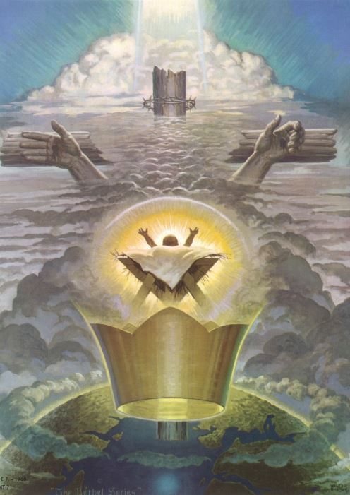

Slide 12
(III) JESUS IS ‘GOD WITH US’ (IMMANUEL)

Slide 13
“they shall call his name Immanuel” (v23)

Slide 14
God’s presence is with us throughout life’s journey

Slide 15
Jesus Himself is God’s presence

Slide 16
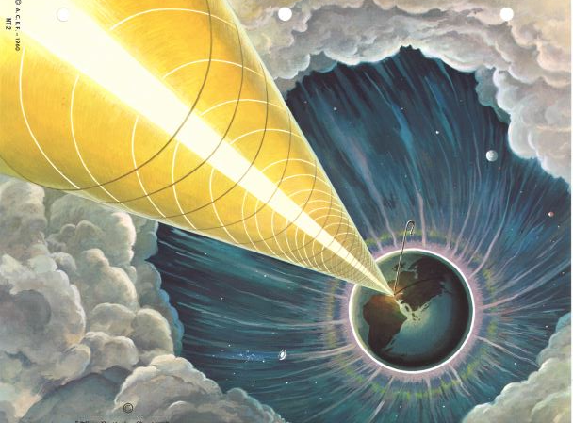

Slide 17
What is your response this Christmas ?

