Slide 1
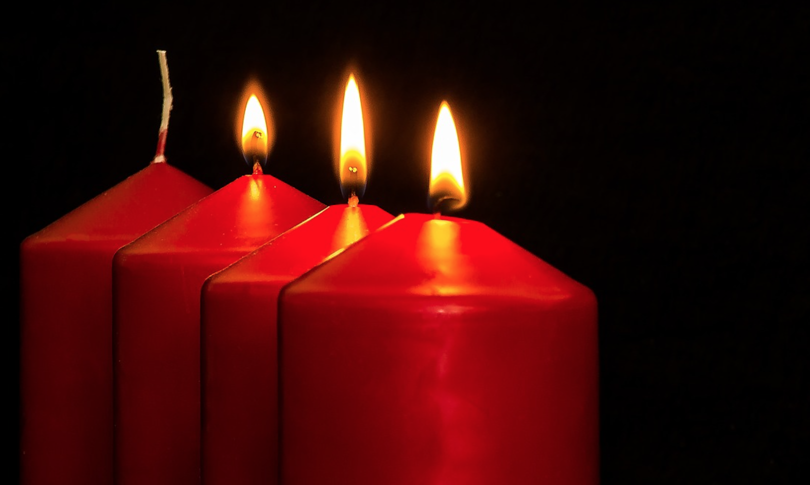
Advent 3 Come and Prepare your Bride
Isaiah 61: 1-4, 8-11

Slide 2
1. Restored (v 1-2)
¹ The Spirit of the Lord God is upon me, because the Lord has anointed me to bring good news to the poor; he has sent me to bind up the brokenhearted, to proclaim liberty to the captives, and the opening of the prison to those who are bound; ² to proclaim the year of the Lord's favor, and the day of vengeance of our God; to comfort all who mourn;

Slide 3
7 Purpose Clauses
Good news for the poor
Heal the broken-hearted
Freedom from legal bind
Freedom from physical bind
Year of the Lord’s favour
Day of Vengeance
Day of comfort

Slide 4
2. Glorified
³ to grant to those who mourn in Zion— to give them a beautiful headdress instead of ashes, the oil of gladness instead of mourning, the garment of praise instead of a faint spirit; …
¹⁰ for he has clothed me with the garments of salvation; he has covered me with the robe of righteousness, as a bridegroom decks himself like a priest with a beautiful headdress, and as a bride adorns herself with her jewels.

Slide 5
2. Glorified
The thief comes only to steal and kill and destroy. I came that they may have life and have it abundantly. – John 10:10

Slide 7
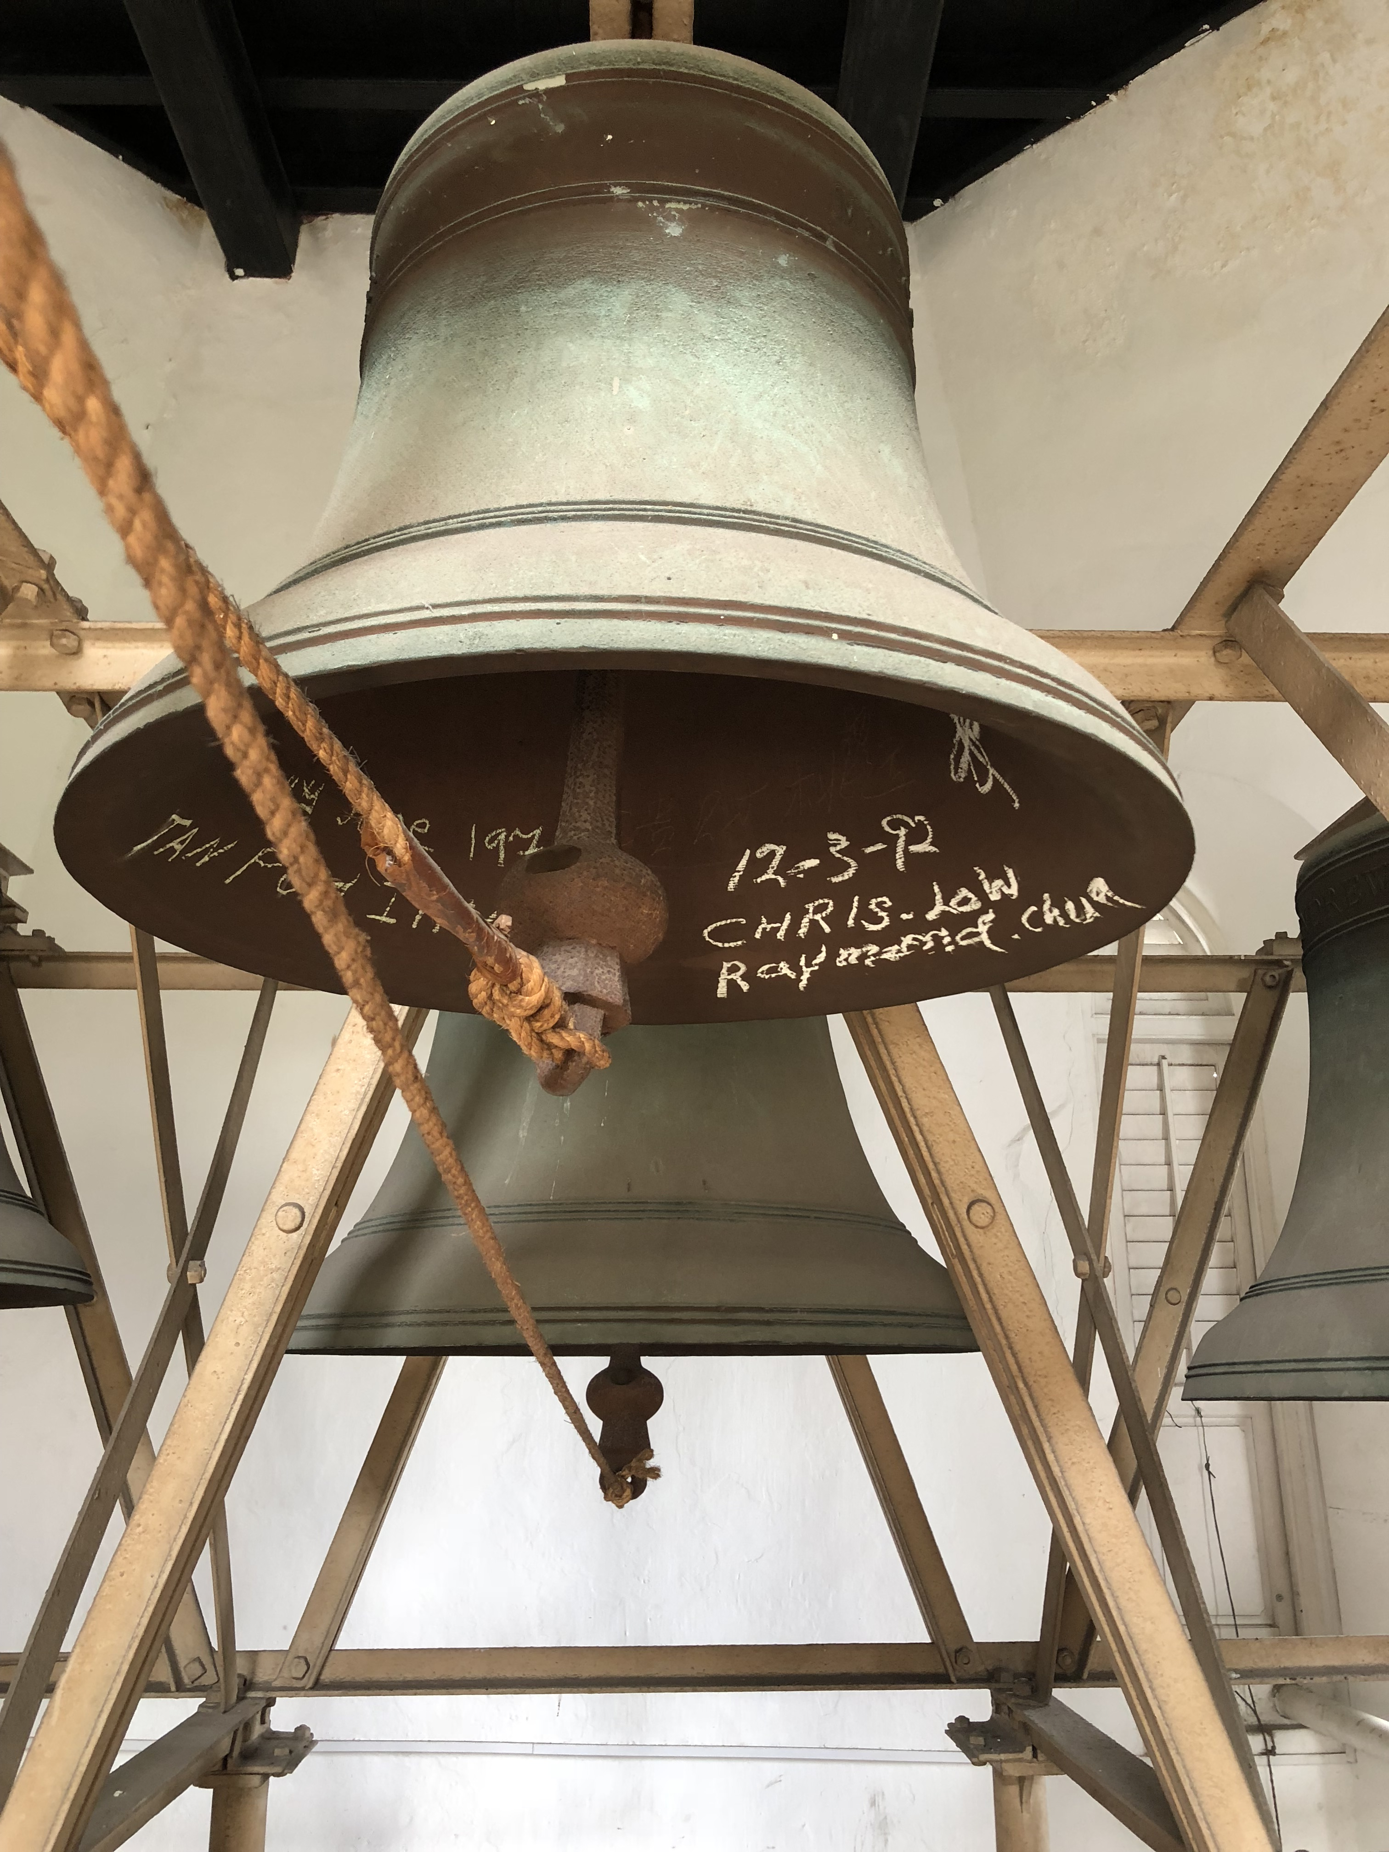

Slide 8
2. Glorified
⁹ Their offspring shall be known among the nations, and their descendants in the midst of the peoples; all who see them shall acknowledge them, that they are an offspring the Lord has blessed.

Slide 9
3. Commissioned
⁴ They shall build up the ancient ruins; they shall raise up the former devastations; they shall repair the ruined cities, the devastations of many generations.
¹¹ For as the earth brings forth its sprouts, and as a garden causes what is sown in it to sprout up, so the Lord God will cause righteousness and praise to sprout up before all the nations.

Slide 11
William James, American Philosopher
I am done with great things and big plans, great institutions and big success. I am for those tiny, invisible loving human forces that work from individual to individual, creeping through the crannies of the world like so many rootlets, or like the capillary oozing of water, which, if given time, will rend the hardest monument of pride.

Slide 12
Patience, hard thing by Gerard Manley Hopkins (1844–1889)
Patience, hard thing! the hard thing but to pray,
But bid for, patience is! Patience who asks,
Wants war, wants wounds; weary his times, his tasks;
To do without, take tosses, and obey.

Slide 13
Rare patience roots in these and, these away,
Nowhere. Natural heart’s ivy, Patience masks
Our ruins of wrecked past purpose. There she basks
Purple eyes and seas of liquid leaves all day.

Slide 14
We hear our hearts grate on themselves: it kills
To bruise them dearer. Yet the rebellious wills
Of us we do bid God bend to him even so.

Slide 15
And where is he who more and more distils
Delicious kindness?—He is patient. Patience fills
His crisp combs, and that comes those ways we know.

